Slide 1
Data Visualization Using ‘R’
Prof. Prarthana Deshkar
YCCE, Nagpur

Slide 2

Numbers do not speak…
Sample of Daily production in yards of 30 carpet looms
Can you tell what is the range for which production frequency is highest?
16.2 | 15.8 | 15.8 | 15.8 | 16.3 | 15.6
15.7 | 16.0 | 16.2 | 16.1 | 16.8 | 16.0
16.4 | 15.2 | 15.9 | 15.9 | 15.9 | 16.8
15.4 | 15.7 | 15.9 | 16.0 | 16.3 | 16.0
16.4 | 16.6 | 15.6 | 15.6 | 16.9 | 16.3

Slide 3

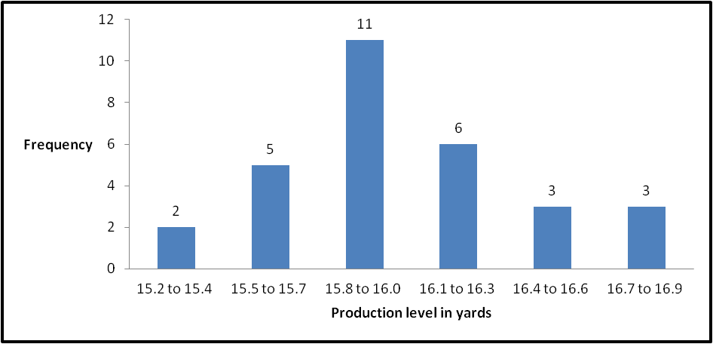
Graphs does…

Slide 4
Data visualization
Visualization is the graphical presentation of information, with the goal of providing the viewer with a qualitative understanding of the information contents.
Graphical presentation may entail manipulation of graphical entities (points, lines, shapes, images, text) and attributes (color, size, position, shape).

Slide 5
Common Techniques
Charts: bar or pie
Graphs: good for structure, relationships
Plots: 1- to n-dimensional
Maps: one of most effective
Images: use color/intensity instead of distance
3-D surfaces and solids
Animation etc…

Slide 6
Data visualization using ‘R’
R graphics functions can be grouped into three types:
High level plotting functions
Low level plotting functions
Interactive graphics functions

Slide 7
Low Level Plotting Functions
Low level plotting functions do not open a graphics device (window) automatically
plot(1:100, 1:100, type="n", xlab=“", ylab="")
We have a palette, let's paint on it.
Plot a curve from an algebraic equation
curve(x^2/100, add=TRUE)
Add some text to the graph

Slide 8
Low Level Plotting Functions
text(80, 50, "This is a graph of")
text(80, 45, "the equation")
text(80, 37, expression(y == frac(1,100) * x^2))
Draw some points on this curve
points(x=c(20, 60, 90), y=c(4, 36, 81), pch=6)
Some fun…
points(x=rep(100,10), y=seq(0,90,10), pch=seq(1,20,2))

Slide 9
Low Level Plotting Functions
Draw a straight line through a couple of those points
Function is abline( ), arguments are "a=the y-intercept" and "b=the slope" of the desired line
abline(a=-18, b=1.1, col="red")
We can also draw horizontal and vertical lines with this function
abline(h=20, lty=2) # abline(h=20, lty="dashed")
abline(v=20, lty=3) # abline(v=20, lty="dotted")

Slide 10
Low Level Plotting Functions
"lty=" option specifies the line type. (1=solid, 2=dashed, 3=dotted.)
To change the color of line, col=
To change the width of line, lwd=

Slide 11
Low Level Plotting Functions
We can also draw lines and/or points using the lines( ) function
lines(x=c(40, 40, 60, 60), y=c(80, 100, 100, 80), type="b")
lines(x=c(40, 60), y=c(80, 80), type="l")
"type=" option tells whether you want just points (type="p"), just lines (type="l"), or both (type="b")

Slide 12
Low Level Plotting Functions
Give final touch to your graph:
title(main="A Drawing To Put On the Refrigerator!")
title(xlab="This is the x-axis", col.lab="black")
title(ylab="This is the y-axis", col.lab="blue")

Slide 13
High Level Plotting Functions
Usually, we don't want to fuss that much
We just want to see a graph of some data we're examining
The basic high level plotting function is plot( )
data(faithful)
attach(faithful)
names(faithful)
plot(waiting, eruptions)
detach(faithful)
rm(faithful)

Slide 14
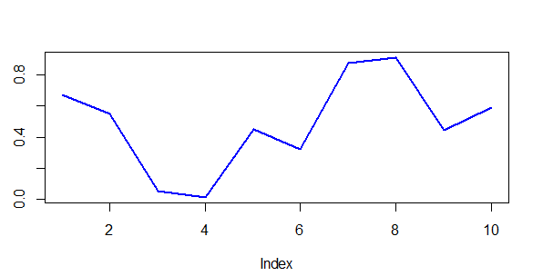
Line Chart
x=c(10,20,30,40,50,60);
Y=c(20,25,30,35,28,40);
> plot(x,y, type="l", lwd=2, col="blue");

Slide 15
Piecharts
When a single categorical variable is being graphed use a piechart or a barplot
margin.table(UCBAdmissions, 3)
margin.table(UCBAdmissions,3) -> Department
pie(Department)
names(Department)=c("ct","et","me","cv","el","it")
pie(Department)
pie(Department, col=c("green","blue","red","pink","light blue","black"))

Slide 16
Barplots
barplot(Department, xlab="Department", ylab="frequency")
names(Department)=c("ct","et","me","cv","el","it")
barplot(Department, xlab="Department", ylab="frequency")

Slide 17
Barplots
If you want to look at two categorical variables at once, a stacked barplot, or better yet, a side-by-side barplot is usually the way to go
margin.table(UCBAdmissions, c(1,3)) -> Admit.by.Dept
barplot(Admit.by.Dept)
stacked barplot is the default

Slide 18
Barplots
barplot(Admit.by.Dept, beside=T, ylim=c(0,1000), legend=T,
main="Admissions by Department")
set the "beside=" option to TRUE, to change the stacked barplot

Slide 19
Histograms
A Histogram is a vertical bar chart that depicts the distribution of a set of data.
Histograms are used to organize and interpret data.
Histograms are often used with frequency tables to give a more visual view of the data.
Each bar represents an interval that contains data.
The height of the bar indicates the frequency of the data.

Slide 20
Constructing a histogram
Step 1 - Count number of data points
Step 2 - Summarize on a tally sheet
Step 3 - Compute the range
Step 4 - Determine number of intervals
Step 5 - Compute interval width
Step 6 - Determine interval starting points
Step 7 - Count number of points in each interval
Step 8 - Plot the data
Step 9 - Add title and legend

Slide 21
Example
Step1: Take a object age enter ages
age =c(83,51,66,61,82,65,54,56,92,60,65,87,68,64,51, 70, 75, 66, 74, 68, 44, 55,78, 69, 98, 67, 82, 77, 79, 62, 38, 88, 76, 99, 84, 47, 60, 42, 66, 74, 91, 71, 83, 80, 68, 65, 51, 56, 73, 55)
Step2:Break the ages in interval of 10
breaks=seq(30,100,10)
Step3:Use cbind() to print age in class interval and frequency.
cbind(table(cut(age,breaks)))
Step4: Use hist() with attribute age and breaks
hist(age,breaks)

Slide 22
Histograms
If you want to analyze already stored data
attach(faithful)
hist(waiting)
If you want more or fewer bars, you can refine your plot by using the "breaks=" option and defining your own breakpoints
range(waiting)
hist(waiting, breaks=seq(40,100,10))

Slide 23
Histograms
R also incorporates many functions for data smoothing
kernel density smoothing of histograms
plot(density(waiting))
Want more fancier?
hist(waiting, prob=T)
lines(density(waiting))

Slide 24
Histograms
The density( ) function does kernel density smoothing
To plot the smoothed curve on top of a histogram, set the "prob=" option to TRUE
This plots densities rather than frequencies
use lines( ) rather than plot( ) to plot the smoothed curve
This low level graphics function will add the smoothed curve to the histogram rather than drawing a new plot and thereby erasing the histogram.

Slide 25
Numerical Summaries by Groups
When you have a numerical variable indexed by a categorical variable or factor, you might want a group-by-group summary in graphical form
The primary way R offers to achieve this is side-by-side boxplots
data(chickwts)
str(chickwts)
attach(chickwts)
plot(feed, weight)
title(main="Body Weight of Chicks by Type of Diet")
detach(chickwts)

Slide 26
Boxplot
A boxplot splits the data set into quartiles.
The body of the boxplot consists of a "box" , which goes from the first quartile (Q1) to the third quartile (Q3).
Within the box, a vertical line is drawn at the Q2, the median of the data set.
Two horizontal lines, called whiskers, extend from the front and back of the box.
The front whisker goes from Q1 to the smallest non-outlier in the data set, and the back whisker goes from Q3 to the largest non-outlier.

Slide 27
Boxplot
The function boxplot( ), which takes a formula interface
boxplot(weight ~ feed, data = chickwts, col = "lightgray",
+ varwidth = TRUE, notch = TRUE, main = "chickwt data",
+ ylab = "Weight at six weeks (gm)")

Slide 28
Bubble Plot
Two quantitative variables are mapped to the x and y axes, and a third quantitative variables is mapped to the size of each point
Uses
Bubble charts are used when you want to compare data points on three quantitative variables.
The x and y position represent the magnitude of two of the quantitative variables, and the area of the bubble represents the magnitude of the third quantitative variable.

Slide 29
Bubble Plot
# 1. create 'x_var' as 15 random, normally distributed numbers (using rnorm)
# 2. create 'y_var' as 15 random, normally distributed numbers (using rnorm)
# 3. create 'size_var' as a random number between 1 and 10
x_var <- rnorm( n = 15, mean = 5, sd = 2)
y_var <- x_var + rnorm(n = 15, mean = 5, sd =4)
size_var <- runif(15, 1,10)
u <- sample( c("pink","green","lightblue"),15,replace=T)
plot(x_var , y_var , cex = size_var , type="p",xlab = "", ylab = "", pch=16,main = "Bubble plot", col=u)
points(x_var, y_var, cex = size_var)

Slide 30
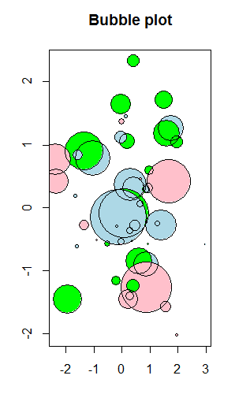
Bubble Plot

Slide 31
Scatterplots
For examining the relationship between two numerical variables, you can't beat a scatterplot
data(mammals, package="MASS")
str(mammals)
attach(mammals)
plot(log(body), log(brain))
scatter.smooth(log(body), log(brain))

Slide 32
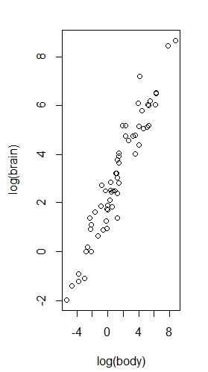
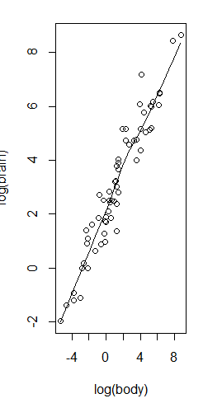
Scatterplots

Slide 33
Scatterplots
In the given example the data frame contains brain and body weights from 62 species of land mammals
To produce a linear plot, need to do a log transform on both variables
The scatter.smooth( ) function also plots a smoothed, nonparametric regression line on the plot

Slide 34
Scatterplots 3D
Step1: Install package scatterplot3d first using
internet.
>install.packages(“scatterplot3d”)
Step2: Import from library in every session.
>library(scatterplot3d)
Step3:This means that the database is searched by R when evaluating a variable, so objects in the database can be accessed by simply giving their names.
> attach(mtcars)

Slide 35
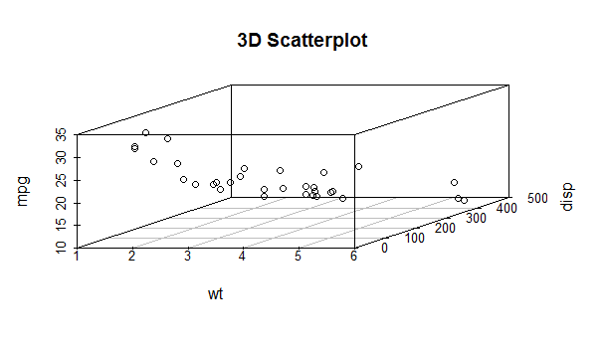
Scatterplots 3D
Step4: Use scatterplot3d() with x , y and z axis.
> scatterplot3d(wt,disp,mpg, main="3D Scatterplot")

Slide 36
HeatMaps
Heat maps enable you to do exploratory data analysis with two dimensions as the axis and the third dimension shown by intensity of color.
However you need to convert the dataset to a matrix format

Slide 37
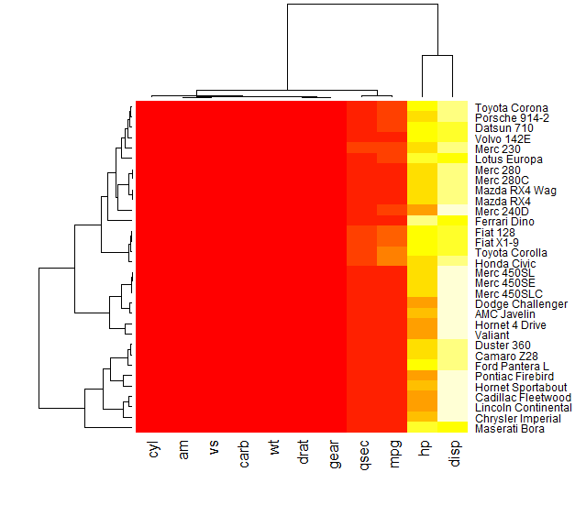
HeatMaps
heatmap(as.matrix(mtcars))

Slide 38
Multiple graphs on a single graphics page
What par(mfrow=) and layout() both do is to split the ploting window based on grids.
The difference is that par(mfrow=) always sets the grids to be of equal widths and hights, and multiple plots are put into the cells accordingly (by row).
while layout() can set the grids to be of different proportions, and multiple plots can be put into arbitrary positions of the grid cells.

