Slide 1
Matplotlib
Dr. Latesh Bhagat
Associate Professor & Head
Government College of Engineering, Nagpur

Slide 2
Installing Matplotlib on Linux
$ sudo apt-get install python3-matplotlib
$ pip install --user matplotlib

Slide 3
Installing matplotlib on Windows
First download matplot library from https://pypi.python.org/pypi/matplotlib/ and look for a wheel file .
pip install matplotlib

Slide 4
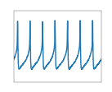
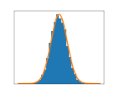
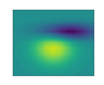
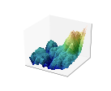
Introduction to Matplotlib
Matplotlib in a Python is 2D plotting library which generates quality figures for publication and interactive environments across platforms.

Slide 5
Matplotlib can generate plots, scatterplots,histograms, power spectra, bar charts, errorcharts, etc.,.
For simple plotting the pyplot provides a an interface to the matplotlib object-oriented plotting library.
It gives full control of axes properties, line styles, font properties, etc, to the programmer.

Slide 6
Simple plot
To use functions defined in pyplot , you have to import specific module pyplot of Matplotlib instead of all modules of Matplotlib. This saves memory space.

Slide 7
Example: Generate values and calculate its sin() and cos() and plot.
import numpy as npimport
matplotlib.pyplot as pl
#generate 256 values from -3.14 to +3.14
X = np.linspace(-np.pi, np.pi, 256, endpoint=True)
print(X)
CP = np.cos(X)
SP= np.sin(X)
pl.plot(X,CP)
pl.plot(X,SP)
pl.show()

Slide 8
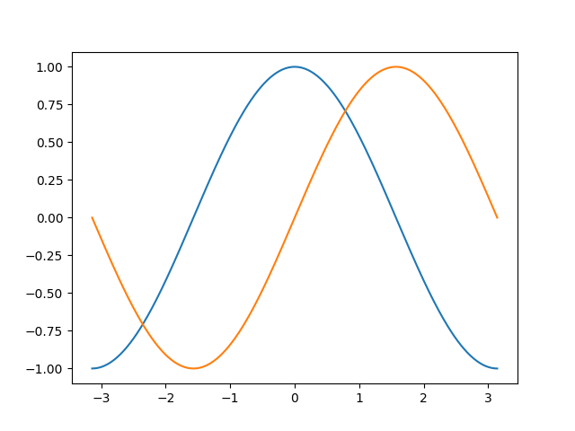

Slide 9
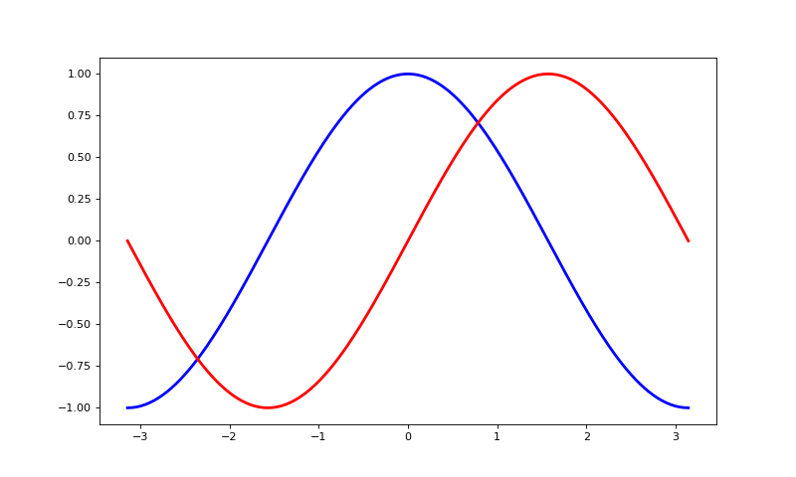
Changing Colors and Line Width
pl.figure(figsize=(10,6), dpi=80)
pl.plot(X, CP, color="blue", linewidth=2.5, linestyle="-")
pl.plot(X, SP, color="red", linewidth=2.5, linestyle="-")

Slide 10
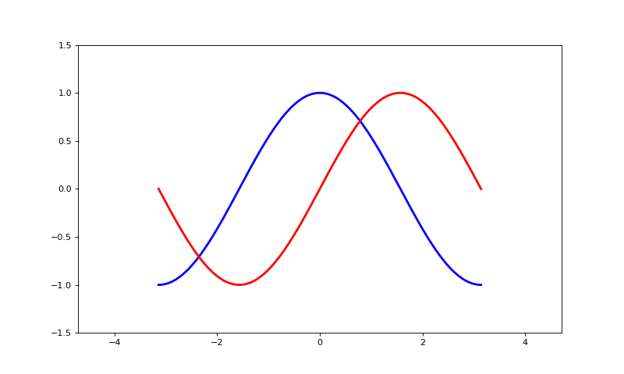
Setting Limits
Current limits of the figure are a bit too tight and we want to make some space in order to clearly see all data points.X axis and Y axis starts from 1.5 and 1.5 of default limits.
pl.xlim(X.min()*1.5, X.max()*1.5)
pl.ylim(CP.min()*1.5, CP.max()*1.5)...

Slide 11
Setting Ticks
Current ticks (Values on X and Y axis) are not ideal because they do not show the values (+/-π,+/-π/2) for sine and cosine. We can change them by using xticks() and yticks()
pl.xticks( [-np.pi, -np.pi/2, 0, np.pi/2, np.pi]) pl.yticks([-1, 0, +1])

Slide 12
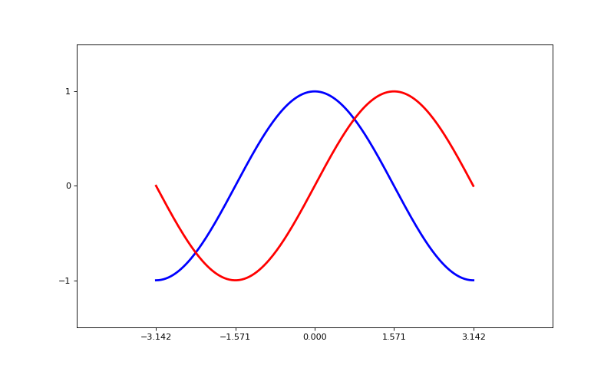

Slide 13
Setting Tick Labels
pl.xticks([-np.pi, -np.pi/2, 0, np.pi/2, np.pi], [r'$-\pi$', r'$-\pi/2$', r'$0$', r'$+\pi/2$', r'$+\pi$'])
pl.yticks([-1, 0, +1], [r'$-1$', r'$0$', r'$+1$'])

Slide 14
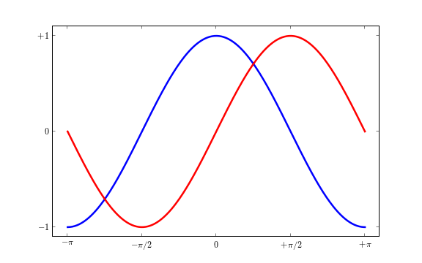

Slide 15
Moving Spines
we can discard the top and right by setting their color to none and will move the bottom and left ones to coordinate 0 in data space coordinates.
axs = pl.gca()axs.spines['right'].set_color('none‘)
axs.spines['top'].set_color('none')
axs.xaxis.set_ticks_position('bottom')
axs.spines['bottom'].set_position(('data',0)) #Place x axis on centre axs.yaxis.set_ticks_position('left') axs.spines['left'].set_position(('data',0)) #Place y axis on centre

Slide 16
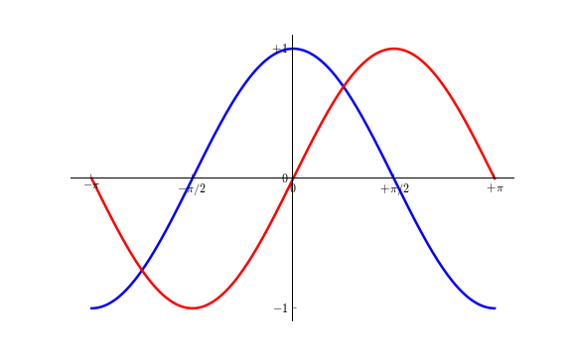

Slide 17
Adding a legend
We can add a legend in the upper left corner. This is required for adding the keyword argument label to the plot commands.
plt.plot(X, CP, color="blue", linewidth=2.5, linestyle="-", label="cosine")
plt.plot(X, SP, color="red", linewidth=2.5, linestyle="-", label="sine")
plt.legend(loc='upper left', frameon=False)...

Slide 18
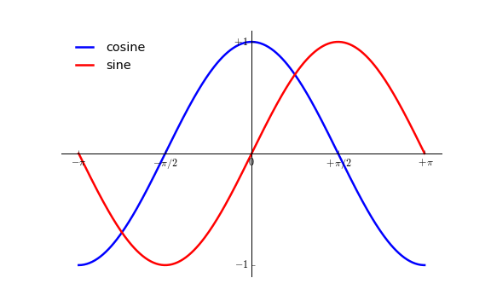

Slide 19
import numpy as np
import matplotlib.pyplot as pl
X = np.linspace(-np.pi, np.pi, 256, endpoint=True)
CP = np.cos(X)
SP= np.sin(X)
pl.figure(figsize=(10,6), dpi=80)
pl.xlim(X.min()*1.5, X.max()*1.5)
pl.ylim(CP.min()*1.5, CP.max()*1.5)
pl.xticks([-np.pi, -np.pi/2, 0, np.pi/2, np.pi],
[r'$-\pi$', r'$-\pi/2$', r'$0$', r'$+\pi/2$', r'$+\pi$'])

Slide 20
pl.yticks([-1, 0, +1],
[r'$-1$', r'$0$', r'$+1$'])
axs = pl.gca()
axs.spines['right'].set_color('none')
axs.spines['top'].set_color('none')
axs.xaxis.set_ticks_position('bottom')
axs.spines['bottom'].set_position(('data',0))
axs.yaxis.set_ticks_position('left')
axs.spines['left'].set_position(('data',0))
pl.plot(X, CP, color="blue", linewidth=2.5, linestyle="-", label="cosine")
pl.plot(X, SP, color="red", linewidth=2.5, linestyle="-", label="sine")
pl.legend(loc='upper left', frameon=False)
pl.show()

Slide 21
Figures, Subplots, Axes and Ticks
A figure in matplotlib means the whole window where plot is displayed in the user interface.
Within this figure there can be one or more subplots. Default is subplot (111).This means only one subplot in figure can be drawn. Subplot positions the plots in regular grid.
Axes allows the placement of subplots .The values (scale) displayed on axis is called ticks. When we call plot, matplotlib calls gca() to get the current axes and gca in turn calls gcf() to get the current figure.

Slide 22
Figure
A figure is the interface in Matplotlib has "Figure #" as title. Figures are numbered starting from 1
Argument | Default | Description
Num | 1 | number of figure in interface
figsize | figure.figsize | Width and height of figure size in inches
Dpi | figure.dpi | dots per inch (resolution of figure)
facecolor | figure.facecolor | Background color of interface
edgecolor | figure.edgecolor | color of edge around the drawing background
frameon | True | draw figure frame or not

Slide 23
Subplots
With subplot you can arrange plots in a regular grid. You need to specify the number of rows and columns and the number of the plot.
Example: Program that will draw two subplots in a figure and write heading in centre of plot.
from pylab import *
subplot(2,1,1)
xticks([]), yticks([]) #No x and y
tickstext(0.5,0.5, 'subplot(2,1,1)',ha='center',va='center',size=24,alpha=.5)
subplot(2,1,2)
xticks([]), yticks([])
text(0.5,0.5, 'subplot(2,1,2)',ha='center',va='center',size=24,alpha=.5)show()

Slide 24
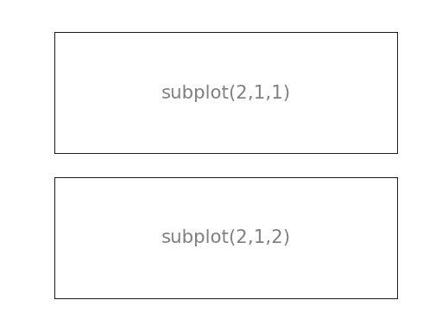

Slide 25
Axes
Axes are similar to subplots but allow placement of plots at any location in the figure. So if a smaller plot is to put inside a bigger one, we can do so this with axes.

Slide 26
from pylab import *
axes([0.1,0.1,.8,.8])
xticks([]), yticks([])
text(0.6,0.6, 'axes([0.1,0.1,.8,.8])',ha='center',va='center',size=20,alpha=.5)
axes([0.2,0.2,.3,.3])
xticks([]), yticks([])
text(0.5,0.5, 'axes([0.2,0.2,.3,.3])',ha='center',va='center',size=16,alpha=.5)
show()

Slide 27
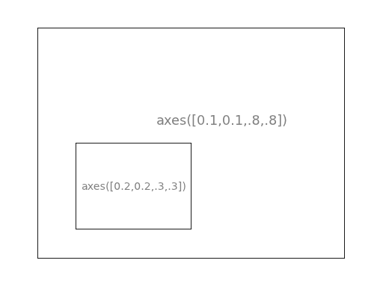

Slide 28
Ticks
Ticks are label to show scale on axis. These make plots more clear to understand. Matplotlib provides a totally configurable system for ticks. Tick locators are used to specify where ticks should appear and tick formatters to customise ticks appearance. Major and minor ticks can be located and formatted independently from each other..

Slide 29
Class | Description
NullLocator | No ticks.
IndexLocator | Place a tick on every multiple of some base number of points plotted.
FixedLocator | Tick locations are fixed.
LinearLocator | Determine the tick locations.
MultipleLocator | Set a tick on every integer that is multiple of some base.
AutoLocator | Select no more than n intervals at nice locations.
LogLocator | Determine the tick locations for log axes.

