Slide 1
Probability Distributions
Presented by:
P. S. Deshpande
Dept of CSE
VNIT Nagpur

Slide 2
Opening problem
Modern filling machines are designed to work efficiently and with high reliability. Machine can fill toothpaste pumps to within 0.1 gm of the desired level 80 percent of the time. A distributor visits to the plant, watching filled pumps being placed into cartons asked “What is the chance that exactly half the pumps in a carton selected at random will be filled to within 0.1 gm of the desired level?”

Slide 3
Random variable
-A variable is random if it is allowed to take different values as result of the outcome of random experiments
-If it is allowed to take any value then it is continuous random variable
-Value changes from occurrence to occurrence with no prediction sequence

Slide 4
Expected value
-Expected value of discrete random variable is summation of product of each value of random variable and probability of getting that value
-In case of tossing coin two times,expected value of number of tail is
=0*0.25+1*0.5+2*0.25=1

Slide 5
Expected value
Construct a probability distribution based on the following frequency distribution.
Draw a graph of hypothetical probability distribution.
Compute the expected value of outcome.

Slide 6
Calculating expected value
> y<-c(102,105,108,111,114,117)
> x1<-c(10,20,45,15,20,15)
> x2<-sum(x1)
> x2
[1] 125
> x3<-x1/x2
> x3
[1] 0.08 0.16 0.36 0.12 0.16 0.12
> x4<-y*x3
> x4
[1] 8.16 16.80 38.88 13.32 18.24 14.04
> x5<-sum(x4)
> x5
[1] 109.44
plot(y,x4,type="h",lwd="2")

Slide 7
Uses of Expected value
A fruit Wholesaler sells strawberries, the product is having only 1 day life .One strawberry cost 20 and it is sold at 50
-There are two types of losses
1. Obsolescence loss:
-Caused by stocking too much fruits (20)
2. Opportunity loss:
-Caused by being out of strawberries any times that customers calls for them(30)
-No loss if numbers of requests are equal to number in stock

Slide 8
Uses of Expected value
Past History (Sales during 100 days)

Slide 9
Uses of Expected value
Conditional loss Table

Slide 10
Expected loss
Expected loss from stocking 10 case

Slide 11
Expected loss
Expected loss from stocking 11 cases

Slide 12
What is probability distribution ?
A probability distribution describes how the values of a random variable are distributed.
a probability distribution assigns a probability to each measurable subset of the possible outcomes of a random experiment.

Slide 13
Example of probability distribution
Probability distribution of number of tails when coin is tossed twice.
First Toss | Second Toss | Number of Tails | Probability
T | T | 2 | 0.25
T | H | 1 | 0.25
H | T | 1 | 0.25
H | H | 0 | 0.25
Number of Tails | Probability
0 | 0.25
1 | 0.5
2 | 0.25

Slide 14
Type of probability Distributions:
Discrete:
Variable is allowed to take certain values
E.g. number of tails in tossed coins
Binomial Distribution, Poisson Distribution
Continuous:
Variable can take any values
E.g. Height of students
Normal Distribution

Slide 15
Random variables
Discrete random variables have a countable number of outcomes
Examples: Dead/alive, treatment/placebo, dice, counts, etc.
Continuous random variables have an infinite continuum of possible values.
Examples: blood pressure, weight, the speed of a car, the real numbers from 1 to 6.

Slide 16
Binomial distribution
Probability distribution of a discrete random variable.
It is discrete distribution
Resulting from an experiment known as Bernoulli Process
EX. : outcome of tossing of a coin, success or failure can be described as a Bernoulli Process
Used to calculate probability of k success in n trials

Slide 17
Use of Bernoulli Process
EX. -Tossing coin
Each trial has only two possible outcome : Head or Tail (H or T).
The probability of outcome of any trial is fixed (for example 0.5)
The trials are statistically independent i.e. Outcome of one toss does not affect outcome of another toss.

Slide 18
Examples :
Suppose that there are 10 independent trials, and that the probability of success on each trial is 0.6, find the probability of 5 successes.
n=10, p=0.6, r=5
>dbinom(r,n,p)
> dbinom(5,10,0.6)
> dbinom(5,size=10,prob=0.60)

Slide 19
Distribution functions in r
d” returns the height of the probability density function
“p” returns the cumulative density function
“q” returns the inverse cumulative density function (quantiles)
“r” returns randomly generated numbers

Slide 20
R bionomial functions
dbinom(x, size, prob)
pbinom(q, size, prob)
qbinom(p, size, prob)
rbinom(n, size, prob)

Slide 21
R bionomial functions
> dbinom(4,10,0.6)
[1] 0.1114767
> dbinom(0,10,0.6)
[1] 0.0001048576
> dbinom(1,10,0.6)
[1] 0.001572864
> dbinom(1,10,0.6)+ dbinom(0,10,0.6)
[1] 0.001677722
> pbinom(1,10,0.6)
[1] 0.001677722
> qbinom(0.001677720,10,0.6)
[1] 1
> c<-rbinom(8,10,0.6)
[1] 6 5 3 5 7 8 4 4

Slide 22
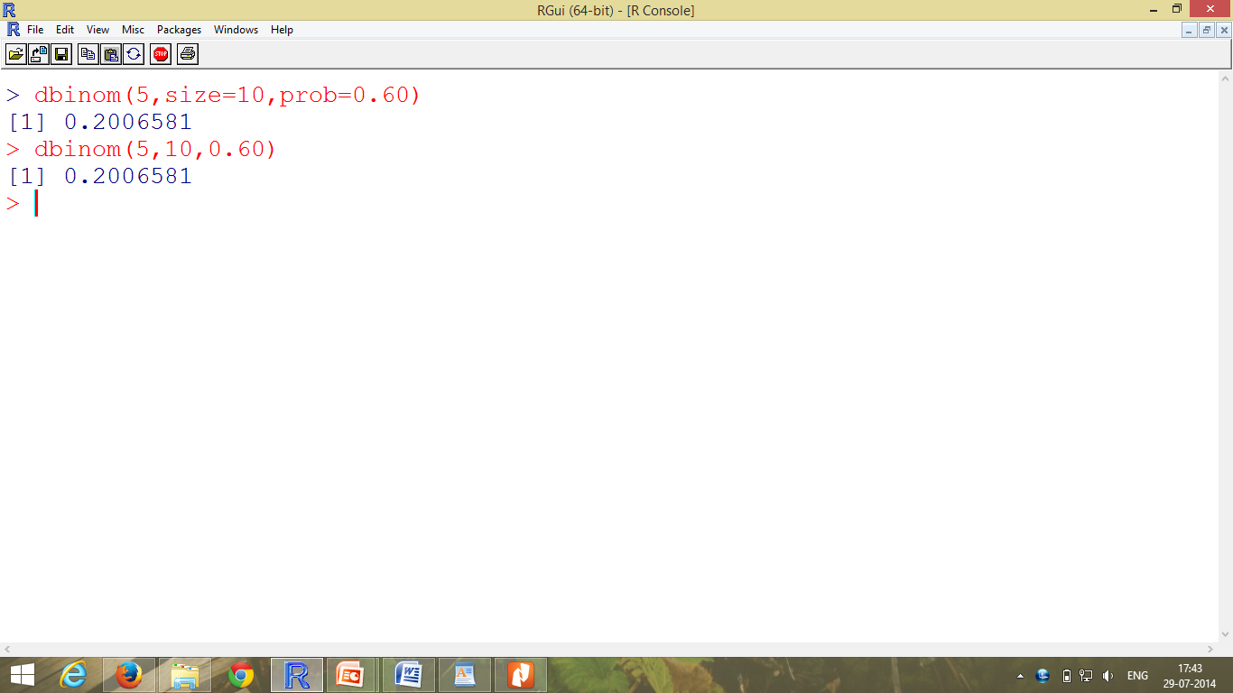
bionomial functions

Slide 23
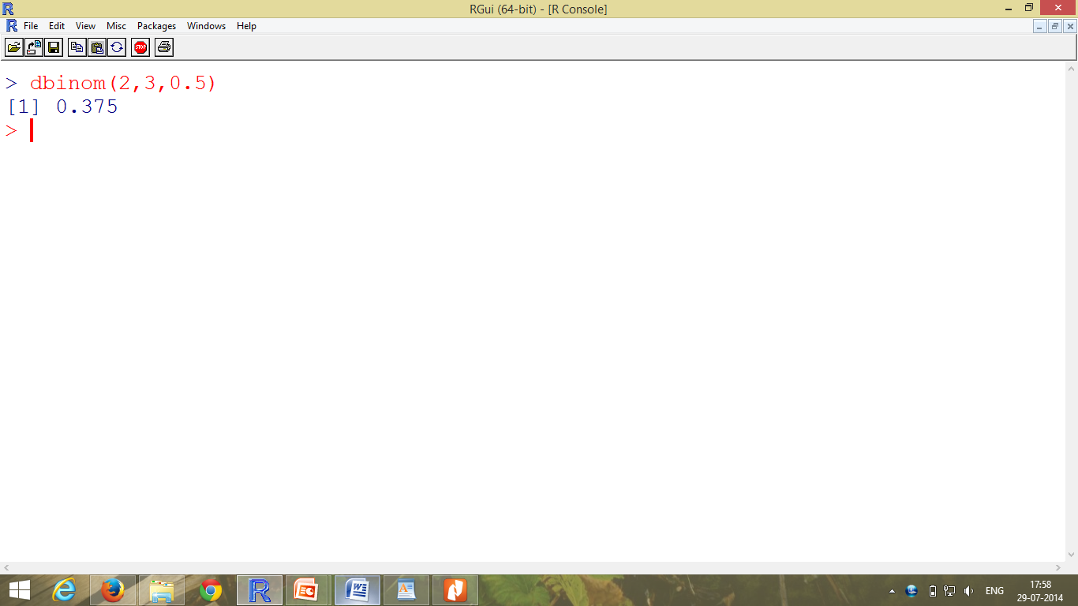
bionomial functions
Calculate probability of getting 2 head in 3 trials.
n=3,r=2, p=0.5,q=0.5

Slide 24
Ex. 2
At Kerr Pharmacy owner determined that there is a 0.4 chance of any one employee being late. 5 employees are in the pharmacy.find the probabilities of 0,1,2,3,4, or 5 employees being late simultaneously?
Probability of r late arrival out of n workers
n=5 p=0.4,q=0.6
r = 0 to 5
> r <- seq(0,5,by=1)
> y <- dbinom(r,5,0.4)
> plot(r,y, type="h", col="blue")

Slide 25
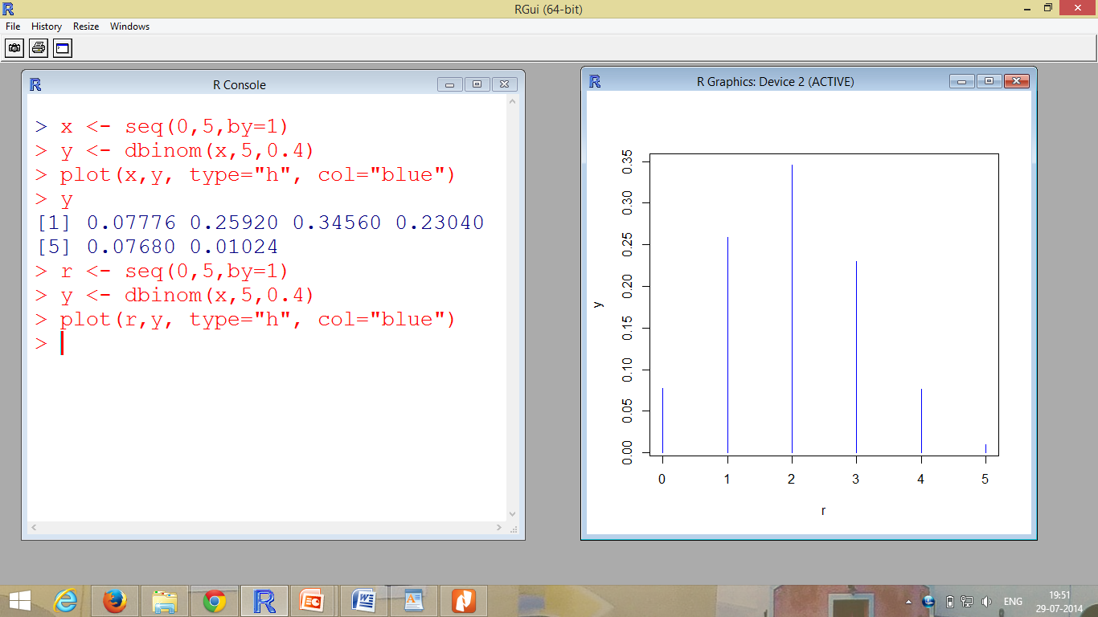

Slide 26
Direct look up interval
pbinom() calculates the c. d. f. of the binomial distribution.
Problem :
Suppose there are 12 multiple choice questions in an English class quiz. Each question has five possible answers, and only one of them is correct. Find the probability of having four or less correct answers if a student attempts to answer every question at random.
[n=12, r<=4,p= (1/5)=0.2]

Slide 27
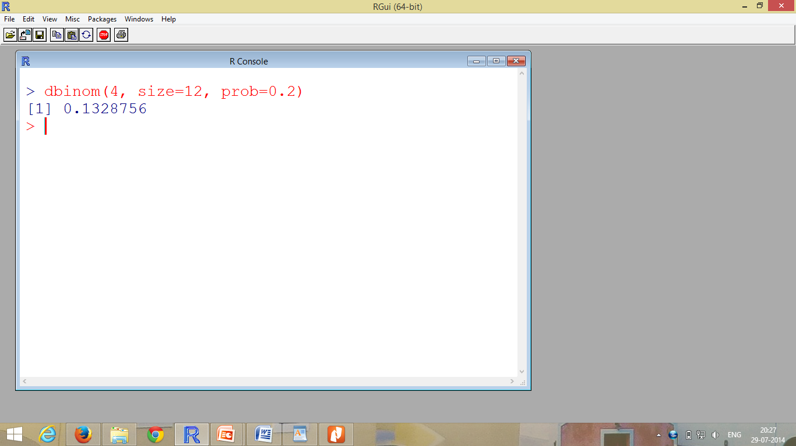
probability of having exactly 4 correct answers
> dbinom(4, size=12, prob=0.2) [1] 0.1329

Slide 28
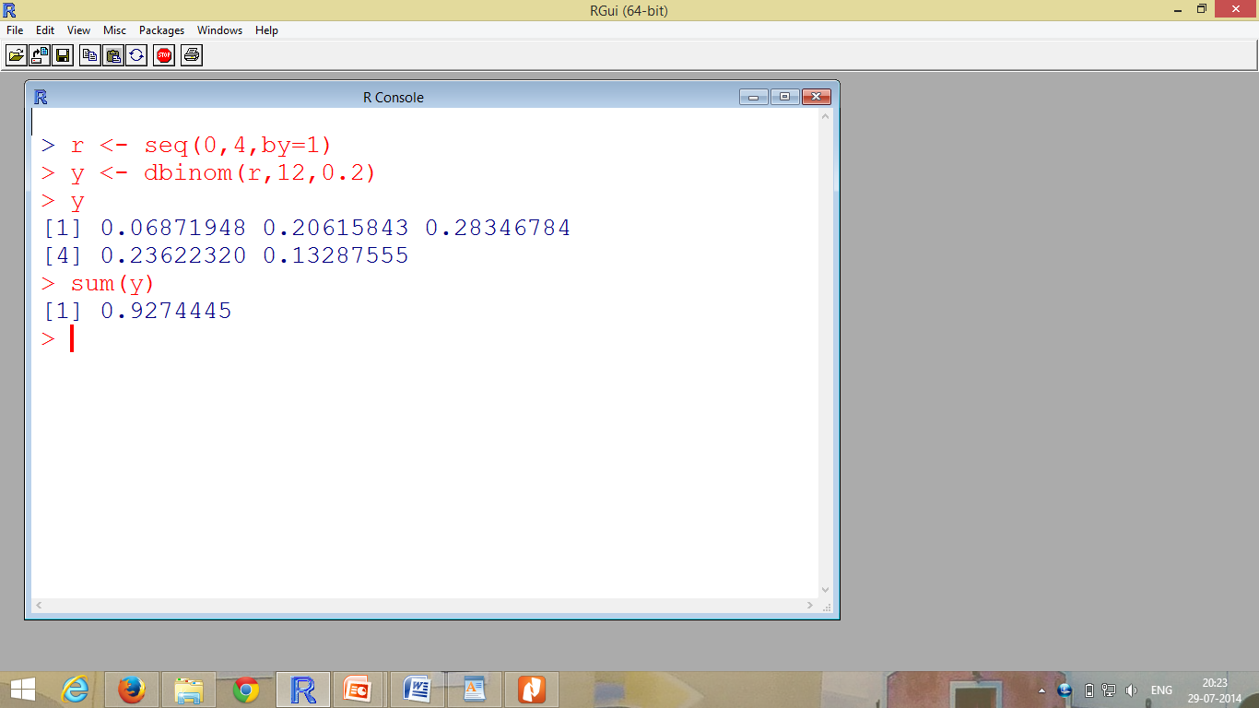
bionomial functions
Probability of having four or less correct answers

Slide 29
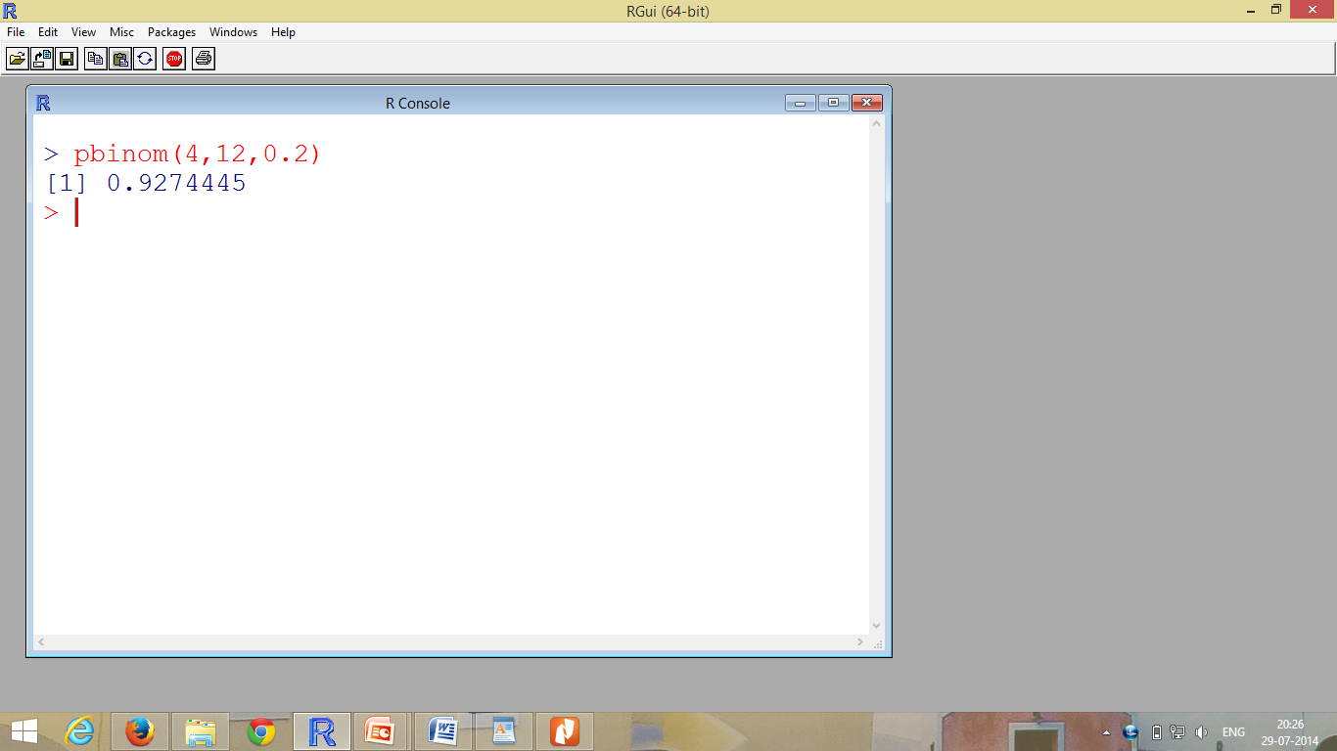
Using pbinom()

Slide 30
Exercise-1
for binomial distribution with n=12 and p=0.45, find :
a) P(r=8)
b) P(r>4)
c) P(r<=10)

Slide 31
Poisson Distribution
The Poisson distribution is the probability distribution of independent event occurrences in an interval.
P(x)=((λ^{x})*(e^{-λ})) / x!
P(x): Probability of exactly x occurrences
λ: mean number of occurrences per interval of time
e: natural logarithm 2.71828
Use for modelling demand of service, arrival of cars, distribution of telephone calls going through switchboard, number of accidents at an intersection.
For example numbers of patients arrive at physician’s office will be 0, 1, 2, 3, 4, and 5.

Slide 32
Example:
Past police records indicates a mean of five accidents per month. The number of accidents is distributed by a Poisson distribution, calculate probability of 0,1,2,3,4 .. Accidents
λ =5
Probability of no accident:
P(0)=((5⁰)*(e⁻⁵)) / 0! = 0.00674
> dpois(0,lambda=5)
[1] 0.006737947

Slide 33
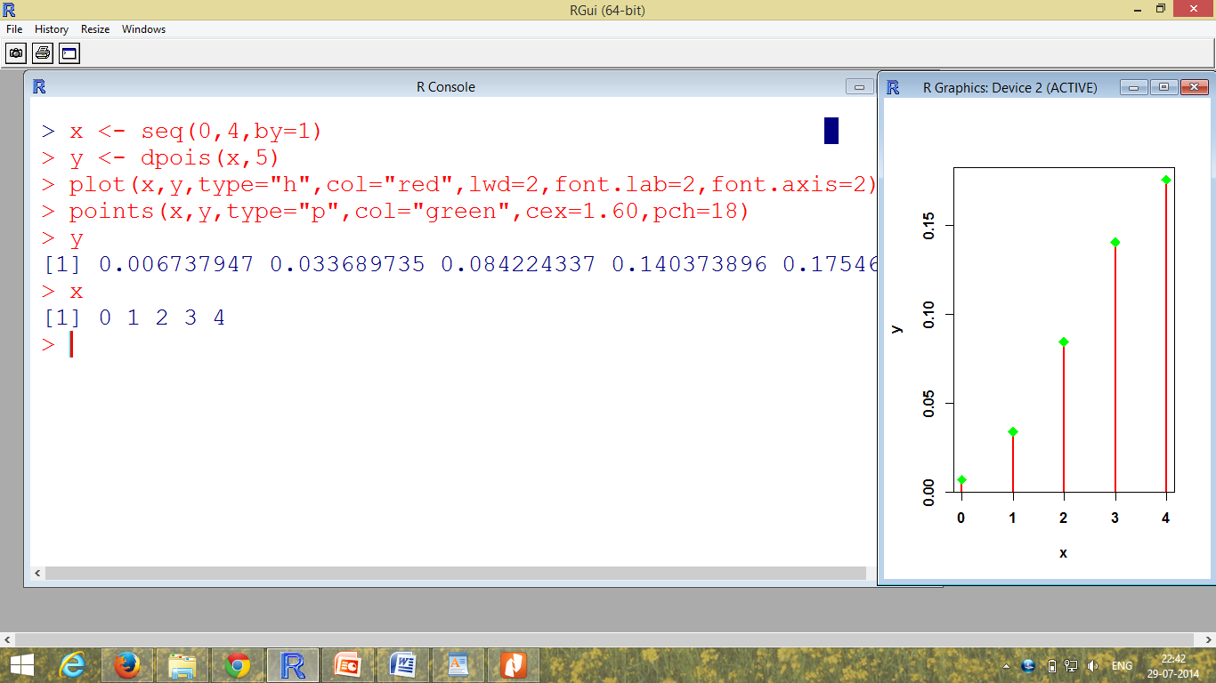

Slide 34
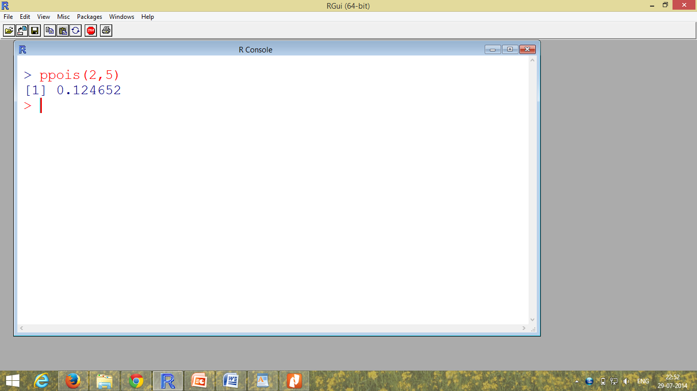
Poisson Distribution
Find the probability of 0,1,or 2 accidents in any month.
P(0)+P(1)+P(2)

Slide 35
Exercise
Calculate the probability for more than 3 accidents per month.
Suppose that the expected number of occurrences per unit space is 5, compute the probability of exactly 4 and exactly 5 occurrences, i.e. P(X = 4) and P(X = 5) respectively.

Slide 36
Example:
If there are twelve cars crossing a bridge per minute on average, find the probability of having seventeen or more cars crossing the bridge in a particular minute (i.e. P(X >= 17)).
The probability of having sixteen or less cars crossing the bridge in a particular minute is given by the ppois() function.
> ppois(16, lambda=12)
[1] 0.89871
Hence the probability of having seventeen or more cars crossing the bridge in a minute is in the upper tail of the probability density function.
> ppois(16, lambda=12, lower=FALSE) # upper tail
[1] 0.10129
If there are twelve cars crossing a bridge per minute on average, the probability of having seventeen or more cars crossing the bridge in a particular minute is 10.1%.

Slide 37
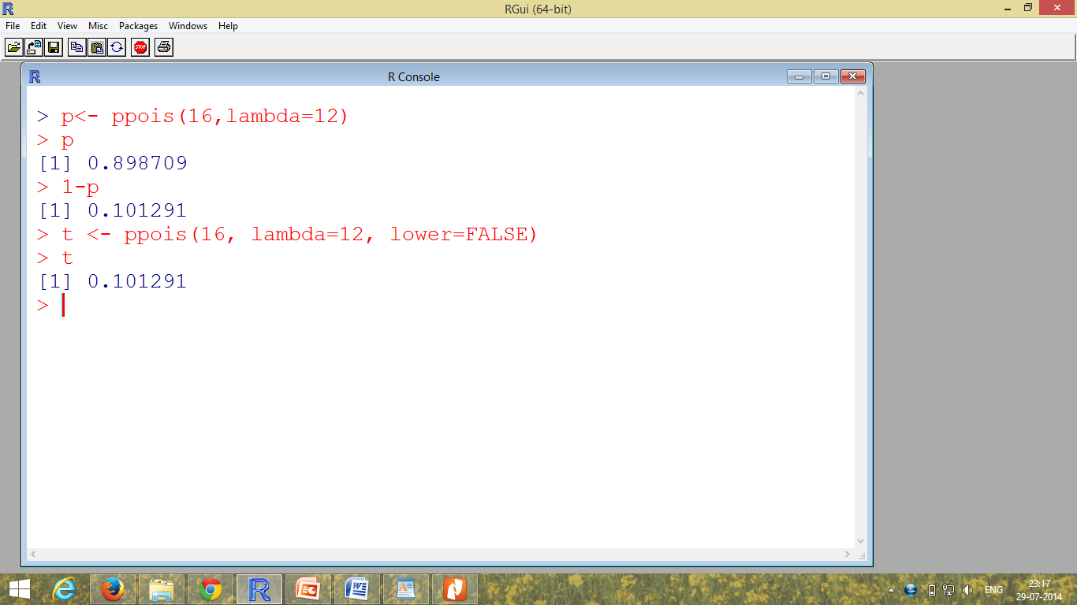
Poisson distribution

Slide 38
Normal distribution
Distribution of a continuous random variable.
Normal distributions have symmetric, bell-shaped density curves that are described by two parameters: the mean μ and the standard deviation σ.
The two tails of the normal probability distribution extend indefinitely and never touch the horizontal axis.

Slide 39


Normal distribution
For the standard normal distribution with a mean of zero and a standard deviation of 1, this simplifies to

Slide 40
Normal distribution
To plot a normal distribution, define some points x, and use dnorm to generate the density at those points.
> x <- seq(-5,5,by=.01)
> y <- dnorm(x)
> plot(x,y,type="l",lwd=2,col="red")
> abline(h=0)
> abline(v=0)

Slide 41
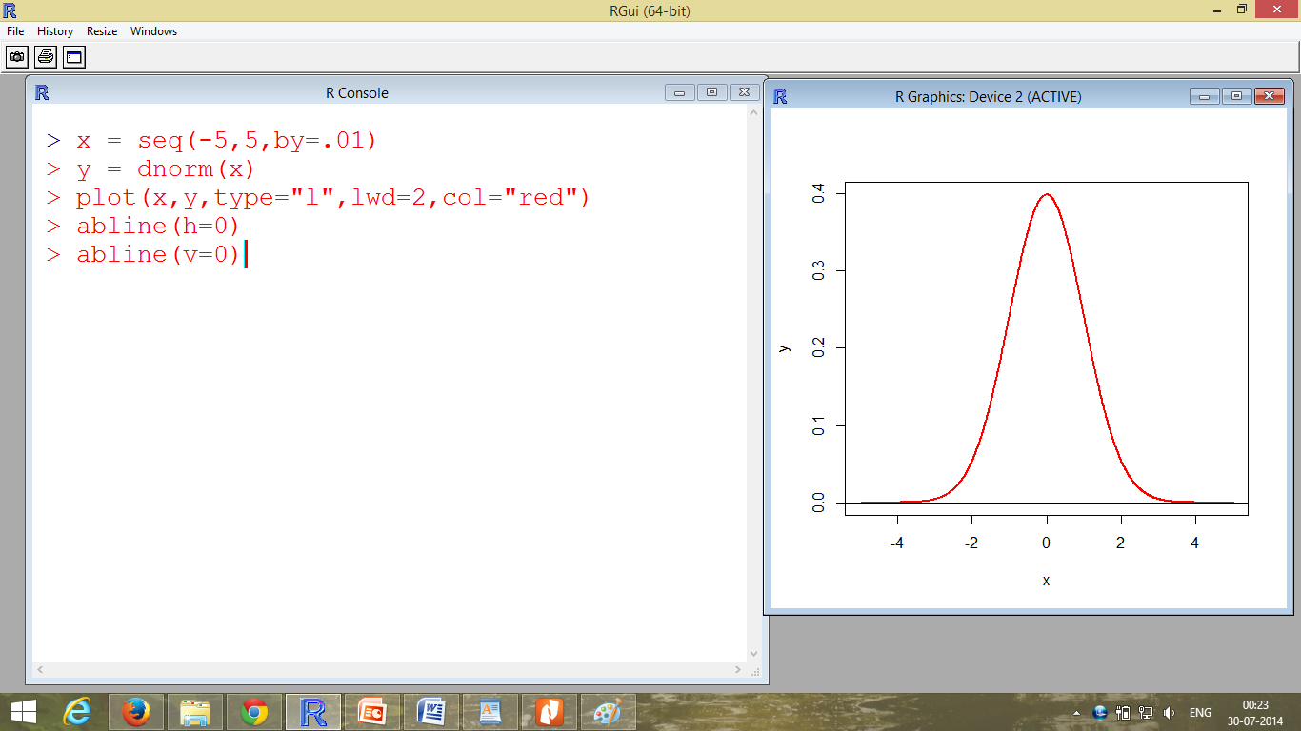

Slide 42
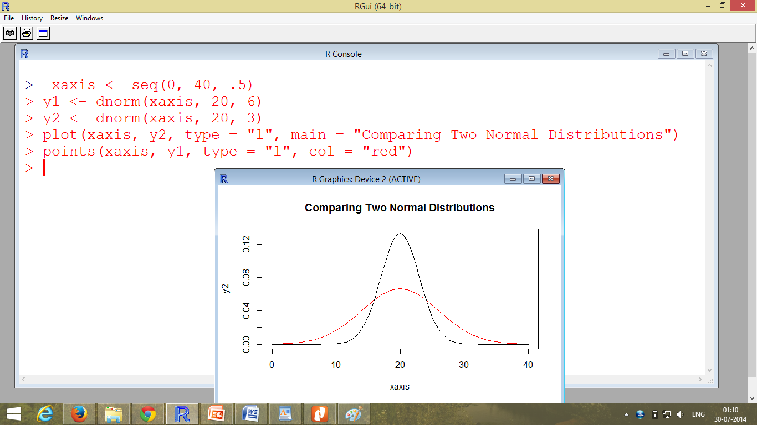
Comparing two normal distribution

Slide 43
Problem
Assume that the test scores of a college entrance exam fits a normal distribution. Furthermore, the mean test score is 72, and the standard deviation is 15.2. What is the percentage of students scoring 84 or more in the exam?
Solution
Use the function pnorm of the normal distribution with mean 72 and standard deviation 15.2.
Since we are looking for the percentage of students scoring higher than 84, we are interested in the upper tail of the normal distribution.
> pnorm(84, mean=72, sd=15.2, lower.tail=FALSE) [1] 0.21492

Slide 44
Example:
Question: Suppose toy weights produced at LEGO Toys Works have weights that are normally distributed with mean 17.46 grams and variance 375.67 grams. What is the probability that a randomly chosen toy weighs more then 19 grams?
Question Rephrased: What is P(X > 19) when X has the N(17.46, 375.67) distribution?
> pnorm(19, mean=17.46, sd=sqrt(375.67))
[1] 0.5316644

Slide 45
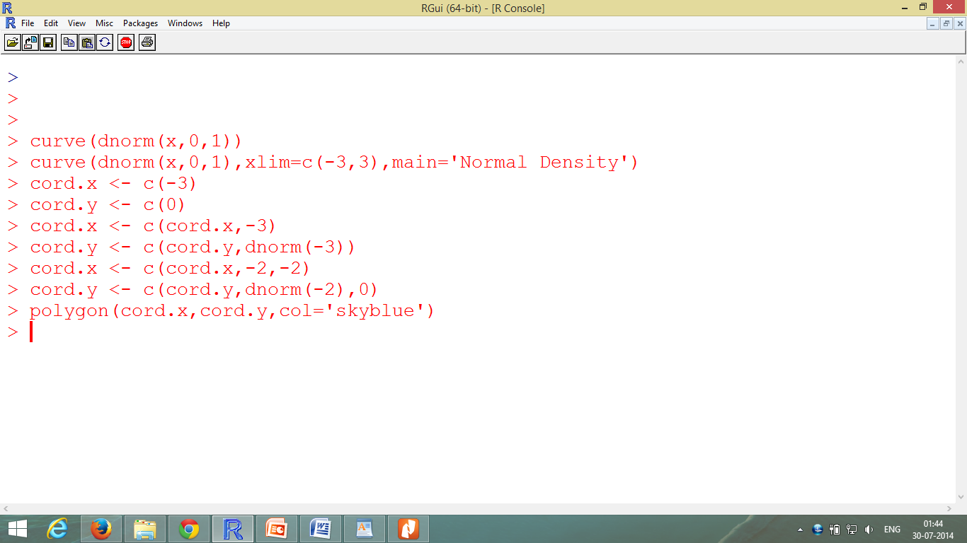
Creating shaded areas

Slide 46
