Slide 1
Why Program?
Chapter 1

Slide 2

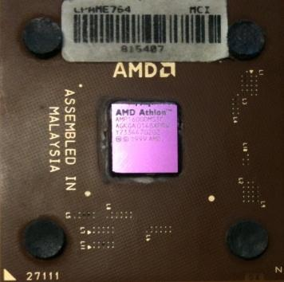
Computers want to be helpful...
What
Next?
Computers are built for one purpose - to do things for us
But we need to speak their language to describe what we want done
Users have it easy - someone already put many different programs (instructions) into the computer and users just pick the ones we want to use
What
Next?
What
Next?
What
Next?
What
Next?
What
Next?
What
Next?

Slide 3
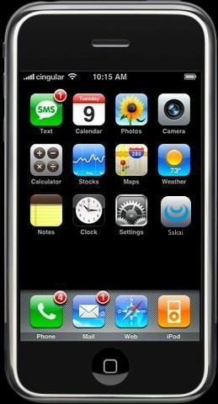
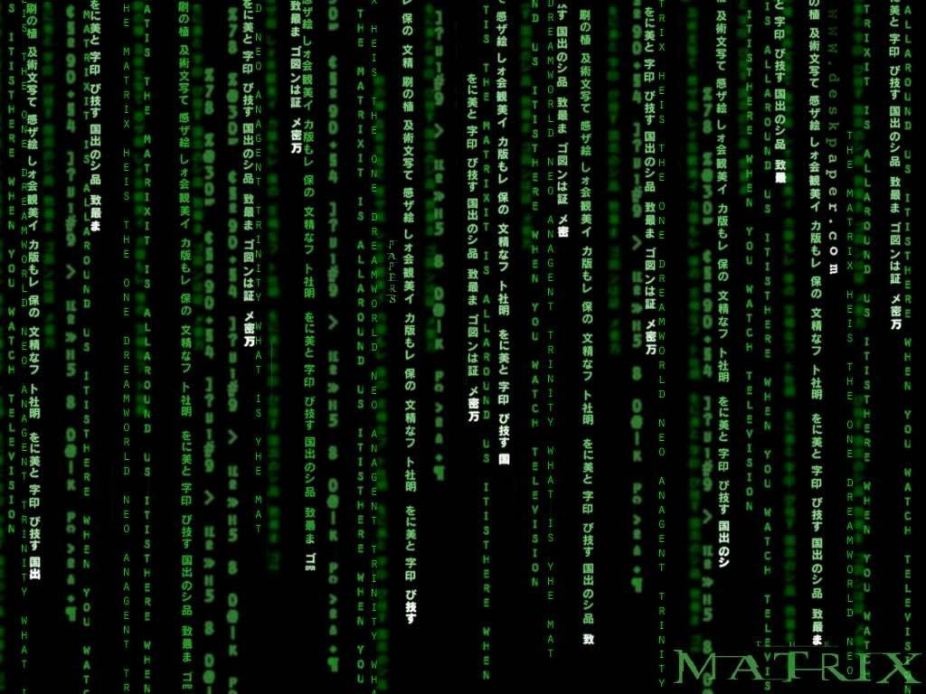
Programmers Anticipate Needs
iPhone Applications are a market
iPhone Applications have over 3 Billion downloads
Programmers have left their jobs to be full-time iPhone developers
Programmers know the ways of the program
Pick
Me!
Pick
Me!
Pick
Me!
Pick
Me!
Pick
Me!
Pay
Me!

Slide 4
Users vs. Programmers
Users see computers as a set of tools - word processor, spreadsheet, map, todo list, etc.
Programmers learn the computer “ways” and the computer language
Programmers have some tools that allow them to build new tools
Programmers sometimes write tools for lots of users and sometimes programmers write little “helpers” for themselves to automate a task

Slide 5
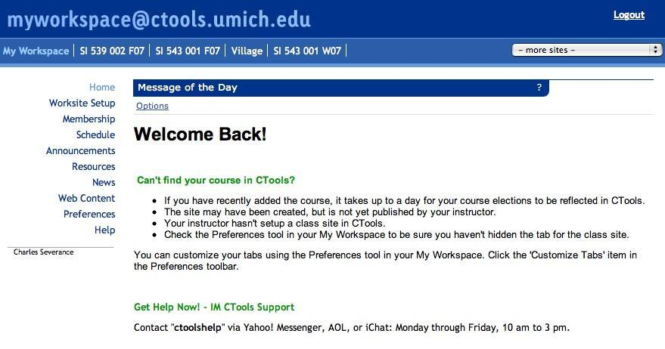

User
Computer
Hardware + Software
Programmer
Data
Information
Networks
....
From a software creator’s point of view, we build the software. The end users (stakeholders/actors) are our masters - who we want to please - often they pay us money when they are pleased. But the data, information, and networks are our problem to solve on their behalf. The hardware and software are our friends and allies in this quest.

Slide 6
Why be a programmer?
To get some task done - we are the user and programmer
  Clean up survey data
To produce something for others to use - a programming job
  Fix a performance problem in the companies softwares
  Add guestbook to a web site

Slide 7
What is Code? Software?
A Program?
A sequence of stored instructions
  It is a little piece of our intelligence in the computer
  It is a little piece of our intelligence we can give to others - we figure something out and then we encode it and then give it to someone else to save them the time and energy of figuring it out
A piece of creative art - particularly when we do a good job on user experience

Slide 8
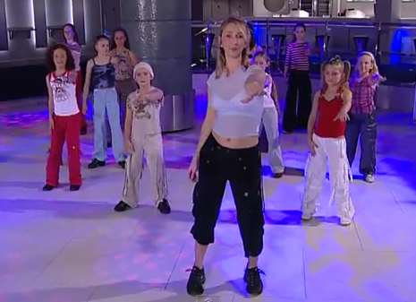
Programs for Humans...
while music is playing:
    Left hand out and up
    Right hand out and up
    Flip Left hand
    Flip Right hand
    Left hand to right shoulder
    Right hand to left shoulder
    Left hand to back of head
    Right ham to back of head
    Left hand to right hit
    Right hand to left hit
    Left hand on left bottom
    Right hand on right bottom
    Wiggle
    Wiggle
    Jump

Slide 9
Programs for Humans...
while music is playing:
    Left hand out and up
    Right hand out and up
    Flip Left hand
    Flip Right hand
    Left hand to right shoulder
    Right hand to left shoulder
    Left hand to back of head
    Right hand to back of head
    Left hand to right hip
    Right hand to left hip
    Left hand on left bottom
    Right hand on right bottom
    Wiggle
    Wiggle
    Jump

Slide 10
name = raw_input('Enter file:')
handle = open(name, 'r')
text = handle.read()
words = text.split()
counts = dict()
for word in words:
counts[word] = counts.get(word,0) + 1
bigcount = None
bigword = None
for word,count in counts.items():
if bigcount is None or count > bigcount:
bigword = word
bigcount = count
print bigword, bigcount
python words.py
Enter file: words.txt
to 16
python words.py
Enter file: clown.txt
the 7

Slide 11
Hardware Architecture

Slide 12
What
Next?
Generic
Computer
Software
Input
and Output
Devices
Central
Processing
Unit
Secondary
Memory
Main
Memory

Slide 13
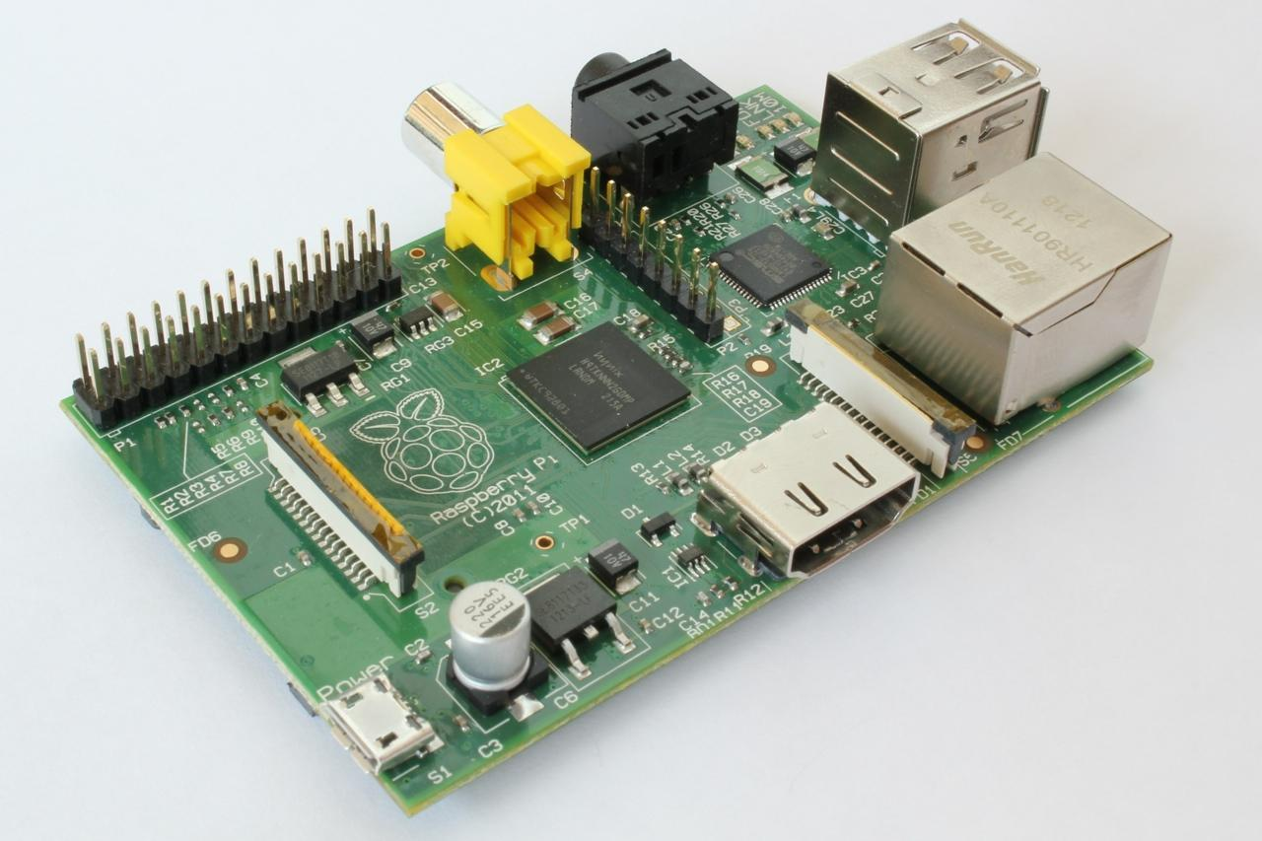

Slide 14
Definitions
What
Next?
Central Processing Unit: Runs the Program - The CPU is
always wondering “what to do next”? Not the brains
exactly - very dumb but very very fast
Input Devices: Keyboard, Mouse, Touch Screen
Output Devices: Screen, Speakers, Printer, DVD Burner
Main Memory: Fast small temporary storage - lost on reboot - aka RAM
Secondary Memory: Slower large permanent storage - lasts until deleted - disk drive / memory stick

Slide 15
What
Next?
Generic
Computer
Software
Input
and Output
Devices
Central
Processing
Unit
Secondary
Memory
if x< 3: print
Main
Memory

Slide 16
What
Next?
Software
Input
and Output
Devices
Central
Processing
Unit
Secondary
Memory
01001001
00111001
Main
Memory
Machine
Language

Slide 17
Python as a Language
from atul

Slide 18
Python is a Interpreter
High level Language

Slide 19
Python is also considered a high-level language, meaning it takes care of a lot of the grunt work involved in programming. For example, Python has a built-in garbage collector so you, as a programmer, don’t really need to worry about memory management and memory leaks, a common occurrence when using older languages such as C.

Slide 20
Early Learner: Syntax Errors
We need to learn the Python language so we can communicate our instructions to Python. In the beginning we will make lots of mistakes and speak gibberish like small children.
When you make a mistake, the computer does not think you are “cute”. It says “syntax error” - given that it *knows* the language and you are just learning it. It seems like Python is cruel and unfeeling.
You must remember that *you* are intelligent and *can* learn - the computer is simple and very fast - but cannot learn - so it is easier for you to learn Python than for the computer to learn English...

Slide 21
Features of Python
Easy to learn
Easy to read
Easy to maintain
Interactive mode
Portable
Extendable
Databases
GUI based Programming
Scalable
It can easily integrate with C, C++, Java, ActiveX, COBRA

Slide 22
Interesting
You will never gonna use
;
AND
{ }

Slide 23
Python Environment
Linux – Ubuntu, Redhat, CentOS etc
Windows
DOS
PalmOS
Nokia Mobile phones
Windows CE
Acorn RISC OS
BeOS
Amiga
VxWorks
QNX
Psion

Slide 24
Talking to Python

Slide 25
Python 2.7.3 (default, Apr 20 2012, 22:44:07)
[GCC 4.6.3] on linux2
Type "help", "copyright", "credits" or "license" for more information.
>>>
What next? (Chevron)

Slide 26
Identifiers

Slide 27
Data Types of Python
Int, Float, Long, Complex , Char, String, Tuple, Bytes, Frozen set, set

Slide 28
csev$ python
Python 2.7.3 (default, Apr 20 2012, 22:44:07)
[GCC 4.6.3] on linux2
Type "help", "copyright", "credits" or "license" for more information.
>>> x = 1
>>> print x
1
>>> x = x + 1
>>> print x
2
>>> exit()
This is a good test to make sure that you have Python correctly installed. Note that quit() also works to end the interactive session.

Slide 29
Mutable and Immutable Data types
Mutable: Byte array, Set, List, Dict
Immutable: Int, float, long, complex, str, bytes, tuple, frozen set

Slide 30
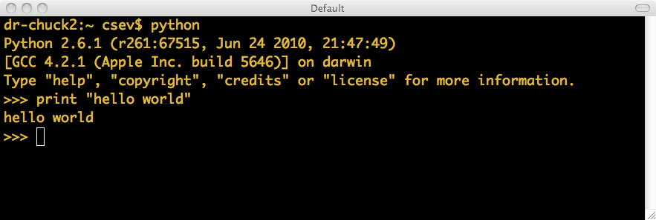
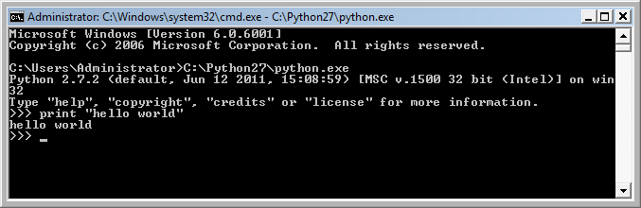
Let’s Talk to Python...

Slide 31
What Do We Say?

Slide 32
Elements of Python
Vocabulary / Words - Variables and Reserved words (Chapter 2)
Sentence structure - valid syntax patterns (Chapters 3-5)
Story structure - constructing a program for a purpose

Slide 33
Reserved Words
You cannot use reserved words as variable names / identifiers
and del for is raise assert elif from lambda return break else global not try class except if or while continue exec import pass yield def ﬁnally in print as with
Chapter 2

Slide 34
Sentences or Lines
x = 2
x = x + 2
print x
Assignment statement
Assignment with expression
Print statement
Variable
Operator
Constant
Reserved Word

Slide 35
Programming Paragraphs

Slide 36
Python Scripts
Interactive Python is good for experiments and programs of 3-4 lines long
Most programs are much longer, so we type them into a file and tell Python to run the commands in the file
As a convention, we add “.py” as the suffix on the end of these files to indicate they contain Python

Slide 37
Writing a Simple Program

Slide 38
Interactive versus Script
Interactive
  You type directly to Python one line at a time and it responds
Script
  You enter a sequence of statements (lines) into a file using a text editor and tell Python to execute the statements in the file

Slide 39
Program Steps or Program Flow
Like a recipe or installation instructions, a program is a sequence of steps to be done in order
Some steps are conditional - they may be skipped
Sometimes a step or group of steps are to be repeated
Sometimes we store a set of steps to be used over and over as needed several places throughout the program (Chapter 4)

Slide 40
Sequential Steps
x = 2
Program:
x = 2
print x
x = x + 2
print x
Output:
2
4
print x
x = x + 2
print x
When a program is running, it flows from one step to the next. As programmers, we set up “paths” for the program to follow.
Chapter 2

Slide 41
Conditional Steps
x = 5
x < 10 ?
Yes
Program:
x = 5
if x < 10:
print 'Smaller’
if x > 20:
print 'Bigger'
print 'Finis'
print 'Smaller'
Output:
Smaller
Finish
x > 20 ?
No
print 'Bigger'
print 'Finis'
Chapter 3

Slide 42
Repeated Steps
n = 5
No
n > 0 ?
Yes
Output:
5
4
3
2
1
Blastoff!
Program:
n = 5
while n > 0 :
print n
n = n – 1
print 'Blastoff!'
print n
n = n -1
print 'Blastoff'
Loops (repeated steps) have iteration variables that change each time through a loop. Often these iteration variables go through a sequence of numbers.
Chapter 5

Slide 43
name = raw_input('Enter file:')
handle = open(name, 'r')
text = handle.read()
words = text.split()
counts = dict()
for word in words:
counts[word] = counts.get(word,0) + 1
bigcount = None
bigword = None
for word,count in counts.items():
if bigcount is None or count > bigcount:
bigword = word
bigcount = count
print bigword, bigcount
Sequential
Repeated
Conditional

Slide 44
name = raw_input('Enter file:')
handle = open(name, 'r')
text = handle.read()
words = text.split()
counts = dict()
for word in words:
counts[word] = counts.get(word,0) + 1
bigcount = None
bigword = None
for word,count in counts.items():
if bigcount is None or count > bigcount:
bigword = word
bigcount = count
print bigword, bigcount
A short Python “Story” about how to count words in a file
A word used to read data from a user
A sentence about updating one of the many counts
A paragraph about how to find the largest item in a list

Slide 45
Summary
This is a quick overview of Chapter 1
We will revisit these concepts throughout the course
Focus on the big picture

Slide 46
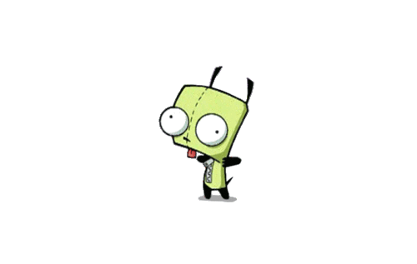
Chapter 1 : Finished
Any Doubt?

