Slide 1
Tuples
Chapter 10

Slide 2
Tuples are like lists
Tuples are another kind of sequence that functions much like a list - they have elements which are indexed starting at 0
>>> x = ('Glenn', 'Sally', 'Joseph')
>>> print x[2]
Joseph
>>> y = ( 1, 9, 2 )
>>> print y
(1, 9, 2)
>>> print max(y)
9
>>> for iter in y:
... print iter
...
1
9
2
>>>

Slide 3
but... Tuples are “immutable”
Unlike a list, once you create a tuple, you cannot alter its contents - similar to a string
>>> x = [9, 8, 7]
>>> x[2] = 6
>>> print x
>>>[9, 8, 6]
>>>
>>> y = 'ABC'
>>> y[2] = 'D'
Traceback:'str' object does
not support item
Assignment
>>>
>>> z = (5, 4, 3)
>>> z[2] = 0
Traceback:'tuple' object does
not support item
Assignment
>>>

Slide 4
Things not to do with tuples
>>> x = (3, 2, 1)
>>> x.sort()
Traceback:
AttributeError: 'tuple' object has no attribute 'sort'
>>> x.append(5)
Traceback:
AttributeError: 'tuple' object has no attribute 'append'
>>> x.reverse()
Traceback:
AttributeError: 'tuple' object has no attribute 'reverse'
>>>

Slide 5
A Tale of Two Sequences
>>> l = list()
>>> dir(l)
['append', 'count', 'extend', 'index', 'insert', 'pop', 'remove', 'reverse', 'sort']
>>> t = tuple()
>>> dir(t)
['count', 'index']

Slide 6
Tuples are more efficient
Since Python does not have to build tuple structures to be modifiable, they are simpler and more efficient in terms of memory use and performance than lists
So in our program when we are making “temporary variables” we prefer tuples over lists

Slide 7
Tuples and Assignment
We can also put a tuple on the left-hand side of an assignment statement
We can even omit the parentheses
>>> (x, y) = (4, 'fred')
>>> print y
fred
>>> (a, b) = (99, 98)
>>> print a
99

Slide 8
Tuples and Dictionaries
>>> d = dict()
>>> d['csev'] = 2
>>> d['cwen'] = 4
>>> for (k,v) in d.items():
... print k, v
...
csev 2
cwen 4
>>> tups = d.items()
>>> print tups
[('csev', 2), ('cwen', 4)]
The items() method in dictionaries returns a list of (key, value) tuples

Slide 9
Tuples are Comparable
The comparison operators work with tuples and other sequences. If the first item is equal, Python goes on to the next element, and so on, until it finds elements that differ.
>>> (0, 1, 2) < (5, 1, 2)
True
>>> (0, 1, 2000000) < (0, 3, 4)
True
>>> ( 'Jones', 'Sally' ) < ('Jones', 'Sam')
True
>>> ( 'Jones', 'Sally') > ('Adams', 'Sam')
True

Slide 10
Sorting Lists of Tuples
We can take advantage of the ability to sort a list of tuples to get a sorted version of a dictionary
First we sort the dictionary by the key using the items() method
>>> d = {'a':10, 'b':1, 'c':22}
>>> t = d.items()
>>> t
[('a', 10), ('c', 22), ('b', 1)]
>>> t.sort()
>>> t
[('a', 10), ('b', 1), ('c', 22)]

Slide 11
Using sorted()
>>> d = {'a':10, 'b':1, 'c':22}
>>> d.items()
[('a', 10), ('c', 22), ('b', 1)]
>>> t = sorted(d.items())
>>> t
[('a', 10), ('b', 1), ('c', 22)]
>>> for k, v in sorted(d.items()):
... print k, v
...
a 10
b 1
c 22
We can do this even more directly using the built-in function sorted that takes a sequence as a parameter and returns a sorted sequence

Slide 12
Sort by values instead of key
If we could construct a list of tuples of the form (value, key) we could sort by value
We do this with a for loop that creates a list of tuples
>>> c = {'a':10, 'b':1, 'c':22}
>>> tmp = list()
>>> for k, v in c.items() :
... tmp.append( (v, k) )
...
>>> print tmp
[(10, 'a'), (22, 'c'), (1, 'b')]
>>> tmp.sort(reverse=True)
>>> print tmp
[(22, 'c'), (10, 'a'), (1, 'b')]

Slide 13
fhand = open('romeo.txt')
counts = dict()
for line in fhand:
words = line.split()
for word in words:
counts[word] = counts.get(word, 0 ) + 1
lst = list()
for key, val in counts.items():
lst.append( (val, key) )
lst.sort(reverse=True)
for val, key in lst[:10] :
print key, val
The top 10 most common words

Slide 14
Even Shorter Version
>>> c = {'a':10, 'b':1, 'c':22}
>>> print sorted( [ (v,k) for k,v in c.items() ] )
[(1, 'b'), (10, 'a'), (22, 'c')]
List comprehension creates a dynamic list. In this case, we make a list of reversed tuples and then sort it.
http://wiki.python.org/moin/HowTo/Sorting

Slide 15
Summary
Tuple syntax
Immutability
Comparability
Sorting
Tuples in assignment statements
Sorting dictionaries by either key or value

Slide 16
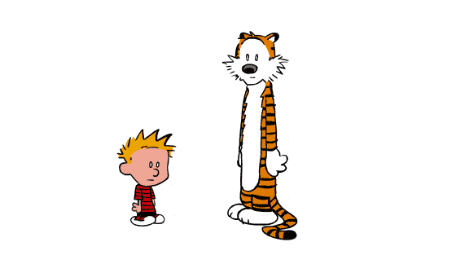
Chapter 10 : Finished
Any Doubt?

