Slide 1
Using Web Services
Chapter 13
Notes:
Note from Chuck. If you are using these materials, you can remove the UM logo and replace it with your own, but please retain the CC-BY logo on the first page as well as retain the entire last page.

Slide 2
Data on the Web
With the HTTP Request/Response well understood and well supported, there was a natural move toward exchanging data between programs using these protocols
We needed to come up with an agreed way to represent data going between applications and across networks
There are two commonly used formats: XML and JSON

Slide 3


Sending Data across the “Net”
Python
Dictionary
Java
HashMap
a.k.a. “Wire Protocol” - What we send on the “wire”

Slide 4
Agreeing on a “Wire Format”
<person>
<name>
Chuck
</name>
<phone>
303 4456
</phone>
</person>
De-Serialize
Python
Dictionary
Java
HashMap
Serialize
XML

Slide 5
Agreeing on a “Wire Format”
{
"name" :
"Chuck",
"phone" :
"303-4456"
}
Python
Dictionary
De-Serialize
Java
HashMap
Serialize
JSON

Slide 6
XML “Elements” (or Nodes)
<people>
<person>
<name>Chuck</name>
<phone>303 4456</phone>
</person>
<person>
<name>Noah</name>
<phone>622 7421</phone>
</person>
</people>
Simple Element
Complex Element

Slide 7
XML
Marking up data to send across the network...
http://en.wikipedia.org/wiki/XML

Slide 8
eXtensible Markup Language
Primary purpose is to help information systems share structured data
It started as a simplified subset of the Standard Generalized Markup Language (SGML), and is designed to be relatively human-legible
http://en.wikipedia.org/wiki/XML

Slide 9
XML Basics
Start Tag
End Tag
Text Content
Attribute
Self Closing Tag
<person>
<name>Chuck</name>
<phone type="intl">
+1 734 303 4456
</phone>
<email hide="yes" />
</person>

Slide 10
White Space
<person>
<name>Chuck</name>
<phone type="intl">
+1 734 303 4456
</phone>
<email hide="yes" />
</person>
Line ends do not matter. White space is generally discarded on text elements. We indent only to be readable.
<person>
<name>Chuck</name>
<phone type="intl">+1 734 303 4456</phone>
<email hide="yes" />
</person>

Slide 11
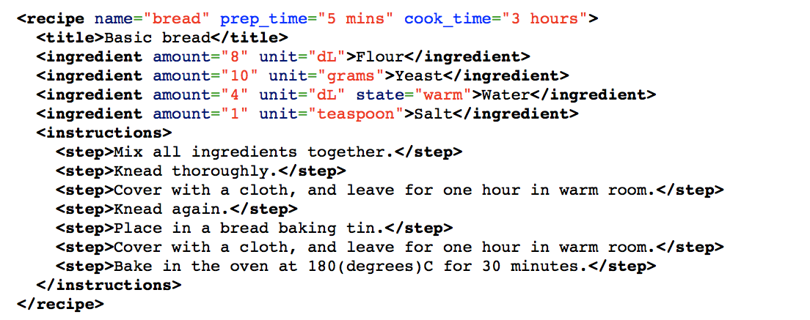
Some XML...
http://en.wikipedia.org/wiki/XML

Slide 12
XML Terminology
Tags indicate the beginning and ending of elements
Attributes - Keyword/value pairs on the opening tag of XML
Serialize / De-Serialize - Convert data in one program into a common format that can be stored and/or transmitted between systems in a programming language-independent manner
http://en.wikipedia.org/wiki/Serialization

Slide 13
XML as a Tree
a
<a>
<b>X</b>
<c>
<d>Y</d>
<e>Z</e>
</c>
</a>
b
c
X
d
e
Y
Z
Elements
Text

Slide 14
XML Text and Attributes
a
<a>
<b w="5">X</b>
<c>
<d>Y</d>
<e>Z</e>
</c>
</a>
b
c
w
attrib
text
node
5
X
d
e
Y
Z
Elements
Text

Slide 15
XML as Paths
a
b
c
<a>
<b>X</b>
<c>
<d>Y</d>
<e>Z</e>
</c>
</a>
X
d
e
Y
Z
/a/b X
/a/c/d Y
/a/c/e Z
Elements
Text

Slide 16
XML Schema
Describing a “contract” as to what is acceptable XML.
http://en.wikipedia.org/wiki/Xml_schema
http://en.wikibooks.org/wiki/XML_Schema

Slide 17
XML Schema
Description of the legal format of an XML document
Expressed in terms of constraints on the structure and content of documents
Often used to specify a “contract” between systems - “My system will only accept XML that conforms to this particular Schema.”
If a particular piece of XML meets the specification of the Schema - it is said to “validate”
http://en.wikipedia.org/wiki/Xml_schema

Slide 18

XML Validation
XML Document
Validator
XML Schema Contract

Slide 19
XML Validation
XML Document
<person>
<lastname>Severance</lastname>
<age>17</age>
<dateborn>2001-04-17</dateborn>
</person>
Validator
XML Schema Contract
<xs:complexType name=”person”>
<xs:sequence>
<xs:element name="lastname" type="xs:string"/>
<xs:element name="age" type="xs:integer"/>
<xs:element name="dateborn" type="xs:date"/>
</xs:sequence>
</xs:complexType>

Slide 20
Many XML Schema Languages
Document Type Definition (DTD)
  http://en.wikipedia.org/wiki/Document_Type_Definition
Standard Generalized Markup Language (ISO 8879:1986 SGML)
  http://en.wikipedia.org/wiki/SGML
XML Schema from W3C - (XSD)
  http://en.wikipedia.org/wiki/XML_Schema_(W3C)
http://en.wikipedia.org/wiki/Xml_schema

Slide 21
XSD XML Schema (W3C spec)
We will focus on the World Wide Web Consortium (W3C) version
It is often called “W3C Schema” because “Schema” is considered generic
More commonly it is called XSD because the file names end in .xsd
http://www.w3.org/XML/Schema
http://en.wikipedia.org/wiki/XML_Schema_(W3C)

Slide 22
XSD Structure
<person>
<lastname>Severance</lastname>
<age>17</age>
<dateborn>2001-04-17</dateborn>
</person>
xs:element
xs:sequence
xs:complexType
<xs:complexType name=”person”>
<xs:sequence>
<xs:element name="lastname" type="xs:string"/>
<xs:element name="age" type="xs:integer"/>
<xs:element name="dateborn" type="xs:date"/>
</xs:sequence>
</xs:complexType>

Slide 23
XSD
Constraints
<xs:element name="person">
<xs:complexType>
<xs:sequence>
<xs:element name="full_name" type="xs:string" minOccurs="1" maxOccurs="1" />
<xs:element name="child_name" type="xs:string" minOccurs="0" maxOccurs="10" />
</xs:sequence>
</xs:complexType>
</xs:element>
<person>
<full_name>Tove Refsnes</full_name>
<child_name>Hege</child_name>
<child_name>Stale</child_name>
<child_name>Jim</child_name>
<child_name>Borge</child_name>
</person>
http://www.w3schools.com/Schema/schema_complex_indicators.asp

Slide 24
XSD Data Types
<xs:element name="customer" type="xs:string"/>
<xs:element name="start" type="xs:date"/>
<xs:element name="startdate" type="xs:dateTime"/>
<xs:element name="prize" type="xs:decimal"/>
<xs:element name="weeks" type="xs:integer"/>
<customer>John Smith</customer>
<start>2002-09-24</start>
<startdate>2002-05-30T09:30:10Z</startdate>
<prize>999.50</prize>
<weeks>30</weeks>
It is common to represent time in UTC/GMT, given that servers are often scattered around the world.
http://www.w3schools.com/Schema/schema_dtypes_numeric.asp

Slide 25
ISO 8601 Date/Time Format
2002-05-30T09:30:10Z
Year-month-day
Time of day
Timezone - typically specified in UTC / GMT rather than local time zone.
http://en.wikipedia.org/wiki/ISO_8601
http://en.wikipedia.org/wiki/Coordinated_Universal_Time

Slide 26
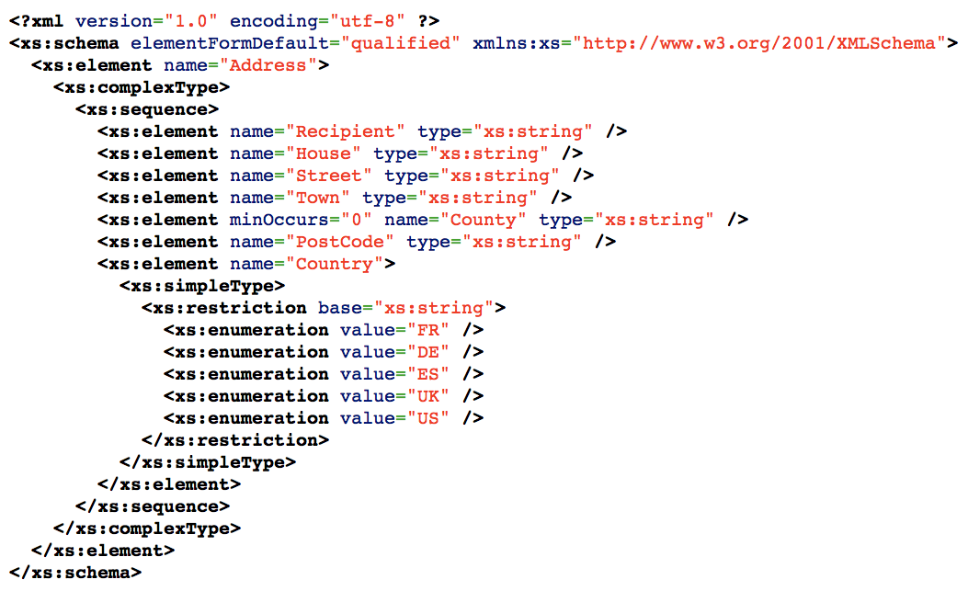
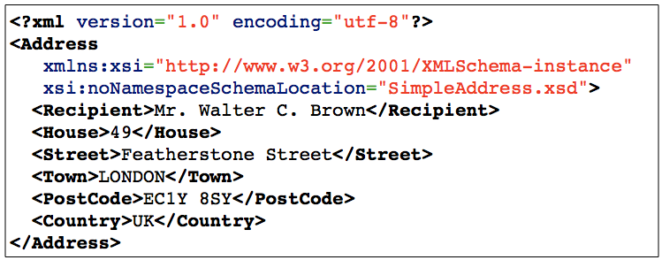

Slide 27
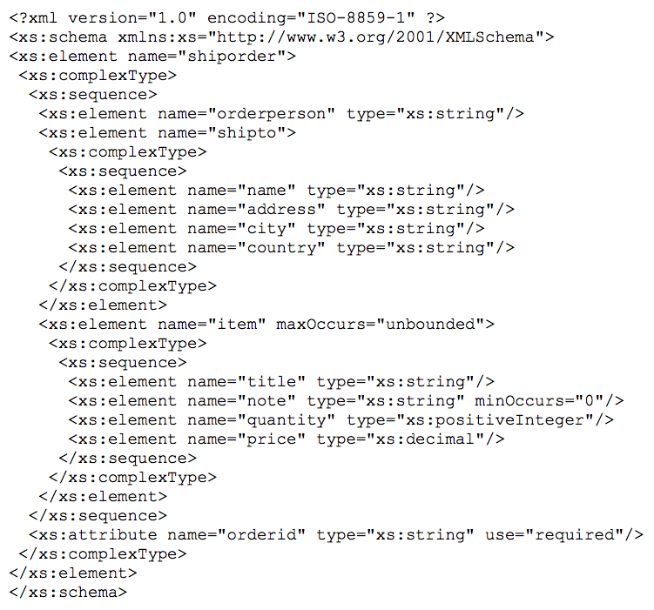
http://www.w3schools.com/Schema/schema_example.asp

Slide 28
xml1.py
import xml.etree.ElementTree as ET
data = '''<person>
<name>Chuck</name>
<phone type="intl">
+1 734 303 4456
</phone>
<email hide="yes"/>
</person>'''
tree = ET.fromstring(data)
print 'Name:',tree.find('name').text
print 'Attr:',tree.find('email').get('hide')

Slide 29
import xml.etree.ElementTree as ET
input = '''<stuff>
<users>
<user x="2">
<id>001</id>
<name>Chuck</name>
</user>
<user x="7">
<id>009</id>
<name>Brent</name>
</user>
</users>
</stuff>'''
stuff = ET.fromstring(input)
lst = stuff.findall('users/user')
print 'User count:', len(lst)
for item in lst:
print 'Name', item.find('name').text
print 'Id', item.find('id').text
print 'Attribute', item.get("x")
xml2.py

Slide 30
JavaScript Object Notation

Slide 31
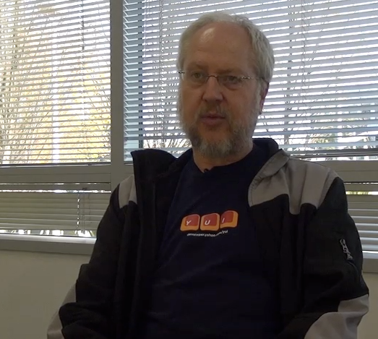
JavaScript Object Notation
Douglas Crockford - “Discovered” JSON
Object literal notation in JavaScript
http://www.youtube.com/watch?v=kc8BAR7SHJI

Slide 32
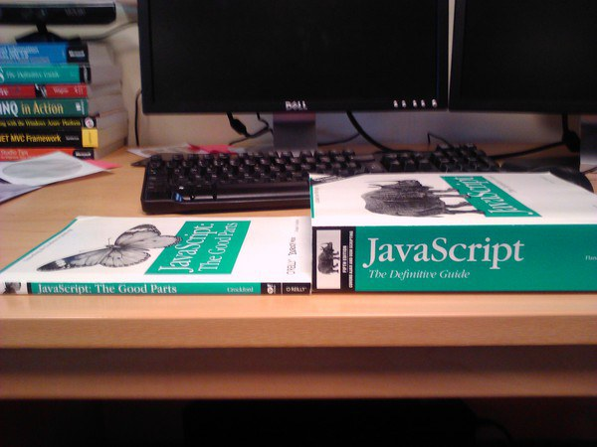

Slide 33
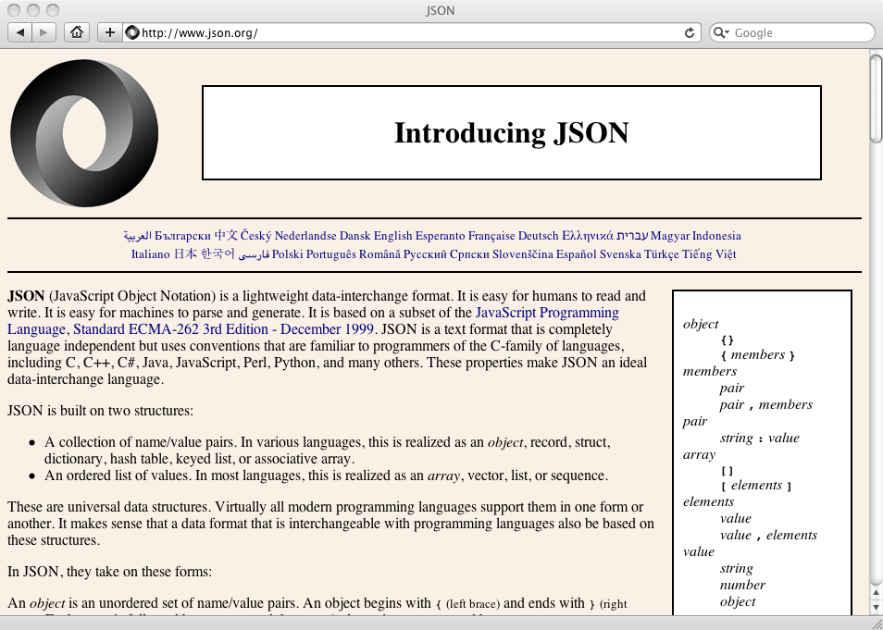

Slide 34
json1.py
import json
data = '''{
"name" : "Chuck",
"phone" : {
"type" : "intl",
"number" : "+1 734 303 4456"
},
"email" : {
"hide" : "yes"
}
}'''
info = json.loads(data)
print 'Name:',info["name"]
print 'Hide:',info["email"]["hide"]
JSON represents data as nested “lists” and “dictionaries”

Slide 35
json2.py
import json
input = '''[
{ "id" : "001",
"x" : "2",
"name" : "Chuck"
} ,
{ "id" : "009",
"x" : "7",
"name" : "Chuck"
}
]'''
info = json.loads(input)
print 'User count:', len(info)
for item in info:
print 'Name', item['name']
print 'Id', item['id']
print 'Attribute', item['x']
JSON represents data as nested “lists” and “dictionaries”

Slide 36
Service Oriented Approach
http://en.wikipedia.org/wiki/Service-oriented_architecture

Slide 37

Service Oriented Approach
Most non-trivial web applications use services
They use services from other applications
  Credit Card Charge
  Hotel Reservation systems
Services publish the “rules” applications must follow to make use of the service (API)
Application
APIs
Service
Service

Slide 38
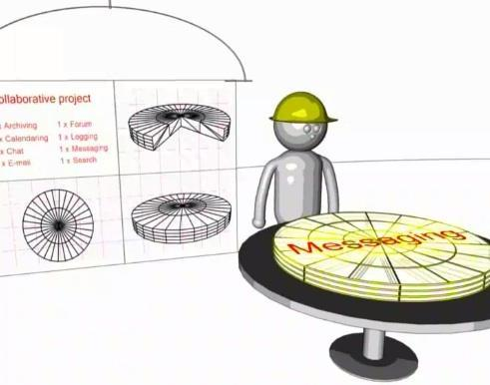
Multiple Systems
Initially - two systems cooperate and split the problem
As the data/service becomes useful - multiple applications want to use the information / application
http://www.youtube.com/watch?v=mj-kCFzF0ME
5:15

Slide 39
Web Services
http://en.wikipedia.org/wiki/Web_services

Slide 40
Application Program Interface
The API itself is largely abstract in that it specifies an interface and controls the behavior of the objects specified in that interface. The software that provides the functionality described by an API is said to be an “implementation” of the API. An API is typically defined in terms of the programming language used to build an application.
Text
http://en.wikipedia.org/wiki/API

Slide 41
Web Service Technologies
SOAP - Simple Object Access Protocol (software)
  Remote programs/code which we use over the network
  Note: Dr. Chuck does not like SOAP because it is overly complex
REST - Representational State Transfer (resource focused)
  Remote resources which we create, read, update and delete remotely
http://en.wikipedia.org/wiki/SOAP_(protocol)
http://en.wikipedia.org/wiki/REST

Slide 42
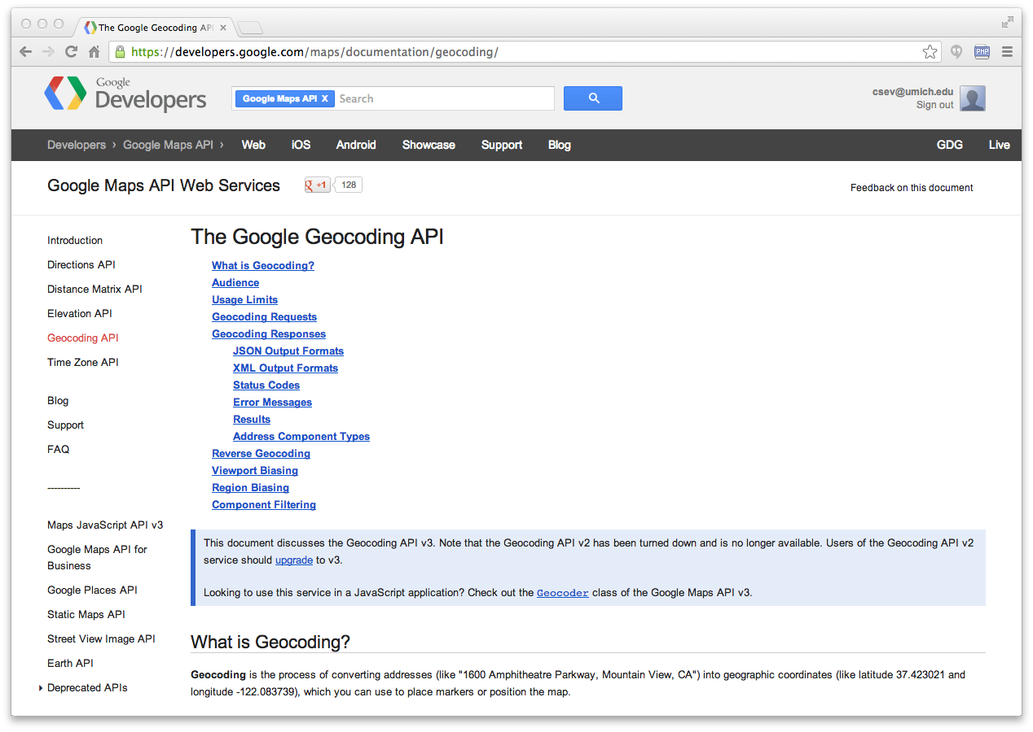
https://developers.google.com/maps/documentation/geocoding/

Slide 43
{
"status": "OK",
"results": [
{
"geometry": {
"location_type": "APPROXIMATE",
"location": {
"lat": 42.2808256,
"lng": -83.7430378
}
},
"address_components": [
{
"long_name": "Ann Arbor",
"types": [
"locality",
"political"
],
"short_name": "Ann Arbor"
}
],
"formatted_address": "Ann Arbor, MI, USA",
"types": [
"locality",
"political"
]
}
]
}
http://maps.googleapis.com/maps/api/geocode/json?sensor=false&address=Ann+Arbor%2C+MI
geojson.py

Slide 44
import urllib
import json
serviceurl = 'http://maps.googleapis.com/maps/api/geocode/json?'
while True:
address = raw_input('Enter location: ')
if len(address) < 1 : break
url = serviceurl + urllib.urlencode({'sensor':'false',
'address': address})
print 'Retrieving', url
uh = urllib.urlopen(url)
data = uh.read()
print 'Retrieved',len(data),'characters'
try: js = json.loads(str(data))
except: js = None
if 'status' not in js or js['status'] != 'OK':
print '==== Failure To Retrieve ===='
print data
continue
print json.dumps(js, indent=4)
lat = js["results"][0]["geometry"]["location"]["lat"]
lng = js["results"][0]["geometry"]["location"]["lng"]
print 'lat',lat,'lng',lng
location = js['results'][0]['formatted_address']
print location
Enter location: Ann Arbor, MI
Retrieving http://maps.googleapis.com/...
Retrieved 1669 characters
lat 42.2808256 lng -83.7430378
Ann Arbor, MI, USA
Enter location:
geojson.py

Slide 45
API Security and Rate Limiting
The compute resources to run these APIs are not “free”
The data provided by these APIs is usually valuable
The data providers might limit the number of requests per day, demand an API “key”, or even charge for usage
They might change the rules as things progress...

Slide 46
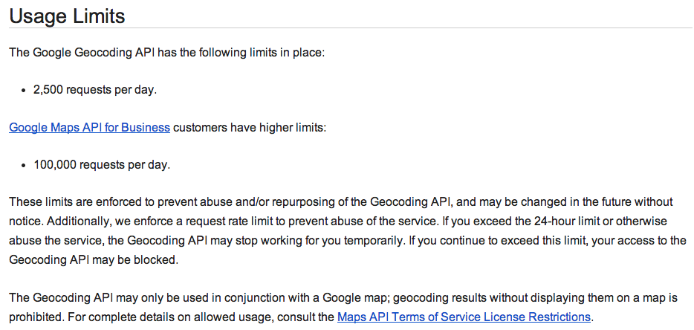

Slide 47
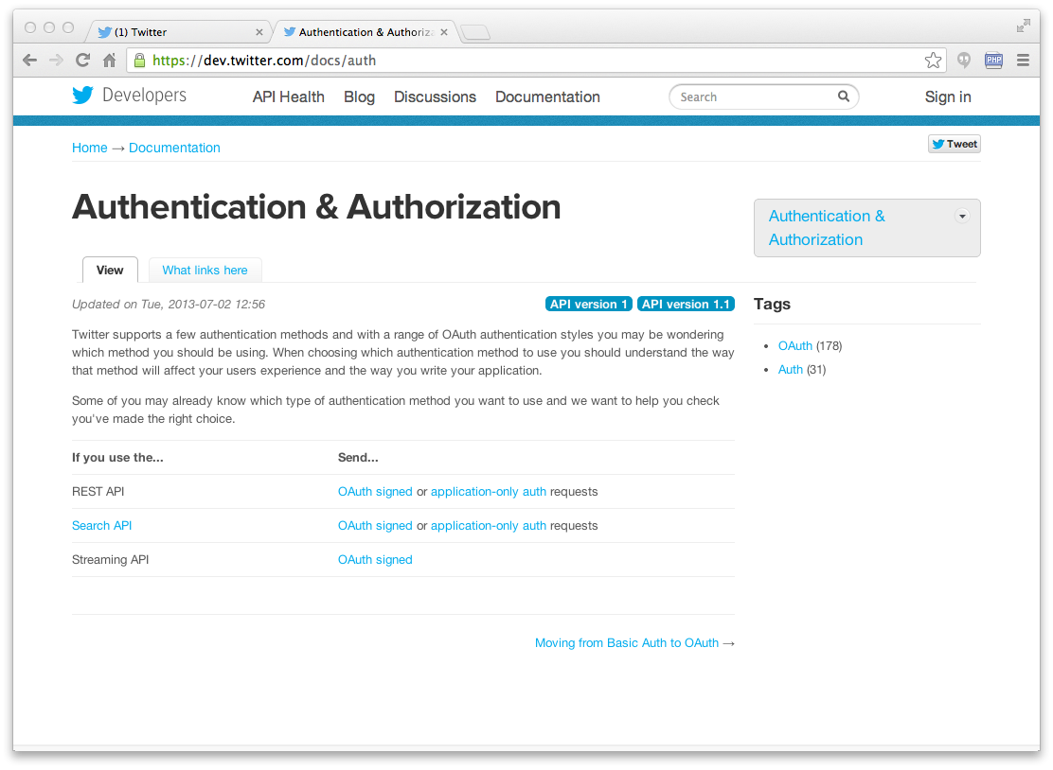

Slide 48
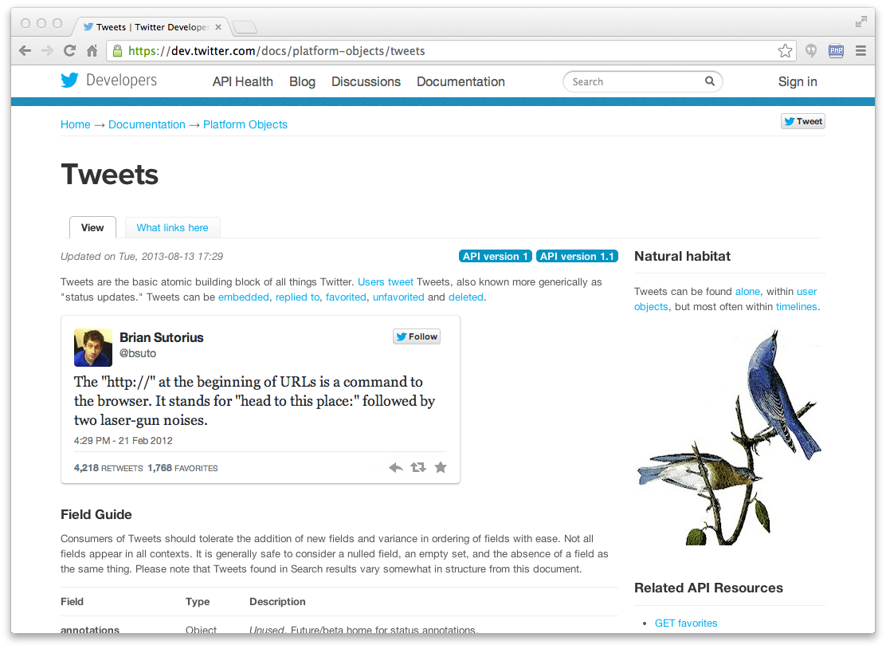

Slide 49
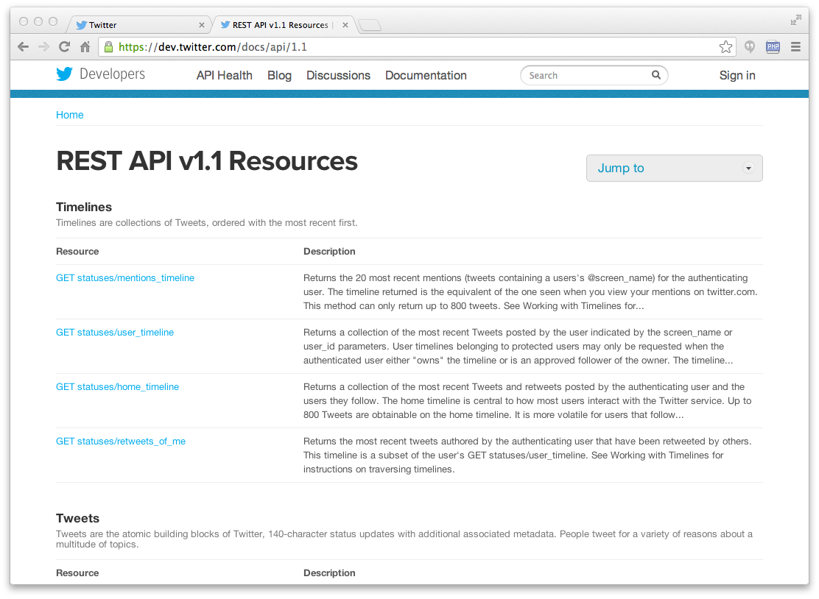

Slide 50
import urllib
import twurl
import json
TWITTER_URL = 'https://api.twitter.com/1.1/friends/list.json'
while True:
print ''
acct = raw_input('Enter Twitter Account:')
if ( len(acct) < 1 ) : break
url = twurl.augment(TWITTER_URL,
{'screen_name': acct, 'count': '5'} )
print 'Retrieving', url
connection = urllib.urlopen(url)
data = connection.read()
headers = connection.info().dict
print 'Remaining', headers['x-rate-limit-remaining']
js = json.loads(data)
print json.dumps(js, indent=4)
for u in js['users'] :
print u['screen_name']
s = u['status']['text']
print ' ',s[:50]
twitter2.py

Slide 51
Enter Twitter Account:drchuck
Retrieving https://api.twitter.com/1.1/friends ...
Remaining 14
{
"users": [
{
"status": {
"text": "@jazzychad I just bought one .__.",
"created_at": "Fri Sep 20 08:36:34 +0000 2013",
},
"location": "San Francisco, California",
"screen_name": "leahculver",
"name": "Leah Culver",
},
{
"status": {
"text": "RT @WSJ: Big employers like Google ...",
"created_at": "Sat Sep 28 19:36:37 +0000 2013",
},
"location": "Victoria Canada",
"screen_name": "_valeriei",
"name": "Valerie Irvine",
],
}
Leahculver
@jazzychad I just bought one .__._
Valeriei
RT @WSJ: Big employers like Google, AT&amp;T are h
Ericbollens
RT @lukew: sneak peek: my LONG take on the good &a
halherzog
Learning Objects is 10. We had a cake with the LO,
twitter2.py

Slide 52
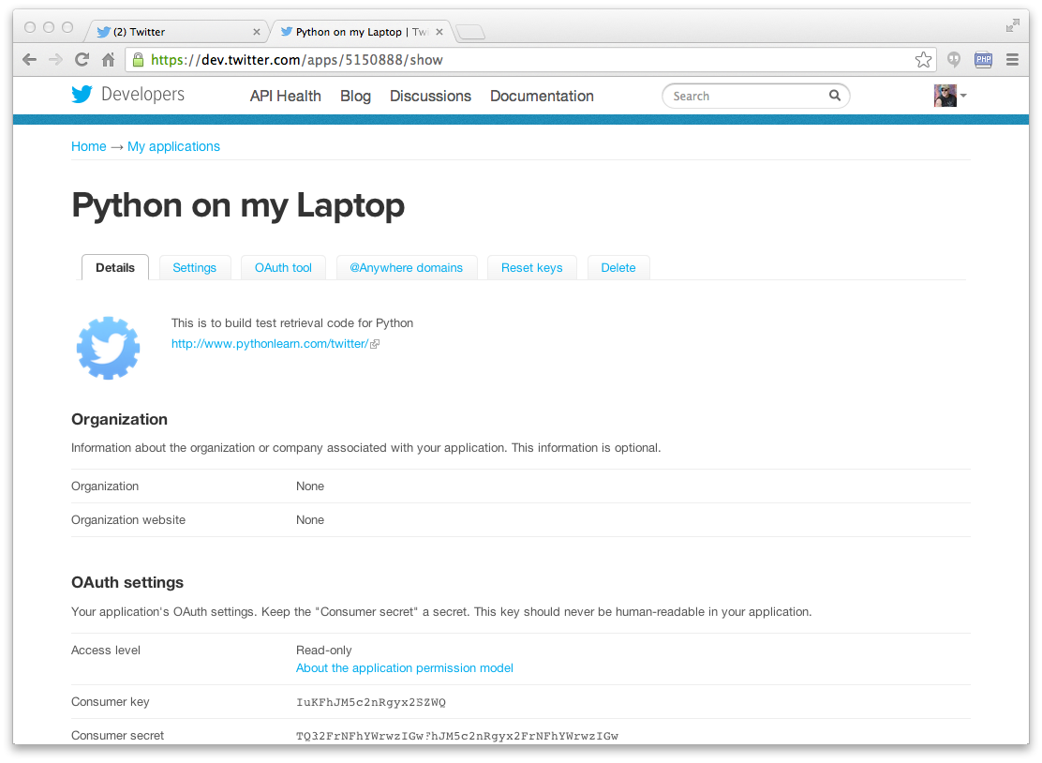

Slide 53
def oauth() :
return { "consumer_key" : "h7Lu...Ng",
"consumer_secret" : "dNKenAC3New...mmn7Q",
"token_key" : "10185562-ein2...P4GEQQOSGI",
"token_secret" : "H0ycCFemmwyf1...qoIpBo" }
hidden.py

Slide 54
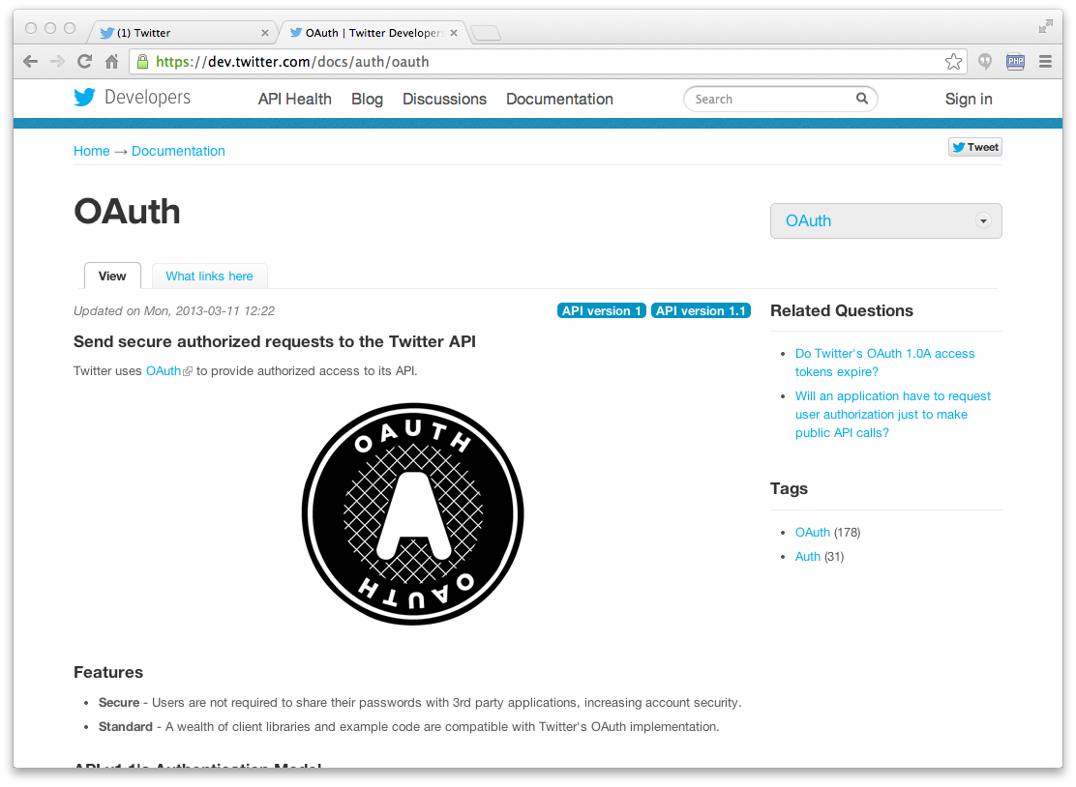

Slide 55
twurl.py
import urllib
import oauth
import hidden
def augment(url, parameters) :
secrets = hidden.oauth()
consumer = oauth.OAuthConsumer(secrets['consumer_key'], secrets['consumer_secret'])
token = oauth.OAuthToken(secrets['token_key'],secrets['token_secret'])
oauth_request = oauth.OAuthRequest.from_consumer_and_token(consumer,
token=token, http_method='GET', http_url=url, parameters=parameters)
oauth_request.sign_request(oauth.OAuthSignatureMethod_HMAC_SHA1(), consumer, token)
return oauth_request.to_url()
https://api.twitter.com/1.1/statuses/user_timeline.json?count=2&oauth_version=1.0&oauth_token=101...SGI&screen_name=drchuck&oauth_nonce=09239679&oauth_timestamp=1380395644&oauth_signature=rLK...BoD&oauth_consumer_key=h7Lu...GNg&oauth_signature_method=HMAC-SHA1

Slide 56
Summary
Service Oriented Architecture - allows an application to be broken into parts and distributed across a network
An Application Program Interface (API) is a contract for interaction
Web Services provide infrastructure for applications cooperating (an API) over a network - SOAP and REST are two styles of web services
XML and JSON are serialization formats

