Slide 1

SCALA
A Scalable Language

Slide 2



Introduction
Father
Martin Odersky
Place
École Polytechnique Fédérale de Lausanne
Date of Birth
20 January 2004
Scala source code is intended to compiled to Java Bytecode, so that resulting executable code runs on a Java Virtual Machine

Slide 3
A language that grows on you …
Growing new types
Growing new control structures
JAVA
recipient ! Msg
loop{
receive {
case Msg1 => ... // handle Msg1
case Msg2 => ... // handle Msg2
}
}
import java.math.BigInteger
public BigIntger factorial(BigInteger x) {
if (x == BigInteger.ZERO) BigInteger.ONE
else x.multiply(factorial(x.subtract(BigInteger.ONE)));
}
SCALA
def factorial(x: BigInt): BigInt =
if (x == 0) 1 else x * factorial(x - 1)

Slide 4
What makes SCALA scalable ?
SCALA is compatible
SCALA is concise
SCALA is object oriented
SCALA is functional
SCALA is high-level
SCALA is statistically typed

Slide 5
Course outline
Session 1
Data types, Control Structures, Classes and Objects, Composition and Inheritance
Session 2
Collections API, Actors and Concurrency
Session 3
Pattern Matching, Working with XML
Session 4
GUI Programming in Scala

Slide 6

Let’s get Started …
Session 1

Slide 7
Session 1
Data Types
Scala is quite “pure” in sense that
Whatever exists is an OBJECT and Whatever performed is a FUNCTION CALL.
Some basic types
Byte
Short
Int
Long
Char
String
Float
Double
Boolean
Control Structures
Classes
Objects
Literals
Compositions
Integer literals
Decimal, Hexadecimal and Octal
Floating point literals
Character literals
String literals
Boolean literals
Inheritance
Custom Objects

Slide 8
Session 1
Control
Structures
There are not many control structures built into Scala.
The only control structures are;
if
for
while
try
match
function call
Data types
The reason Scala has so few is that it has included function literals since its inception.
Classes
Objects
if
Version 1
var my_name = “Ram”
if(!args.isEmpty){
my_name = args(0)
}
Version 2
val my_name =
if (!args.isEmpty)
args(0)
else
“Ram“
Compositions
Inheritance
Version 3
println(if (!args.isEmpty) args(0) else “Ram")

Slide 9
Session 1
Control
Structures
while
while
def makeEqual(that: Int) = {
while(this != that){
this += 1;
}
}
do-while
def makeEqual(that: Int) = {
do{
this += 1;
}while((this !=that))
}
Data types
Classes
Objects
for
Compositions
Iterating through list
val filesHere = (new java.io.File(".")).listFiles
for (file <filesHere)
println(file)
Inheritance
Iterating through numbers
for (i <- 1 to 5)
println("Iteration " + i)
The built in APIs like foreach and forall, performs same task.

Slide 10
Session 1
Control
Structures
try
Throwing Exception
val half =
if (n % 2 == 0)
n / 2
else
throw new Exception("n must be even")
Catching Exception
try {
doSomething()
}
catch {
case ex: IOException => println("Oops!")
case ex: NullPointerException => println("Oops!!")
}
Yielding a value
val url = try {
new URL(path)
} catch {
case e: MalformedURLException =>
new URL("http://www.scalalang.org")
}
Data types
Classes
Objects
Compositions
Inheritance

Slide 11
Session 1
Control
Structures
match
val firstArg = if (!args.isEmpty) args(0) else ""
val friend =
firstArg match {
case "salt" => "pepper"
case "chips" => "salsa"
case "eggs" => "bacon"
case _ => "huh?"
}
Data types
Classes
Living without break and continue
Objects
// This is Java...
int i = 0;
boolean foundIt = false;
while (i < args.length) {
if (args[i].startsWith("")){
i = i + 1;
continue;
}
if (args[i].endsWith(".scala")){
foundIt = true;
break;
}i = i + 1;
}
// This is Scala...
var i = 0
var foundIt = false
while (i < args.length && !foundIt){
if (!args(i).startsWith("")){
if(args(i).endsWith(".scala"))
foundIt = true
}
i = i + 1
}
Compositions
Inheritance

Slide 12
Session 1
Classes
As in Java, classes in Scala encapsulate fields and methods. Fields are defined with either val or var. Methods are defined with def.
class SimpleGreeter{
var greeting_1 = “Hello, World!”;
val greeting_2 = “Hello, World!”;
def greet() = println(greeting1);
}
Data types
Control Structures
Objects
var
val
Compositions
Can be changed over time. Just like variables in Java
Can’t be changed over time. Just like final variables in Java.
Inheritance

Slide 13

Session 1
Classes
(Continued..)
One difference between Java and Scala involves constructors. In Java, classes have constructors, which can take parameters, whereas in Scala, classes can take parameters directly.
class SimpleGreeter(greeting : String){
def greet() = println(greeting);
}
Data types
Auxiliary constructor
Control Structures
You deﬁne auxiliary constructors like methods named this that have no result type.
The ﬁrst statement in an auxiliary constructor must be an invocation of another constructor in the same class.
Objects
class Person(name : String, age: Int){
def this(name: String) = this(name,-1);
}
Compositions
Inheritance
Self references
def max(that: Rational) =
if (this.lessThan(that)) that else this
The area in which Scala departs from Java is that you can’t have any static ﬁelds or methods in a Scala class

Slide 14
Session 1
Classes
(Continued..)
Access specifier in Scala; either Private or None
class Person{
private var age = 0;
}
val aditi = new Person;
aditi.age = 25; //won’t compile at all
Data types
Control Structures
One important characteristic of method parameters in Scala is that they are val, not var.
Objects
class Person{
private var age = 0;
def add(b : Int): Unit = {
b += 1 // not allowed, compilation error
age += b; // no problem
}
}
Compositions
Inheritance

Slide 15



Session 1
Objects
For depicting of real life scenario, you create objects which replicate specific class.
var i_name= “Peter”;
Like Java, Scala created an object in the heap.
Data types
var i = 5;
Unlike Java, Scala also created object in the heap.
Control Structures
var tomato = 7;
var tomhato = 7;
Classes
Compositions
var tomato = 7;
var tomhato = 8;
Inheritance
var tomato = 7;
tomato=tomhato;
Poor tomato!!

Slide 16
Session 1
Objects
(Continued..)
REMEBERED? You can’t have any static ﬁelds or methods in a Scala class !
Concept of Singleton Object
// The WorldlyGreeter class
class WorldlyGreeter(greeting: String) {
def greet() {
val worldlyGreeting = WorldlyGreeter.worldify(greeting)
println(worldlyGreeting)
}
}
// The WorldlyGreeter companion object
object WorldlyGreeter {
def worldify(s: String) = s + ", world!"
}
Data types
Control Structures
Classes
Compositions
Singleton Object
Inheritance
companion
stand alone
If class name is same as object name.
If class name is not same as object name.

Slide 17
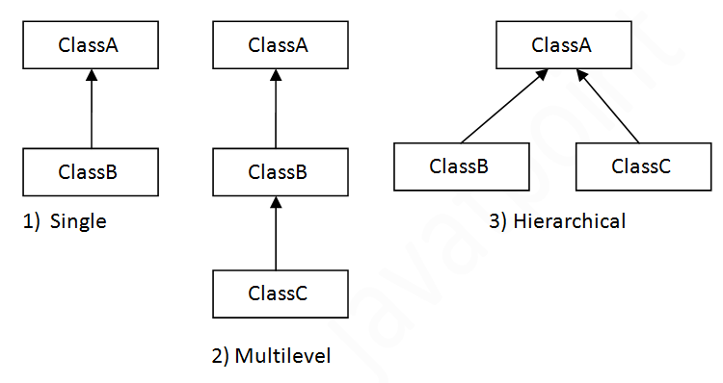
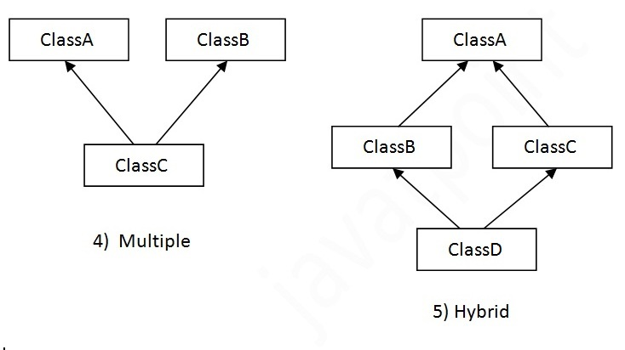
Session 1
Inheritance
Inheritance is merely the concept of reusability
class Animal(mammal: Boolean = true){
}
class whale(length: Double) extends Animal{
}
Data types
Types of Inheritance, Scala supports ;
Control Structures
Classes
Objects
Compositions
Multiple and hybrid can only be achieved by using traits.

Slide 18
Session 1
Compositions
Mix-in class composition in Scala
trait Runner {
def run(feet: Double) = {
println (" ran: "+feet+" feets")
}
}
trait Walker {
def walk(feet: Double) = {
println (s"Walked: $feet feets")
}
}
class Person(name: String) extends Walker with Runner {
override def run(feet: Double){
println(name+" ran "+feet+" feets")
}
}
var person :Person = new Person("Shubham");
person.run(30);
person.walk(40);
Data types
Control Structures
Classes
Objects
Inheritance
Traits are used to share interfaces and fields between classes. They are similar to Java 8’s interfaces.

Slide 19
{|>_<|}
Let’s Code !
because nobody understand words …

