Slide 1

Session 2
Collections API
Pattern Matching

Slide 2
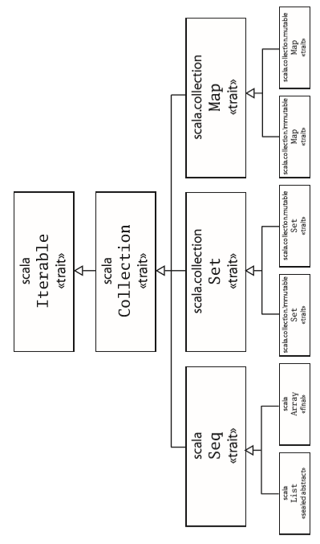
Session 2
Collection API
Array
List
Tuple
Set
Map
List
Array
Set
Set
Map
Map
Immutable
Mutable
Immutable
Mutable
Collections API

Slide 3
Session 2
Array
Sequences
Sequences, classes that inherit from the Seq trait, let you work with groups of data lined up in order.
List
Arrays are normally created with the usual new keyword.
Tuple
val numbers = new Array[Int](5)
O/p = numbers: Array[Int] = Array(0, 0, 0, 0, 0)
Set
Writing into an array uses a similar syntax
Map
numbers(3) = 42 //is same as
numbers.update(3, 42)
Looping over the elements of an array is easy:
for(x<- numbers){
println(x) //prints the number sequentially
}

Slide 4
Session 2
List
The most important sequence type is class List.
Lists support fast addition and removal of items to the beginning of the list, but they do not provide fast access to arbitrary indexes.
val fruit = List("apples", "oranges", "pears")
val nums = List(1, 2, 3, 4)
val diag3 = List(List(1, 0, 0), List(0, 1, 0), List(0, 0, 1))
val empty = List()
Tuple
Set
List can also be created like;
val fruit = "apples" :: ("oranges" :: ("pears" :: Nil)) val nums = 1 :: (2 :: (3 :: (4 :: Nil)))
scala> val List(a, b, c) = fruit
a: java.lang.String = apples
b: java.lang.String = oranges
c: java.lang.String = pears
scala> List(1, 2) ::: List(3, 4, 5)
res0: List[Int] = List(1, 2, 3, 4, 5)
Map
Array

Slide 5
Session 2
Tuple
A tuple combines a ﬁxed number of items together so that they can be passed around as a whole.
Items may or may not be of same type !
Set
Tuple can be defined as :
val temp_tuple = (1, "hello", Console)
Map
To access elements of a tuple
scala> longest._1
res1: Int = 1
scala> longest._2
res2: String = hello
Array
List
Tuple comes very handy when you have to returns of different types.

Slide 6
Session 2
Set
Set basically comes with two flavours;
scala.collection.mutable
scala.collection.immutable
You can create a new set using the empty method:
scala> val words = mutable.Set.empty[String] words: scala.collection.mutable.Set[String] = Set()
scala> words += "hello"
scala> words += "there"
scala> words += "there"
scala> words
res1: scala.collection.mutable.Set[String] = Set(there, hello)
Map
Array
List
Tuple
To access elements of set :
text: java.lang.String = See Spot run. Run, Spot, Run!
scala> for (w <- text.split("[ !,.]+"))
| println(w)
See Spot run Run Spot Run

Slide 7
Session 2
Map
Maps helps you to deal with key : value pair of data.
They are also flavoured like set as :
scala.collection.mutable
scala.collection.immutable
Array
What it is What it does
----------------------------------------------------------------------------------------------------------------
Import scala.collection.mutable - make the mutable collections easy to access
-----------------------------------------------------------------------------
val words = mutable.Set.empty[String] - create an empty set
-----------------------------------------------------------------------------
words += "the" - add one object
-----------------------------------------------------------------------------
words -= "the" - remove an object, if it exists
-----------------------------------------------------------------------------
words++=List("do","re","mi") - add multiple objects
-----------------------------------------------------------------------------
words --= List("do", "re") - remove multiple objects
-----------------------------------------------------------------------------
words.size - ask for the size of the set (returns 1)
------------------------------------------------------------------------
words.contains("mi") - check for inclusion (returns true)
List
Tuple
Set

Slide 8
Pattern Matching
A pattern match includes a sequence of alternatives …
Each alternative includes a pattern …
Each pattern includes one or more expressions (considering data types as expressions) …
Java
switch(case_parameter){
case #1 : ------ break;
case #2 : ------ break;
case #3 : ------ break;
case default : -----
}
Scala
case_parameter match {
case #1 => ------
case #2 => ------
case #3 => ------
case _=> -----
}

Slide 9
Pattern Matching (continued …)
Kinds of Pattern
The Wildcard
Constant
The wildcard pattern _ matches any object whatsoever.
expr match {
case Map(_, _) => println(expr+"is a Map)
case _ =>
println(“Not a Map”) }
A constant pattern matches only itself.
x match {
case 5 => "five"
case true => "truth"
case "hello" => "hi!"
case Nil => "the empty list"
case _ => "something else"
}

Slide 10
Pattern Matching (continued …)
Kinds of Pattern
Constructors
Sequences
Constructors are where pattern matching becomes really powerful.
Person match {
case Person(“Ram”,18) => println(Person.name+” found”)
case _ =>
println(“No person found”)
}
A constant pattern matches only itself.
//checks for 3 elements, starting with 0
case List(0, _, _) => println("found it")
//checks for n elements, starting with 0
case List(0, _, _) => println("found it")

Slide 11
Pattern Matching (continued …)
Kinds of Pattern
Tuple
Typed patterns
You can match against tuples, too.
A pattern like (_, _, _) matches an arbitrary 3-tuple.
("hello", 10, true) match {
case (word, idx, bool) =>
// use word, idx and bool here...
}
. A form of patterns not seen so far is a convenient replacement for Java’s type tests and type casts.
x match {
case s: String => s.length
case m: Map[_, _] => m.size
case _ => -1
}

Slide 12
Pattern Matching (continued …)
Pattern guards
A pattern guard comes after a pattern and starts with an if.
Let’s consider an example;
e match {
case BinOp("+", x, y) if x == y =>
BinOp("*", x, Number(2))
case _ =>
e
}
Pattern overlaps
some_string_expr match{
case “God” => //accepts god only
case String => //accepts any string
case _ => //accepts whatsoever passed
}
//Patterns are tried in the order in which they are written.

Slide 13
{|>_<|}
Let’s Code !
because there are collections in the house …

