Slide 1

Reduce TCO for Cloud Infrastructure with Data Science
In this presentation, we will explore how Data Science can help reduce TCO in the Cloud Infrastructure at very high level.
by Bipin Sinha

Slide 2
Understanding TCO and Cloud Infrastructure
Cloud Infrastructure
Cloud infrastructure enables scalable, flexible, and on-demand access to computing resources while eliminating the need for physical hardware.
1
2
3
Total Cost of Ownership (TCO)
Benefits of Cloud Infrastructure
TCO is the total cost associated with purchasing, deploying, and maintaining an IT infrastructure.
Cloud infrastructure reduces upfront costs, provides flexibility, enables scalability, and supports remote work.

Slide 3
What is Data Science and Its Role in Reducing TCO?
Data Science
Data Science and TCO Reduction
Data Science Applications
Data Science involves the use of algorithms, statistical models, and machine learning techniques to extract insights and knowledge from structured and unstructured data.
Data Science can help organizations optimize resource allocation and reduce costs by identifying inefficiencies, predicting failures, and automating repetitive tasks.
Data Science applications include predictive maintenance, anomaly detection, and real-time resource optimization.

Slide 4

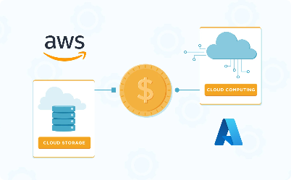
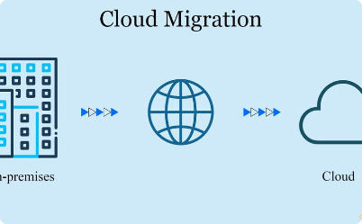
Optimizing Resource Allocation and Reducing Costs with Data Science
Resource Allocation Optimization
Cost Reduction
Migrating to Cloud
Data Science can help reduce costs by identifying underutilized resources, suggesting purchase options, and optimizing pricing models.
Data Science can also help organizations in the cloud migration process by analyzing data to make the transition easy and cost-effective.
Data Science can help optimize resource allocation by analyzing usage patterns, identifying over-provisioned resources, and suggesting optimal configurations.

Slide 5

Best Practices for Leveraging Data Science to Reduce TCO
1
Data Quality
2
Collaboration
Ensure data quality by cleaning, validating, and transforming data to avoid errors and biases.
Promote collaboration between IT and Data Science teams to ensure successful implementation and adoption of Data Science solutions.
3
Continuous Improvement
Continuously monitor, evaluate, and improve Data Science models and processes to keep up with changing business needs and technology trends.

Slide 6
Potential Challenges and How to Overcome Them
Security and Privacy
Data Integration
Skills Gap
Ensure data integration by establishing a data governance framework, setting standards, and adhering to data management best practices.
Address the skills gap by training employees, hiring Data Science experts, and partnering with service providers.
Ensure data security and privacy by implementing data protection measures and complying with regulations.

Slide 7

Conclusion: Data Science is Critical in Lowering TCO for Cloud Infrastructure
Data Science is the key to optimizing resource allocation, reducing costs, and achieving scalability and flexibility in Cloud Infrastructure while maintaining high performance and availability. By following best practices and addressing potential challenges, organizations can leverage Data Science to reduce TCO and achieve their business goals.

