Slide 1
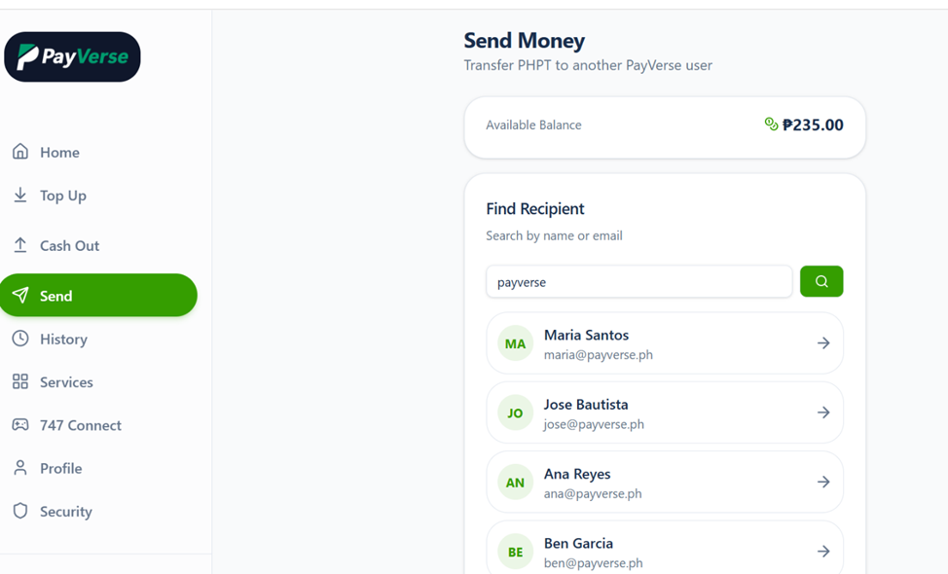
SEND MONEY - MODULE
Sending money from one account to another is functioning as intended. Funds are credited instantly to the intended recipient without any issues.
However, when searching for a recipient, typing a keyword (e.g., “payverse”) displays all accounts containing that keyword. This may compromise user privacy by exposing other users’ accounts.
To address this, I recommend tagging each account with a unique account number or requiring the use of the registered mobile number or username when searching for a recipient. This approach ensures that only the intended beneficiary’s account is displayed.
This same method is already implemented by GCash and Maya, where transfers require the exact mobile number of the recipient.

Slide 2
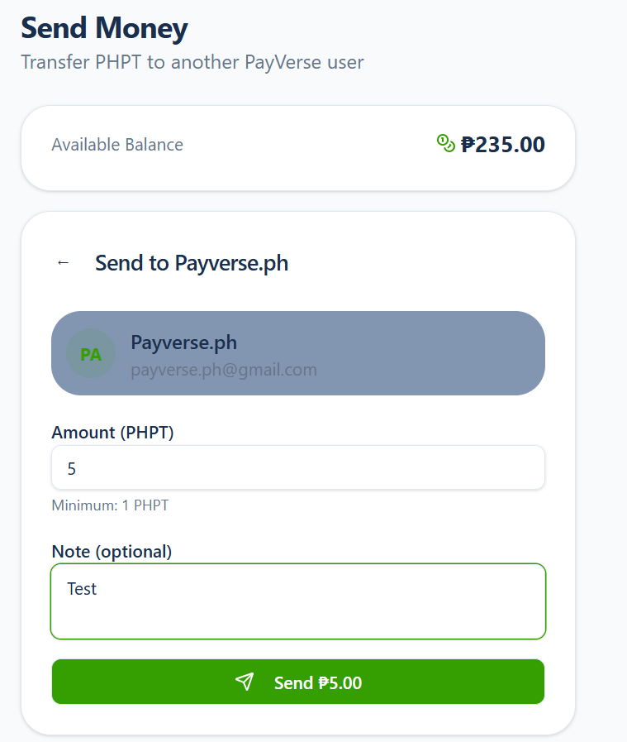
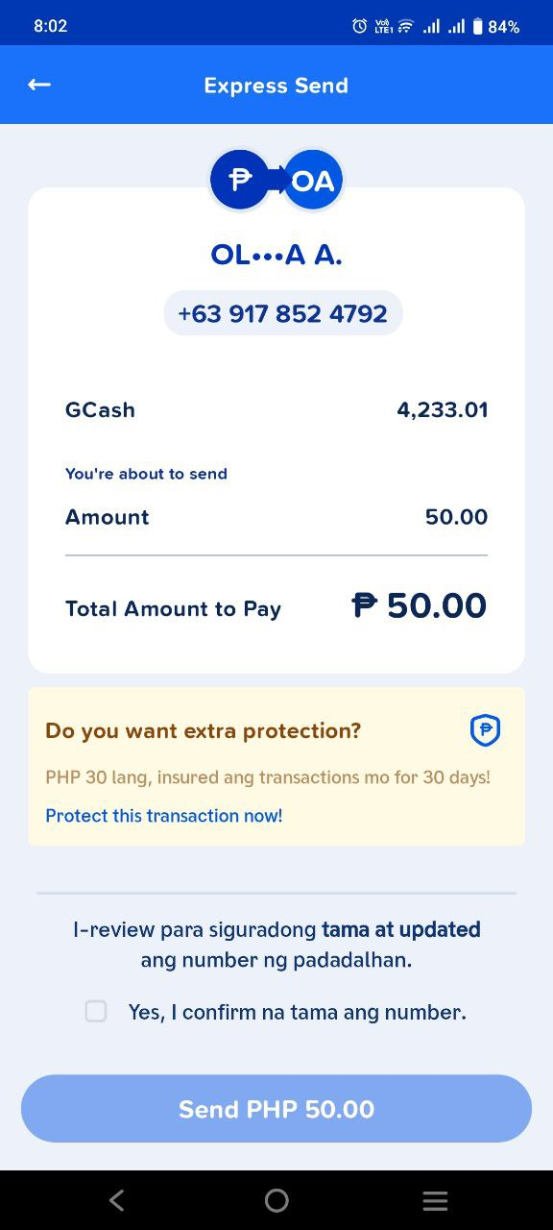
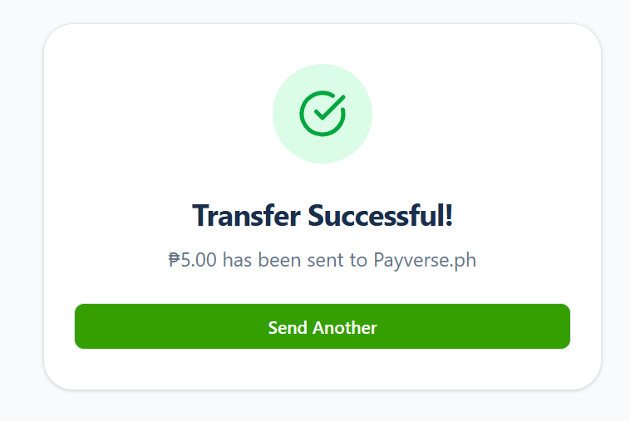
SEND MONEY - MODULE
3. After selecting the intended recipient and entering the transfer amount, it is recommended to include a confirmation page before proceeding with the actual transaction. This will allow users to review and validate all transaction details—such as the recipient information and amount—prior to final submission, thereby

Slide 3
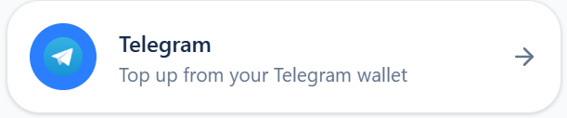
TOP-UP via TELEGRAM
1. Top-up via Telegram is functioning as intended. Once the top-up is successful, the PayGram Bot automatically notifies the user of the updated account balance. The Payverse wallet is credited accordingly, while the PayGram account is debited.
2. However, upon reviewing the Transaction History, the transaction is reflected as “Transfer” instead of “Top-up,” which may cause confusion and should be corrected for proper transaction classification and user clarity.

Slide 4
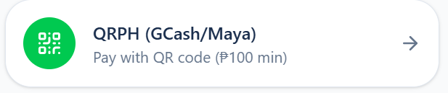
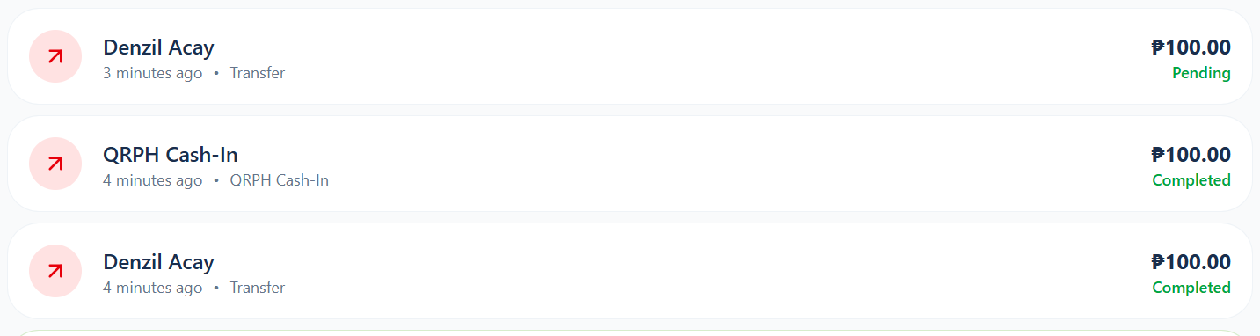
TOP-UP via QRPH (Maya & Gcash)
1. Bug: On the first attempt to top up using QRPH, after entering the amount (e.g., ₱100) and generating the QR code, the system immediately proceeds to a “Successful Top-up” screen—even without completing or confirming the payment. As a result, the ₱100 amount is instantly credited to the account despite no actual payment action being taken.
2. Transaction History also reflects multiple transaction entries, including one successful ₱100 QRPH cash-in, despite the top-up process not being properly completed.

Slide 5
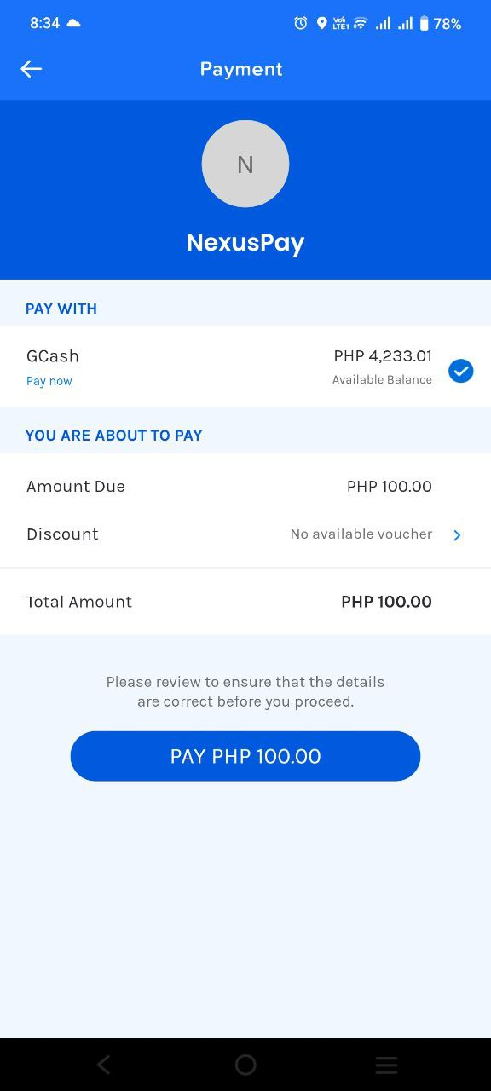
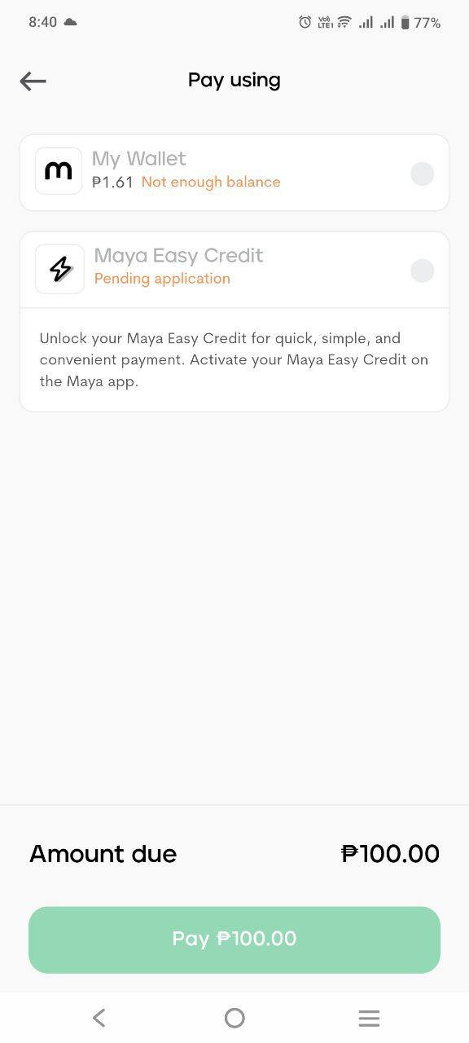
TOP-UP via QRPH (Maya & Gcash)
3. On the second attempt, the process appears to work as expected. The system did not automatically proceed to a successful transaction on its own. After scanning the generated QR code using GCash, all transaction details were displayed correctly.

Slide 6
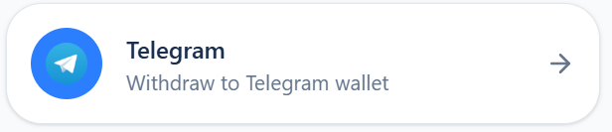
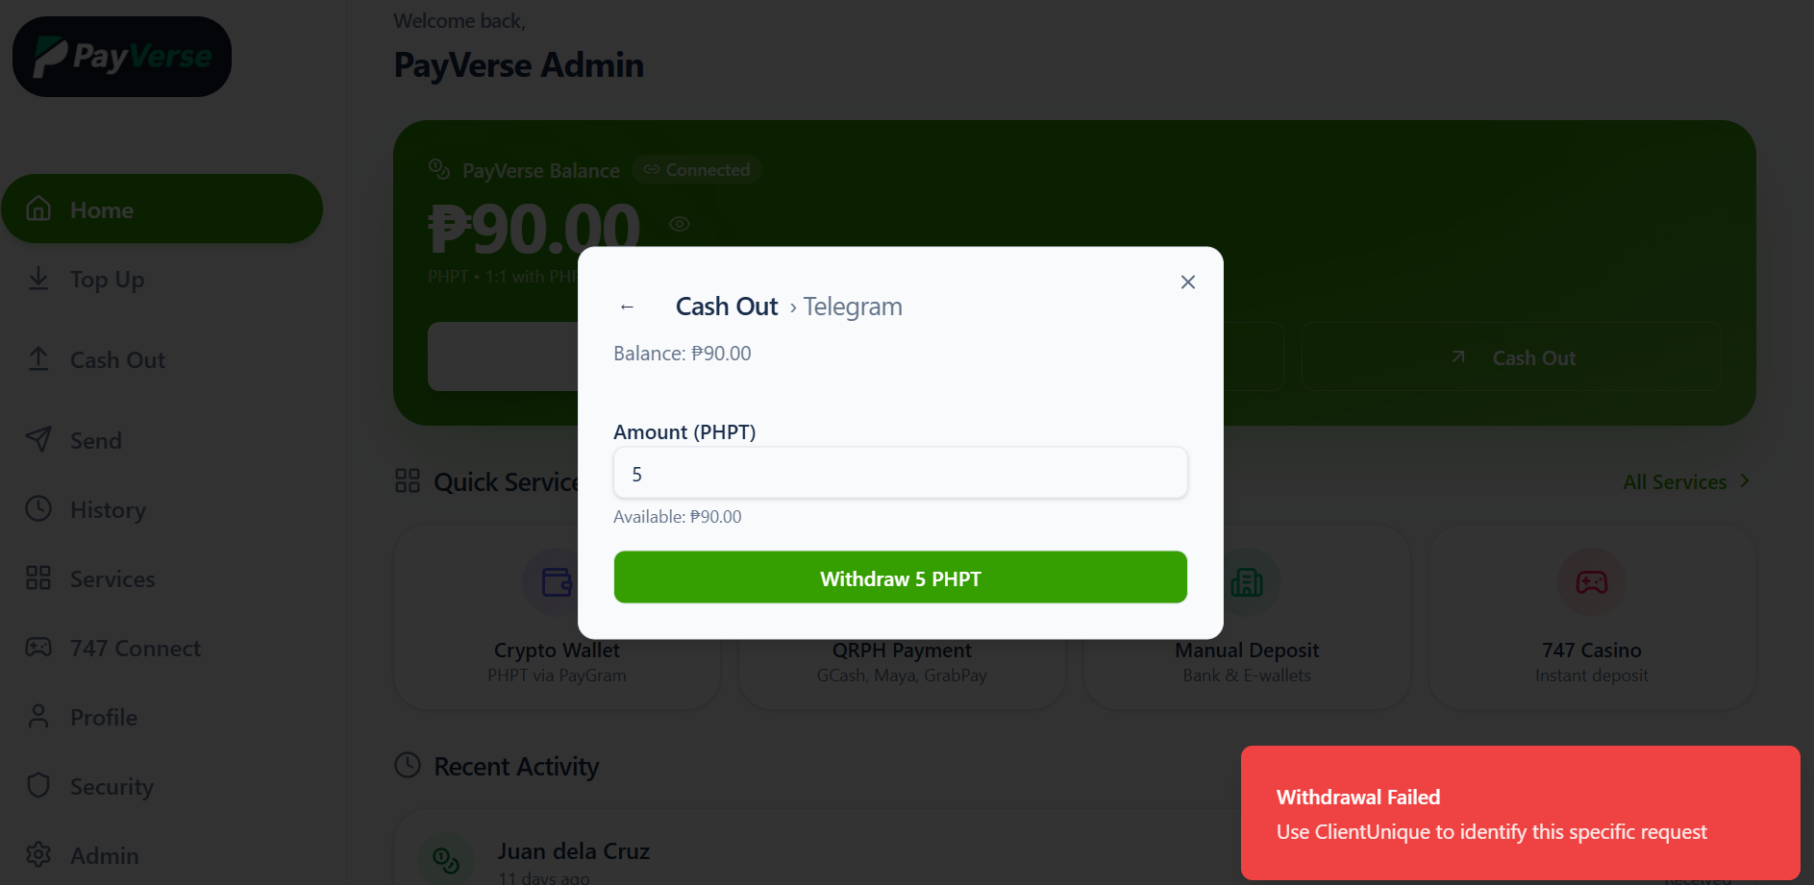
CASH-OUT via Telegram wallet
1. Error on first attempt to cash-out or withdraw via Telegram

Slide 7
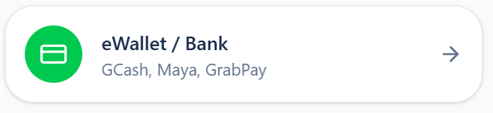
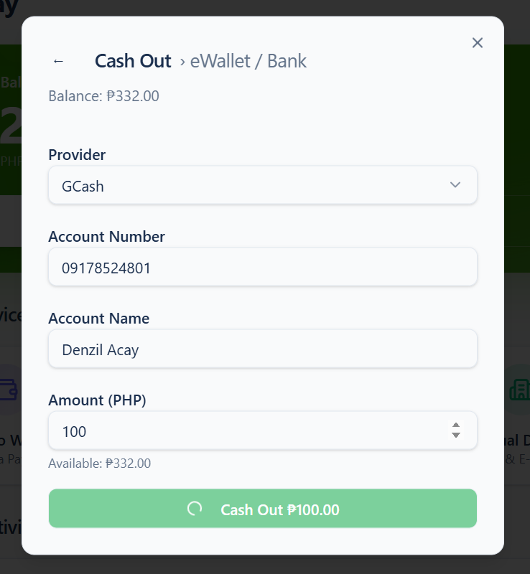
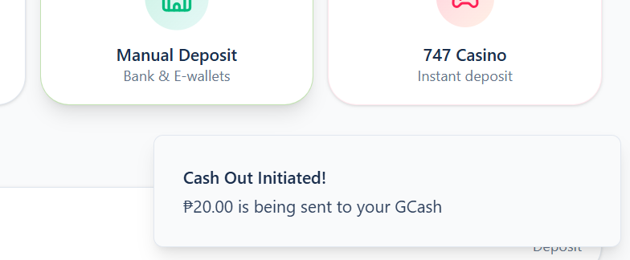
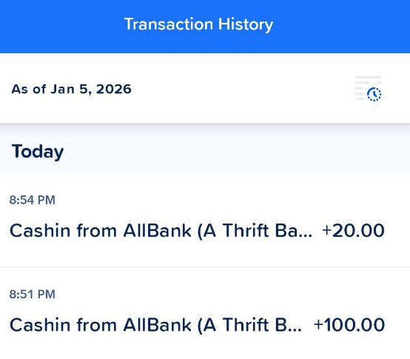
CASH-OUT via eWallet / Bank
1. First Attempt: After entering all required information, the next page unexpectedly redirects to the dashboard, with a small pop-up stating: “Cash-out is being sent to your GCash.”
2. I recommended to include a confirmation page after entering all withdrawal details, allowing the user to review and validate the information before submission. Following confirmation, a dedicated status page should display a message such as: “Withdrawal is being processed and sent to your account” to clearly indicate that the transaction is in progress.
3. Successful Transaction: The transaction was successfully credited to my GCash account instantly. Please see the screenshot below for reference.

Slide 8
CASH-OUT via eWallet / Bank
1. First Attempt: After entering all required information, the next page redirects to the dashboard, with a small pop-up stating: “Cash-out is being sent to your GCash.”
2. Successful Transaction: The transaction was successfully credited to my GCash and Maya accounts instantly. Please see the screenshot below for reference.
3. I recommend including a confirmation page after entering all withdrawal details, allowing the user to review and validate the information—including the cash-out fee—before submission.

