Slide 1
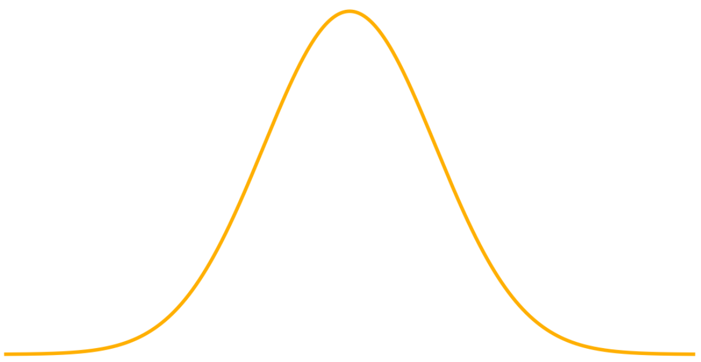
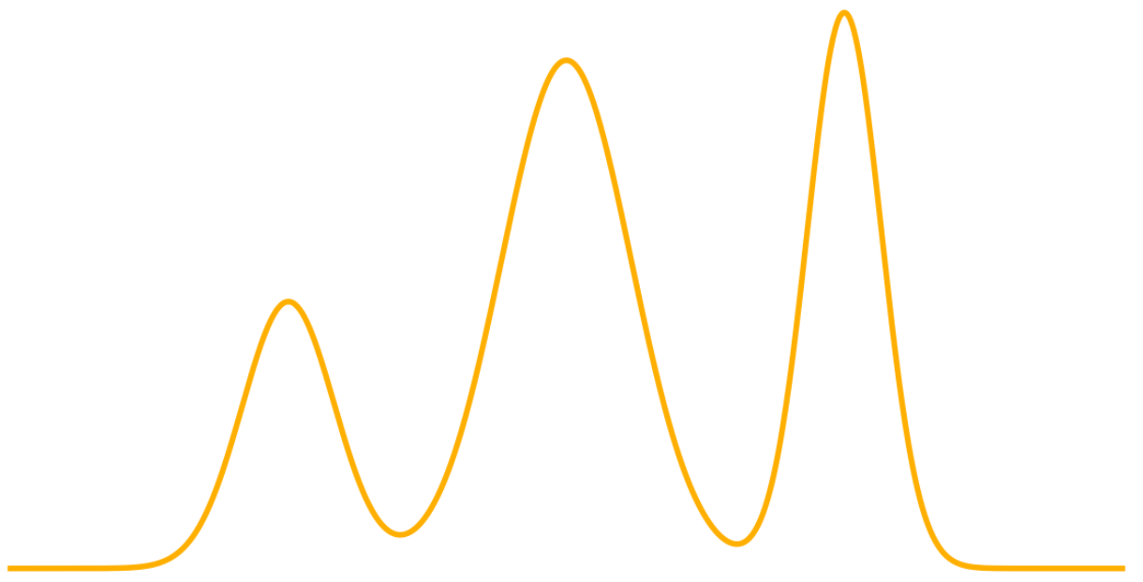


$$p_{init}$$
$$p_{data}$$

Slide 2
Conditional Probability Path
Marginal Probability Path

Slide 3
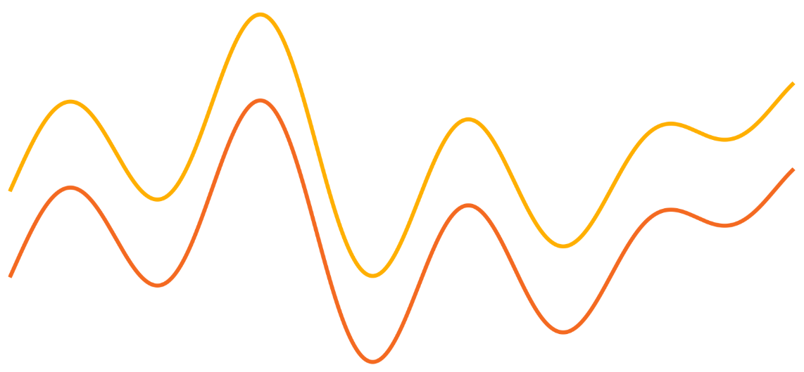



$$C$$
$$L_{FM}$$
$$L_{CFM}$$

