Slide 1
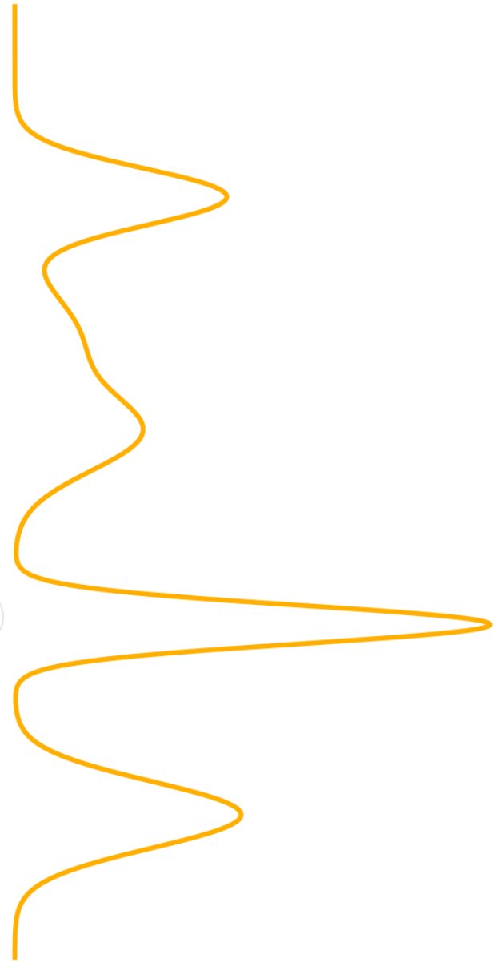
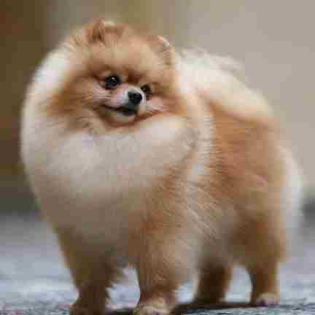
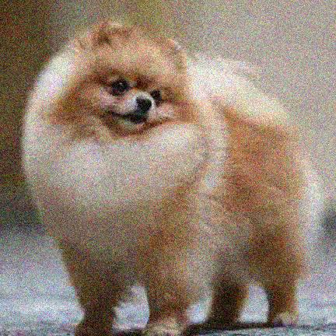

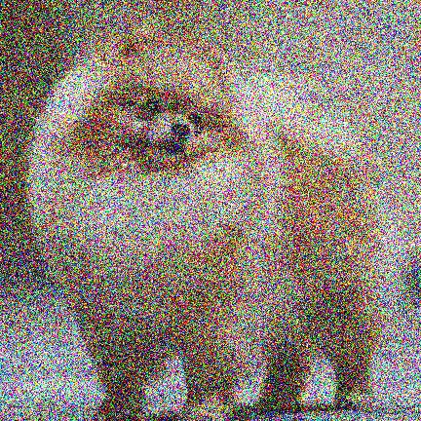
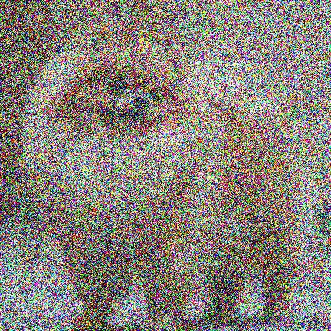
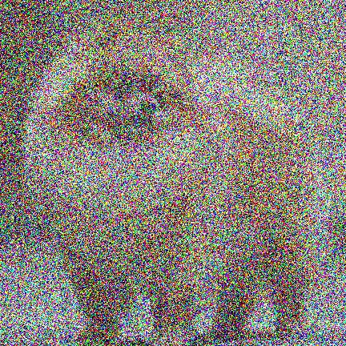


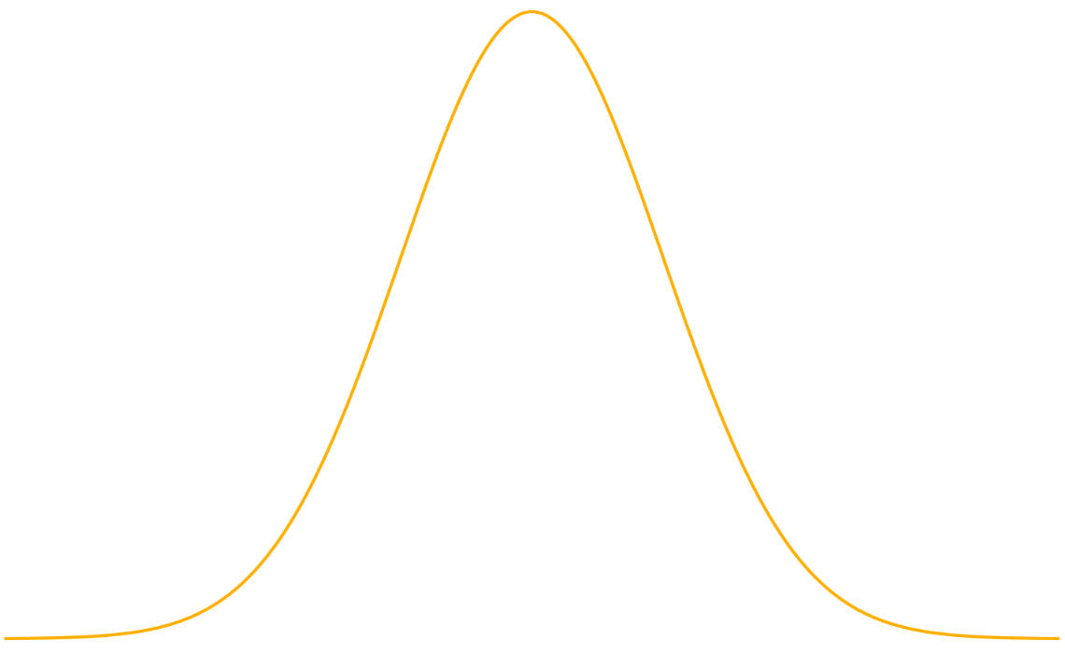




Forward process
$$t=0$$
$$t=T$$
$$p_{data}$$
Reverse process
$$p_{init}$$

Slide 2




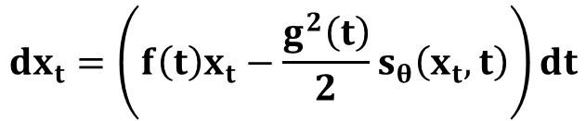
Discrete
Continuous
Unified Expression :
$$x_{t}=s\left(t\right) x_{0}+σ\left(t\right) ε$$
Unified Expression :
Forward
Example: VP-Style: Linear, Cosine, …
$${dx}_{t}=f\left(t\right)x_{t}dt+g\left(t\right)dw_{t}$$
VE-Style: EDM
Unified Expression :
Unified Expression :
$$x_{t−1}=x_{t}+h∗μ\left(t\right)s_{θ}+\sqrt{g\left(t\right)h} ε$$
Stochastic
$${dx}_{t}=\left(f\left(t\right)x_{t}−g^{2}\left(t\right)s_{θ}\left(x_{t}, t\right)\right)dt+g\left(t\right)d{\overline{w}}_{t}$$
Example: DDPM, NCSN, …
Reverse
Unified Expression :
Unified Expression :
Deterministic
$$x_{t−1}=x_{t}+h∗μ\left(t\right)s_{θ}$$
$${dx}_{t}=\left(f\left(t\right)x_{t}−\frac{g^{2}\left(t\right)}{2}s_{θ}\left(x_{t}, t\right)\right)dt$$
Example: DDIM, …

