Slide 1
Boost your productivity with Babel
Anup Vasudeva

Slide 2
Agenda
Application walkthrough
Challenges:
Automate code reviews
Optimize bundle size by excluding files
Solutions

Slide 3
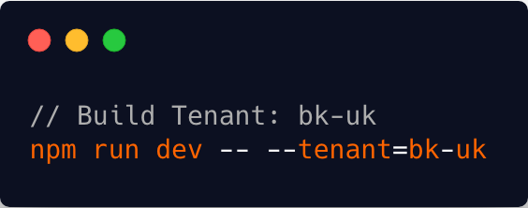
Application walkthrough
Available at https://github.com/innovation-stack/boost-productivity-with-babel
Built using AngularJS v1.7
Applicable to any modern UI framework
Single codebase serving multiple clients
All tenants share common code logic
Data served from https://jsonplaceholder.typicode.com/
Built via Webpack
Credentials: test@test.com / test

Slide 4
Challenges faced by application
Client’s Code Review Comments:
“Avoid using array’s .forEach() and instead use .map(), .reduce() or native for loop”
“Avoid empty class methods”
Optimize bundle size by removing unnecessary files

Slide 5
Fix Code Review Comments
Configure custom rules through eslint
Eslint parses code into an AST
Default parser: espree
Online Editor: https://astexplorer.net/

Slide 6
Optimize Bundle Size
Remove import statements
Remove injections
Remove method calls

Slide 7
Thank you

