Slide 1
Introducing RobotLab
Tony Hirst
Computing and Communicatons,
The Open University

Slide 2
Play along…
Online demo via MyBinder:
https://github.com/ouseful-demos/tm129-lite
Or try it yourself via Docker:
docker run -p 8129:8888 ousefulcoursecontainers/ou-tm129:current
https://github.com/innovationOUtside/tm129-robotics2020

Slide 3
In the beginning…

Slide 4
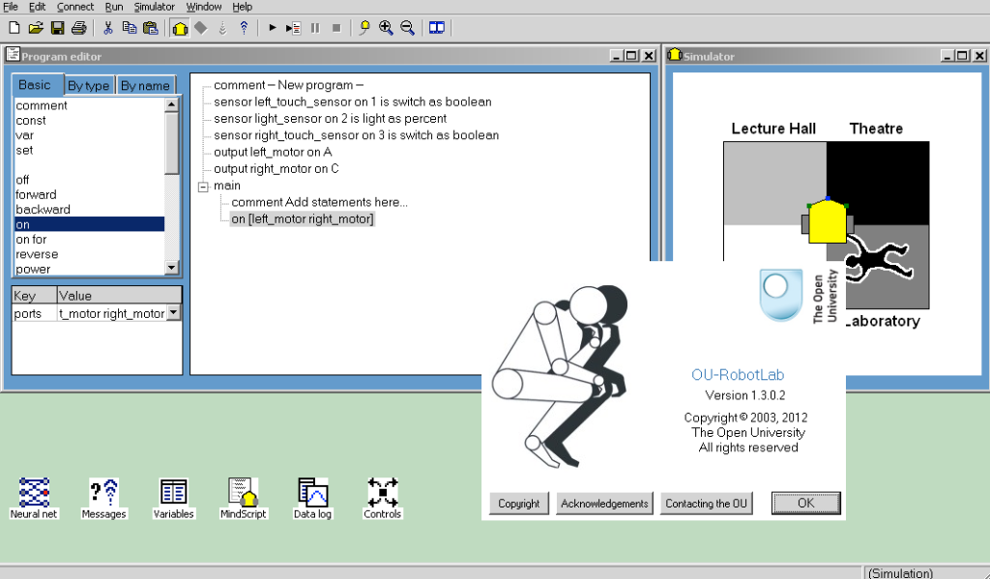
In the Beginning — RoboLab

Slide 5
Updating the TM129 Robotics Activity (1)
replace RobotLab
retain original narrative and activity coverage
move to a Python style text based programming language
work on OU minimum specification computers

Slide 6
Updating the TM129 Robotics Activity (2)
(deliver software through a browser)
(use Jupyter notebooks)
as with the original T184 design, the activities should be fun

Slide 7
TM129 Original RoboLab Activities
Desktop application
2D simulator (code could also run on Lego Mindstorms RCX brick)
range of sensor types (touch, light) and output tones and pre-recorded speech messages
integrated charting tools for sensor data analysis
neural network (multilayer perceptron) training and testing
"multi-agent" activity with co-operating robot and MLP

Slide 8
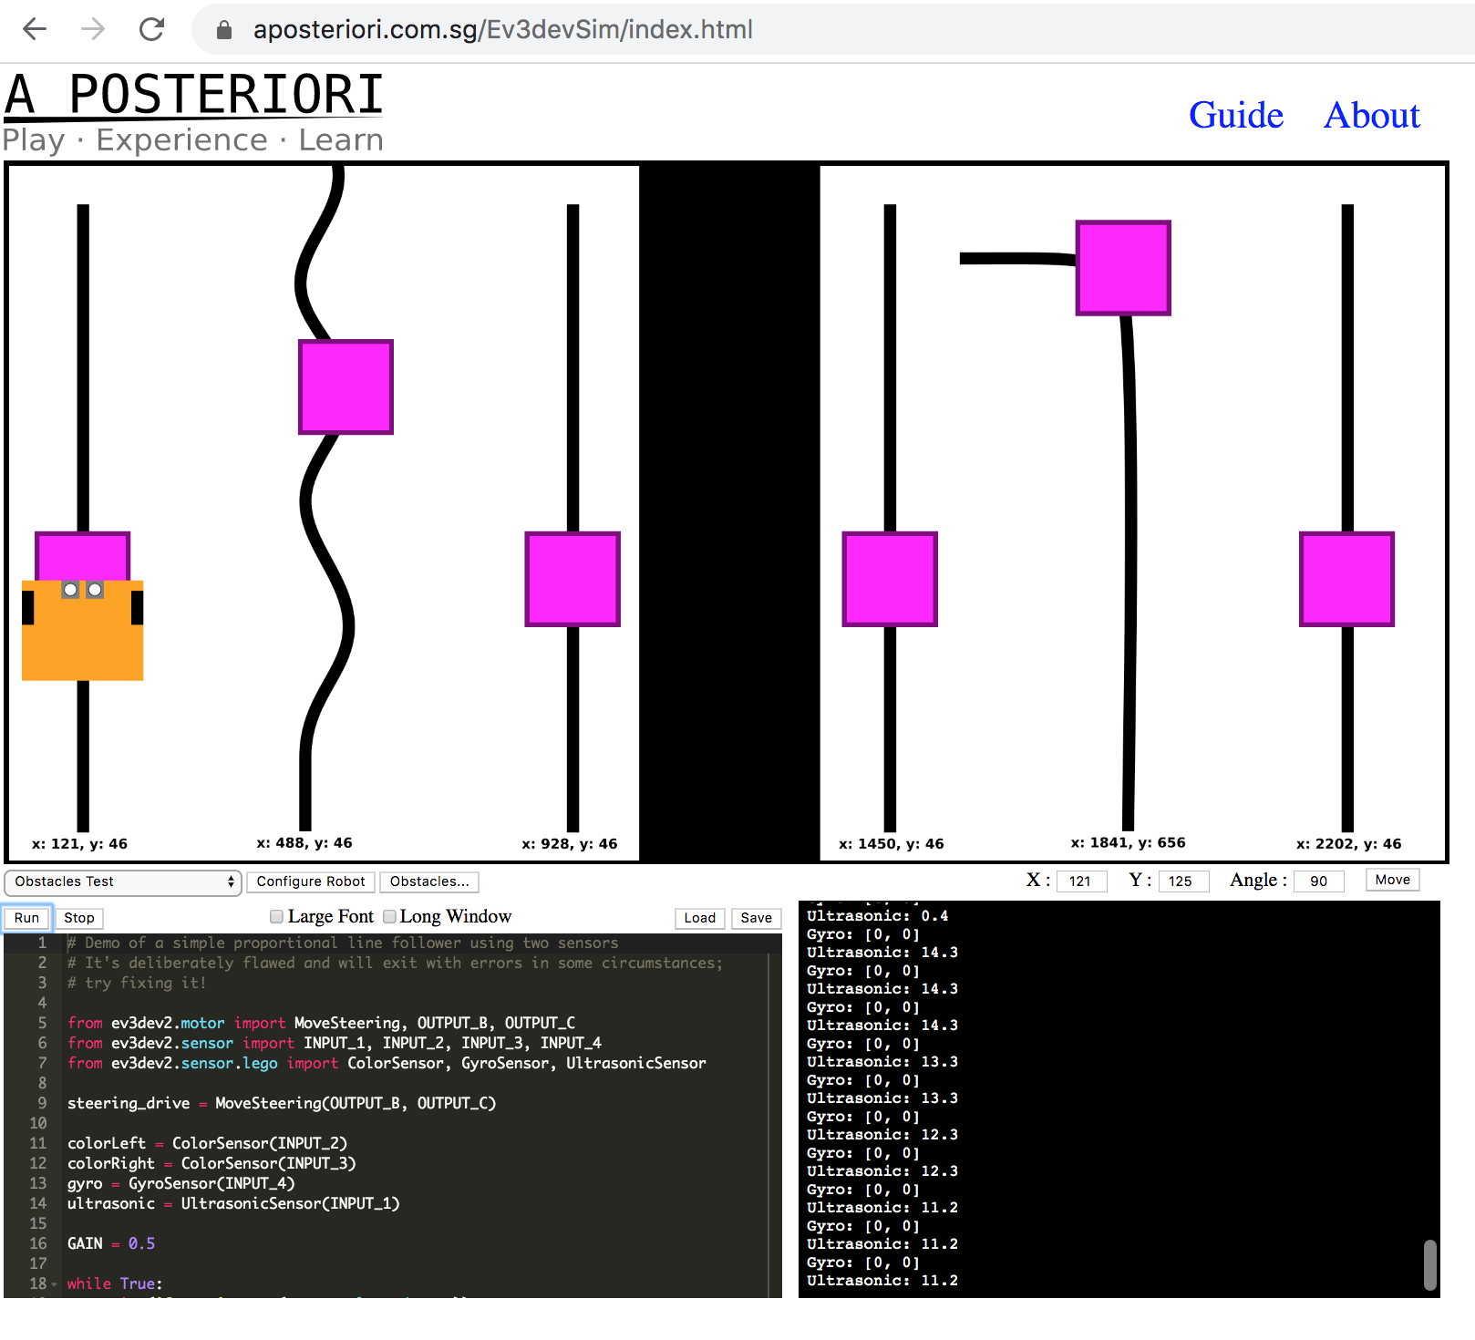
Alternatives — Ev3devsim
Browser based Javascript 2D simulator
In-browser Python (skulpt)
In-page syntax highlighting code editor
Light, ultrasound & gyroscope sensors
Motor/wheel odometry
Uses ev3dev Python API for Lego Mindstorms brick running ev3dev

Slide 9
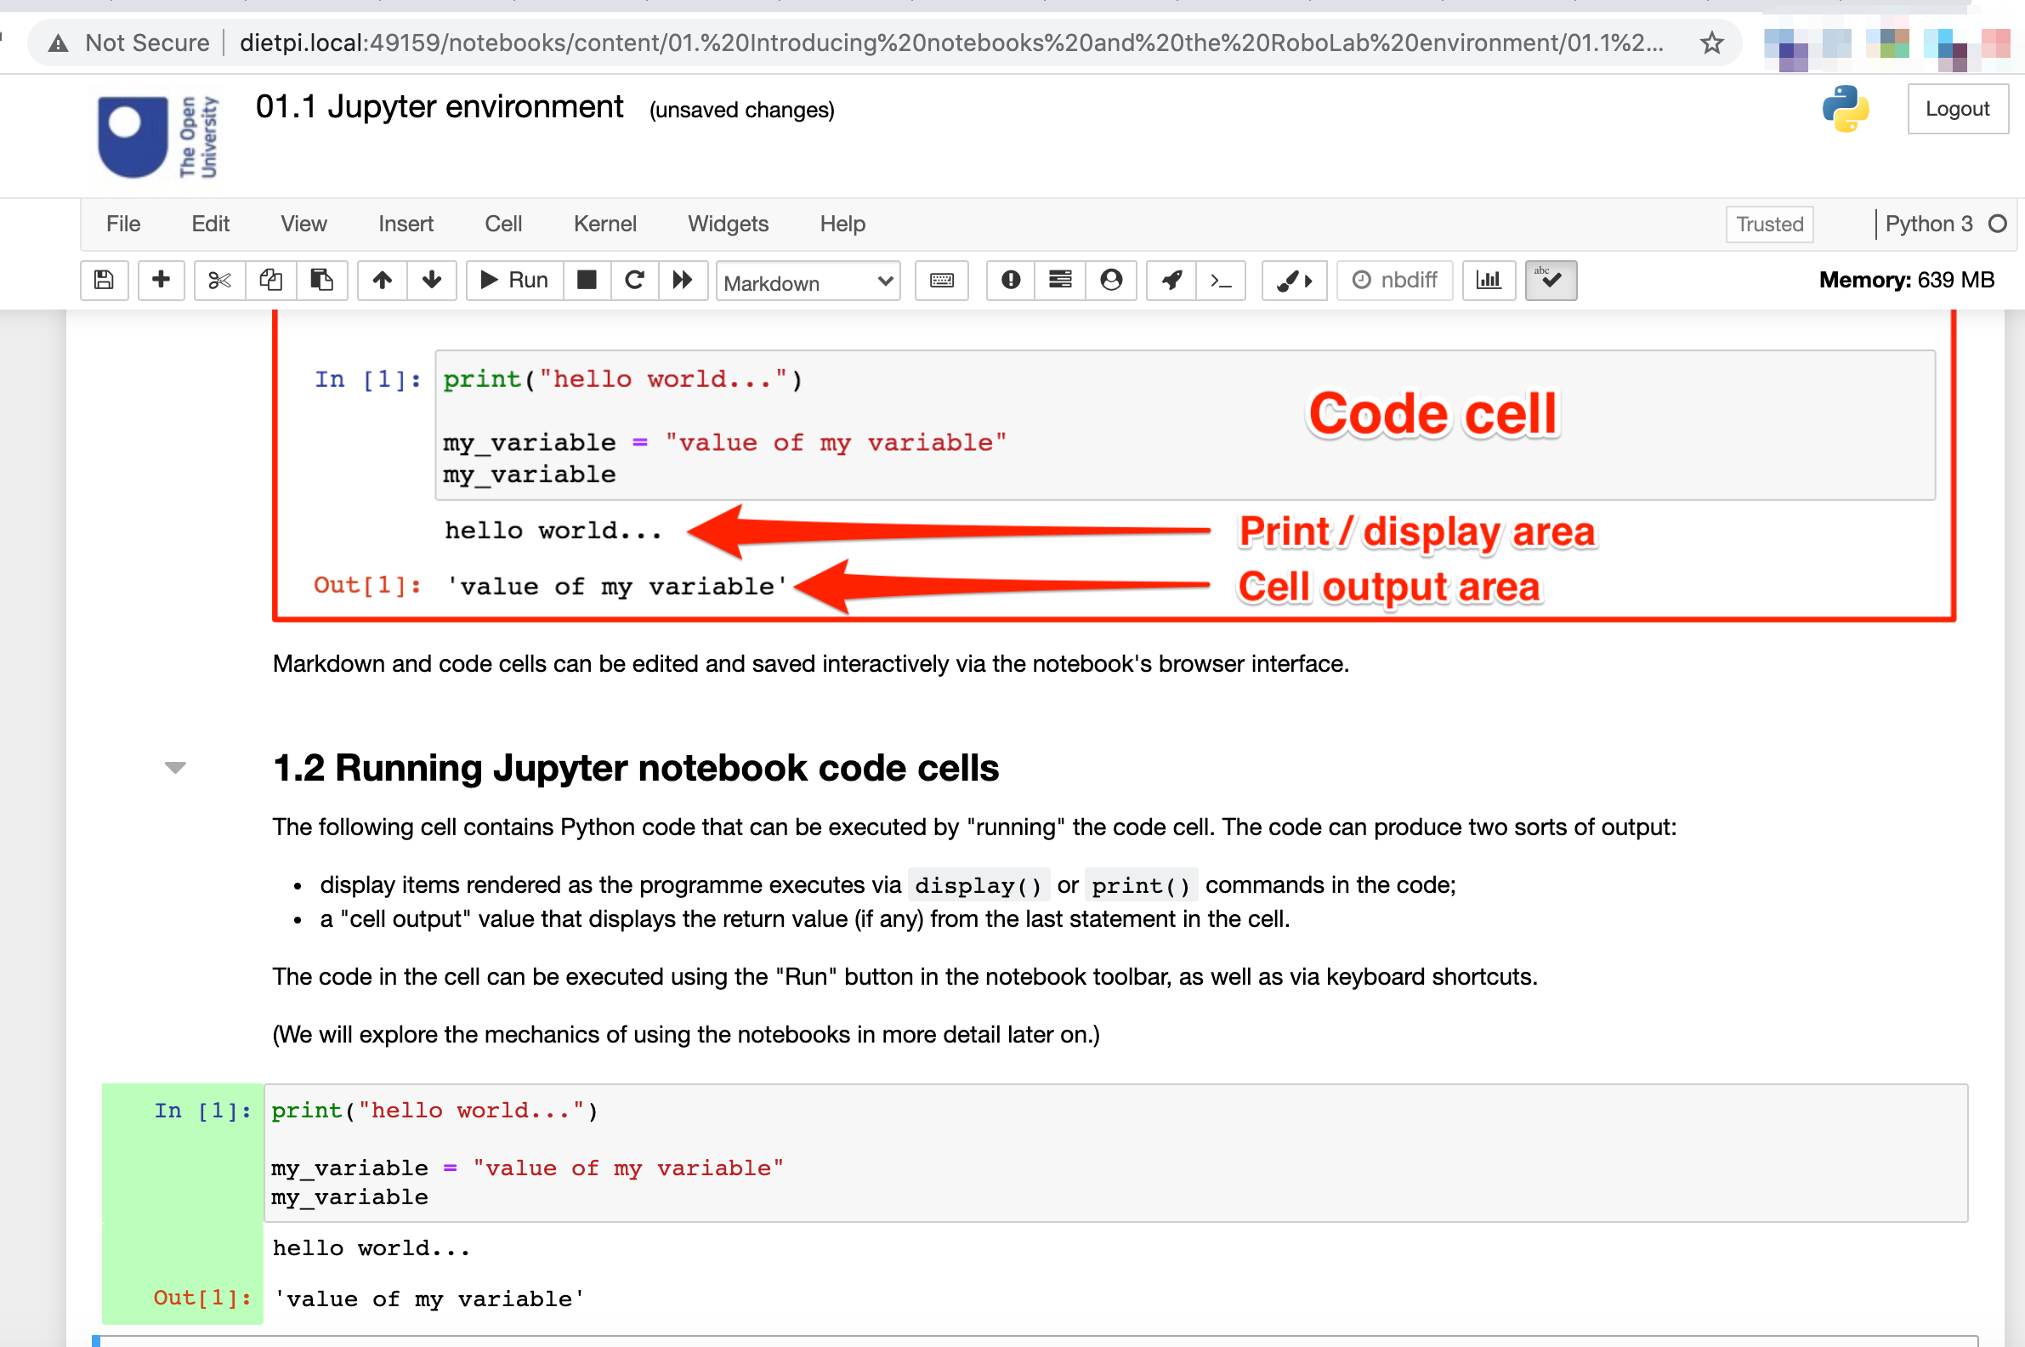
Jupyter Notebooks
In-browser
Read/write/execute
Rich text (markdown)
Embed images, audio
Embed interactive widgets
Execute code & display code outputs

Slide 10
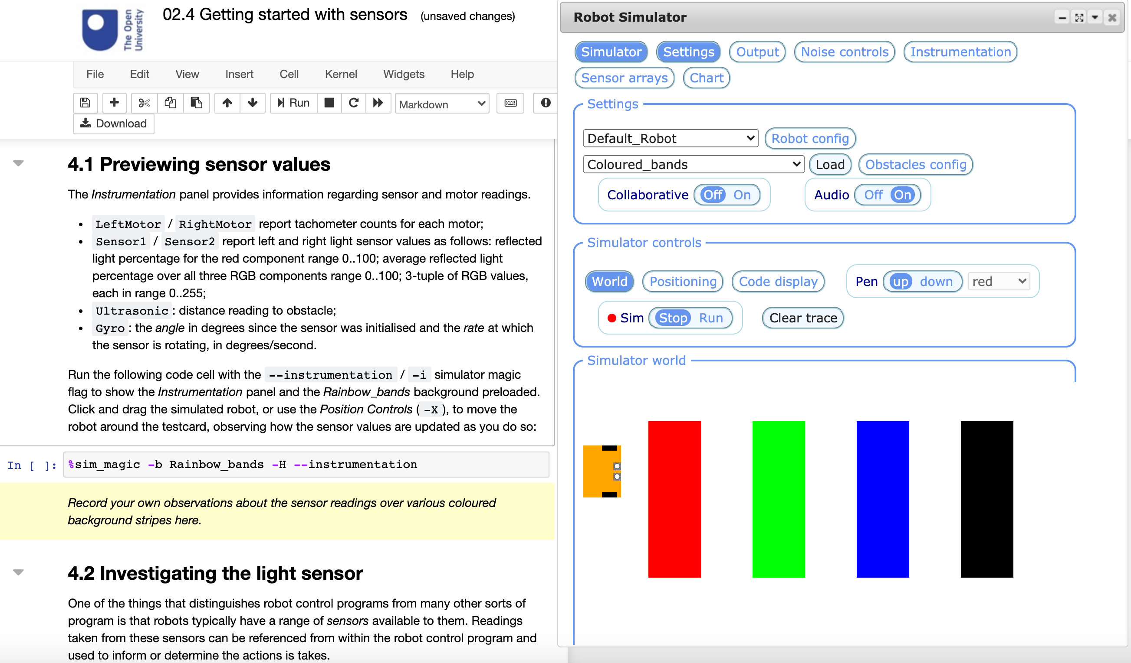
RobotLab — notebook + nbev3devsim

Slide 11
%sim_magic — line magic lab assistants
load a specified background
hide / reveal different simulator display panels
enable pen up / pen down mode
situate the robot at a specific location
automatically run a downloaded program

Slide 12
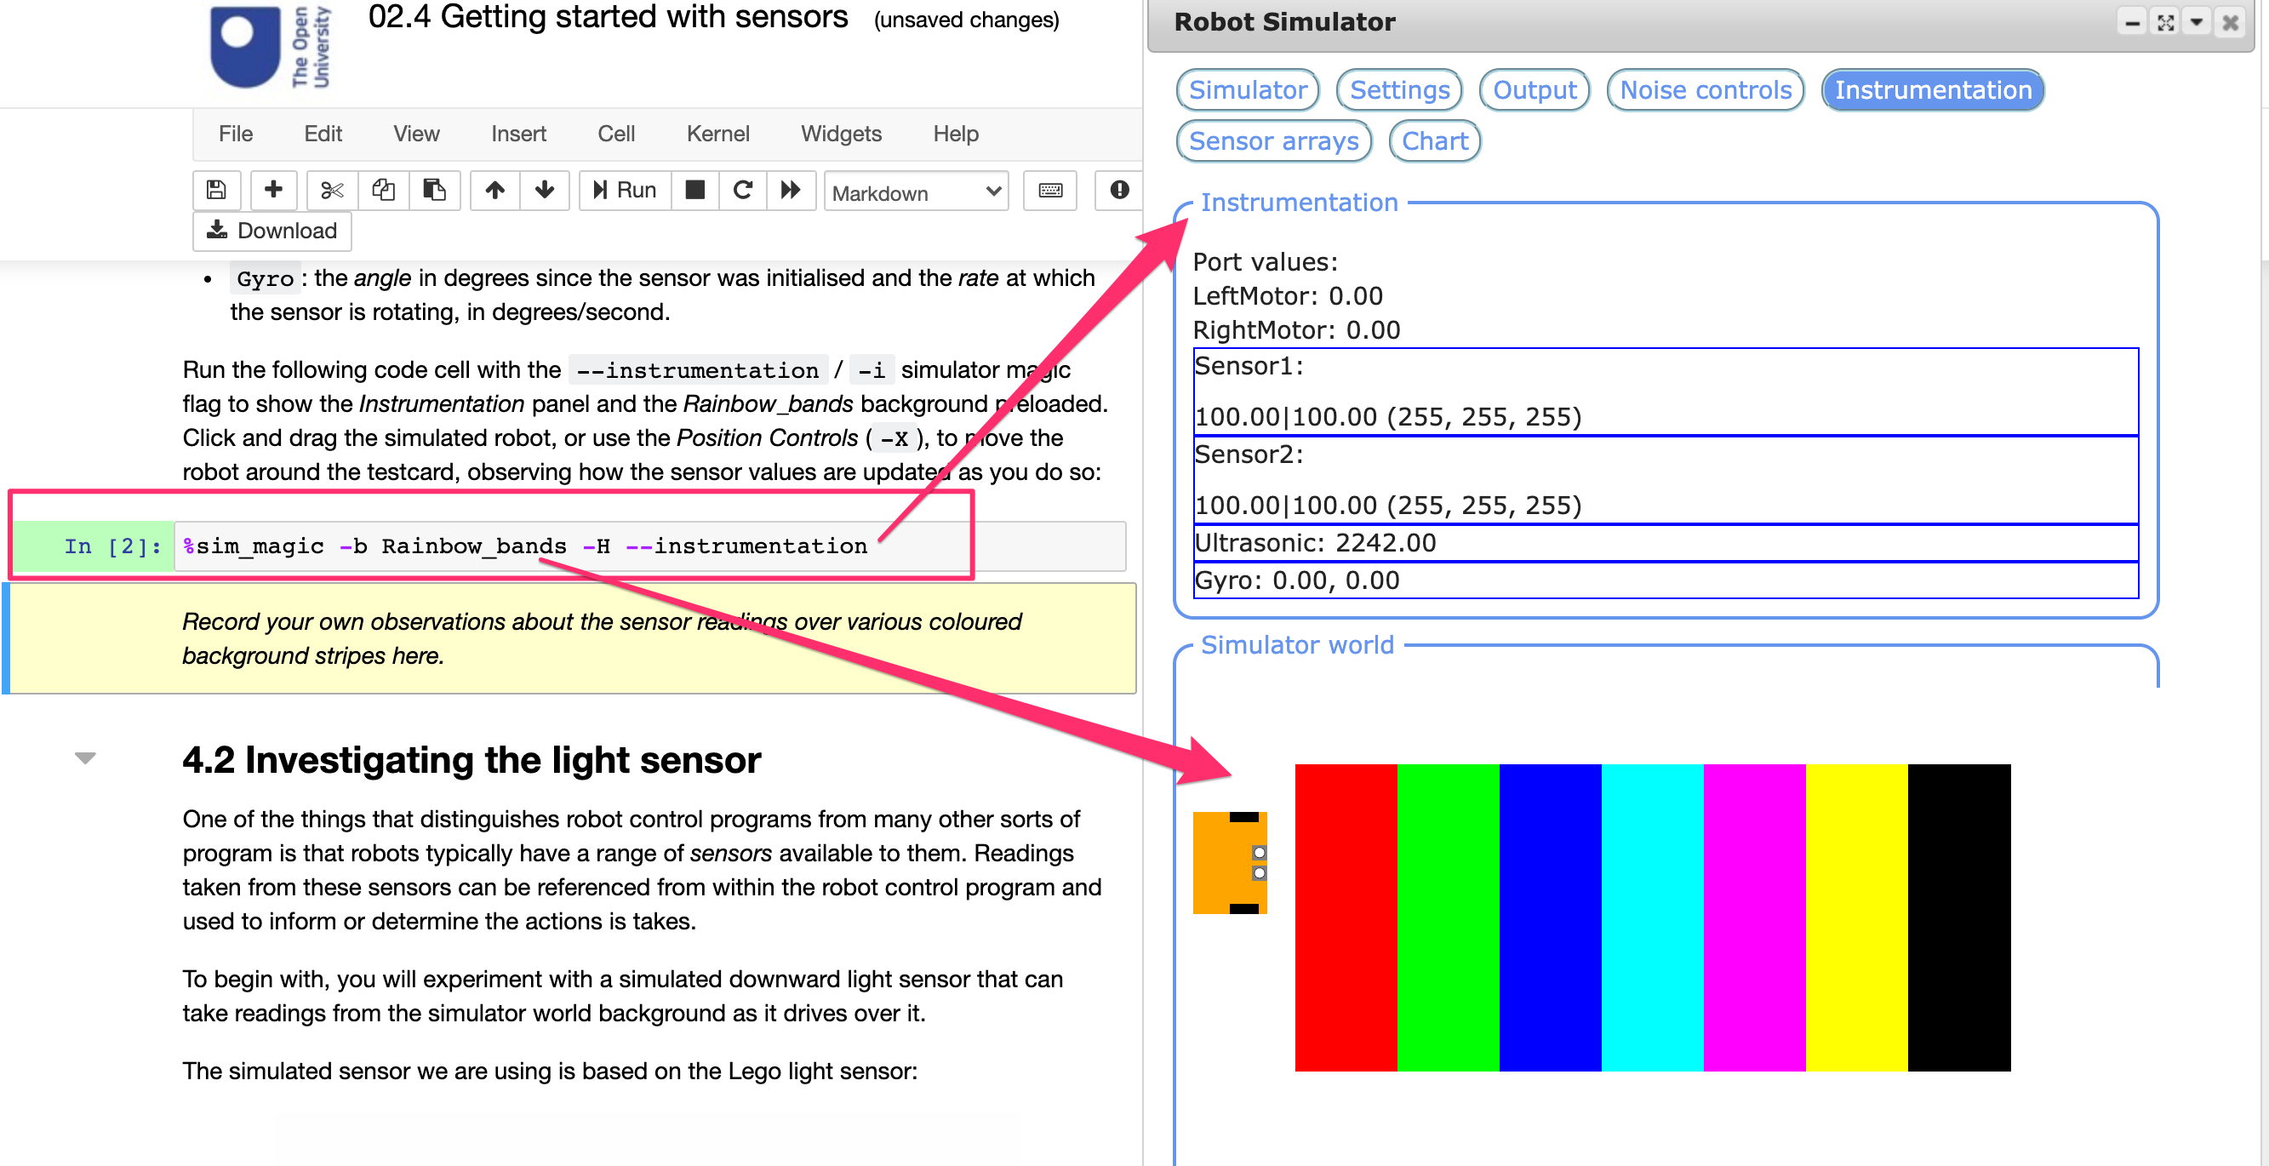
RobotLab — defining simulator setups

Slide 13
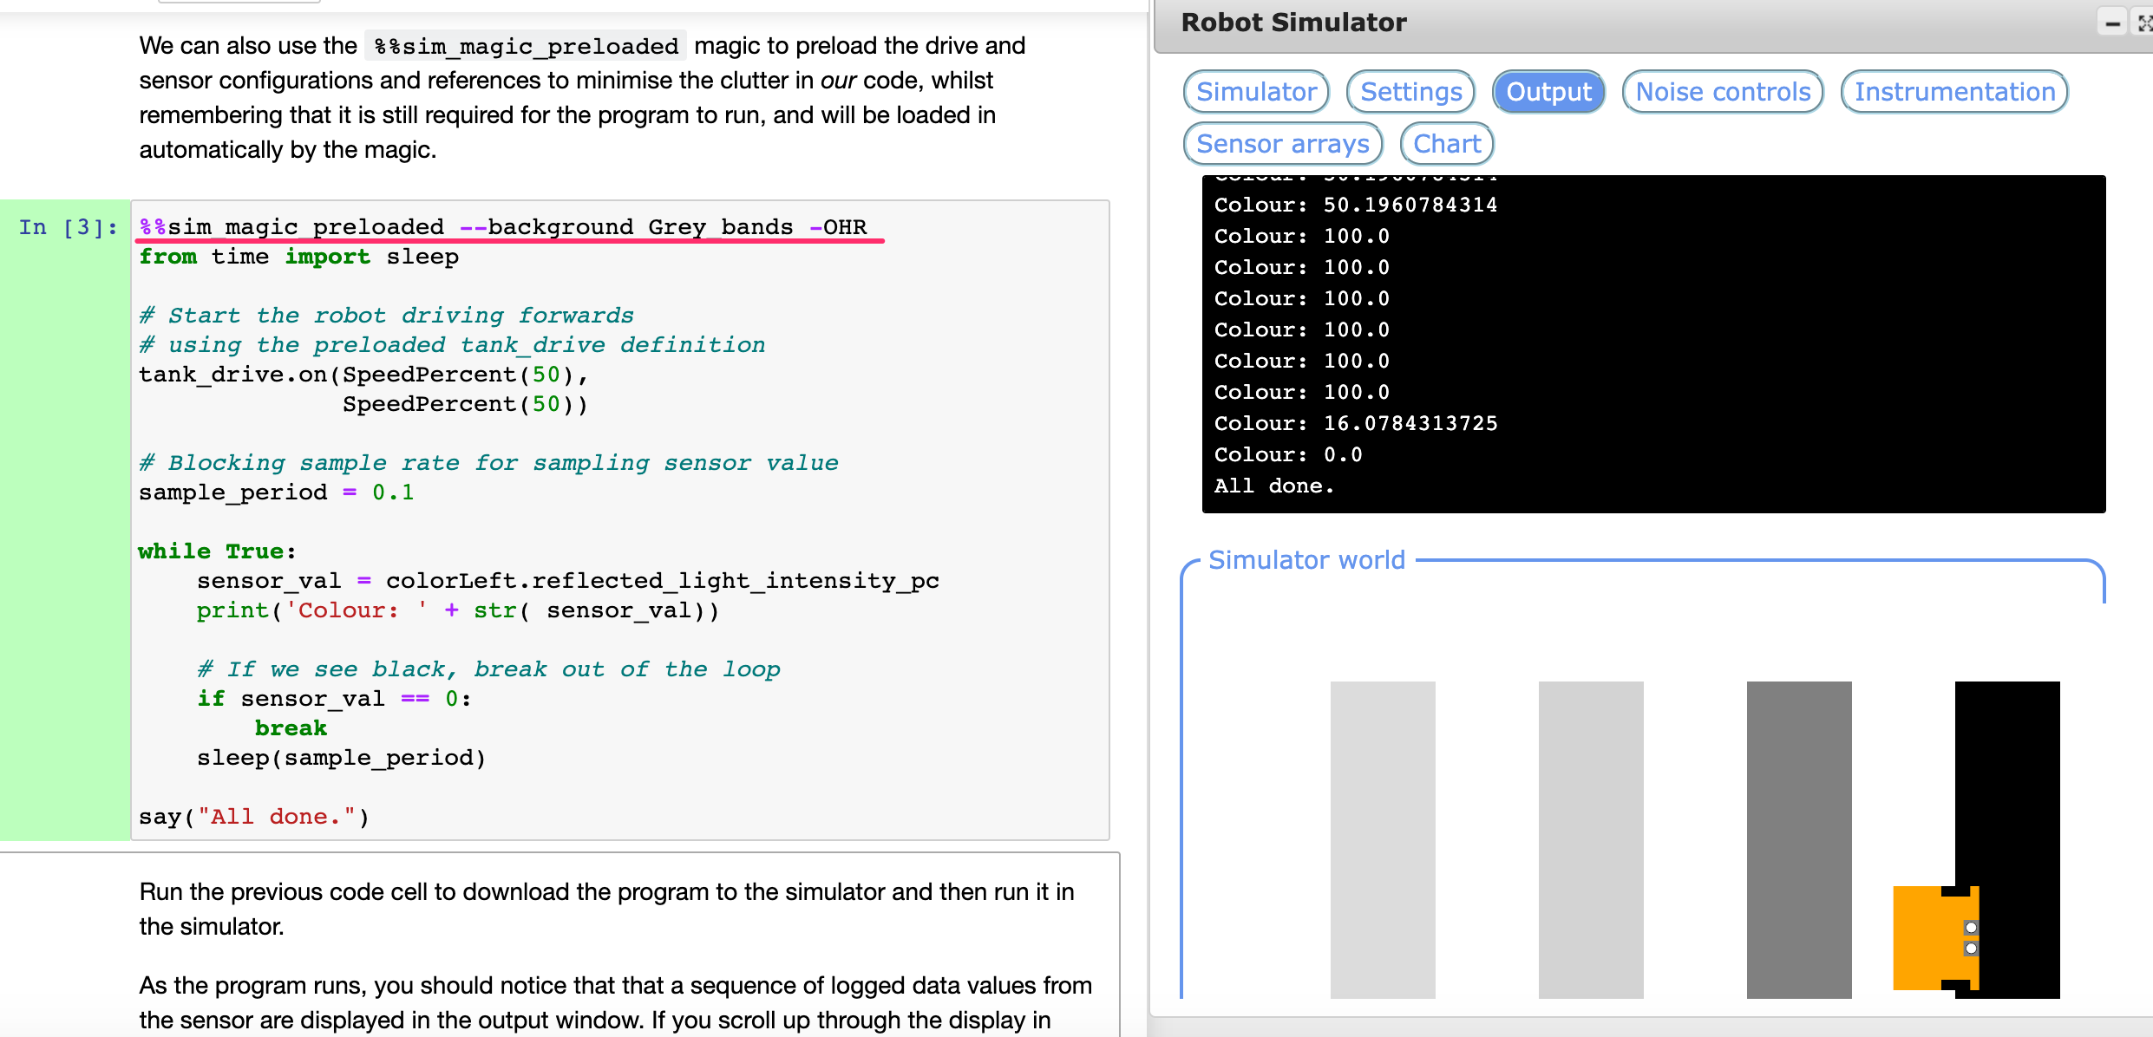
Downloading code from block %%sim_magic

Slide 14
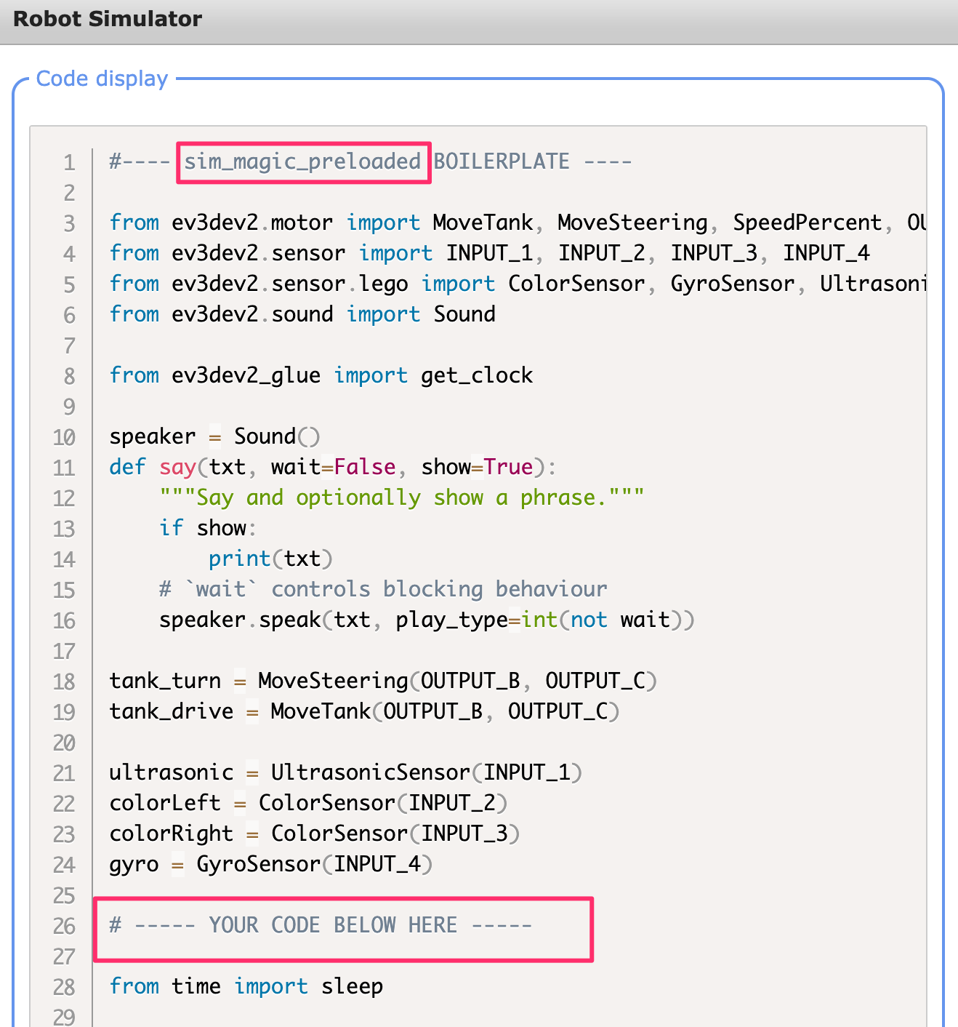
Using magics to preload boilerplate code
Block magics preload boilerplate
Preview boilerplate in notebook
View complete program in simulator

Slide 15
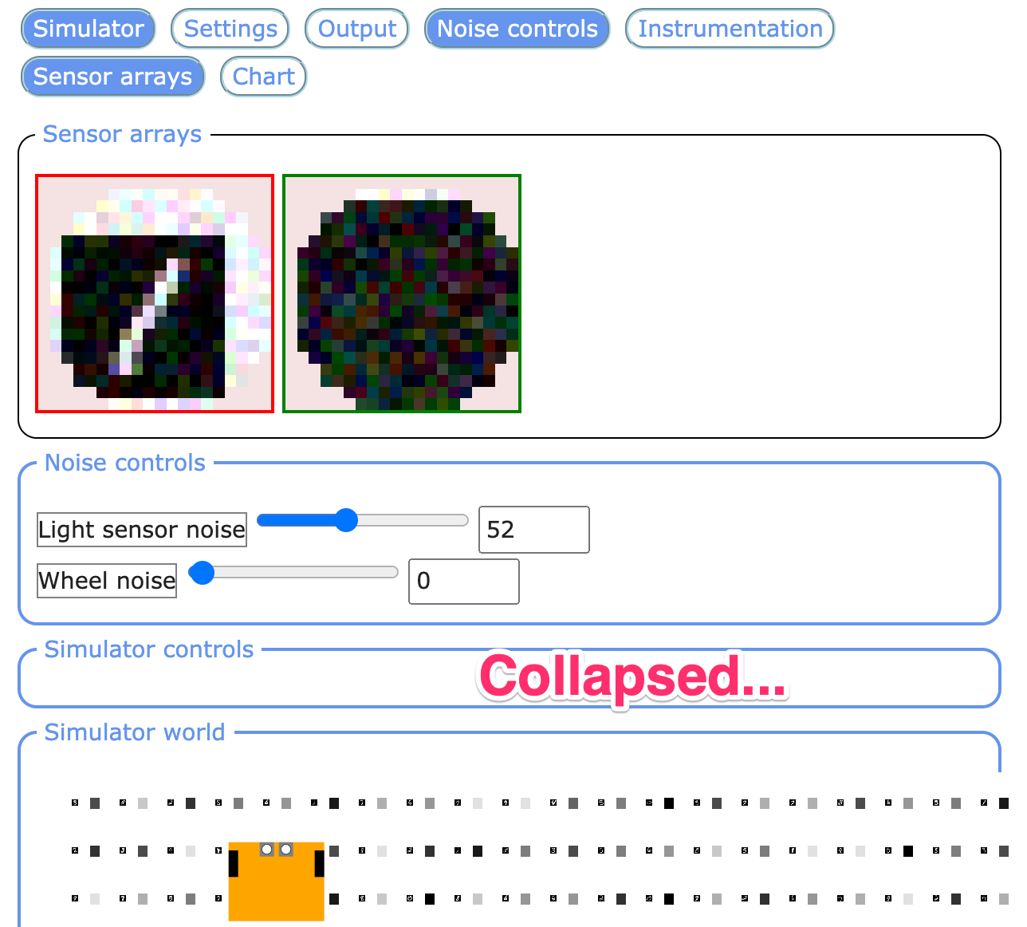
Light Sensor Display and Control
Light sensor acts as crude camera
User controlled noise levels
Logged data available in notebook

Slide 16
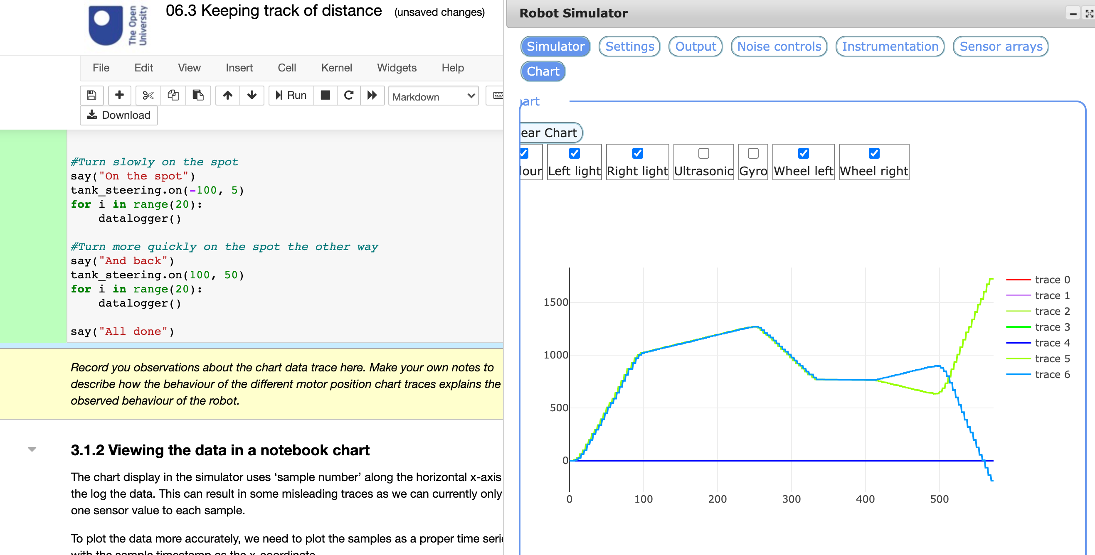
Live Charts Available in Simulator

Slide 17
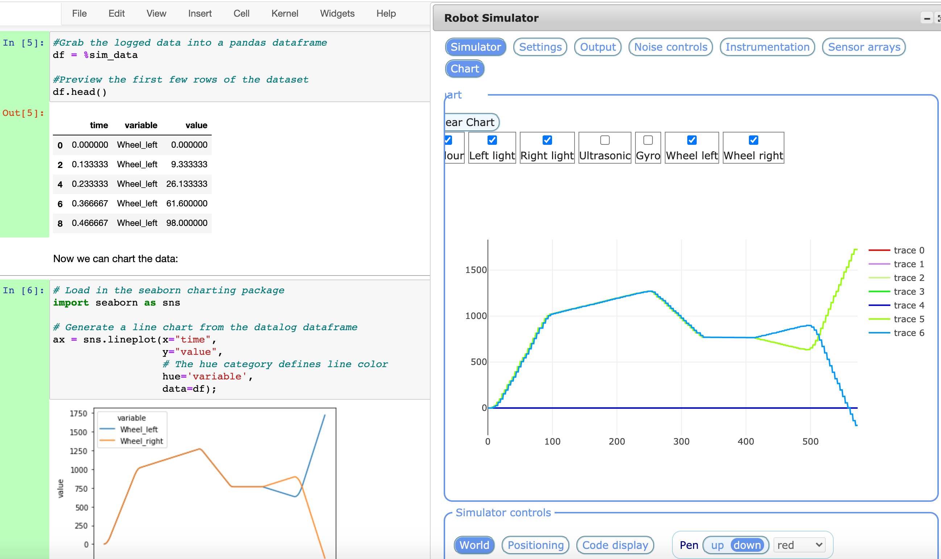
Data Available for Charting in Notebook

Slide 18
fin

Slide 19
Extras

Slide 20
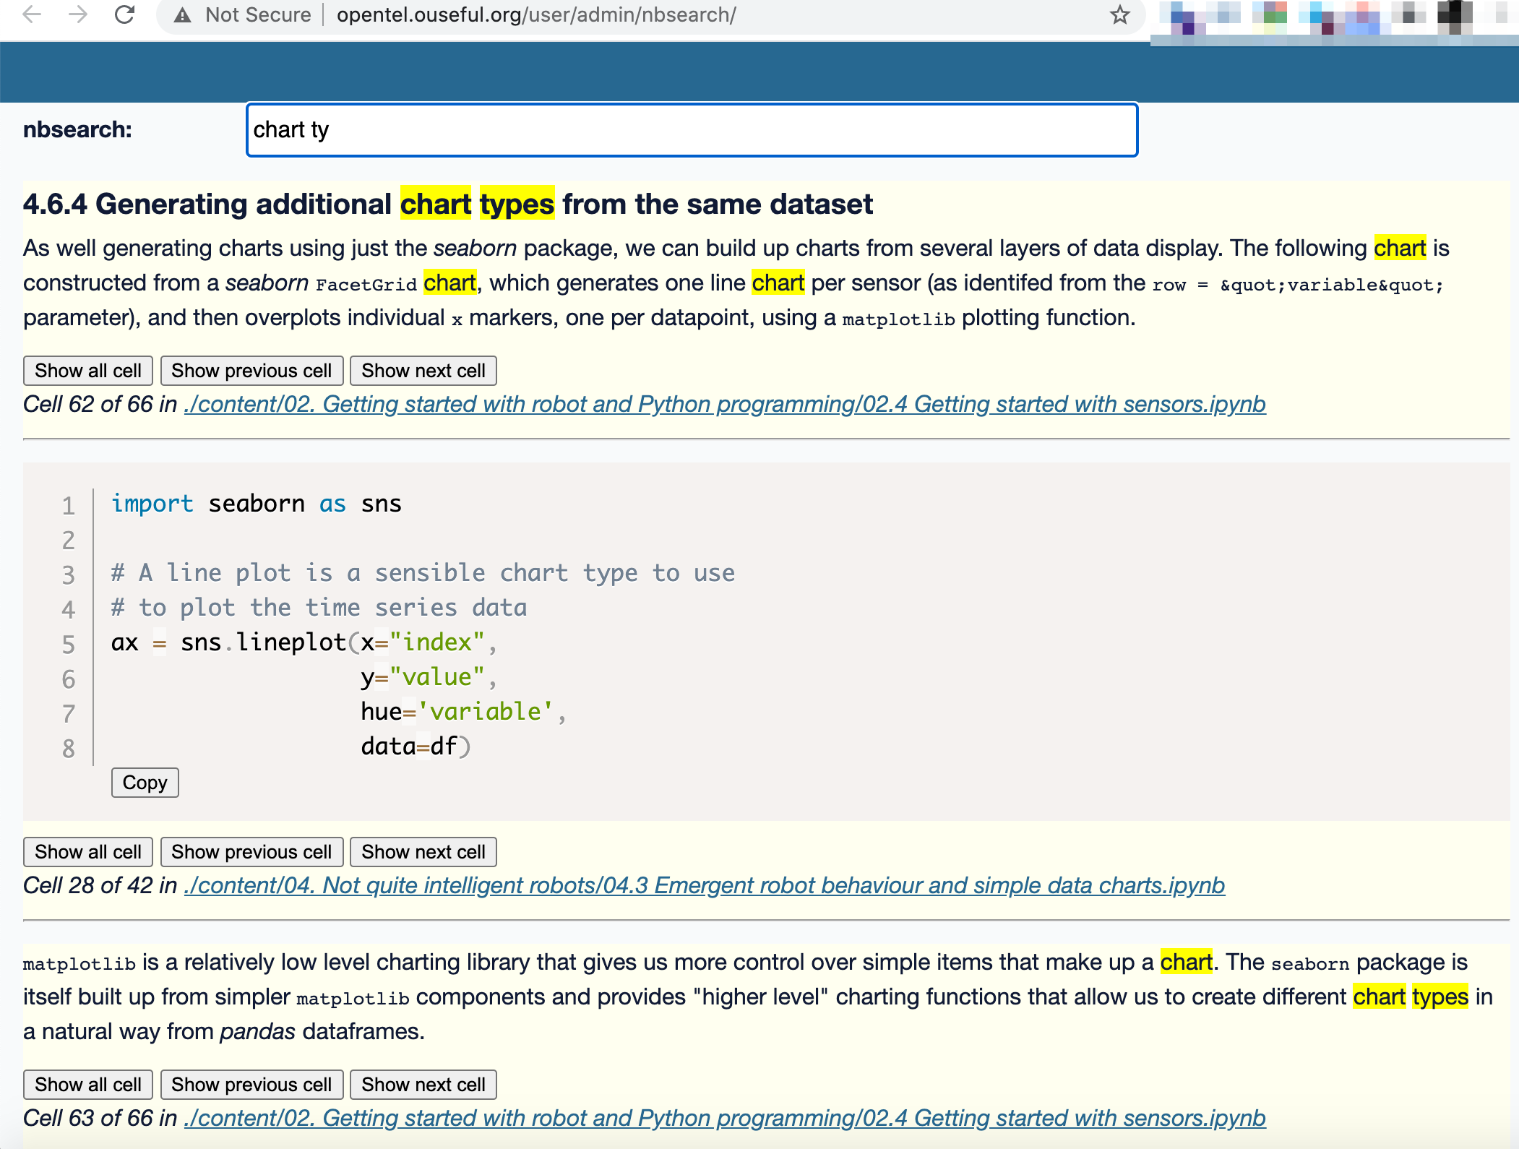
Cross-Notebook Search
Search across notebooks
Search markdown & code cells
Highlight search term
Show full cell contents
Code syntax highlighting
Show next/previous cell
Link to original notebook

Slide 21
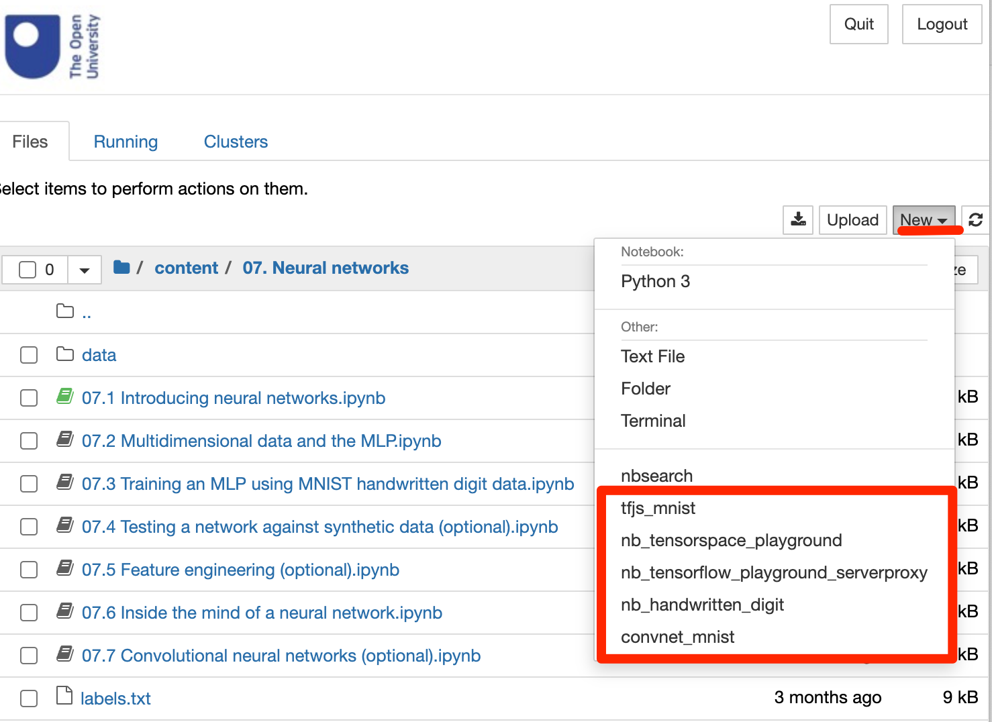
Proxied Interactive Web Apps
Provide links to neural network web apps

Slide 22
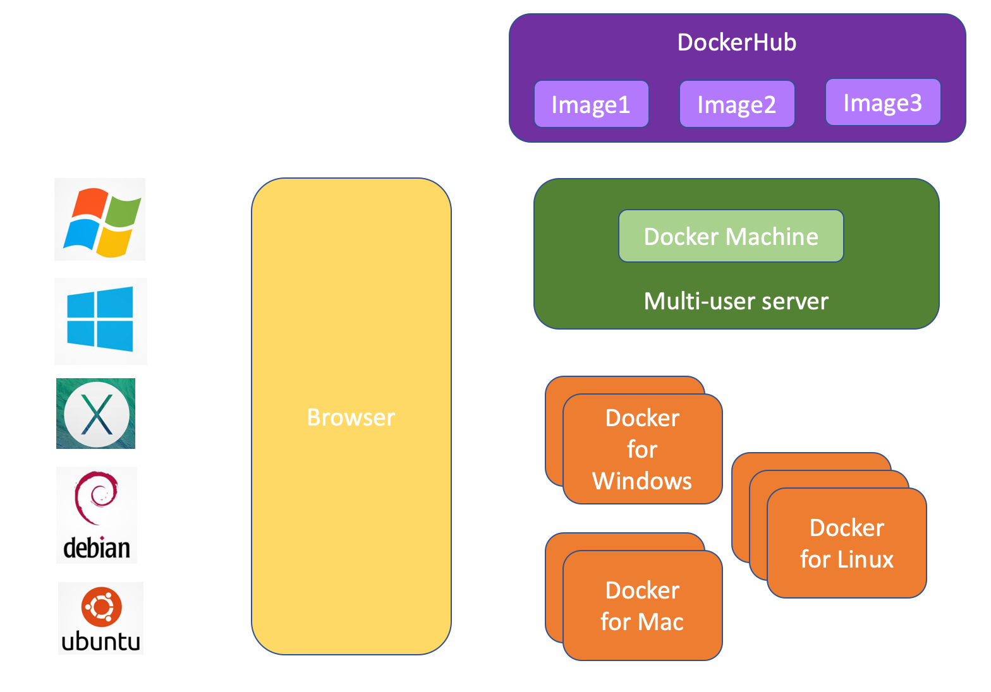
Distribution via Docker Container
Cross-platform
All software preinstalled
Can be run from remote server (e.g. Raspberry Pi)

