Slide 1
Challenges to Innovate:
Key Issues for Brazil
Carlos Américo Pacheco - CNPEM
Brasília, July 2013

Slide 2

Innovation:
The Brazilian Model?
But throw in the word “innovation” and businessmen become more philosophical. Brazil spends a paltry 1.1% of its GDP on research and development compared with 1.4% in China and 3.4% in Japan. Last year Brazil fell 18 places in Insead's annual innovation index, from 50th to 68th. Worse still, its ratio of basic-product to manufactured-product exports was the highest since 1978. These figures confront Brazilians with a troubling question. Can their country become an innovator in its own right, or is its recent growth little more than a by-product of China's appetite for commodities?

Slide 3
Brazil: strength
  Graduate system and research institutions
  Scientific production: international papers & diversification of competences
  Some (few, but very good) examples:
    Petrobras, Embraer, Embrapa, Weg, Embraco, etc.
    Select group of international enterprises
  National Agencies for Industrial and ST Policies - as BNDES and FINEP – Public resources
  Window of opportunity: natural resources, internal market, growth, reduction of inequality

Slide 4
Brazil: weakness
  Asymmetric Innovation System:
    relative good academic production .. but
    weak results in business innovation
  Fragmentation and weak coordination of activities – strong difficult to select & implement priorities
  Secondary and third grade education enrollment
  Science and engineering degrees
  S&T not at core of development strategies
  Very recent policies for innovation
  Incomplete support for business innovation

Slide 5
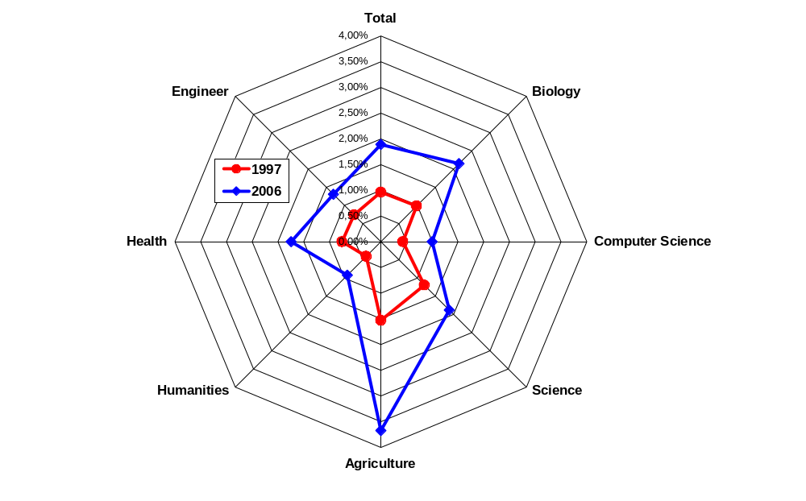
Growth and diversification of Brazilian academic papers (% of world: 1997-2006)
Source: ISI, MCT

Slide 6
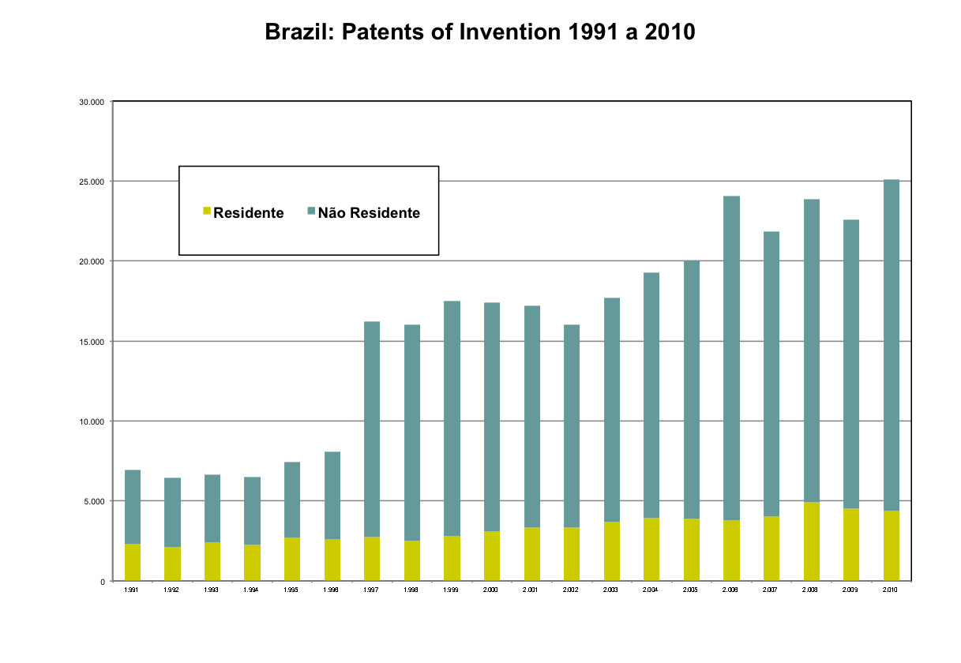
Patents of Invention in INPI: 1991 – 2010 - weak perform of residents

Slide 7
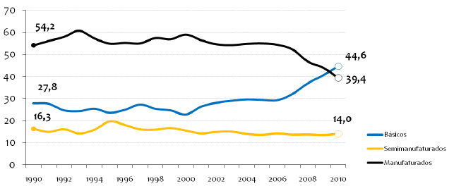
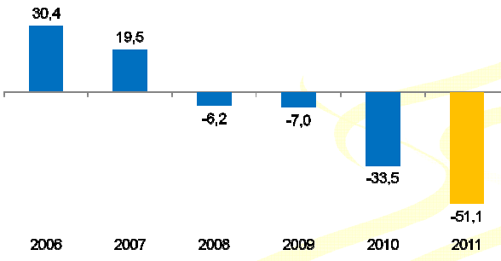
Trade: share and deficit of manufacturing

Slide 8
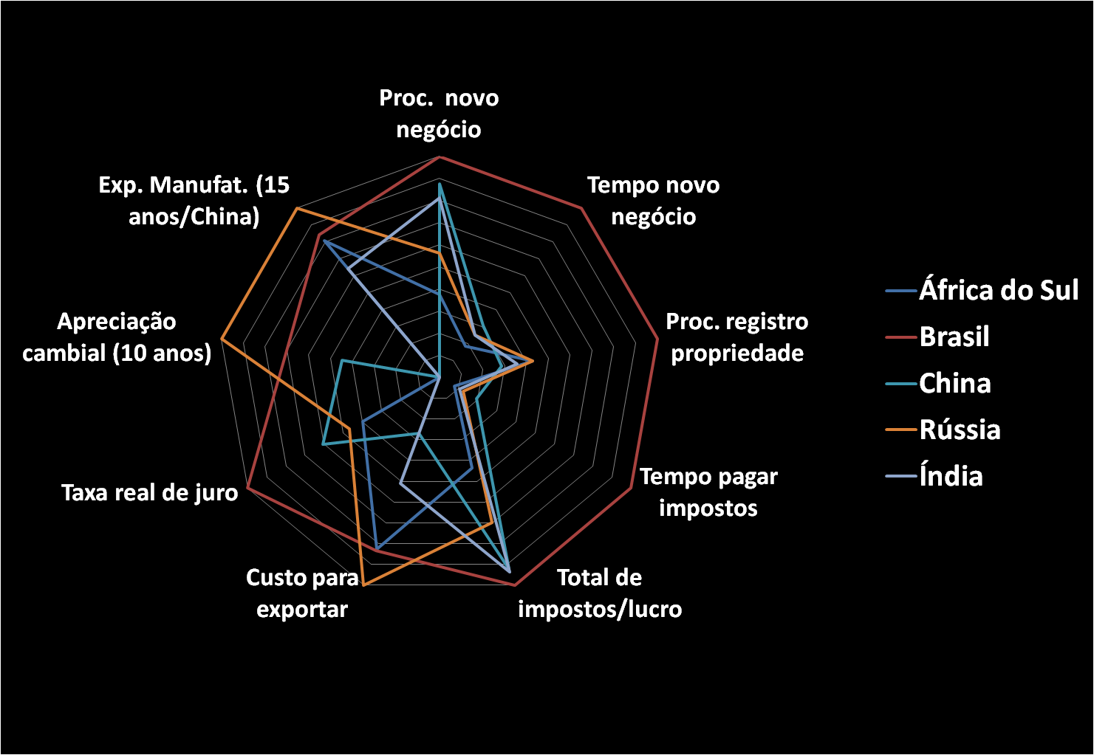
Competitiveness vs Innovation
Challenges to be competitive
  Exchange rate
  Cost of investment
  Tax system
  Infrastructure and logistics
  Business environment
  Bureaucracy
  Education
Fonte: Pacheco, 2009.
Poor performance – compare with all the BRICs
Poor environment to innovation

Slide 9
National Innovation System
Incomplete – but many actors and institutions
Complex framework (law and regulation)
Institutional framework: heritage of 4 periods of reforms: superposition of institutional design created in the past (distinct generations of reforms with different objectives)
4 generation of institutions
  50’s – first generation of policies: agencies for science
  70’s – State Co and National Institutes of R&D
  80’s – creation of Ministry of S&T
  90’s – PPP, innovation and new industrial policies

Slide 10
Recent Emphasis on Innovation
Institutional reform (Innovation Law, private non profit national labs and R&D institutes)
Emphasis on PPP and university-business cooperation
Creation of externalities (infrastructure) and environment for innovation
Different instruments for each actor:
  Fellowships, credit, tax incentives, subsidies, etc.
Reform of financing and incentives
  Sectorial funds
  Subsidies and tax incentives
  Credit and Demand push initiatives (Inova Empresa, Embrapii, PSI BNDES, etc.)
  Equity and Venture Initiatives

Slide 11
Horizontal and Vertical instruments to promote innovation
Horizontal
  Tax incentives (tax allowances – two times or more for eligible R&D expenditure)
  Subsidies for interest rates (loans to R&D), grants to SME’s business research and to fix researchers at private sector
  Venture capital (participation of federal funds in new venture initiatives)
  Grants for university-business cooperative R&D
Vertical
  Tax credit for ICTs industry
  Subsidies for R&D in priorities sectors of industrial policy
  New industrial policy (PDP)
    Procurement
    Special sectorial loans (software, pharmaceutical, aircrafts, etc.)
    Support for business consolidations and mergers

Slide 12
The Brazilian experience
Recent strategic align between public and private leaders about importance of innovation ... But few results
Innovation is related to intermediary staff of Co: a weak involvement of high level CEO with innovation strategies
Private efforts focus on internal market and incremental or ‘tropicalization’ of technologies
Public expenditure don’t induce private innovation (don’t focus on impacts and more relate to graduate education)
Few public-private strategic projects capable of creating technological capabilities in private sector
More emphasis on new instruments than on strategic planning and evaluation

Slide 13
Brazilian Policies for innovation
Conflicts between actors: demands, views, timing
  academics – emphasis on knowledge
  private sector – emphasis on innovation (not R&D);
  government/industrial policies: emphasis on business R&D;
Big problem – coordination
  Many actors – very complex decision process
  How to share and implement decisions
  How to coordinate government, private sector and academia
Main question: relation between economic policy, industrial policy and S&T policy
  strategic orientation to policies: competitiveness
  zero links between trade commerce & S&T policies

Slide 14
Brazilian Policies for innovation
Challenges to Implementation:
  Select few and simple instruments (all actors, all phases, but without large diversification)
  Selection – acceptable criteria to select strategic projects
Innovation:
  More than R&D
  More incremental and business oriented
  Market oriented
  Dependency on macro and micro economics
Increase skepticism and liberal vision
  Few failures more important than many success cases

Slide 15
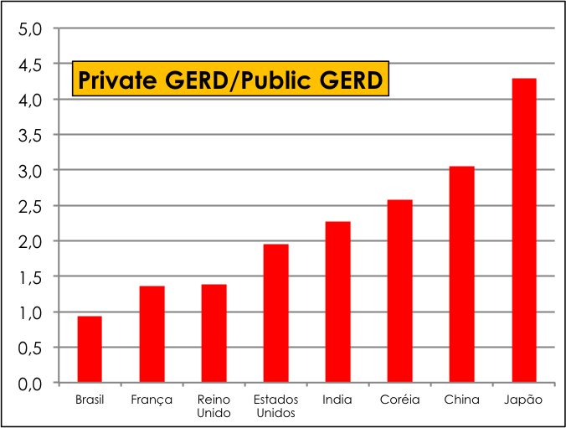
Public & Private GERD
Current Diagnostic:
  Public GERD performance is enough: 0.6% of GDP
  Private GERD performance disappoints: only 0.5% of GDP
Another way to interpret theses numbers is:
Public expenditure don’t change private decision
  Public expenditure focus on education and basic science
  Few public incentives or inefficient incentives
  No links between trade policies and innovation policies
Private initiative focus on internal market and incremental innovation

Slide 16
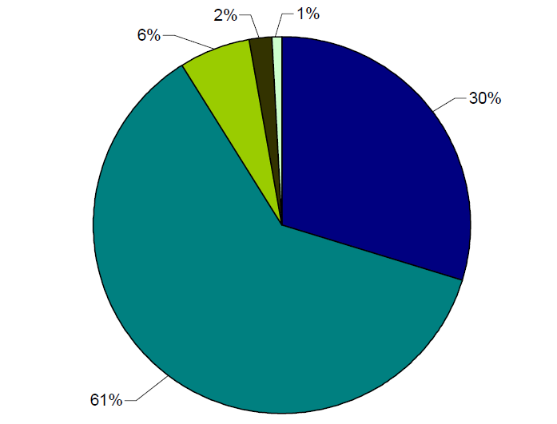
Direct and Indirect Incentives for RD – heritage of old policies
Incentives:
most important are old policies (27 years ago)
2/3 related to the informatics law (ZFM)
Incentives:
inefficient to improve private perform
inefficient to transform private structure

Slide 17
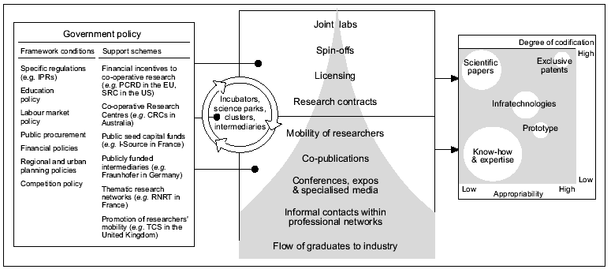
Industry & Science
Relationships (OCDE)

Slide 18
Industry & Science
Relationships (OCDE)
Many kinds of relationships
  many kinds of institutions (innovation system)
  Universities, National Labs, R&D Institutes, R&D services, training, regulation, etc.
Very important role of support for basic science and support very qualify Human Resources
But at same time …
  Focus on strategic long term PPP project
  Focus on external markets or in a global approaches
  Focus on create industrial capabilities

