Slide 1
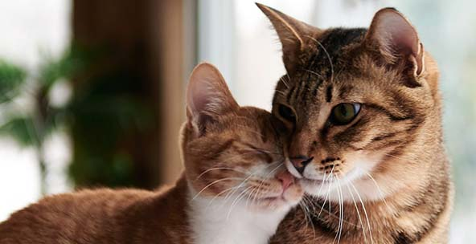
sdasadsada

Slide 2
