Slide 1


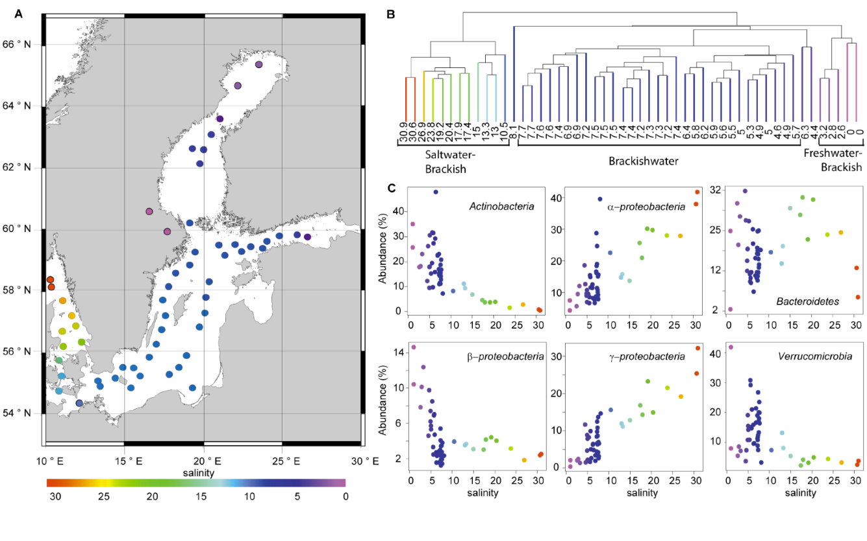
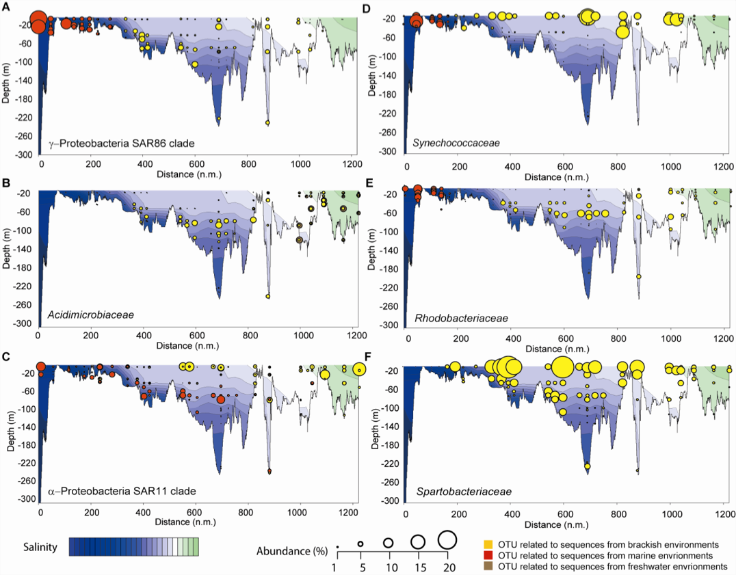
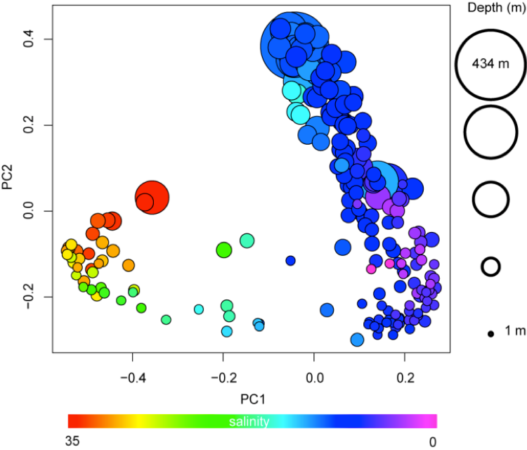
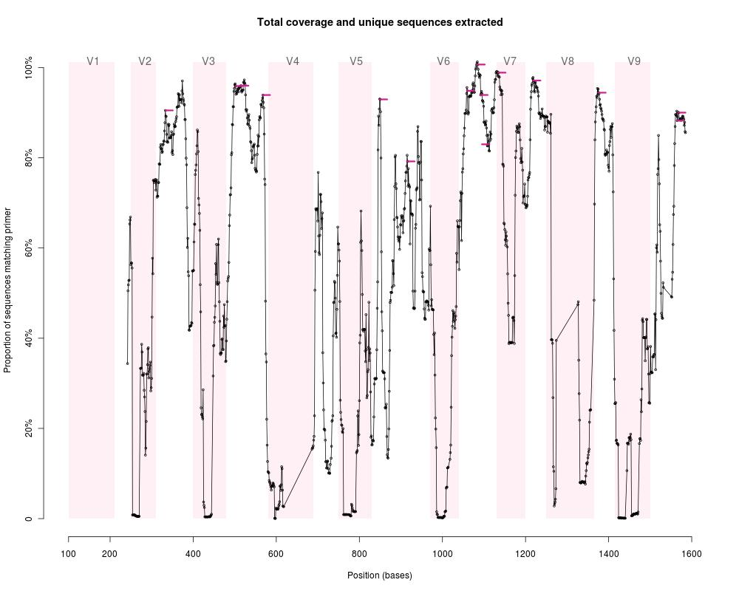
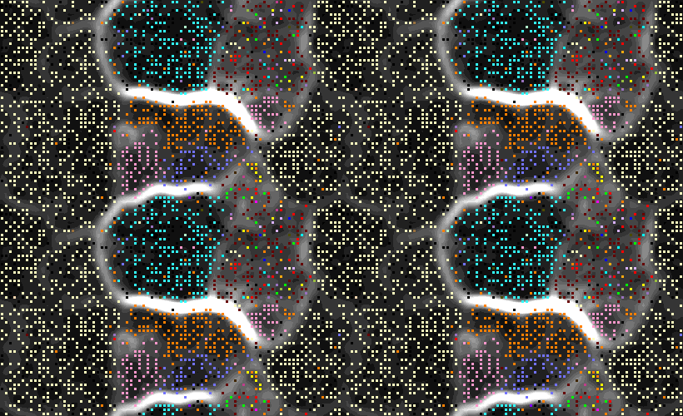
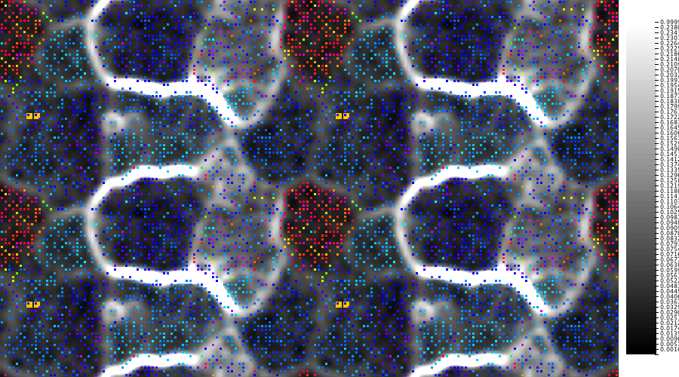
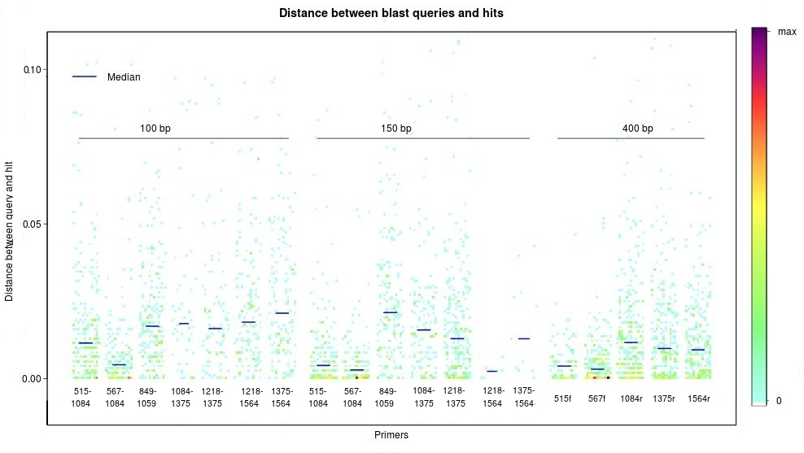
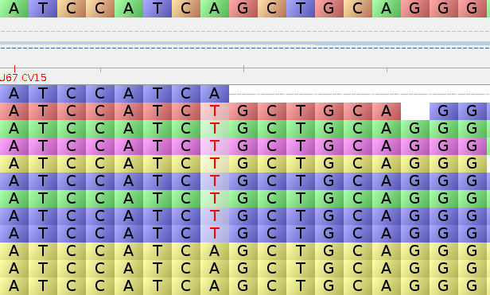







Baltic Sea Metagenomics:
Getting a Grip of a Sea of Microbes
Luisa Hugerth¹, Daniel Lundin¹, Ino DeBruijn¹, Daniel Herlemann², Anders F Andersson¹
1) Science for Life Laboratory, School of Biotechnology, KTH Royal Institute of Technology,
Tomtebodavägen 23 B, SE-17165 Solna, Sweden
2) Leibniz Institute for Baltic Sea Research Warnemünde, Seestraße 15, 18119 Rostock
Email: anders.andersson@scilifelab.se
A 3D map of the Baltic Sea microbiome
The Baltic Sea is one of the largest brackish environments on Earth. In all marine environments, including the Baltic Sea, microbes are essential for the fluxes of nutrients and energy and are integral components of food webs. Little has been known about microbial diversity of the Baltic Sea, but recently we used barcoded high-throughput sequencing of 16S ribosomal RNA (rRNA) genes to get a biogeographic view of the Baltic Sea microbial world by monitoring bacterial composition at different depths at 60 sampling stations distributed along the salinity gradient of the Baltic Sea (Herlemann et al 2011).
Figure 1. A) Stations in the Baltic Sea transect study (sampled by IOW). A - inlet) PCoA based on microbial community composition in the 213 samples. The first principal component correlates strongly with salinity and the second with depth and oxygen content. B) Hierchical clustering of surface water samples based on community compositions. C) Correlations between broader taxonomic groups and salinity levels of surface waters.
Figure 2. Spatial distributions of selected bacterial populations (16S rDNA sequence clusters) along the transect route connected by lines in Figure 1A. Note the distinct niches for closely related pairs of organisms in A,C, D and E. F shows a member of the Verrucomicrobium phylum that displays high abundances in brackish waters. This organism has no closely related sequenced or cultured relatives.
Systematic design of 18S rDNA primers for assessing eukaryotic diversity
De novo (meta)genomic reconstruction of abundant bacterial populations
Small single-cellular eukaryotes are important components of marine microbial food webs. The eukaryotic 18S rDNA gene is conserved and phylogenetically informative. However, short NGS reads require that PCR targets only the most informative sites. We identified conserved regions flanking highly variable ones as candidate primer binding regions. These were evaluated in silico for sequence-wide and taxonomical recall of short reads. A set of primer pairs suitable for NGS of eukaryotic communities is now being tested in the lab.
454 and Illumina metagenomic (shotgun) sequencing were applied with the goal of reconstructing the genomes of the most abundant microbial populations of Baltic Sea surface waters. In a pilot study of a single sample we were able to reconstruct near complete genomes of the Verrucomicrobial population in Figure 2F above and of an Actinobacterial population. Metabolic reconstruction of the Verrucomicrobium suggests it is an aerobic heterotroph with cellulose degrading capacity.
Figure 3. Profile of conservation of the 18S gene across 37,435 sequences. At each position a degenerate 18 bp primer of degeneracy 12 was designed with the program DeBug (in preparation) which uses a heuristic to find the degenerate primer of highest coverage at every position within a sequence alignment. Variable regions are marked in pink and conserved regions in white. Conserved regions flanking variable regions are good primer site regions, and these are marked in purple.
Figure 5. Self-organising map of metagenomic contigs based on tetranucleotide frequencies. Pixels are contigs, colored according to bacterial phyla, based on BLASTX matches to reference genomes. The magenta colored area represents a near complete Verrucomicrobia genome based on presence on single copies of universal marker genes.
Figure 6. Same as Figure 5 but with pixels/contigs colored according to mean coverage. The region with red contigs (ca 20X coverage) represents a near complete Actinobacteria genome based on presence of single copies of universal marker genes. (The map is continuous, thereby the repeated pattern.)
Figure 4. Distance between full length sequence of blast queries and hits. Short sequences were extracted from the database using different combinations of primer pairs and read lengths. These were blasted against the same database at a 99% identity cutoff and the distance between full length sequences was plotted. The color of each point represents the local density of data, according to the scale to the right. Medians are marked as blue bars.
Figure 7. Contigs assembled using 454 reads are extended into scaffolds using pair information from Illumina reads..
Publications
Andersson AF, Riemann L, Bertilsson S. Pyrosequencing reveals contrasting seasonal dynamics of taxa within Baltic Sea bacterioplankton communities. ISME J, 2010. 4(2): p. 171-81.
Herlemann DPR, Labrenz M, Jürgens K, Bertilsson S, Waniek JJ, Andersson AF. Transitions in bacterial communities along the 2000 km salinity gradient of the Baltic Sea. ISME J, 2011. Apr 7.
Sponsored by
In collaboration with

