Slide 1
Metagenomic Assembly with Ray and Velvet

Slide 2
Content
Assembly Intro
  Velvet
Ray on single genomes (2010)
Ray on metagenomes (2012)
Workshop

Slide 3
Assembly intro
Different technologies to sequence your sample
  Sanger (~400-600nt, error rate ~0.001-1.0%)
  454 (~400nt, error rate ~1-4%)
  Illumina (~100nt, error rate ~0.1-1%)
  PacBio (~3k-5knt, error rate ~13-20%)
  Ion Torrent (~200-400nt, error rate ~0.5-2.5%)
Turn reads in to longer contigs or scaffolds
Assembly Goal
  the breadth of coverage (how much of the genome is represented) is maximal
  the number of assembly errors (chimeric contigs, mismatches, insertions, and deletions) is minimal
  the number of contigs is minimal

Slide 4
Assembly intro
Algorithms fit sequencing technologies
Three general approaches
  Overlap-Layout-Consensus (Long reads Celera 2000, Newbler 2005)
  Greedy (Short reads, SSAKE 2007)
  de Bruijn Graph (Short reads, Velvet 2008

Slide 5
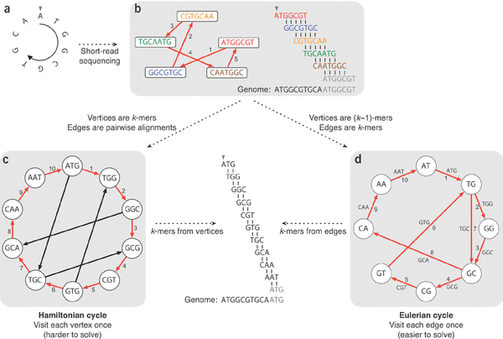
Assembly intro
De Bruijn Graph

Slide 6
Assembly intro
Choosing the right K...
  larger K more specific less coverage (span repeats, regions occurring twice, less connections in the graph)
  Smaller K more sensitive more coverage (more connections in the graph)
  Ideally combine both
De Bruijn Graph potential information available
  Overlap between kmers
  Kmer coverage (how often does a kmer occur)
  Read that created the kmer (choose between paths)
  Insert size distribution between pairs (if paired reads were used)
Programs differ in
  how the graph is stored
  how the graph is traversed

Slide 7
Assembly intro
Metagenomic assembly more difficult than single genome assembly
  Number of genomes unknown (maybe a rough idea)
  Coverage of genomes differs (different abundances of genomes)
  Closely related strains complicate the graph (in de Bruijn: anything that shares stretches of DNA shorter than K)

Slide 8
Assembly intro
Velvet's most important parameters
  K
    larger K more specific less coverage (span repeats, regions occurring twice, less connections in the graph)
    Smaller K more sensitive more coverage (more connections in the graph)
    Ideally combine both
  Expected coverage
    Low coverage kmers are errors, high coverage repeats
  Coverage cutoff
    Low coverage kmers are errors
Paired read data can be used to determine path in the graph

Slide 9
Ray Single Genomes (2010)
Ray is a de Bruijn Graph assembler
Three reasons for Ray
Parallel, can be run over multiple nodes
  faster real time computation + distributed so memory requirements go down (Message Passing Interface)
Mixed sequencing data (454 and Illumina)
No coverage cut-off like Velvet but an approach that focuses on seed selection with global coverage and seed-extension based on local coverage, reads and paired reads

Slide 10
Ray Single Genomes (2010)
Select seeds
  Seeds are walks in the graph with a coverage > (c_min + c_peak) / 2 and vertices af indegree and outdegree at most one (basically highly covered unitigs)
Increase seeds based on paired information and/or read information

Slide 11
Ray Meta (2012)
Metagenomic sample has different abundances
From Ray to Ray Meta
  Seed selection changed, cov_peak and cov_min now local to unitig (walks with indegree and outdegree at most one)
No graph simplification
  like Meta-Velvet and Meta-IDBA based on coverage and connected components, because the graph is not easily mutable in Ray with its distributed nature

Slide 12
bit.ly/metalove

