Slide 1
Benchmark of de novo Short Read Assembly Strategies for Metagenomics
Ino de Bruijn

Slide 2
Content
Introduction on Assembly
  What is assembly?
  Popular methods
Benchmark Method
  Which assemblers have been validated?
  How have they been validated?
Benchmark Results
  What is the most awesome assembler?

Slide 3
Introduction on Assembly
Different technologies to sequence your sample
  Sanger (400-600nt, error rate 0.001-1.0%)
  454 (400nt, error rate 1-4%)
  Illumina (100nt, error rate 0.1-1%)
  PacBio (3k-5knt, error rate 13-20%)
  Ion Torrent (200-400nt, error rate 0.5-2.5%)
Assembly turns reads into contigs and/or scaffolds
Algorithms fit sequencing technologies
Three general approaches
  Overlap-Layout-Consensus (Long reads Celera 2000, Newbler 2005)
  Greedy (Short reads, SSAKE 2007)
  de Bruijn Graph (Short reads, Velvet 2008)

Slide 4
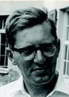
Introduction on Assembly
Different technologies to sequence your sample
  Sanger (400-600nt, error rate 0.001-1.0%)
  454 (400nt, error rate 1-4%)
  Illumina (100nt, error rate 0.1-1%)
  PacBio (3k-5knt, error rate 13-20%)
  Ion Torrent (200-400nt, error rate 0.5-2.5%)
Assembly turns reads into contigs and/or scaffolds
Algorithms fit sequencing technologies
Three general approaches
  Overlap-Layout-Concensus (Long reads Celera 2000, Newbler 2005)
  Greedy (Short reads, SSAKE 2007)
  de Bruijn Graph (Short reads, Velvet 2008)
FYI, this man is not my grandpa

Slide 5
Introduction on Assembly
Algorithms fit sequencing technologies
Three general approaches
  Overlap-Layout-Concensus (Long reads Celera 2000, Newbler 2005)
  Greedy (Short reads, SSAKE 2007)
  de Bruijn Graph (Short reads, Velvet 2008)

Slide 6
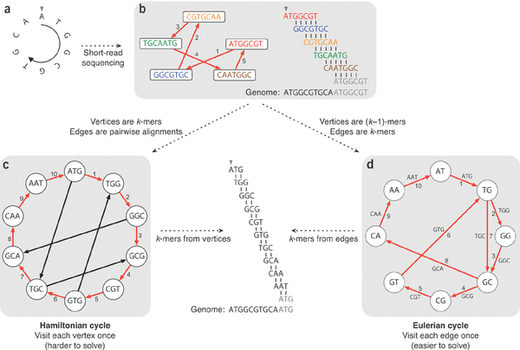
Introduction on Assembly
  De Bruijn Graph

Slide 7
Introduction on Assembly
Choosing the right K...
  larger K more specific less coverage (span repeats, regions occurring twice, less connections in the graph)
  Smaller K more sensitive more coverage (more connections in the graph)
  Ideally combine both
De Bruijn Graph potential information available
  Overlap between kmers
  Kmer coverage (how often does a kmer occur)
  Read that created the kmer (choose between paths)
  Insert size distribution between pairs (if paired reads were used)
Programs differ in
  how the graph is stored
  how the graph is traversed

Slide 8
Introduction on Assembly
Metagenomics uses DNA from environmental sample
  Not all microbes can be cultured in the lab
  Study microbial communities in their natural environment
Metagenomic assembly more difficult than single genome assembly
  Number of genomes unknown (maybe a rough idea)
  Coverage of genomes differs (different abundances of genomes)
  Closely related strains complicate the graph (in de Bruijn: anything that shares stretches of DNA longer than K)

Slide 9
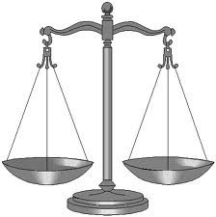

Benchmark Method
Use an in vitro simulated metagenome with known species
  59 species, total size 195Mb
  Two abundance distributions of genomes
    Even, approximately the same genome copy numbers
    Uneven, log-normal distribution of phyla similar to soil
    Assemblies can be validated by aligning them against the reference genomes (we used nucmer for this)
Use Illumina paired end reads since that is currently one of the most popular sequencing techniques for metagenomic samples

Slide 10
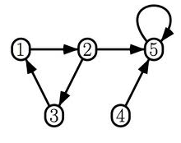

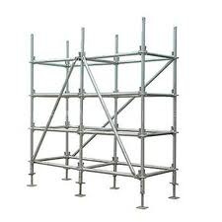

Benchmark Method
Enormous amount of assembly strategies possible
  Select a number of assembly strategies to test
Contiging with
  Velvet
  Meta-Velvet
  Ray
Merging with
  Newbler
  Minimus2
Scaffolding with
  Velvet
  Meta-Velvet
  Ray
  Bambus2

Slide 11
Benchmark Method
Enormous amount of assembly strategies possible
  Select a number of assembly strategies to test
Contiging with
  Velvet
  Meta-Velvet
  Ray
Merging with
  Newbler
  Minimus2
Scaffolding with
  Velvet
  Meta-Velvet
  Ray
  Bambus2

Slide 12
Benchmark Method
Enormous amount of assembly strategies possible
  Select a number of assembly strategies to test
Contiging with
  Velvet
  Meta-Velvet
  Ray
Merging with
  Newbler
  Minimus2
Scaffolding with
  Velvet
  Meta-Velvet
  Ray
  Bambus2

Slide 13
Benchmark Method
Enormous amount of assembly strategies possible
  Select a number of assembly strategies to test
Contiging with
  Velvet
  Meta-Velvet
  Ray
Merging with
  Newbler
  Minimus2
Scaffolding with
  Velvet
  Meta-Velvet
  Ray
  Bambus2

Slide 14
Benchmark Method
Enormous amount of assembly strategies possible
  Select a number of assembly strategies to test
Contiging with
  Velvet
  Meta-Velvet
  Ray
Merging with
  Newbler
  Minimus2
Scaffolding with
  Velvet
  Meta-Velvet
  Ray
  Bambus2

Slide 15
Benchmark Method
Enormous amount of assembly strategies possible
  Select a number of assembly strategies to test
Contiging with
  Velvet
  Meta-Velvet
  Ray
Merging with
  Newbler
  Minimus2
Scaffolding with
  Velvet
  Meta-Velvet
  Ray
  Bambus2

Slide 16
Benchmark Method
Enormous amount of assembly strategies possible
  Select a number of assembly strategies to test
Contiging with
  Velvet
  Meta-Velvet
  Ray
Merging with
  Newbler
  Minimus2
Scaffolding with
  Velvet
  Meta-Velvet
  Ray
  Bambus2
= 3 strategies
= 2 x 3 stragies = 6 strategies
= 3 strategies
= (6 merge + 3 contig ) strategies = 9 strategies
Total of 21 strategies

Slide 17
Benchmark Method
How to compare all these different strategies?
Validation of metagenomic assembly often focuses on one or more of the following points:
  contig/scaﬀold length distribution
  contig/scaﬀold coverage of the reference metagenome
  chimericity and erroneousness of the contigs/scaﬀolds
  functional annotation
  phylogenetic classiﬁcation
We focus on the first three since those also tend to improve 4 and 5 as shown by Mende et al (2012)
Select winner in three categories

Slide 18
Benchmark Results
contig/scaffold length distribution
  Popular statistic: N50 length (or L50)
    Weighted median of contig lengths (contigs weighted by length)
    50% of all bases in the assembly are in contigs >= L50
    Bigger is better
  Problem when comparing between different assemblers: cut-off length matters and sum of bases between assemblies differs
    Advantage for assemblers that only output long contigs

Slide 19
Benchmark Results
Legend
  Community distribution
    Even
    Unbalanced
  Assembly strategies
    Build contigs one k-mer with de Bruijn
      Velvet, Meta-Velvet, Ray
    Merge multiple kmers
    Scaffold as well with de Bruijn
    Scaffold assemblies with bambus2 (combinable with 1 and 2)

Slide 20
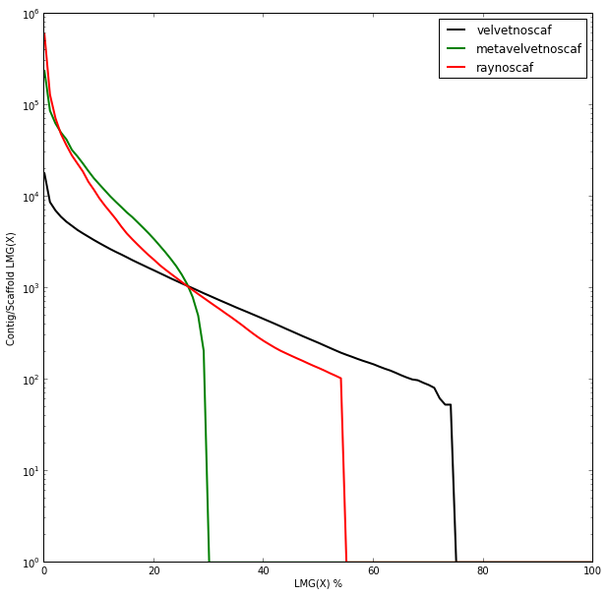
Benchmark Results
contig/scaffold length distribution
Contig
Shows best single kmer
strategy per assembler
based on L50
Dots are L50 values at cut-off 100
Contig/Scaffold length
Sum of bases as percentage of ref metagenome length

Slide 21

Benchmark Results
contig/scaffold length distribution
Difficult to say which is winning based on length distribution alone.
Contig/Scaffold length
>1000?
Sum?
Sum of bases as percentage of ref metagenome length

Slide 22
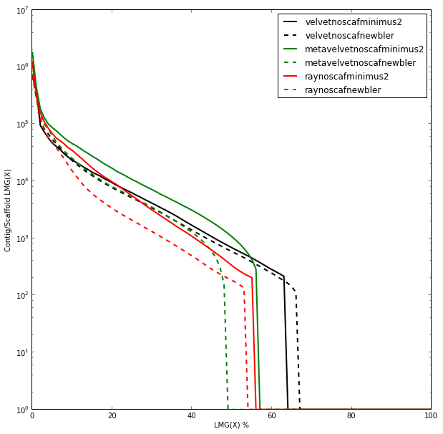
Benchmark Results
contig/scaffold length distribution
Contig
Merge
Contig/Scaffold length
Merging increases lengths and makes length distributions more similar.
L50 before → after
V 665 → 3487 / 2553
M-V 6892 → 43685 / 45085
R 919 → 4076 / 1731
Sum of bases as percentage of ref metagenome length

Slide 23
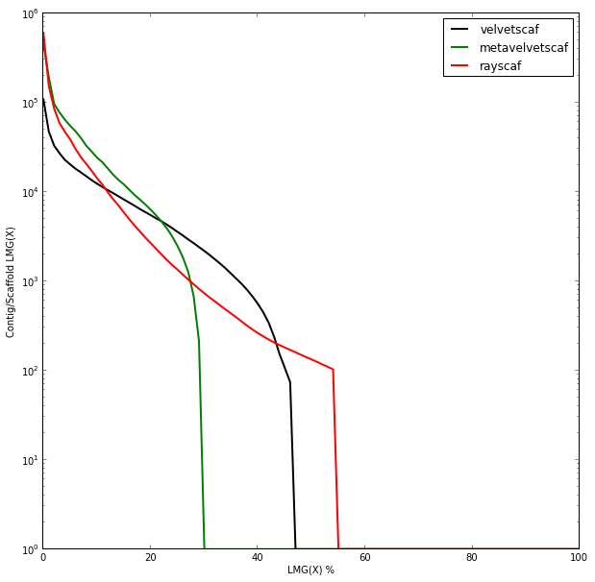
Benchmark Results
contig/scaffold length distribution
Contig
Scaf
Contig/Scaffold length
Scaffolding most notable with Velvet and Meta-Velvet
L50 before → after
V 665 → 4453
M-V 6892 → 12604
R 919 → 1002
Sum of bases as percentage of ref metagenome length

Slide 24
Benchmark Results
contig/scaﬀold coverage of the reference metagenome
  So the length distributions don't say a lot, how much of the reference metagenome is actually covered?

Slide 25
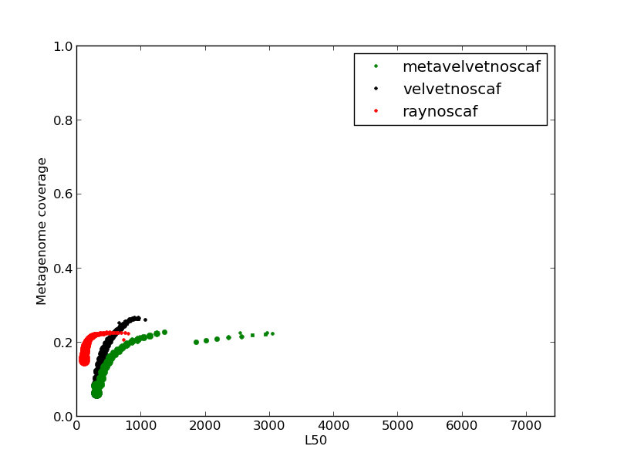
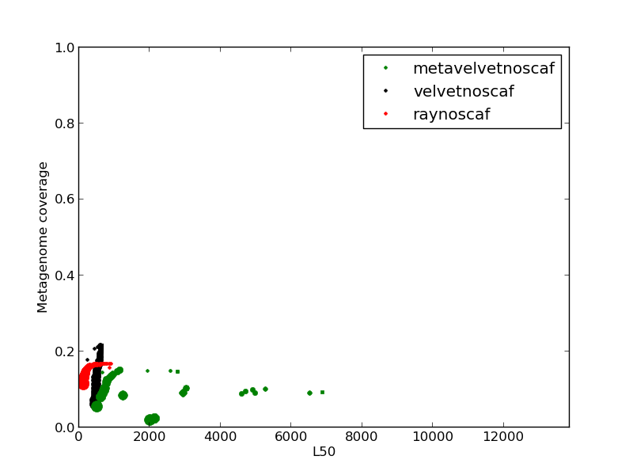
Benchmark Results
contig/scaﬀold coverage of the reference metagenome
Contig
Contig
Metagenome coverage:
Number of non-overlapping bases covered by the assembly expressed as ratio of entire metagenome
Each dot is an assembly
Point size indicates kmer size (21-79)

Slide 26
Benchmark Results
contig/scaﬀold coverage of the reference metagenome
Contig
Contig
Velvet does a good job covering the metagenome.

Slide 27
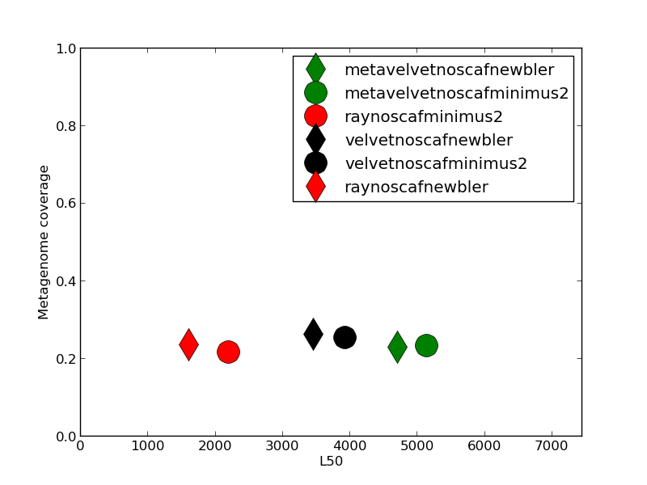
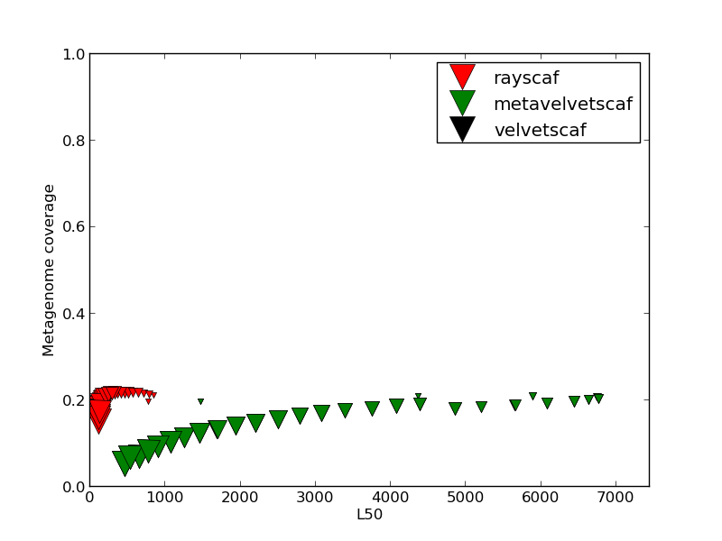
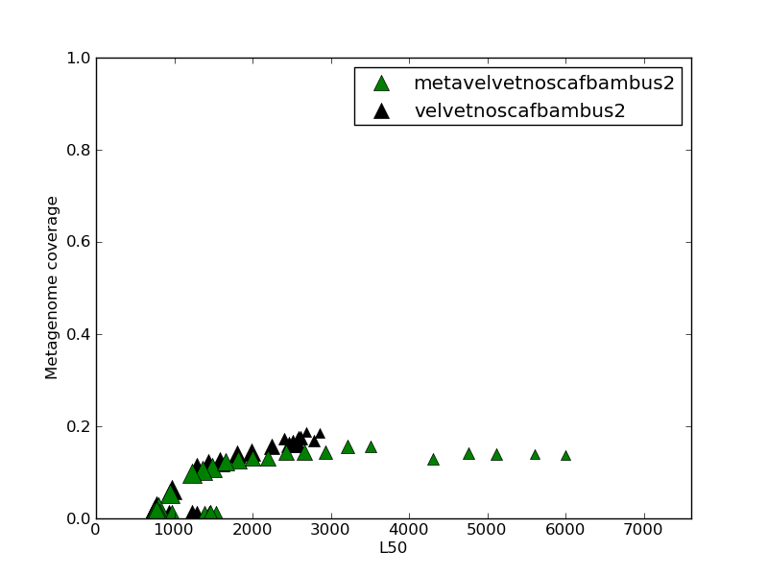
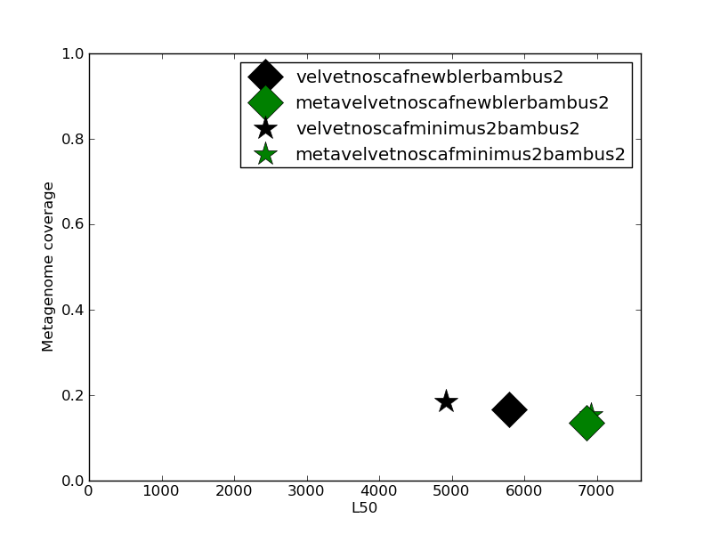
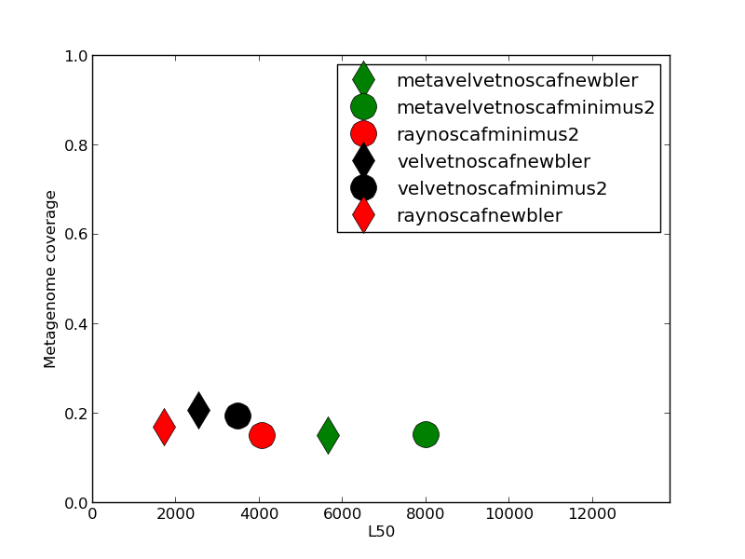
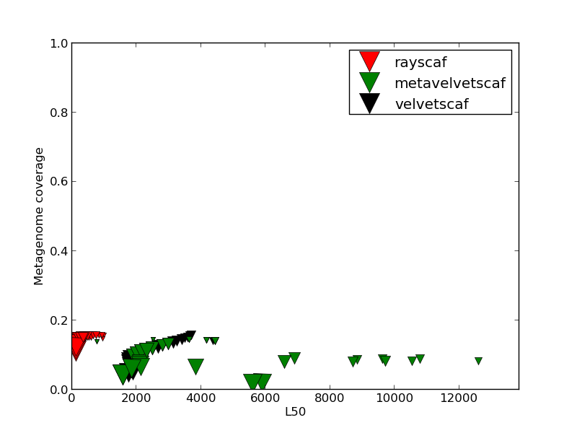
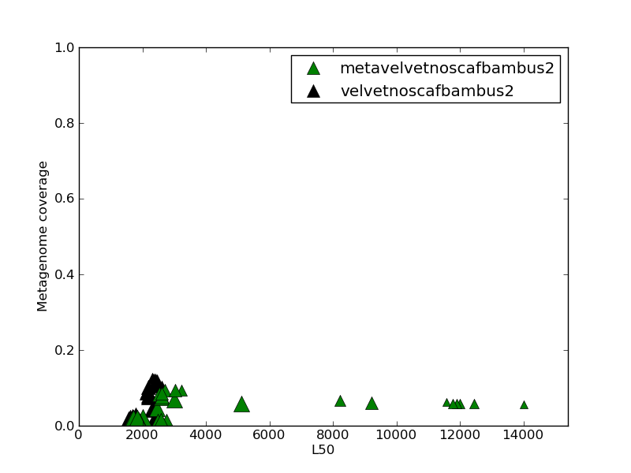
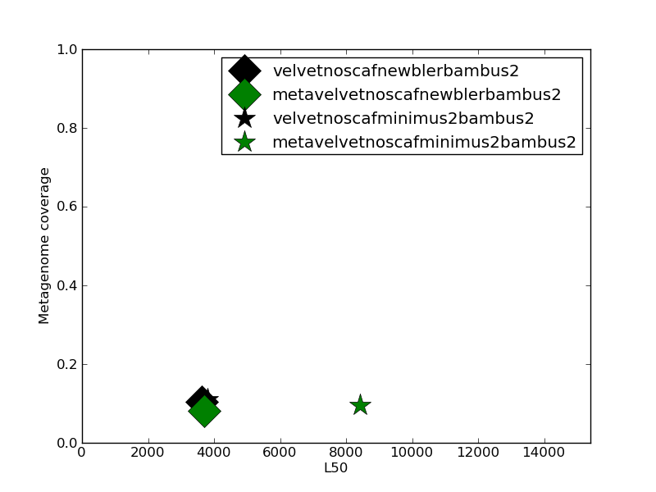
Benchmark Results
contig/scaﬀold coverage of the reference metagenome
Merge
Scaf
Bambus2
Merge-Bambus2
Merge
Scaf
Bambus2
Merge-Bambus2

Slide 28
Benchmark Results
contig/scaﬀold coverage of the reference metagenome
Merge
Scaf
Bambus2
Merge-Bambus2
Merge
Scaf
Bambus2
Merge-Bambus2
Merging increases length while keeping coverage high. Still original Velvet contigs win overal

Slide 29
Benchmark Results
chimericity and erroneousness of the contigs/scaﬀolds
  If lengths increase, but coverage doesn't. Do we have duplicate contigs or erroneous contigs?

Slide 30
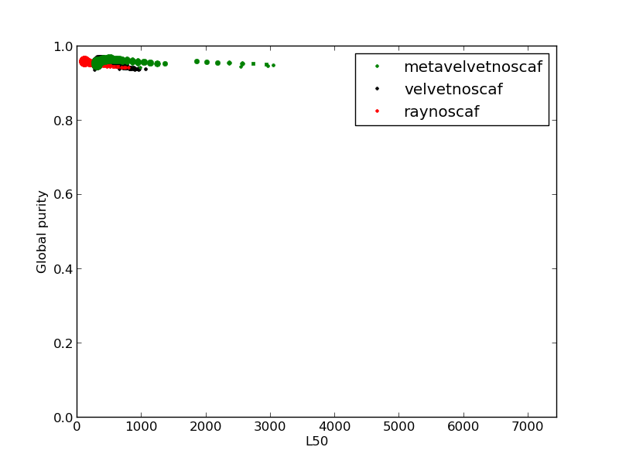
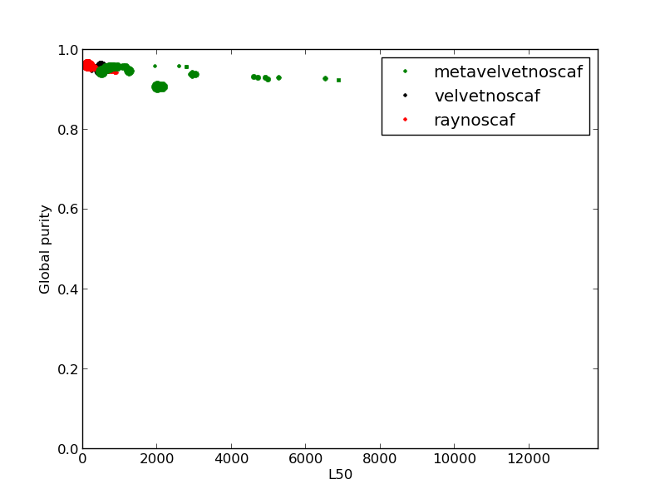
Benchmark Results
chimericity and erroneousness of the contigs/scaﬀolds
Contig
Contig
∑
Global purity:
# bases in best alignment contig
total nr of bases assembly
Each dot is an assembly
Point size indicates kmer size (21-79)
contigs

Slide 31
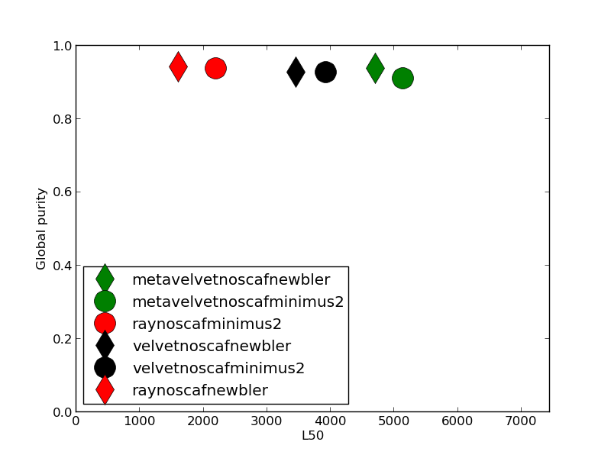
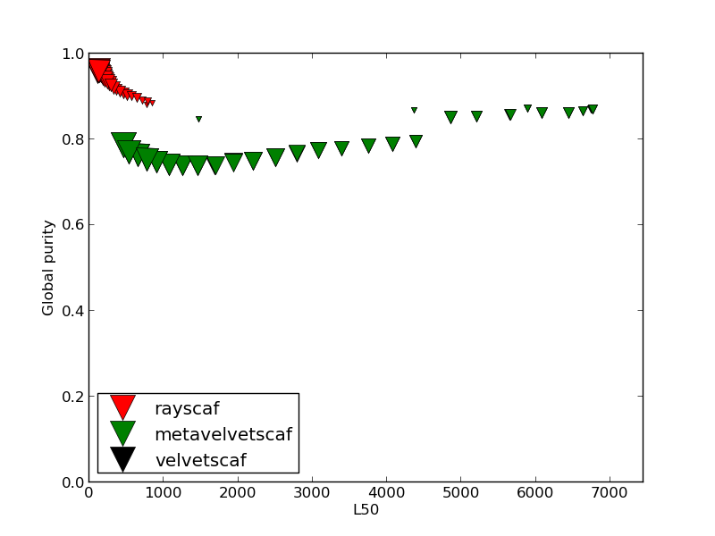
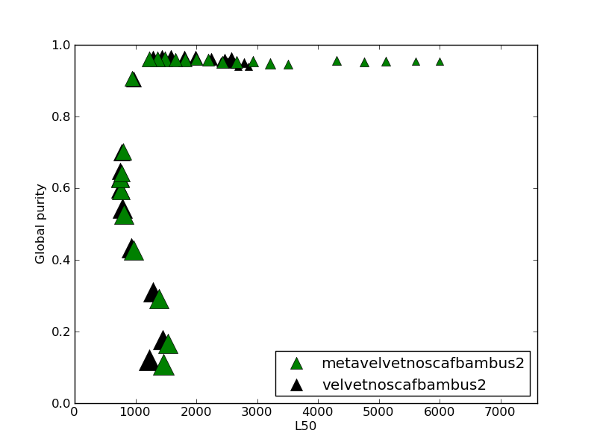
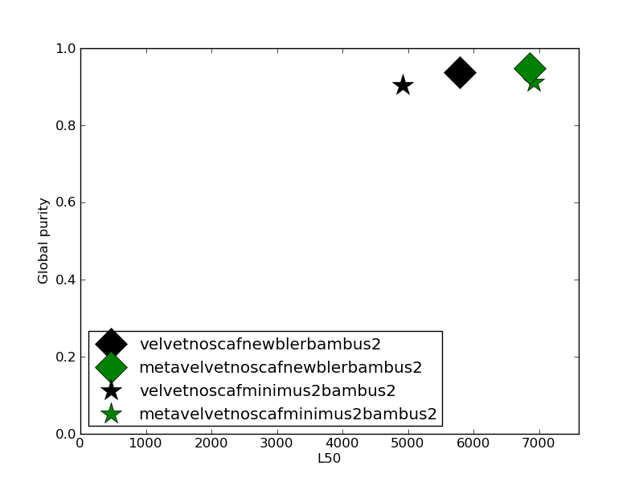
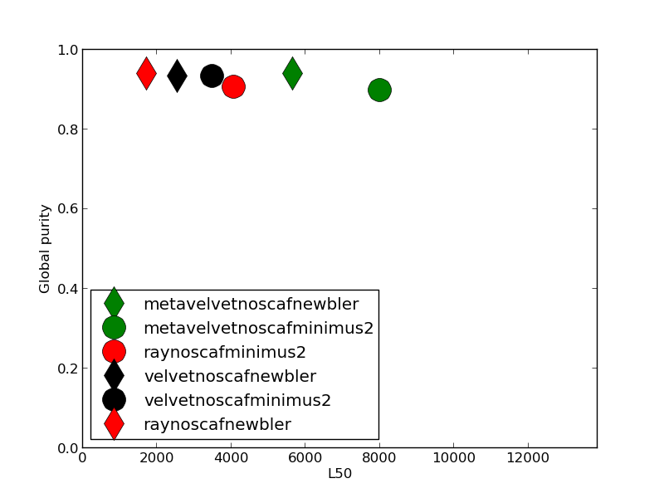
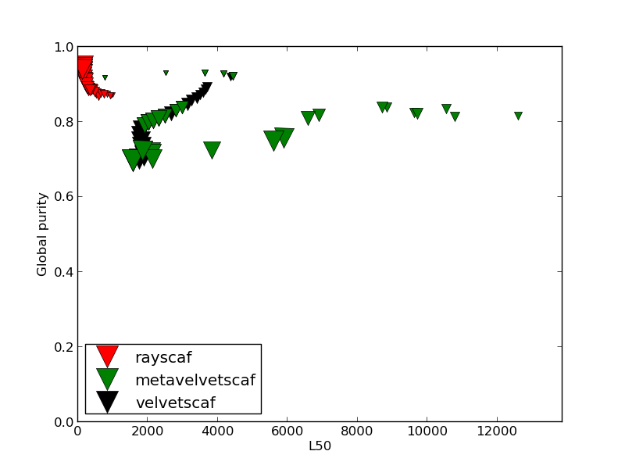
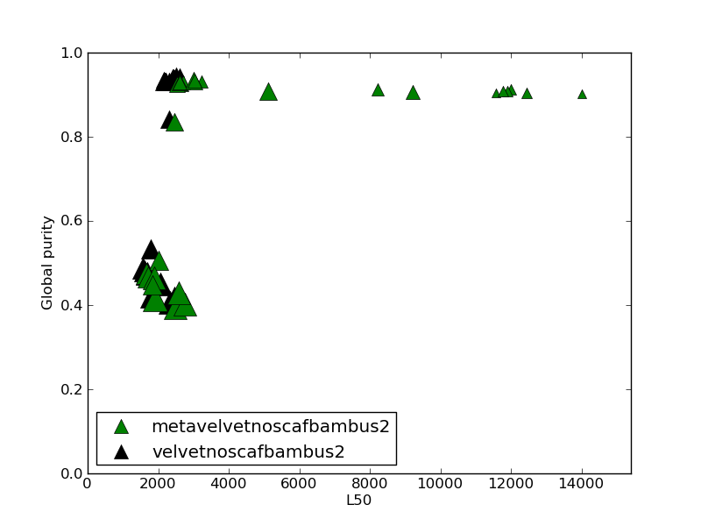
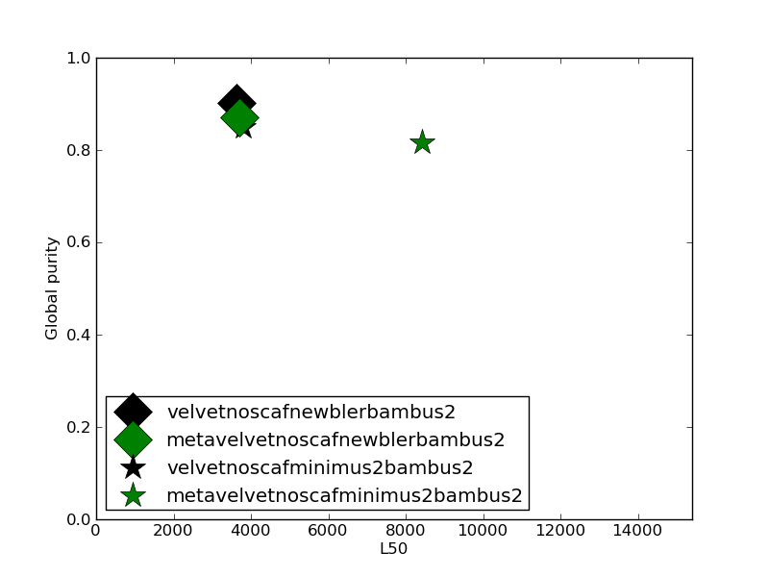
Benchmark Results
chimericity and erroneousness of the contigs/scaﬀolds
Merge
Scaf
Bambus2
Merge-Bambus2
Merge
Scaf
Bambus2
Merge-bambus2

Slide 32
Benchmark Results
chimericity and erroneousness of the contigs/scaﬀolds
Merge
Scaf
Bambus2
Merge-Bambus2
Merge
Scaf
Bambus2
Merge-bambus2
Ergo, Merging and Bambus2 both perform well purity-wise

Slide 33
Conclusions
Difficult to name one true winner. Depends on what the post-processing will be like
  Velvet provides good coverage of the metagenome at cost of length
  Meta-Velvet improves length at a substantial cost of purity and coverage of the meta-genome
  Ray seems middle ground between Velvet and Meta-Velvet
  Merging improves lengths while keeping purity and coverage high
  Internal scaffolding improves lengths at a cost of purity
  Bambus2 scaffolding improves lengths but mostly by throwing away all short contigs (??)

Slide 34
Conclusions
Difficult to name one true winner. Depends on what the post-processing will be like
  If interested in functional annotation: Ray or Velvet. Velvet preferred if annotation works on really short contigs 100-1000 (more coverage of metagenome).
  If only interested in long contigs and less so in their purity, perhaps choose Meta-Velvet.
  Merging seems to work quite well although you lose some metagenome coverage
  Might want to avoid scaffolding since it doesn't work that well
    bambus2 in particular loses a lot of metagenome coverage
    Internal scaffolding works better than bambus2, but merging alone does a better job

Slide 35
Conclusions
Recommendations
  If interested in functional annotation: Ray or Velvet. Velvet preferred if annotation works on really short contigs 100-1000 (more coverage of metagenome).
  If only interested in long contigs and less so in their purity, perhaps choose Meta-Velvet.
  Merging seems to work quite well although you lose some metagenome coverage
  Might want to avoid scaffolding since it doesn't work that well
    bambus2 in particular loses a lot of metagenome coverage
    Internal scaffolding works better than bambus2, but merging alone does a better job

Slide 36
Future work
Try different mock communities, preferably higher covered samples
See how results hold with functional annotation
Compare reference-less validation against this validation
  Compare for instance with Feature Response Curve (Vezzi, 2012)
Make the validation pipeline available as a web service
  Give reference and assemblies, watch the performance of your assembly
  Make your own assembly of existing reference and reads and compare against existing ones

Slide 37
Future work
Try different mock communities, preferably higher covered samples
See how results hold with functional annotation
  How many false positives and true positives versus reference metagenome
  What is an adequate cut-off length to use for the assemblies?
Compare reference-less validation against this validation
  Compare for instance with Feature Response Curve (Vezzi, 2012)
Make the validation pipeline available as a web service
  Give reference and assembly, watch the performance of your assembly
  Make your own assembly of existing reference and reads and compare against existing ones
  Allow users to add their own analysis. For example through ipython notebook

Slide 38
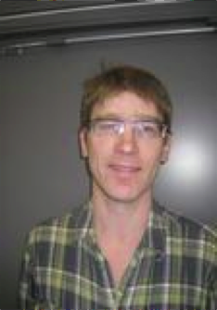


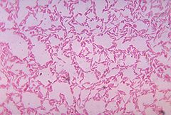
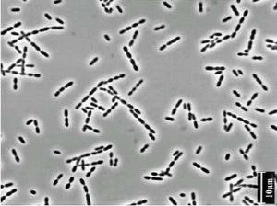
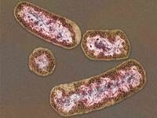




Thanks!
Tack!
Obrigado!
Kiitos!
Teşekkürler!
धन्यवाद!
நன்றி!
Amesegënallô
Hvala!
Gracias!
謝謝
ขอบคุณ
شكرا
I was gonna put your picture as well, but I got lazy so here are some pictures of possibly highly expressed bacteria in your gut instead that I'm equally grateful to

Slide 39
Questions?

