Slide 1
Ray
Ray: Simultaneous Assembly of Reads from a Mix of High-Throughput Sequencing Technologies (2010)
Sébastien Boisvert, François Laviolette, and Jacques Corbeil
Ray Meta: scalable de novo metagenome assembly and profiling (2012)
Sebastien Boisvert, Frederic Raymond, Elenie Godzaridis, Francois Laviolette and Jacques Corbeil

Slide 2
Content
Assembly Intro
Ray on single genomes (2010)
Ray on metagenomes (2012)
Assemblethon 2 Ray results

Slide 3
Assembly intro
Different technologies to sequence your sample
  Sanger (~400-600nt, error rate ~0.001-1.0%)
  454 (~400nt, error rate ~1-4%)
  Illumina (~100nt, error rate ~0.1-1%)
  PacBio (~3k-5knt, error rate ~13-20%)
  Ion Torrent (~200-400nt, error rate ~0.5-2.5%)
Turn reads in to longer contigs or scaffolds
Assembly Goal
  the breadth of coverage (how much of the genome is represented) is maximal
  the number of assembly errors (chimeric contigs, mismatches, insertions, and deletions) is minimal
  the number of contigs is minimal

Slide 4
Assembly intro
Algorithms fit sequencing technologies
Three general approaches
  Overlap-Layout-Concensus (Long reads Celera 2000, Newbler 2005)
  Greedy (Short reads, SSAKE 2007)
  de Bruijn Graph (Short reads, Velvet 2008

Slide 5
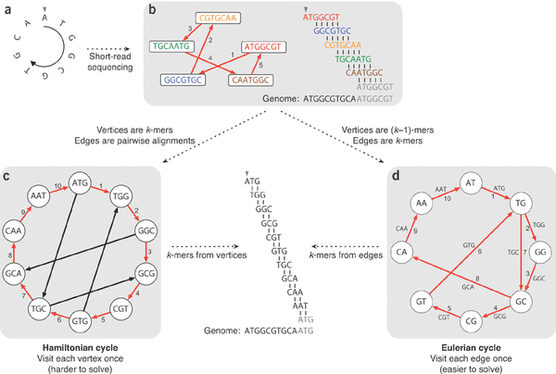
Assembly intro
De Bruijn Graph

Slide 6
Assembly intro
Velvet's most important parameters
  K
    larger K more specific less coverage (span repeats, regions occurring twice, less connections in the graph)
    Smaller K more sensitive more coverage (more connections in the graph)
    Ideally combine both
  Expected coverage
    Low coverage kmers are errors, high coverage repeats
  Coverage cutoff
    Low coverage kmers are errors
Paired read data can be used to determine path in the graph

Slide 7
Ray Single Genomes (2010)
Ray is a de Bruijn Graph assembler
Three reasons for Ray
Parallel, can be run over multiple nodes
  faster real time computation + distributed so memory requirements go down (Message Passing Interface)
Mixed sequencing data (454 and Illumina)
No coverage cut-off like Velvet but an approach that focuses on seed selection with global coverage and seed-extension based on local coverage, reads and paired reads

Slide 8
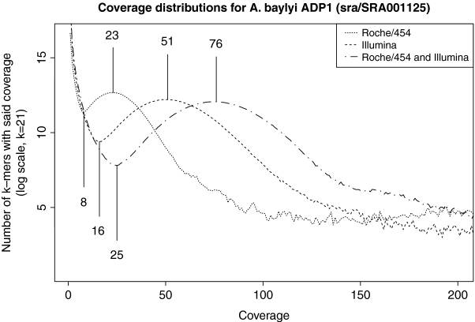
Ray Single Genomes (2010)
2. Figure Mixed sequencing data

Slide 9
Ray Single Genomes (2010)
3. Seeds extension
Select seeds
  Seeds are walks in the graph with a coverage > (c_min + c_peak) / 2 and vertices af indegree and outdegree at most one (basically highly covered unitigs)
Increase seeds based on paired information and/or read information

Slide 10
Ray Single Genomes (2010)
3 criteria to extend path w with vertex y instead of vertex y'
  Multiplier m is confidence required for choice and is based on coverage of vertex
    m=3 for 20 > coverage >= 2
    m=2 for 25 > coverage >= 20
    m=1.3 for coverage > 25
the total amount of reads that overlap y and w is more than m times than the same amount for y′
the number of reads that strongly overlap y and w is more than m times the corresponding value for y′
the read that has the maximal overlap over w and y is more than m times the same value for y′
Same criteria for paired reads, see paired read as one long read

Slide 11
Ray Meta (2012)
Metagenomic sample has different abundances
From Ray to Ray Meta
  Seed selection changed, cov_peak and cov_min now local to unitig (walks with indegree and outdegree at most one)
No graph simplification
  like Meta-Velvet and Meta-IDBA based on coverage and connected components, because the graph is not easily mutable in Ray with its distributed nature
Validated simulated genomes using MUMmer, performed better than Meta-Velvet
  1000 genomes 3 billion reads (101nt), uneven proportions 1024 cores, 1.5 GB per core ~15h (incl profiling)
  100 genomes 400M reads 128 cores, 2 GB per core ~13,5h (incl profiling)

Slide 12
Ray Meta (2012)
Ray Communities
Taxonomic profiling, how abundant is each strain, species genus, etc?
  Color de Bruijn graphs by assigning k-mers to taxon using bacterial genomes in Genbank. (LCA in case of multiple)
  # of kmers x mode coverage of unique kmers = kmer observation
  Express as ratio of total kmer observations = sum coverage all colored kmers
  Compared to using 16S gene some biases are removed, like copy-number of a gene
  Sequencing errors are not very likely to be included due to kmer being more stringent than alignment
Validated with samples from HMP against MetaPhlAn, shows similar accuracy

Slide 13
Ray Meta (2012)
Gene Ontology profiling
  Same k-mer observations as taxonomic profiling but for genes using EMBL nucleotide sequence database and uniprot gene ontology

Slide 14
Ray Meta (2012)
Gene Ontology profiling
  Same k-mer observations as taxonomic profiling but for genes using EMBL nucleotide sequence database and uniprot gene ontology

Slide 15
Single genome validation in Assemblethon 2
How well does single genome Ray perform?
  Assemblethon is a competition for the best single genome assembly.
  N50 length half of bases in assembly is located in contigs of length >= N50 length
  NG50 length half of bases in reference genome is located in contigs of length >= NG50 length
  Show graphs p. 63, 76 and beyond as an indication of assembly quality compared to other assemblers

