Slide 1
Metagenomic Assembly with Ray and Velvet

Slide 2
Content
Assembly Intro
  Velvet
Ray on single genomes (2010)
Ray on metagenomes (2012)
Benchmark Method
Benchmark Conclusions

Slide 3
Assembly intro
Different technologies to sequence your sample
  Sanger (~400-600nt, error rate ~0.001-1.0%)
  454 (~400nt, error rate ~1-4%)
  Illumina (~100nt, error rate ~0.1-1%)
  PacBio (~3k-5knt, error rate ~13-20%)
  Ion Torrent (~200-400nt, error rate ~0.5-2.5%)
Turn reads in to longer contigs or scaffolds
Assembly Goal
  the breadth of coverage (how much of the genome is represented) is maximal
  the number of assembly errors (chimeric contigs, mismatches, insertions, and deletions) is minimal
  the number of contigs is minimal

Slide 4
Assembly intro
Algorithms fit sequencing technologies
Three general approaches
  Overlap-Layout-Consensus (Long reads Celera 2000, Newbler 2005)
  Greedy (Short reads, SSAKE 2007)
  de Bruijn Graph (Short reads, Velvet 2008

Slide 5
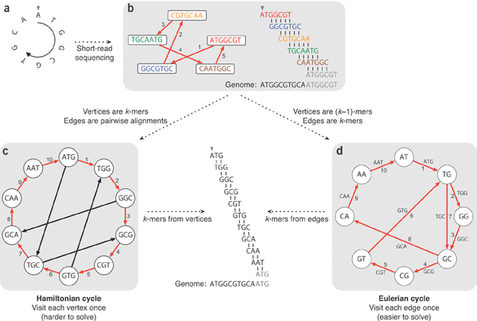
Assembly intro
De Bruijn Graph

Slide 6
Assembly intro
Choosing the right K...
  larger K more specific less coverage (span repeats, regions occurring twice, less connections in the graph)
  Smaller K more sensitive more coverage (more connections in the graph)
  Ideally combine both
De Bruijn Graph potential information available
  Overlap between kmers
  Kmer coverage (how often does a kmer occur)
  Read that created the kmer (choose between paths)
  Insert size distribution between pairs (if paired reads were used)
Programs differ in
  how the graph is stored
  how the graph is traversed

Slide 7
Assembly intro
Metagenomic assembly more difficult than single genome assembly
  Number of genomes unknown (maybe a rough idea)
  Coverage of genomes differs (different abundances of genomes)
  Closely related strains complicate the graph (in de Bruijn: anything that shares stretches of DNA shorter than K)

Slide 8
Assembly intro
Velvet's most important parameters
  K
    larger K more specific less coverage (span repeats, regions occurring twice, less connections in the graph)
    Smaller K more sensitive more coverage (more connections in the graph)
    Ideally combine both
  Expected coverage
    Low coverage kmers are errors, high coverage repeats
  Coverage cutoff
    Low coverage kmers are errors
Paired read data can be used to determine path in the graph

Slide 9
Ray Single Genomes (2010)
Ray is a de Bruijn Graph assembler
Three reasons for Ray
Parallel, can be run over multiple nodes
  faster real time computation + distributed so memory requirements go down (Message Passing Interface)
Mixed sequencing data (454 and Illumina)
No coverage cut-off like Velvet but an approach that focuses on seed selection with global coverage and seed-extension based on local coverage, reads and paired reads

Slide 10
Ray Single Genomes (2010)
Select seeds
  Seeds are walks in the graph with a coverage > (c_min + c_peak) / 2 and vertices af indegree and outdegree at most one (basically highly covered unitigs)
Increase seeds based on paired information and/or read information

Slide 11
Ray Meta (2012)
Metagenomic sample has different abundances
From Ray to Ray Meta
  Seed selection changed, cov_peak and cov_min now local to unitig (walks with indegree and outdegree at most one)
No graph simplification
  like Meta-Velvet and Meta-IDBA based on coverage and connected components, because the graph is not easily mutable in Ray with its distributed nature

Slide 12
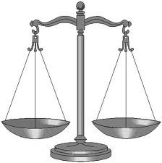

Benchmark Method
Use an in vitro simulated metagenome with known species
  59 species, total size 195Mb
  Two abundance distributions of genomes
    Even, approximately the same genome copy numbers
    Uneven, log-normal distribution of phyla similar to soil
    Assemblies can be validated by aligning them against the reference genomes (we used nucmer for this)
Use Illumina paired end reads since that is currently one of the most popular sequencing techniques for metagenomic samples

Slide 13
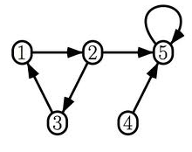

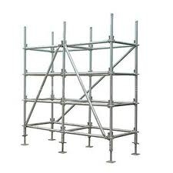

Benchmark Method
Enormous amount of assembly strategies possible
  Select a number of assembly strategies to test
Contiging with
  Velvet
  Meta-Velvet
  Ray
Merging with
  Newbler
  Minimus2
Scaffolding with
  Velvet
  Meta-Velvet
  Ray
  Bambus2

Slide 14
Benchmark Method
Enormous amount of assembly strategies possible
  Select a number of assembly strategies to test
Contiging with
  Velvet
  Meta-Velvet
  Ray
Merging with
  Newbler
  Minimus2
Scaffolding with
  Velvet
  Meta-Velvet
  Ray
  Bambus2

Slide 15
Benchmark Method
Enormous amount of assembly strategies possible
  Select a number of assembly strategies to test
Contiging with
  Velvet
  Meta-Velvet
  Ray
Merging with
  Newbler
  Minimus2
Scaffolding with
  Velvet
  Meta-Velvet
  Ray
  Bambus2

Slide 16
Benchmark Method
Enormous amount of assembly strategies possible
  Select a number of assembly strategies to test
Contiging with
  Velvet
  Meta-Velvet
  Ray
Merging with
  Newbler
  Minimus2
Scaffolding with
  Velvet
  Meta-Velvet
  Ray
  Bambus2

Slide 17
Benchmark Method
Enormous amount of assembly strategies possible
  Select a number of assembly strategies to test
Contiging with
  Velvet
  Meta-Velvet
  Ray
Merging with
  Newbler
  Minimus2
Scaffolding with
  Velvet
  Meta-Velvet
  Ray
  Bambus2

Slide 18
Benchmark Method
Enormous amount of assembly strategies possible
  Select a number of assembly strategies to test
Contiging with
  Velvet
  Meta-Velvet
  Ray
Merging with
  Newbler
  Minimus2
Scaffolding with
  Velvet
  Meta-Velvet
  Ray
  Bambus2
= 3 strategies
= 2 x 3 stragies = 6 strategies
= 3 strategies
= (6 merge + 3 contig ) strategies = 9 strategies
Total of 21 strategies

Slide 19
Benchmark Method
How to compare all these different strategies?
Validation of metagenomic assembly often focuses on one or more of the following points:
  contig/scaﬀold length distribution
  contig/scaﬀold coverage of the reference metagenome
  chimericity and erroneousness of the contigs/scaﬀolds
  functional annotation
  phylogenetic classiﬁcation
We focus on the first three since those also tend to improve 4 and 5 as shown by Mende et al (2012)
Select winner in three categories

Slide 20
Conclusions
Difficult to name one true winner. Depends on what the post-processing will be like
  If short contigs useful: Ray or Velvet. Velvet preferred if really short contigs 100-1000 (more coverage of metagenome).
  If only interested in long contigs and less so in their purity, perhaps choose Meta-Velvet.
  Merging seems to work quite well although you lose some metagenome coverage
  Might want to avoid scaffolding since it doesn't work that well
    bambus2 in particular loses a lot of metagenome coverage
    Internal scaffolding works better than bambus2, but merging alone does a better job

Slide 21
Future work
See how results hold with functional annotation
  How many false positives and true positives versus reference metagenome
  What is an adequate cut-off length to use for the assemblies? (700 with Prodigal)
Compare reference-less validation against this validation
  Compare for instance with Feature Response Curve (Vezzi, 2012)
Make the validation pipeline available as a web service

