Slide 1
Algorithms and Algorithm Analysis
The “fun” stuff

Slide 2
Algorithms
What is an algorithm?
A finite set of steps that specify a sequence of operations to be carried out in order to solve a specific problem.

Slide 3
Properties of Algorithms
Finiteness
Absence of Ambiguity
Definition of Sequence
Feasibility
Input
Output

Slide 4
What is Programming?
Phases of Programming
  Design
  Implementation
  Testing
  Repeating

Slide 5
Algorithm vs. Programs
A computer program is one concrete implementation of an algorithm using a particular computer language
The design phase should produce an algorithm
The implementation phase should produce a program
The design phase is typically much longer than the programming phase

Slide 6
Algorithm Performance
It would be great if you could code up an algorithm and then run it with a bunch of input.
Take a look at the clock and decide how well it ran
There are many problems with this approach and it suffices to say that this is bad

Slide 7
A better way
What is often done is to approximate or estimate the performance of an algorithm
Estimation is an important skill to learn and to use
Question: How many hotdogs tall is the Empire State Building?

Slide 8
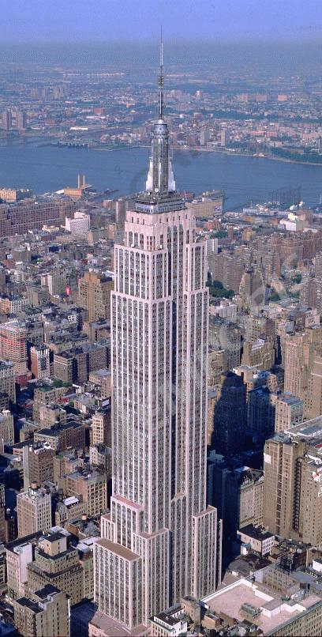
Example
Question: How many hotdogs tall is the Empire State Building?
Answer: The ESB is 1250 feet tall.
Assuming that a hotdog is 6 inches from end to end, you would need, 1250 * 2 = 2500 hotdogs.

Slide 9
Complexity Analysis
An objective way to evaluate the cost of an algorithm or code section.
The cost is computed in terms of space or time, usually
The goal is to have a meaningful way to compare algorithms based on a common measure.
Complexity analysis has two phases,
  Algorithm analysis
  Complexity analysis

Slide 10
Algorithm Analysis
Algorithm analysis requires a set of rules to determine how operations are to be counted.
There is no generally accepted set of rules for algorithm analysis.
In some cases, an exact count of operations is desired; in other cases, a general approximation is sufficient.
The rules presented that follow are typical of those intended to produce an exact count of operations.

Slide 11
Rules
We assume an arbitrary time unit.
Execution of one of the following operations takes time 1:
  assignment operation
  single I/O operations
  single Boolean operations, numeric comparisons
  single arithmetic operations
  function return
  array index operations, pointer dereferences

Slide 12
More Rules
Running time of a selection statement (if, switch) is the time for the condition evaluation + the maximum of the running times for the individual clauses in the selection.
Loop execution time is the sum, over the number of times the loop is executed, of the body time + time for the loop check and update operations, + time for the loop setup.
  † Always assume that the loop executes the maximum number of iterations possible
Running time of a function call is 1 for setup + the time for any parameter calculations + the time required for the execution of the function body.

Slide 13
Example
Sum = 0;
In >> Value;
while ( In )
{
  if ( Value < 0 )
  {
    Sum = -Sum;
    Sum = Sum + Value;
  }else {
    Sum = Sum + Value;
  }
  In >> Value;
}

