Slide 1
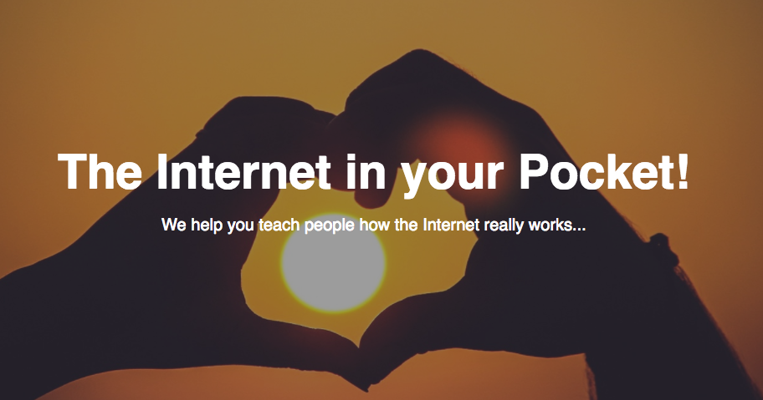
Pocket_Internet

Slide 2
Overall idea
Create a highly automated lab environment to
resemble basic Internet connectivity and services
Based mostly on a virtualized environment,
with the ability to break out to the physical world
Offer IPv4, IPv4+IPv6 and IPv6-only environments,
so trainees understand and can experience the difference
Based on a modular architecture so that
different lab environments can be set up

Slide 3
Fundamentals
Docker + automation is used to create repeatable lab setups
Create a single backbone for interconnects
Define modular PODs of different type to connect to this backbone
POD to POD communication is via BGP routing (defines the topology)

Slide 4
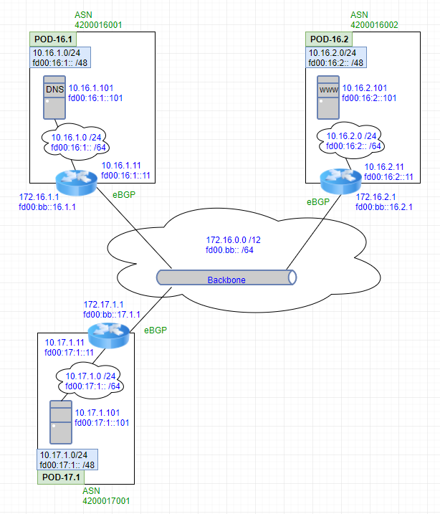
Simple example:
Three PODs:
  One with a DNS server
  One with a http server
  One with a client
All PODs with just a
single backbone router
Dual-stack setup with
IPv4 + IPv6

Slide 5
Addressing + DNS names
Each interface (for routers & server instances)
can have IPv4, IPv6 or both configured
DNS names are pre-configured for every interface,
one for dual-stack (resolving as AAAA + A)
and one each for v4 and v6 (resolving as A, or AAAA only)
Naming is specific per POD, with an
addtl. global domain for cross-POD testing

Slide 6



Container instances
Defined base container image, including network tools (traceroute, curl,... )
Every container is based on that.
For the initial setup:
  Routing containers run BIRD
  [due to BIRDs restrictions, there is one container for BIRD4 and one for BIRD6]
  DNS container runs BIND
  www container runs NGNIX
  Client container offers SSH

Slide 7
Build-process
Proof-of-concept builds with docker-compose through a yaml file
  Creates the backbone and POD networks
  Instantiates all containers and connects them to the right networks
Started work on defining the lab setup through a config file,
which specifies the logic of a lab:
  How many and which kind of PODs
  Specify peering relationships
  Specify protocol (dual-stack, IPv4, IPv6-only)

Slide 8
Use case examples
Simple dual-stack BGP lab, checking out BIRD and routing
Advanced routing workshops with filters, route policies, …
IXP, how does an internet exchange work
DNS, how name resolution enables migration to IPv6

Slide 9
Evolution
Define more complex PODs, such as simulating an ISP
Define IPv6 transition PODs, such as one for NAT64
Define an exit-node, which can link the virtual environment out
to a physical network, so that real hardware can be also used for testing, such as client OSes, network hardware, ...
Still need more automation, i.e. to create DNS zone files.
Create a front-end for ease of lab setup

Slide 10
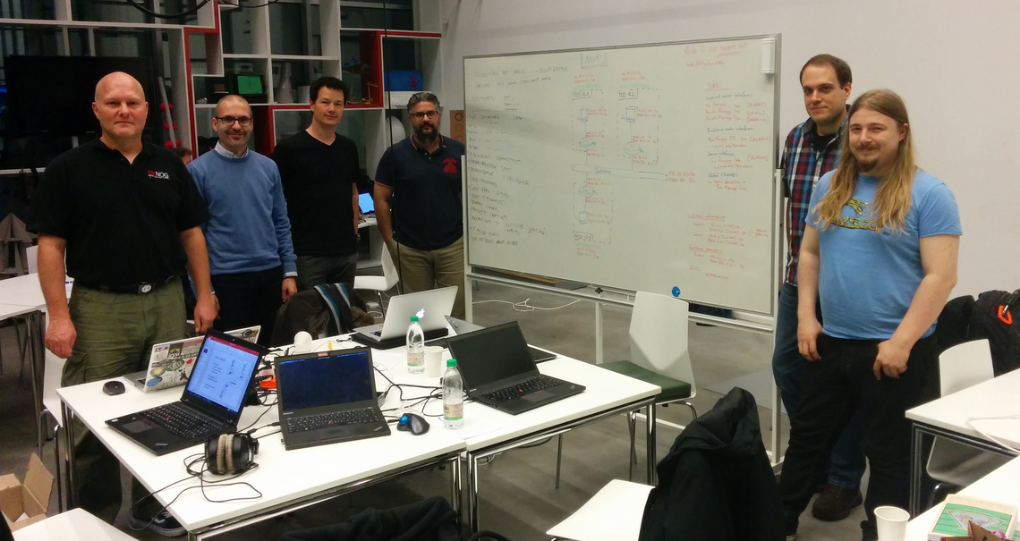
Not the end of the story...
;-)
Contributors:
  Cristian Sirbu
  Evangelos Balaskas
  Henrik Kramshøj
Harry Reeder
Samer Lahoud
  Andy Mindnich

