Slide 1
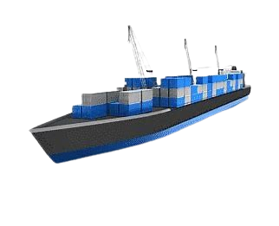

BlockVoyage: Revolutionizing Shipping with Blockchain Technology
Team Defenders

Slide 2
Project purpose
The purpose of the Blockchain-Powered shipping plattform is to create an advanced shipping system that leverages blockchain and ICP technologies to enhance the security, transparency, and privacy of the product shipment. By doing so, the project aims to overcome challenges in traditional shipping, fostering trust and inclusivity in product shipment.

Slide 3
BlockVoyage shipping system
The Internet Computer Protocol (ICP) is a revolutionary technology that expands the functionality of the public internet. It allows developers to build and host software systems directly on the internet, eliminating the need for traditional servers or commercial cloud services.
We are creating a blockchain shipping on the ICP for several reasons:

Slide 4
We are leveraging ICP for our blockchain shipping platform for the following reasons:
Decentralization: ICP operates on a decentralized network, ensuring that our application is not dependent on any single entity, which enhances security and trust.
Scalability: The platform can seamlessly scale to accommodate increased user demands and transaction volumes without sacrificing performance.
Security: Built-in cryptographic features provide a high level of security for data storage and transactions, protecting sensitive shipping information.
Cost Efficiency: By eliminating the need for traditional infrastructure, ICP reduces operational costs, allowing us to allocate resources more effectively.
Enhanced Performance: ICP enables faster execution of smart contracts, leading to quicker transaction processing and improved user experience.
Interoperability: The platform facilitates easy integration with existing systems and protocols, promoting a more versatile and adaptable shipping solution.

Slide 5
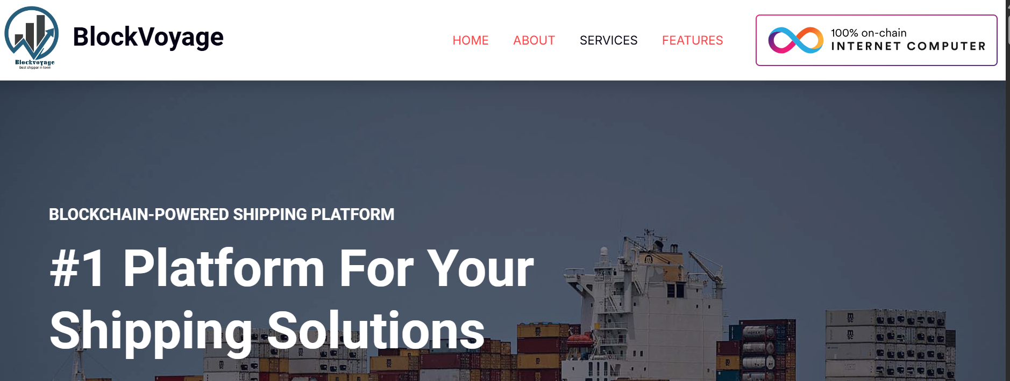
How the shipping with Blockchain works

Slide 6
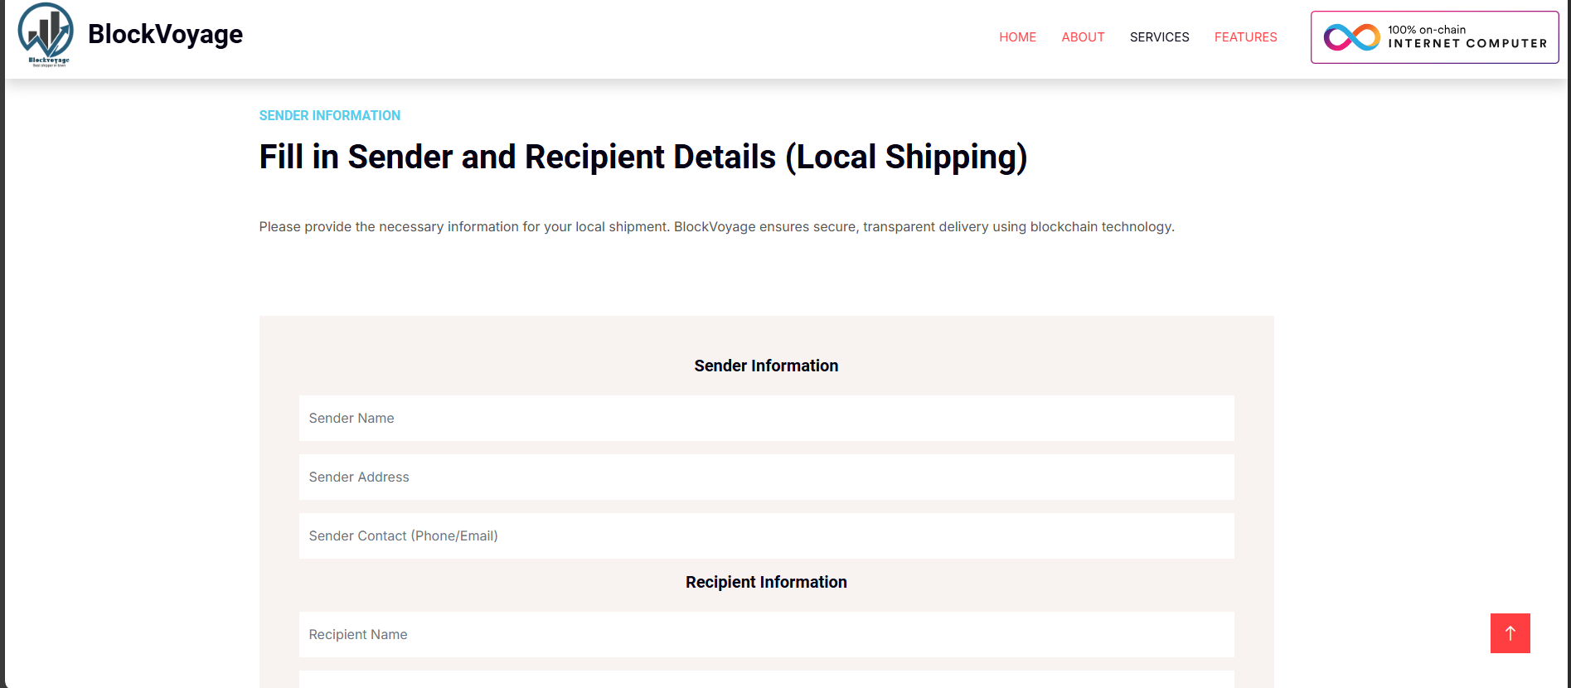
Local Shipping Process
Utilizes smart contracts integrated with the ICP blockchain for enhanced security and transparency.
Enables quick and efficient processing of local shipments.
Facilitates tracking and verification of shipments in real time.

Slide 7
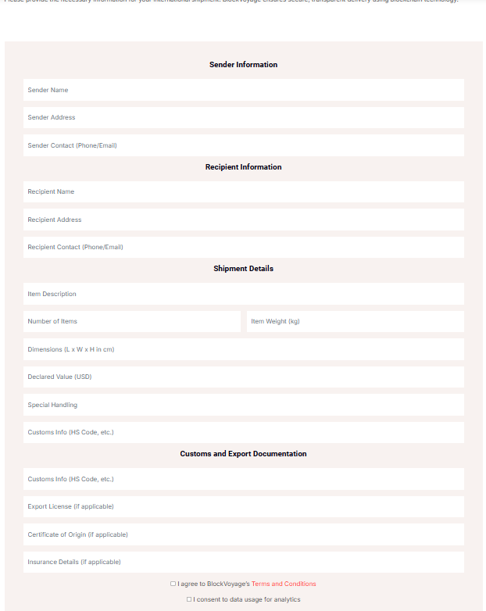
International Shipping Parameters
Sender Information:
Sender Name
Sender Address
Sender Contact (Phone/Email)
Recipient Information:
Recipient Name
Recipient Address
Recipient Contact (Phone/Email)
Shipment Details:
Item Description
Item Category
Number of Items
Item Weight (kg)
Dimensions (L x W x H in cm)
Declared Value (USD)
Special Handling
Customs Info (HS Code, etc.)ss

Slide 8
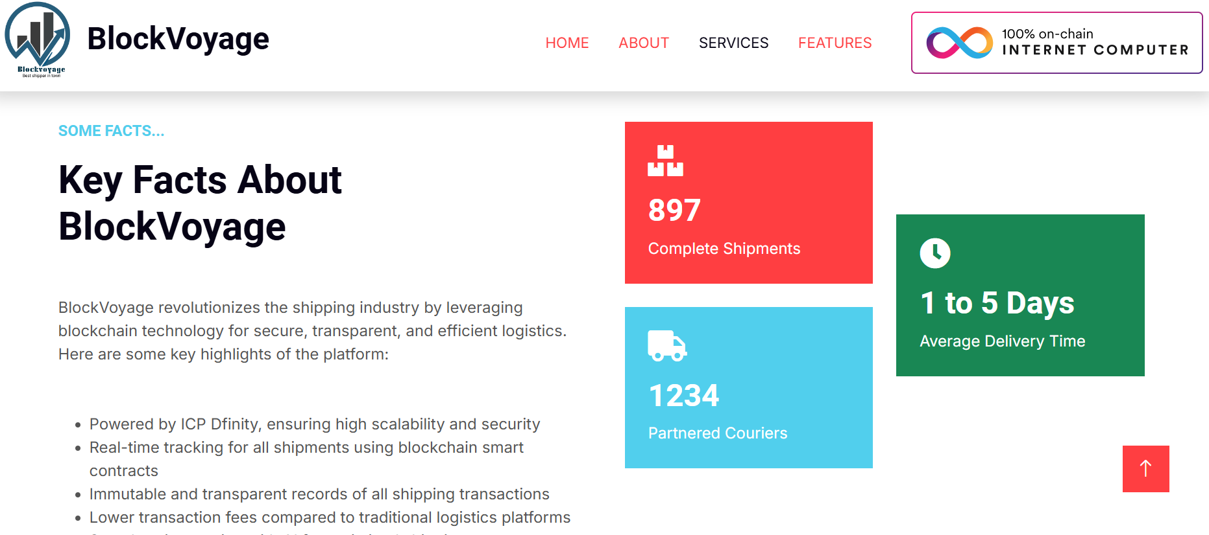
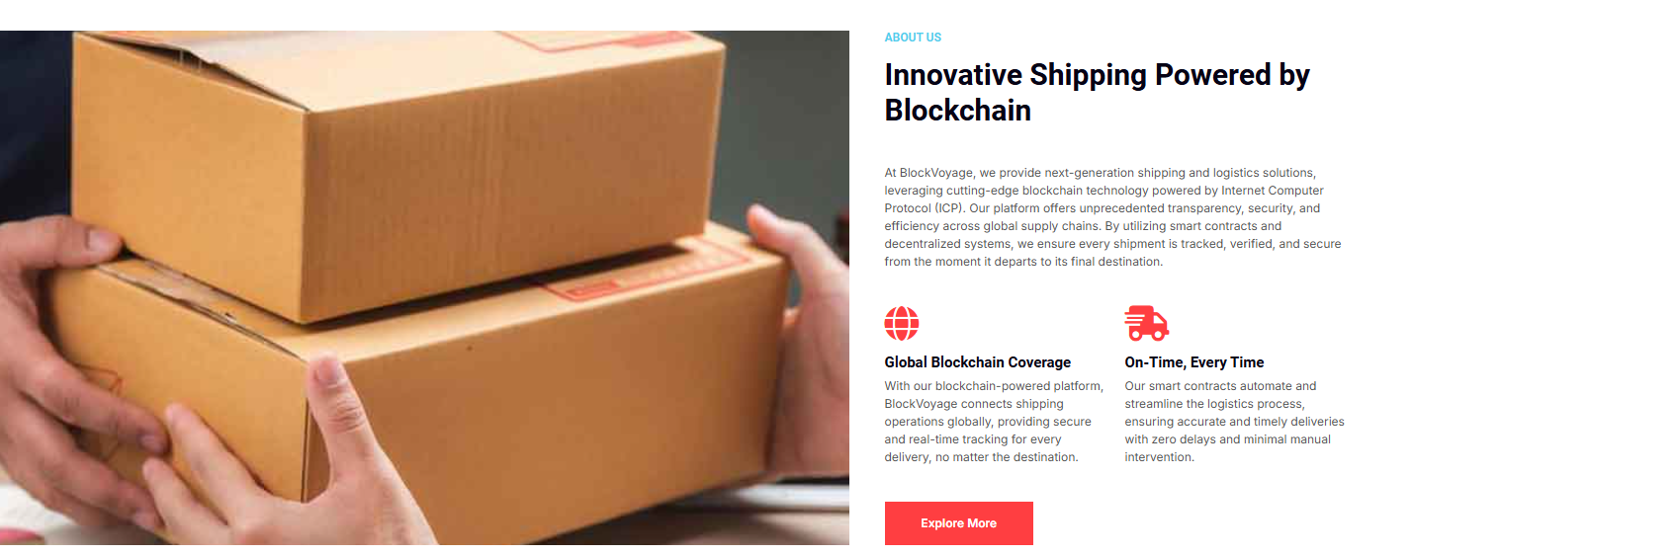
About BlockVoyage shipping plattform
At BlockVoyage, we leverage blockchain technology powered by the Internet Computer Protocol (ICP) to offer unprecedented transparency, security, and efficiency across global supply chains.
Our platform ensures that every shipment is tracked, verified, and secure from the moment it departs to its final destination
.

Slide 9
Key facts on Blockvoyage

Slide 10
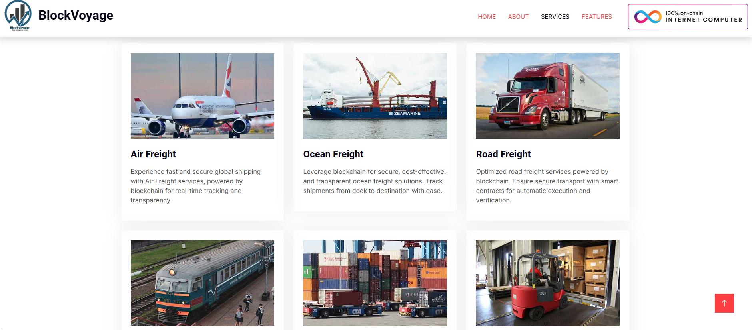
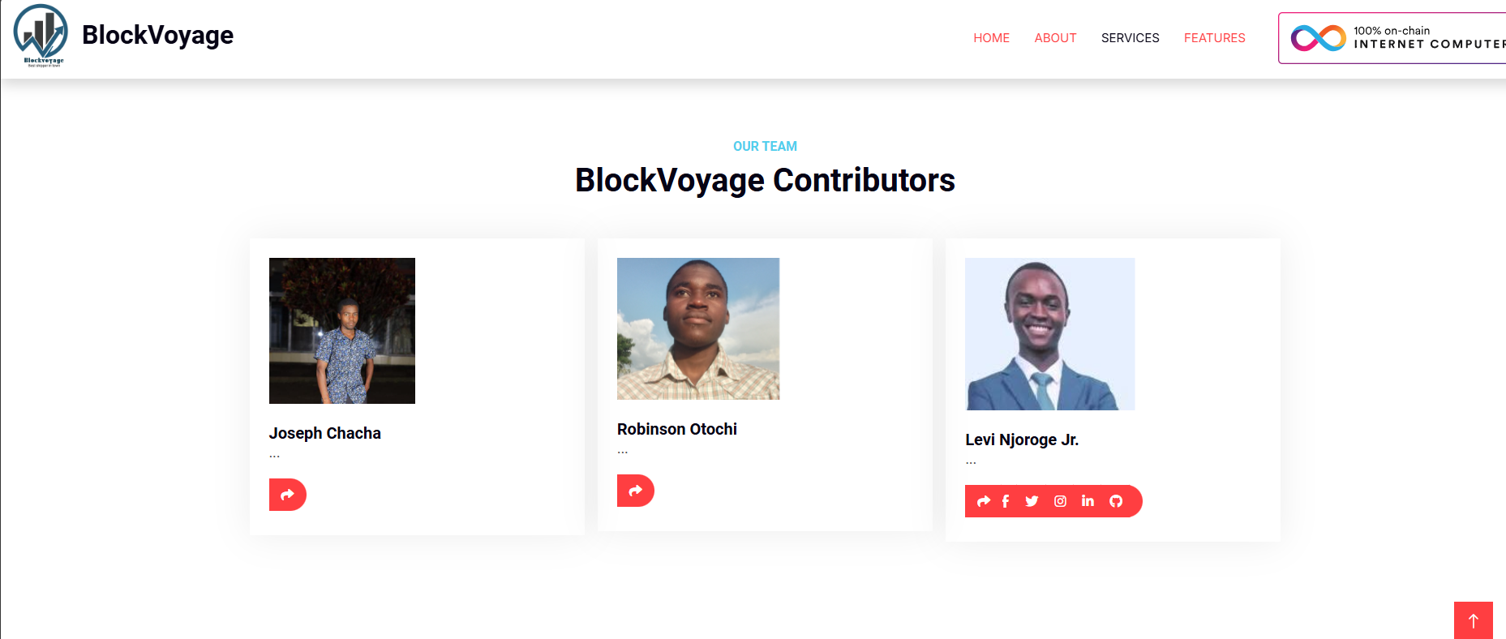

Slide 11
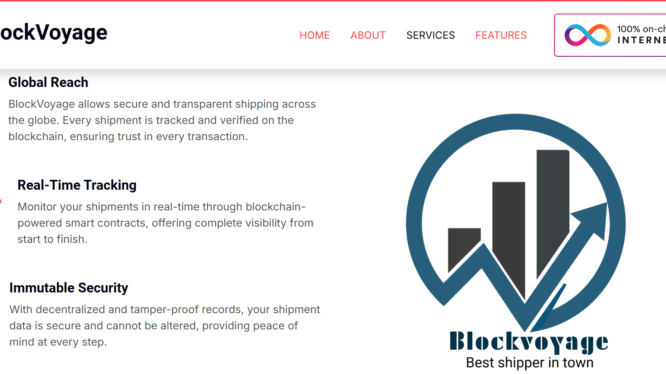
Blockvoyage caption
Powered by IP

