Slide 1
Conda Hands-on
7 June 2024
Conda is a powerful command line tool for package and environment management that runs on Windows, macOS, and Linux.
Conda can install entire software stacks such as Python, Python packages, R, R libraries, Java programs, C and C++ programs and libraries, Perl programs. It can be adapted for many use cases, but it is mainly oriented towards the scientific community.
Conda can install complex software stacks on a system without needing root privileges.

Slide 2
Two keywords you need to be familiar with before starting: environment and channel
Environment: A collection of packages (libraries, programs, etc…). Conda organizes the packages that you install into “environments”. A package can be part of different environments. You create an environment by specifying the software you would like to have. When you activate the environment, you can use the packages you have installed freely. When you deactivate it, your system will revert to its original state.
Environments give you the opportunity to test multiple versions of a software avoiding conflicts. It is also a good idea to have a separate environment for each of your projects.

Slide 3
Channels are the remote locations where packages are stored and that you can use to download them on your computer.
By default, packages are automatically downloaded and updated from the default channel, curated, built, maintained, and served by Anaconda (a software company)
Another channel that we will use is conda-forge, that is instead a channel managed by a community. This channel contains the Copernicus Marine Service Toolbox that we are going to install.

Slide 4
Let’s start! We will now install conda and anaconda-navigator, a tool to administrate the conda environments.
Open the following web page:
https://docs.anaconda.com/free/miniconda/
and download an appropriate installer for your system.
Windows users: Start the executable program
Mac / Linux users: Execute the script inside a console

Slide 5
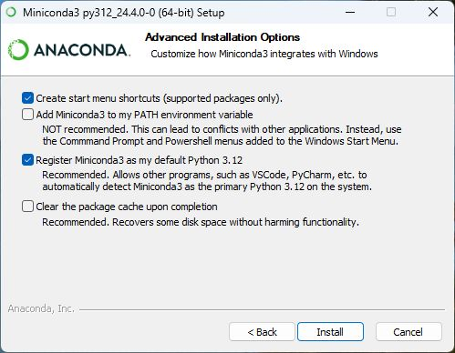
Windows users: Choose the default options

Slide 6
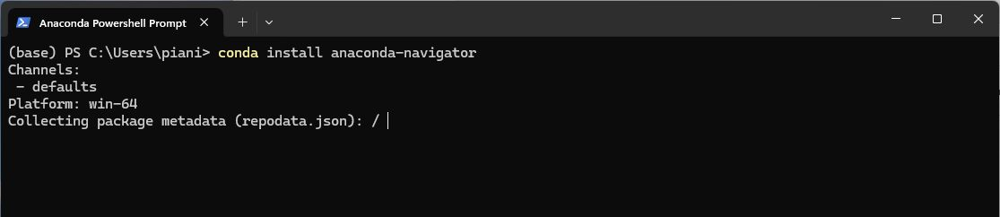
Windows users:
Once the installation is complete, start the anaconda powershell prompt and run:
conda install anaconda-navigator
to install the navigator. This is the application that we will use to administrate conda

Slide 7
Mac / Linux users:
Execute the script:
Accept the license
Choose a path for the installation (usually, the default is fine)
Do NOT execute conda init (choose no)
Mac / Linux users:
In the last part of the text written by the installation script, there is the command to activate conda; it is something like
eval "$(MINICONDAPATH/bin/conda shell.YOUR_SHELL_NAME hook)"
Execute this command to activate conda. Substitute MINICONDAPATH with the path where you have installed conda and YOUR_SHELL_NAME with the name of your shell (usually, bash or zsh). If you don’t know what shell you are using, just type:
echo $SHELL

Slide 8
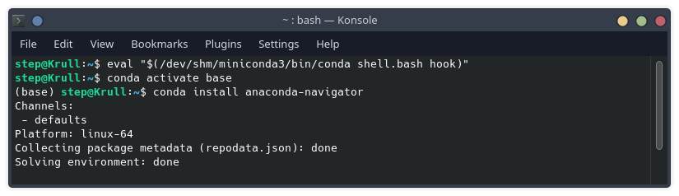
Mac / Linux users:
Do not forget the command that you used to activate conda, because you will need that command every time you want to use conda.
Now run the following commands to install the anaconda-navigator:
conda activate base
conda install anaconda-navigator
anaconda-navigator

Slide 9
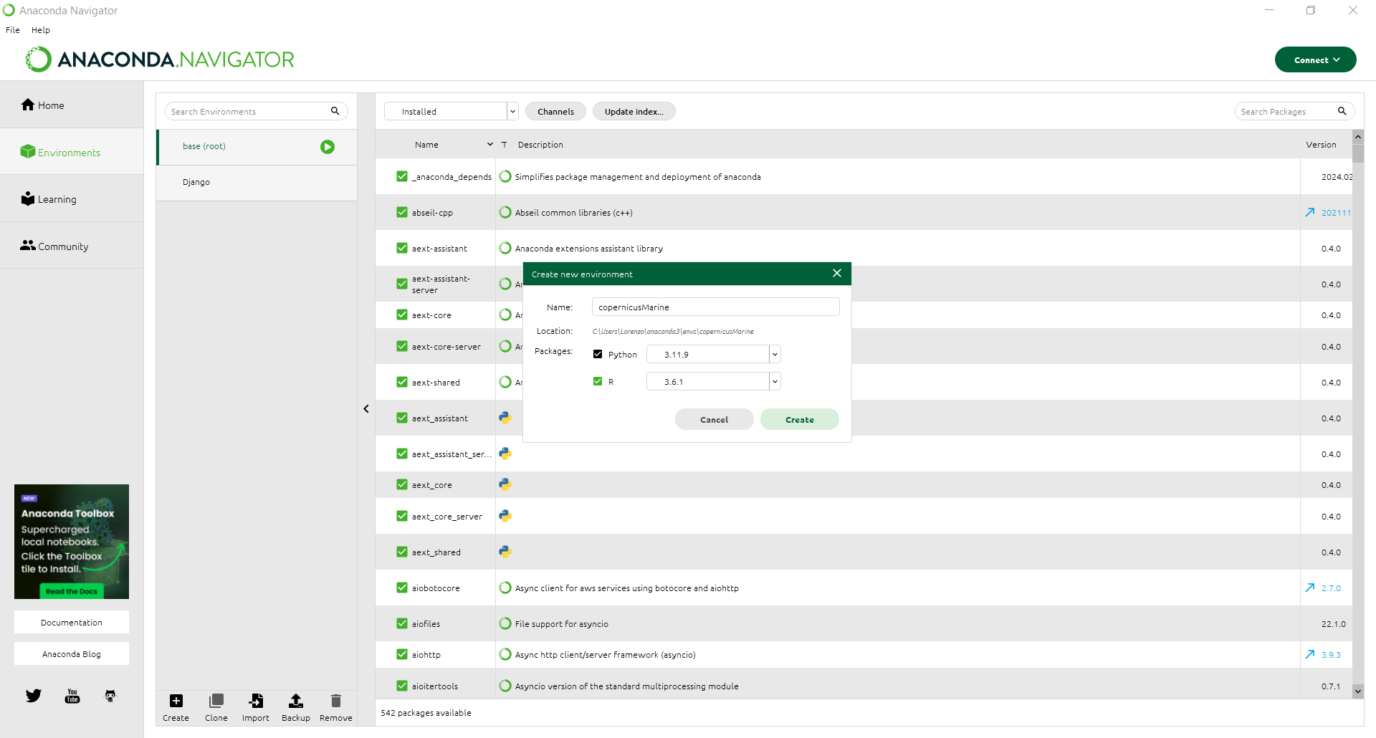
Create a new environment called “copernicusmarine” (for example) with Python and R
1
2

Slide 10
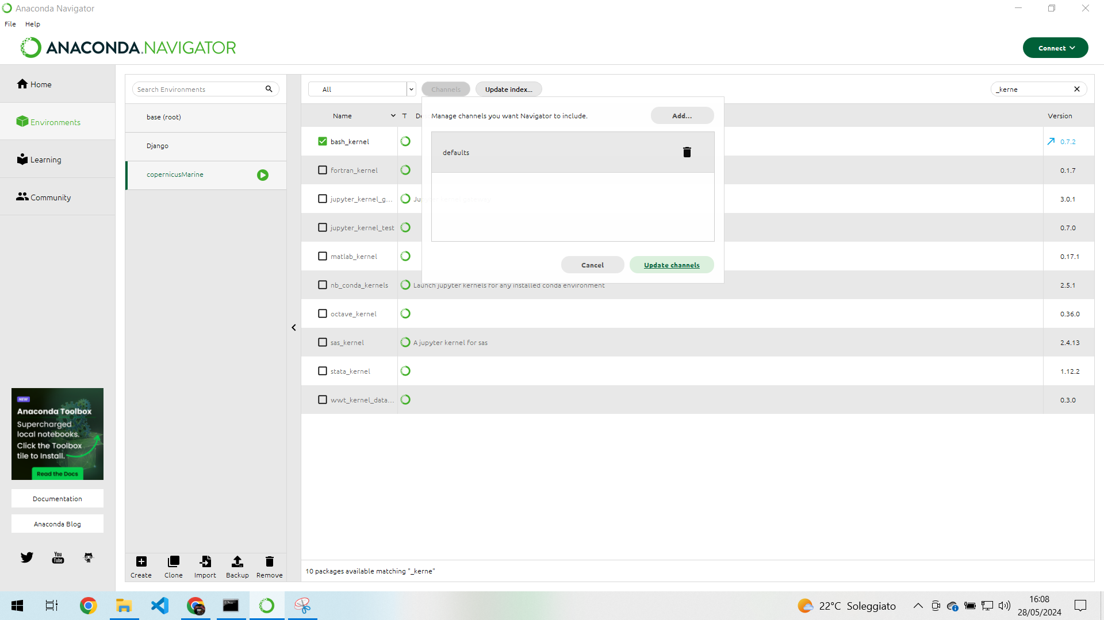
Add a new channel named “conda-forge” (this time the name is mandatory)
2
3
1

Slide 11
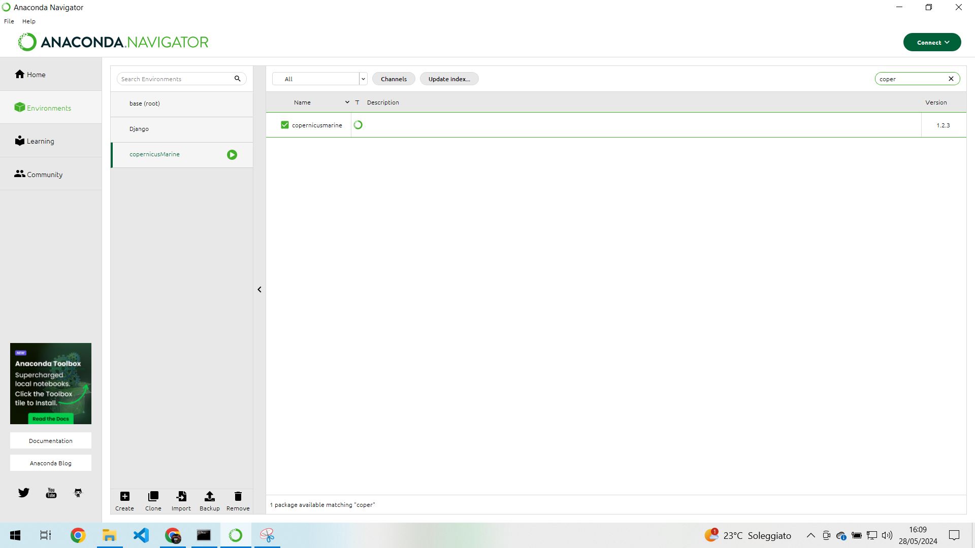
Search for the “copernicusmarine” package on the right and install it inside your current environment
2
1
3

Slide 12
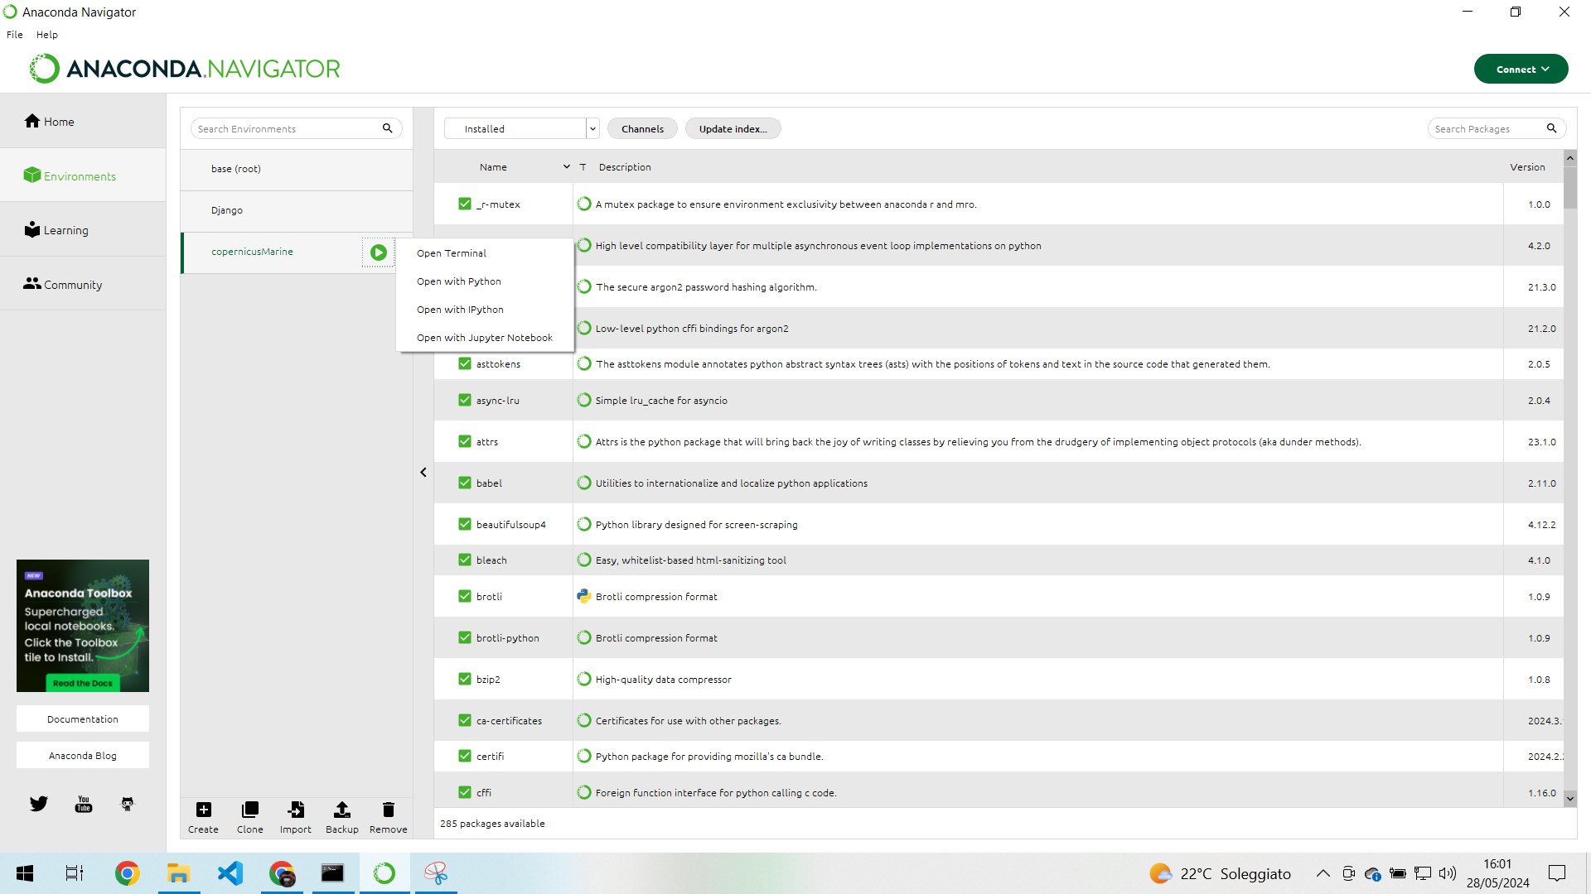
Start a jupyter notebook inside your new environment
1
2

