Slide 1
Data Analysis Technical Skills Demonstration
By: Peter Ugbashi

Slide 2
Contents
Scenario/Problem Statement
Dataset Description
Tools & Techniques Employed
Analysis Performed (including code)
Results Generated (Dashboard)
Improvement
Summary
Q & A

Slide 3
Scenario/Problem Statement
Assumed role: Data Analyst working for a charity organisation
Task: present data to provide insight into donation trends with the view to help the charity address the following objectives:
Increase number of donors in database
Increase donation frequency of donors
Increase the value of donations received from donors
Problem statement: How can a charity organisation attract even greater flow of donations to support its charitable
efforts?

Slide 4
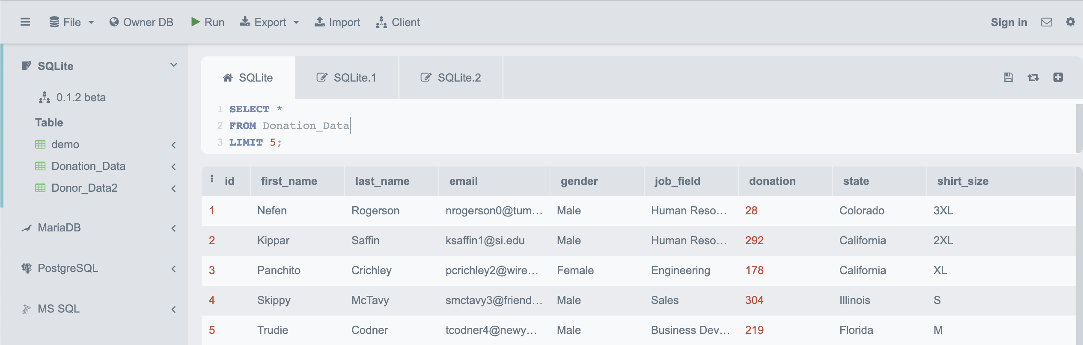
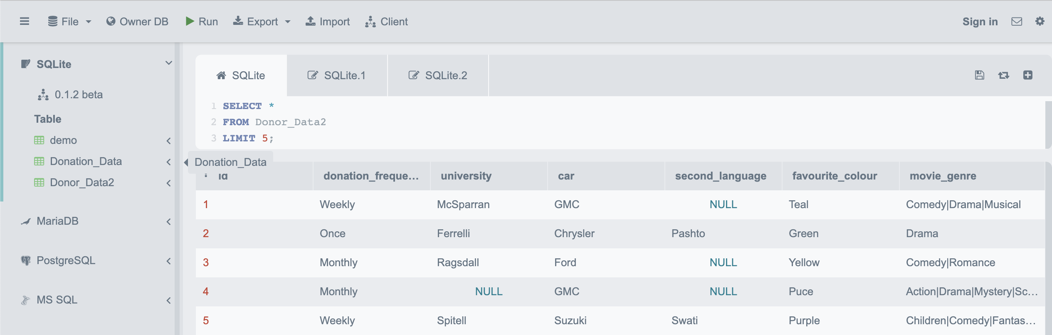
Dataset Description
Two database files containing data about donations and donors
Dataset 1: Donation_Data (1000 records)
Dataset 2: Donor_Data (500 records)

Slide 5
Tools & Techniques Employed
Tools
Tool used | Purpose | Justification
SQLite | To load dataset file | Database tables created from scratch
SQL | To manipulate dataset and perform analysis | Fast and easy way to work with data stored in a database
Tableau | Data viz and building dashboard | Offers an easy way to share report and dashboard with stakeholders
Analysis Techniques
Descriptive analysis - ‘What happened?’
Diagnostics analysis – ‘Why did it happen?’

Slide 6
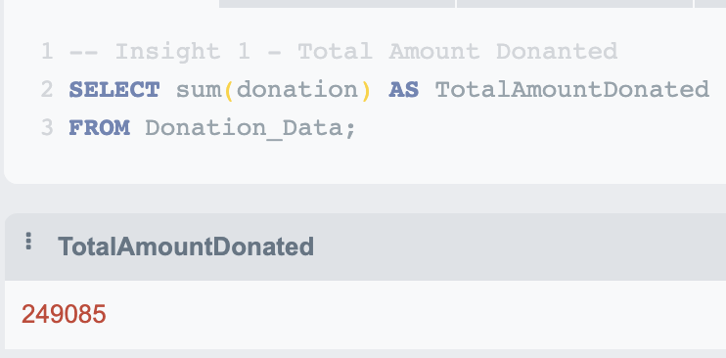
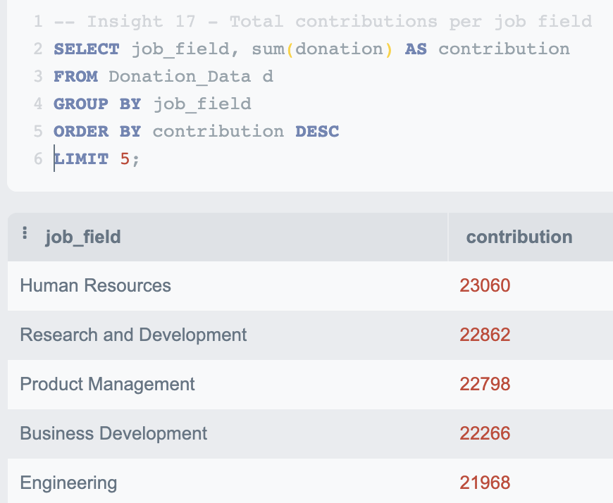
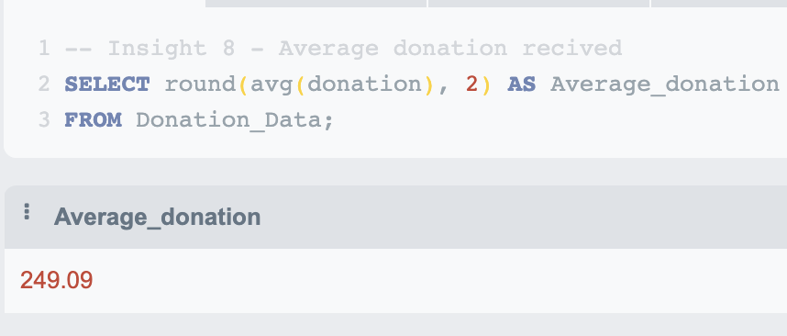
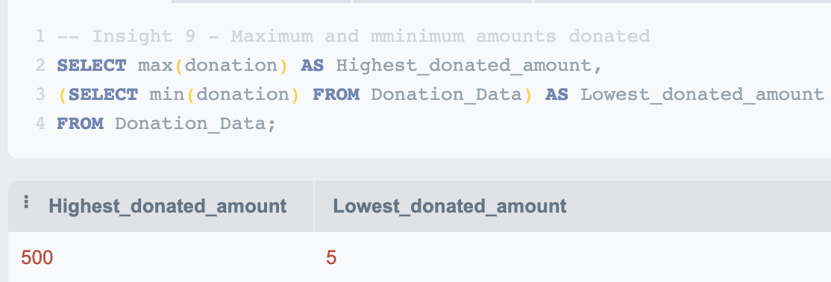
Analysis Performed
By manipulating dataset with SQL code in SQLite, the following insights were uncovered;

Slide 7
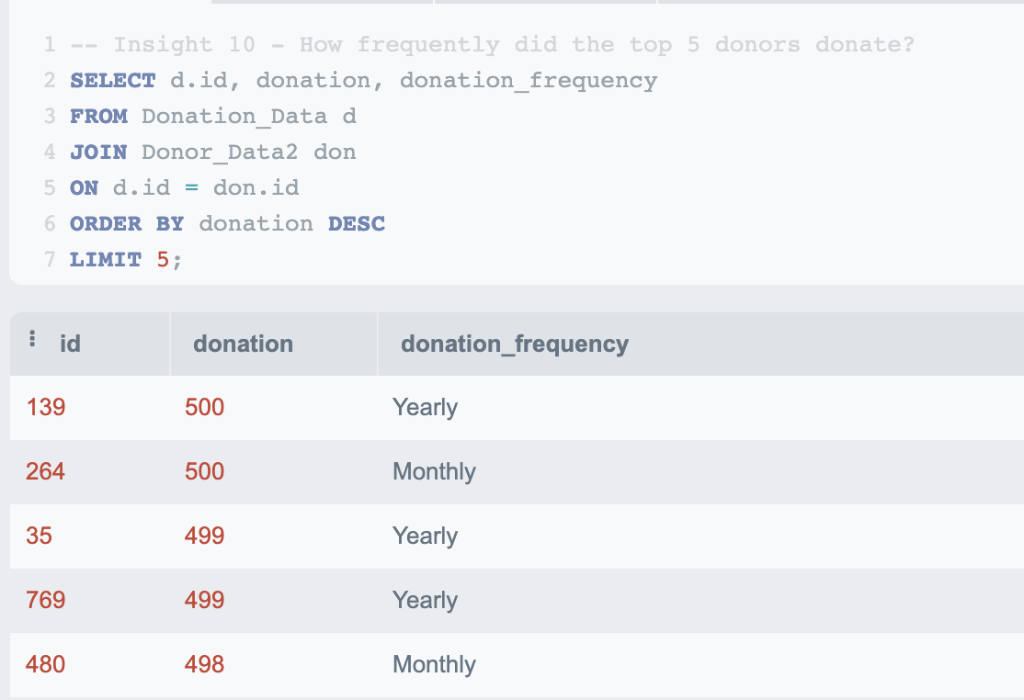
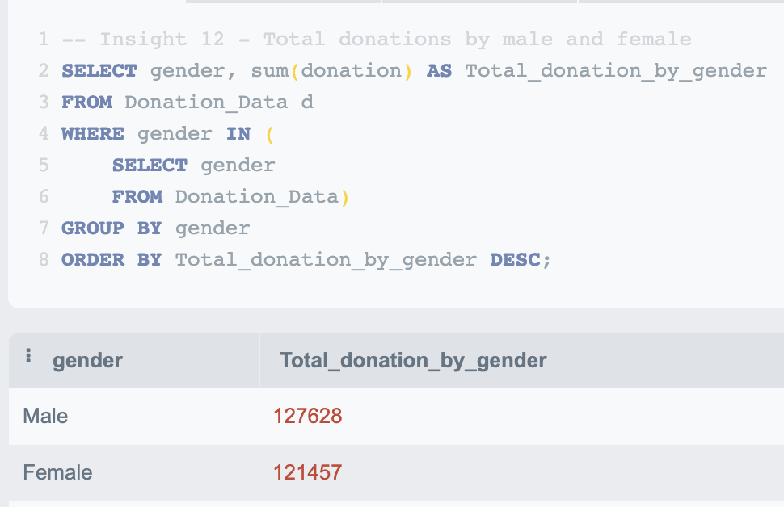
Analysis Performed (Cont..)

Slide 8
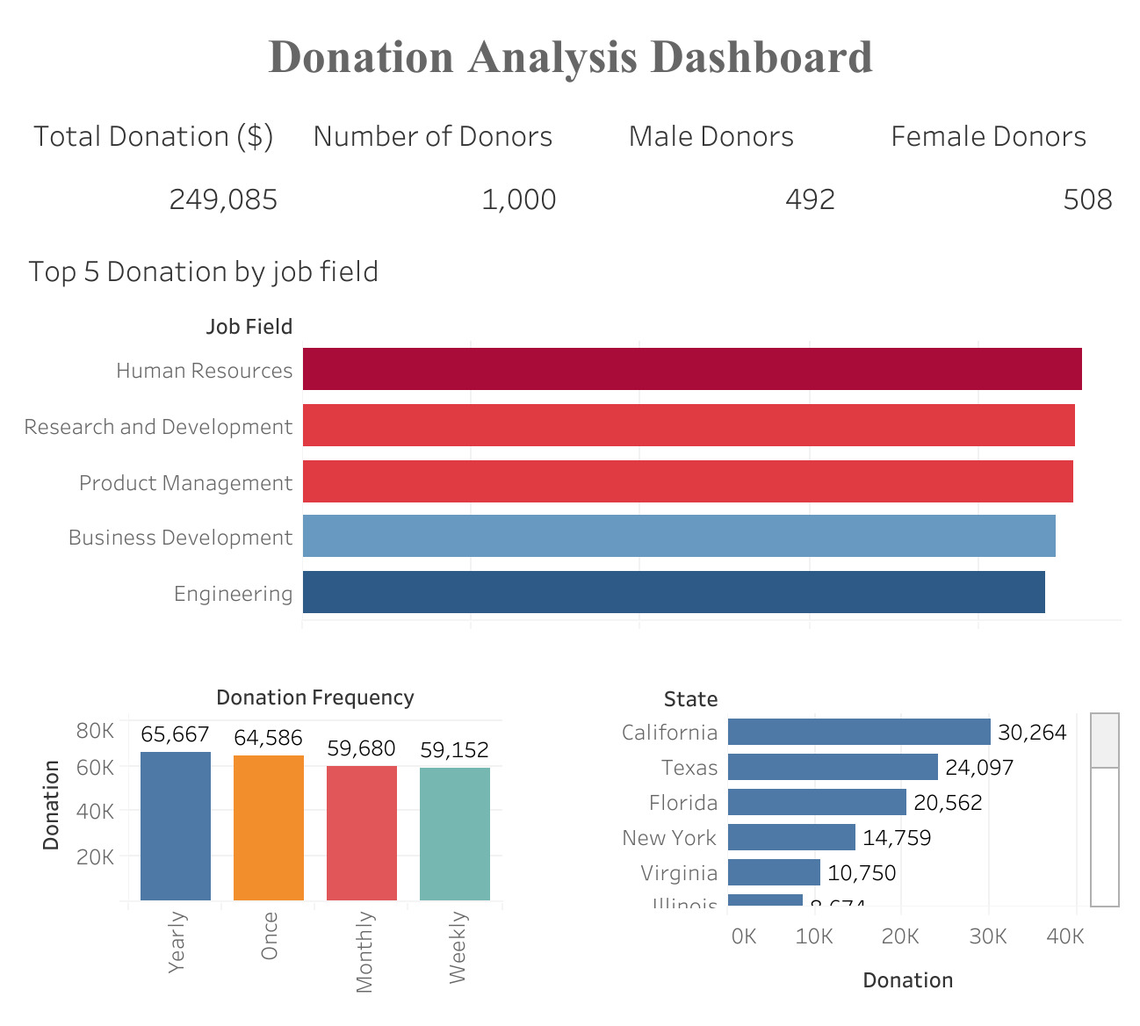
Results (Dashboard)
Link to dashboard

Slide 9
Improvement
Some issues identified with the dataset which if resolved could improve the kind of analysis done;
Incomplete data e.g;
Age of donors
Dates donations were made
Donation channels (e.g online, bank transfer etc)
Irrelevant datapoints e.g
second_language
favorite_color
movie_genre

Slide 10
Summary
Loaded database file into a DBMS (SQLite)
Queried and manipulated data to generate insights (SQL)
Visualised and built dashboard to communicate insight (Tableau)
Identified ways to improve dataset to further enhance analysis

Slide 11
Q & A

