Slide 1
Learning How Cities Respond
Intervention-Conditioned Urban Representations
from Causal Response Labels
Sirun Li
Mentor: Yunhan Zheng
RESPONSE, NOT RESEMBLANCE
Massachusetts Institute of Technology

Slide 2
What does this research aim to answer?
RESEARCH QUESTION
How do metro station openings change nearby urban activity, and can pre-opening conditions predict which places will respond similarly?
The study covers 44 Chinese metro cities and station openings from 2010 to 2025. It estimates responses in POI activity, night lights, population, and housing price, then learns a representation that brings places with similar estimated responses closer together.
1
Spatial unit
2
Treatment
3
Causal label
4
Final test
A fixed 500 m × 500 m grid containing the station coordinate.
Official station opening. The partial opening month is excluded; the next complete month or year is t = 1.
Post-opening observed change minus the strongest credible untreated counterfactual.
Predict responses for other stations, especially cities not used in training.
Core estimand: the response of a station grid relative to what would have happened without that opening.
Massachusetts Institute of Technology

Slide 3
The presentation follows the research design in order
STUDY WORKFLOW
1
2
3
Step 1 Matching
Step 2 Counterfactual response
Step 3 Representation learning
Define treated and donor grids; match on pre-opening outcomes; accept pairs only when pre-treatment quality gates pass.
→
Estimate post-opening response with matched change, GSC, or Matrix Completion; convert each grid–outcome–horizon estimate into a label.
→
Encode 27 pre-opening features; align embedding geometry with response similarity; evaluate prediction and cross-city transfer.
Causal credibility comes before embedding quality.
The response labels are the supervised signal; they must be auditable before the representation can be trusted.
Massachusetts Institute of Technology

Slide 4
Data sources and their role in the design
DATA INVENTORY
Variable | Spatiotemporal unit | Coverage | Frequency | Source | Role
Housing price | 500 m grid × month/year | 2004–2025* | Monthly + annual | Lianjia, Anjuke, archived and open sources | Outcome; matching; representation
POI activity | 500 m grid × year | 2012–2024 | Annual | AMap historical archive | Outcome; matching; representation
Population | 500 m grid × year | 2010–2024 | Annual | WorldPop legacy + R2024b | Outcome; matching; representation
Night lights | 500 m grid × month/year | 2012–2024 monthly; 2014–2024 annual | Monthly + annual | NASA VIIRS VNP46A2 via GEE | Outcome; matching; representation
NDVI / NDBI | 500 m grid × year | 2014–2024 | Annual | Copernicus Sentinel-2 via GEE | Representation input
Station openings | Station event + treated grid | 2010–2025 | Event month | Official and compiled opening records | Treatment index
Scale indicators: POI archive 14.39 million rows; formal annual housing input 239,591 grid-years; frozen donor universe 3.77 million grids. These are different units and are not summed.
* Housing coverage is city-specific and irregular; coverage years do not imply a complete panel for every treated–control pair.
Massachusetts Institute of Technology

Slide 5
Three model time points are pre-treatment summaries—not three monthly observations
TEMPORAL DESIGN
Original outcome timing
Representation input
•
Housing and VIIRS are available as monthly outcomes.
Opening −3
Opening −2
Opening −1
•
POI and population are annual outcomes.
•
Opening month is partial exposure and is excluded.
lag 2 and lag 3
lag 1
used for matching distance
held out for pre-fit validation
•
Monthly labels use months 1, 3, 6, 12, 18, and 24; annual labels use full years 1, 2, and 3.
Why aggregate?
It harmonizes mixed-frequency sources, keeps every input strictly before treatment, creates a fixed 9 × 3 = 27-dimensional tensor, and reserves the closest pre-period as an honest quality check.
The model uses three comparable pre-opening lags; the causal outcome paths still retain their monthly or annual horizons.
Massachusetts Institute of Technology

Slide 6
Full research population and current usable release are different quantities
SAMPLE ACCOUNTING
FULL RESEARCH POPULATION
CURRENT PARTIAL RELEASE
44
cities
388
grids with ≥1 available label
5,048
treated grids = station events
7,671
available response labels
136,296
expected label slots = 5,048 × 27
7,668
training rows; 3 population–MC labels excluded
How one treated grid can generate up to 27 labels
POI
12
Population
3
Night lights
6
Housing
6
4 outcomes × 3 years
1 outcome × 3 years
1 outcome × 6 months
1 outcome × 6 months
Final representation sample: 387 units. Housing currently contributes only 1 grid × 6 horizons and is excluded from comparative result plots.
Massachusetts Institute of Technology

Slide 7
Step 1 — build a credible treated–control pair
MATCHING
1
2
3
4
Treated grid
Eligible donor pool
Pre-only matching
Acceptance and routing
A 500 m grid containing a station that officially opens during 2010–2025. Opening month is excluded.
→
Nonexperimental grids after station and spatial exclusions; the main donor exclusion is 1 km. Frozen universe: 3,771,800 grids.
→
Matching::Match; Mahalanobis distance; M = 1 with replacement. Active pre-opening outcomes at lag 2 and lag 3 define distance.
→
Try same-city donors first, then all-city standardized fallback. Lag 1 is held out. Failed quality gates route to GSC, then Matrix Completion.
Quality gates
training distance, held-out RMS standardized gap, and held-out maximum standardized gap must each be below the q95 threshold from 200 deterministic donor-placebo matches.
Massachusetts Institute of Technology

Slide 8
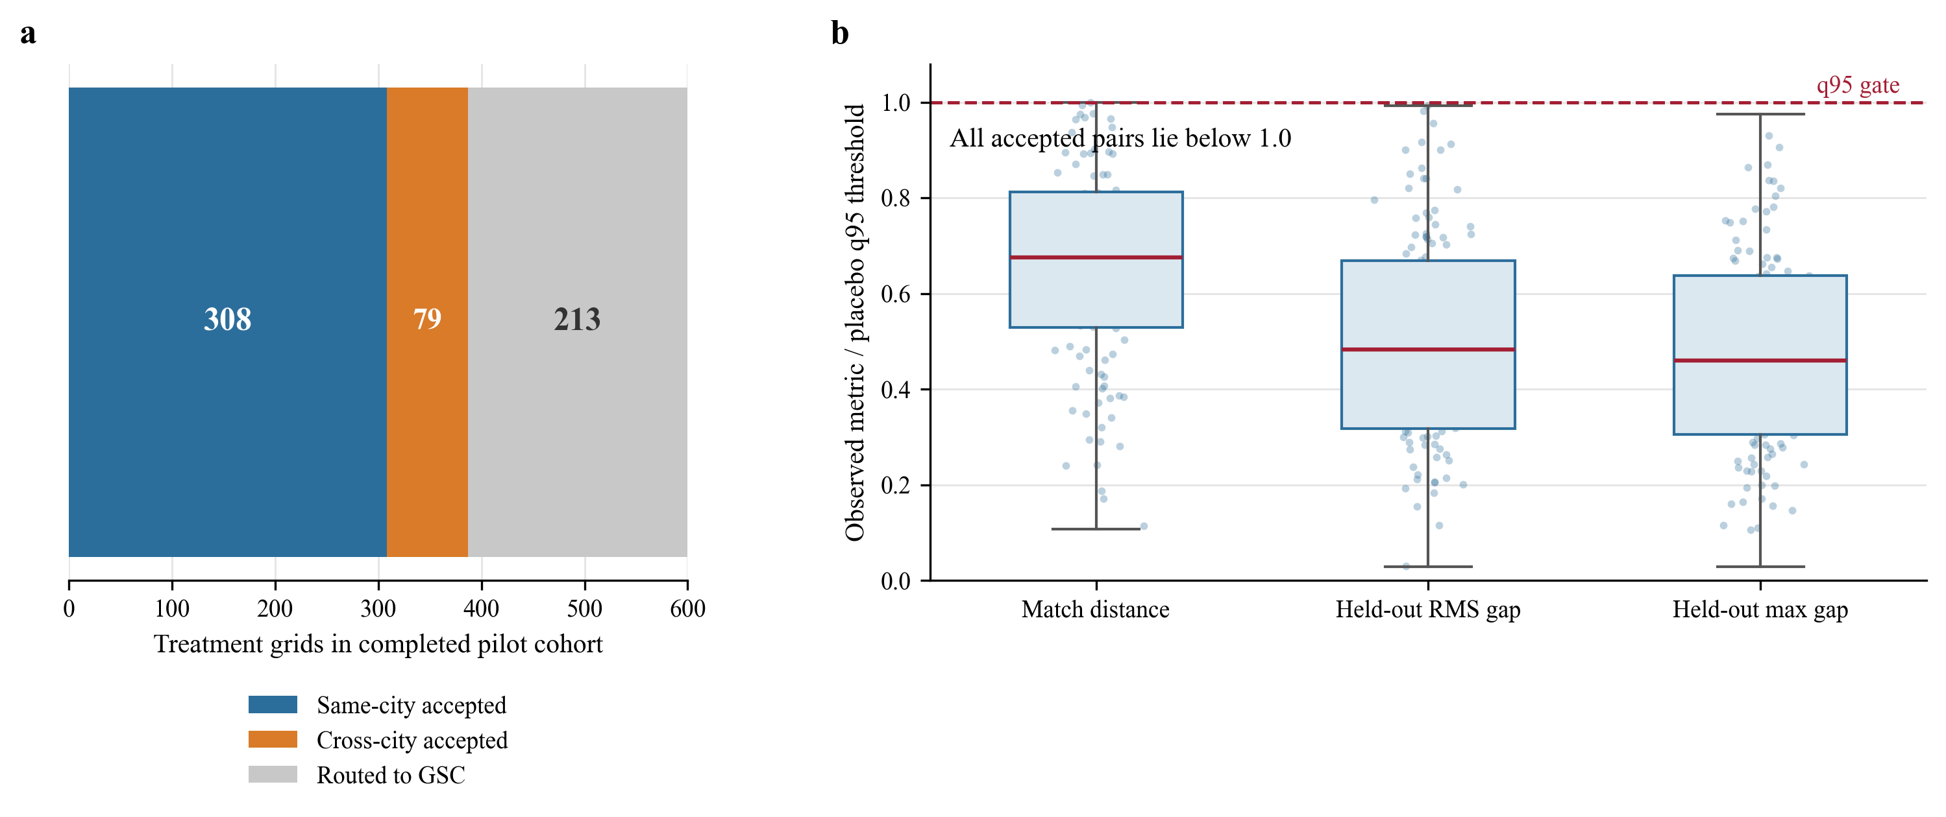
Matching diagnostics: sample flow and held-out pre-fit
MATCHING EVIDENCE
Completed pilot cohort
600 treated grids → 387 accepted pairs (308 same-city, 79 cross-city) → 213 routed to GSC.
A conventional unmatched-versus-matched SMD table is not yet exported; the current evidence is the prespecified distance plus held-out pre-period gates.
Massachusetts Institute of Technology

Slide 9
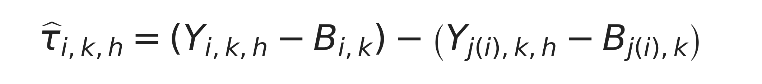

Step 2 — estimate the untreated counterfactual and form response labels
COUNTERFACTUAL ESTIMATION
A. Accepted matched pair
B. Generalized Synthetic Control
A difference in changes removes each grid’s baseline level. The coefficient is the estimated response for grid i, outcome k, and horizon h.
Interactive fixed effects estimate the missing untreated path. Rank r = 0…5 is chosen by cross-validation; uncertainty uses 200 parametric bootstrap draws.
1
Matching + change
2
Xu GSC
3
Matrix Completion
Use when all three pre-treatment quality gates pass.
Use richer donor trajectories when fixed-pair matching is not credible.
Low-rank fallback after GSC failure; failed units never silently disappear.
Primary key: treatment grid × outcome × horizon × specification. Every available estimate becomes one response-label row.
Massachusetts Institute of Technology

Slide 10
Event time, pre-fit, and the boundary of current causal evidence
IDENTIFICATION CHECKS
Monthly outcomes
What is checked now
•
All matching variables are pre-treatment.
Pre
Open
+1
+3
+6
+12
+24
Opening month is excluded; the first complete month is event time 1. The full path is stored monthly, with key label horizons 1, 3, 6, 12, 18, and 24.
•
Lag 1 is held out from matching and used for pre-fit validation.
Annual outcomes
•
GSC reports pre-RMSPE and bootstrap uncertainty.
Pre years
Opening year
Year +1
Year +2
Year +3
What is still required
The opening year is excluded; the next full calendar year is event time 1.
A formal cohort event-study / parallel-trend figure has not yet been produced for this partial release. It must be completed before strong causal claims.
Interpretation rule
Current plots show available response-label paths and pre-fit evidence—not a completed pooled event-study with validated parallel trends.
Massachusetts Institute of Technology

Slide 11
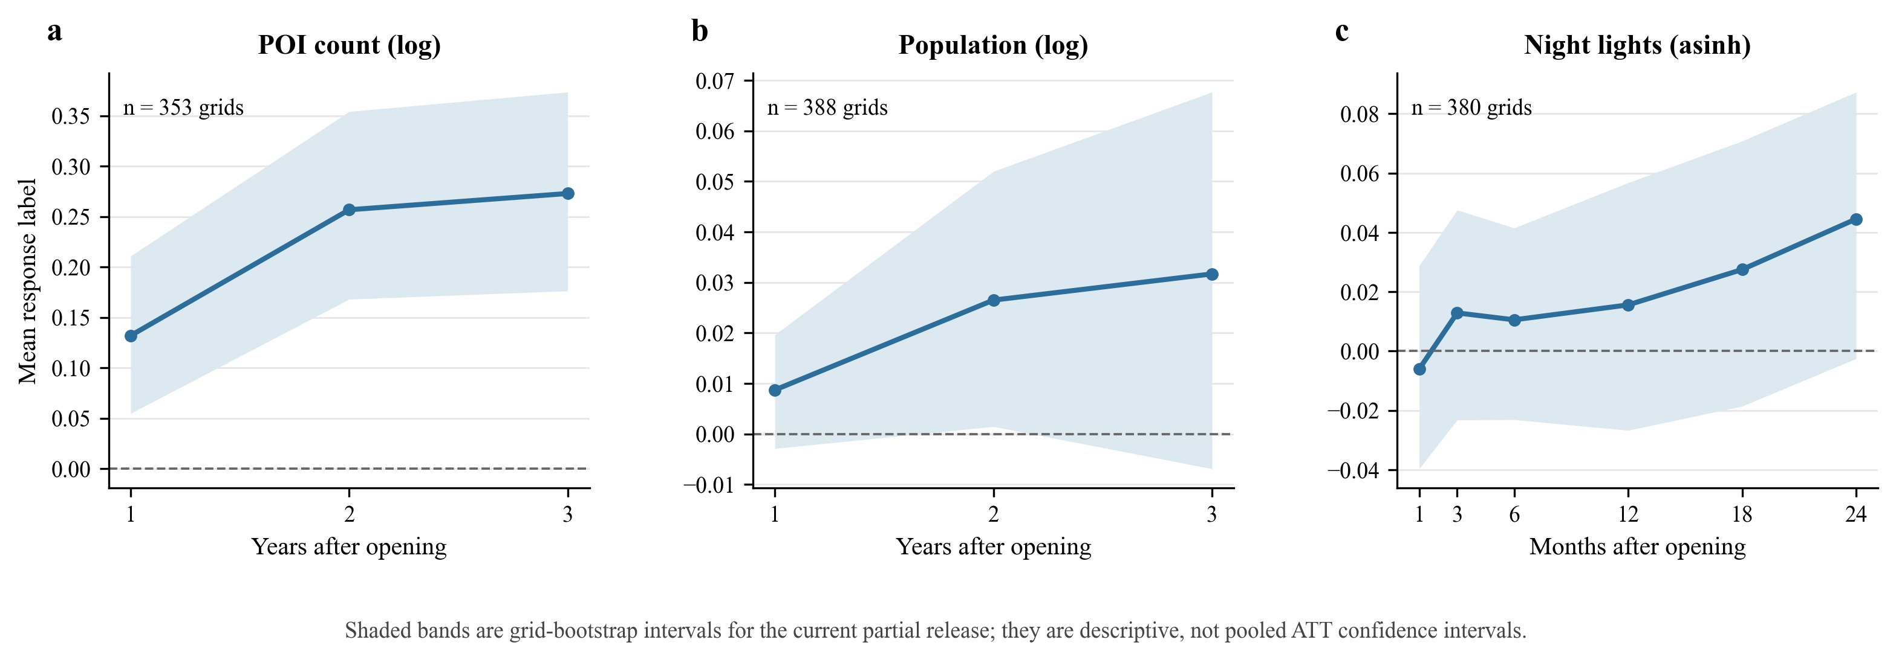
Current response-label paths: POI, population, and night lights
PRELIMINARY RESPONSE RESULTS
Reading these results
POI count labels are positive on average in the current release. Population and night-light intervals are much wider and include zero at most horizons, so evidence is still preliminary.
Housing is excluded: only 1 grid currently yields 6 key-horizon labels after strict treated-and-frozen-control coverage checks.
Massachusetts Institute of Technology

Slide 12

Step 3 — learn a response-aligned urban representation
REPRESENTATION LEARNING
1
2
3
4
Input xᵢ
Encoder fθ
Embedding zᵢ
Response label yᵢ
→
→
→
27 pre-opening values: 9 variables × lags 1, 2, and 3.
MLP 256 → 128, batch normalization, ReLU, dropout.
128-dimensional place representation; L2-normalized for response geometry.
Sparse outcome–horizon vector from 7,668 training rows across 387 units.
Learning target
If two places have similar causal response vectors, their embeddings should be close—even when their visible urban form differs.
Massachusetts Institute of Technology

Slide 13
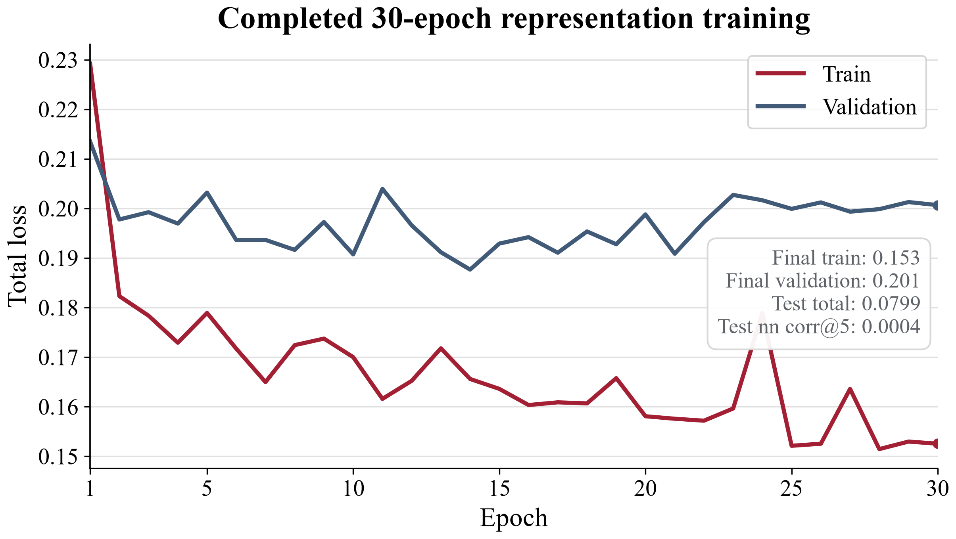


Training is stable; predictive and cross-city evidence remains incomplete
LOSS AND EVALUATION
Training objectives
Current test and baseline status
Learned embedding
nn_corr@5 = 0.0004
Run; test n = 5
Random correlation baseline
0.0000
Run
Raw 27-D nearest neighbors
—
Not yet run
30-epoch result
Direct Ridge / MLP prediction
—
Not yet run
Train loss 0.229 → 0.153; validation loss 0.214 → 0.200; no NaN. Test: total 0.0799, representation 0.0886, prediction 0.0713.
Leave-one-city-out transfer
—
Not yet run
A stable optimization run is not yet evidence of useful city transfer.
Massachusetts Institute of Technology

Slide 14
What is established—and what must be completed next
CONCLUSION
Established in the current project
Required before the main claim
•
A clear estimand for metro-opening responses at 500 m station grids.
•
Finish counterfactual queues and publish a strict release.
•
A frozen 44-city treatment and donor universe with auditable routing.
•
Produce cohort event-study / parallel-trend and full pre-fit diagnostics.
•
Resolve housing coverage or keep housing outside comparative findings.
•
7,671 available response labels, of which 7,668 train the model.
•
Run raw-feature and direct-prediction baselines.
•
A stable 30-epoch representation run with complete model artifacts.
•
Evaluate leave-one-city-out transfer with adequate test sample size.
Main takeaway
The project has built the causal-label-to-representation pipeline. The next scientific milestone is to prove that the labels are credible and that the learned geometry transfers beyond the cities used for training.
Thank you
Massachusetts Institute of Technology

