Slide 1
Learning How Cities Respond
Intervention-Conditioned Urban Representations
Dynamic responses to rail station openings
Estimating local responses and testing urban representations across cities
Sirun Li
Undergraduate Student, Institute of Remote Sensing and Geographical Information Systems
Peking University, Beijing, China
Supervised by Prof. Yunhan Zheng
1
Notes:
Hello everyone. I'm Sirun Li from Peking University and My mentor is Professor Yunhan Zheng, this summer, We study how places respond to a new rail station, and use these responses to train the guide comparisons across cities by representations learning. Let me start with a familiar example.
Sources and figure notes:
Current project_intro.tex and frozen project assets. Conceptual diagrams are illustrations.
Assets: seminar_materials/.

Slide 2
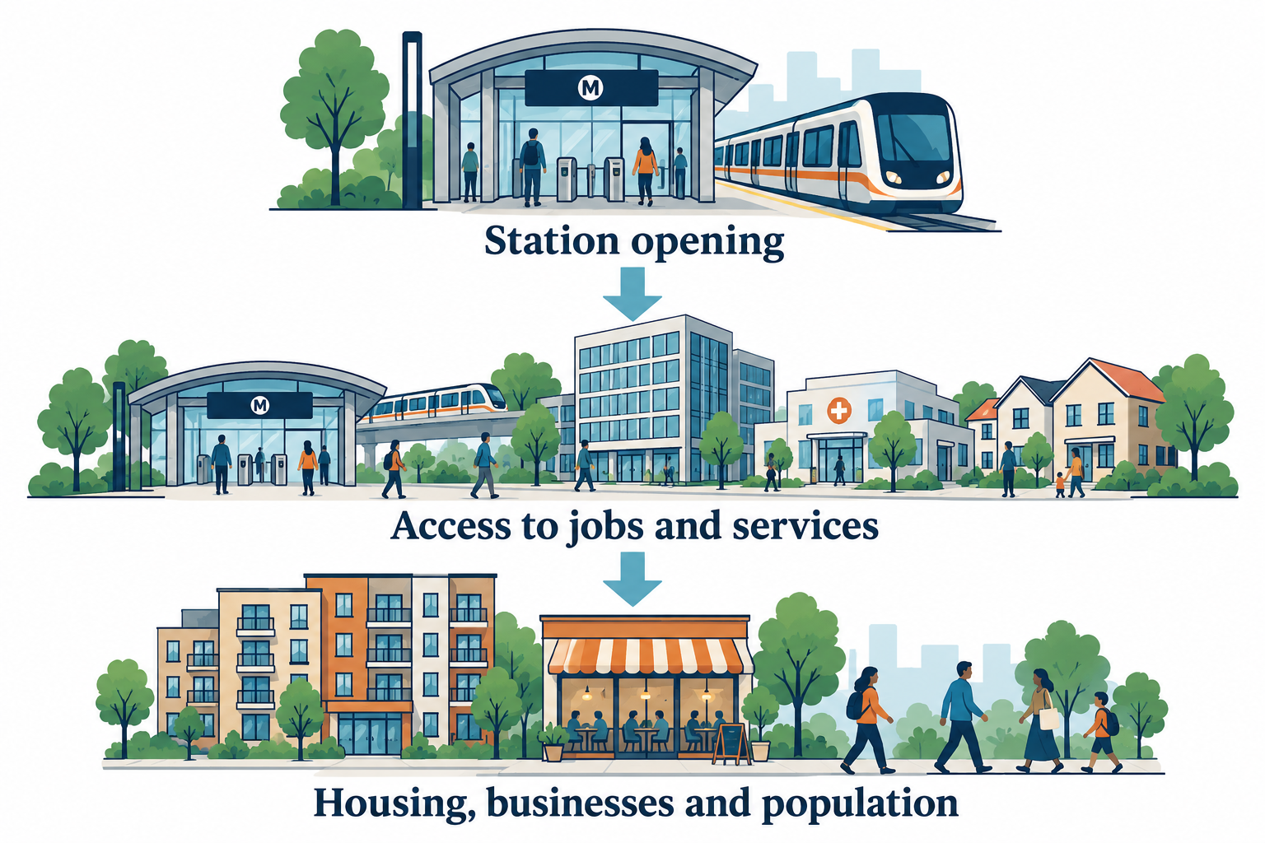
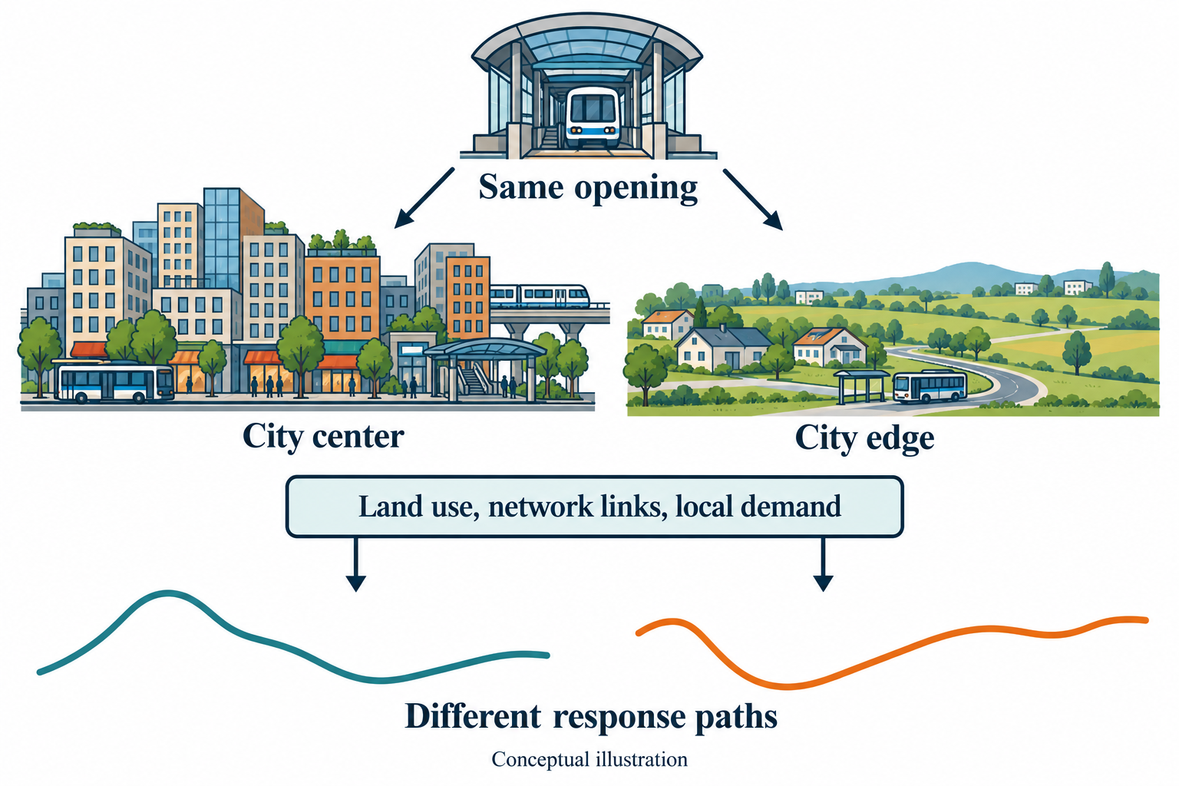
Why do places respond differently?
Rail expansion and
transit-oriented development
Mechanisms and
local conditions
Can past response profiles help us compare places in new cities?
Conceptual illustrations. Lu et al. (2016); Wang & Xia (2024); Cervero & Kockelman (1997);
Gonzalez-Navarro & Turner (2018).
2
Notes:
A station opens near your home. Jobs become easier to reach, shops gain customers, and housing demand may change. These changes depend on local conditions. A city center and the city edge may respond differently. Our goal is to use earlier local information to find places with similar responses.
Sources and figure notes:
Current project_intro.tex and frozen project assets. Conceptual diagrams are illustrations.
Assets: seminar_materials/.
Background mechanism diagrams: built-in GPT-image conceptual illustrations, not measured effects. Assets and exact prompts: seminar_materials/background_images/prompts_and_usage.md.

Slide 3
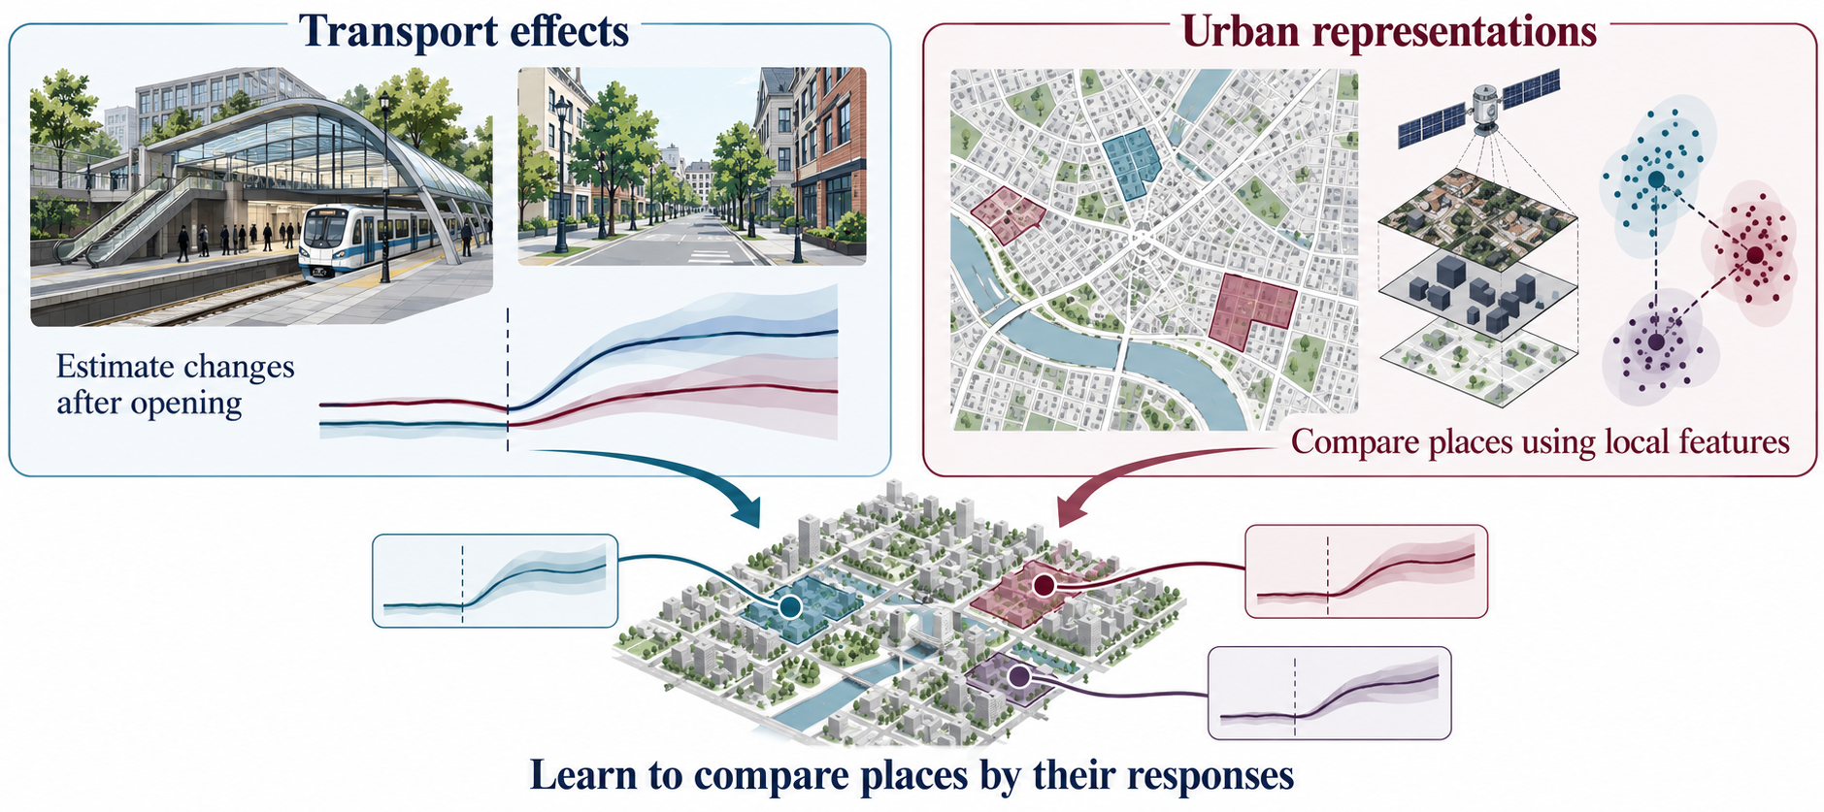
Related Work: causal effects and representation learning
Matching · GSC · MC · event studies
Urban2Vec · RegionDCL · FLORAL
Conceptual illustrations. Gonzalez-Navarro & Turner (2018); Xu (2017); Athey et al. (2021); Sun & Abraham (2021);
Wang et al. (2020); Li et al. (2023); Wei et al. (2016); Tec et al. (2023); Zeng et al. (2022); Fang et al. (2025).
3
Notes:
Two research areas inform this goal. Transport studies estimate infrastructure effects. Urban representation learning turns local information into numerical descriptions of places. Our project connects them: estimated response paths guide how we learn those descriptions.
Sources and figure notes:
Mayer & Trevien (2017); Gonzalez-Navarro & Turner (2018); Diao et al. (2017); Bardaka et al. (2018); Imai et al. (2023); Xu (2017); Athey et al. (2021); Sun & Abraham (2021); Roth (2022). Existing project bibliography.
Assets: seminar_materials/.
Sources and figure notes:
Wang et al. (2020), Urban2Vec; Li et al. (2023), RegionDCL; Wei et al. (2016), Transfer knowledge between cities; Tec et al. (2023), Weather2vec; Zeng et al. (2022), CauOD; Fang et al. (2025), CGNet-PIE. Existing project bibliography.
Assets: seminar_materials/.
Conceptual illustration generated with built-in GPT-image. Assets and prompts: seminar_materials/concept_figures_v8/. Concept curves do not report measured estimates.

Slide 4
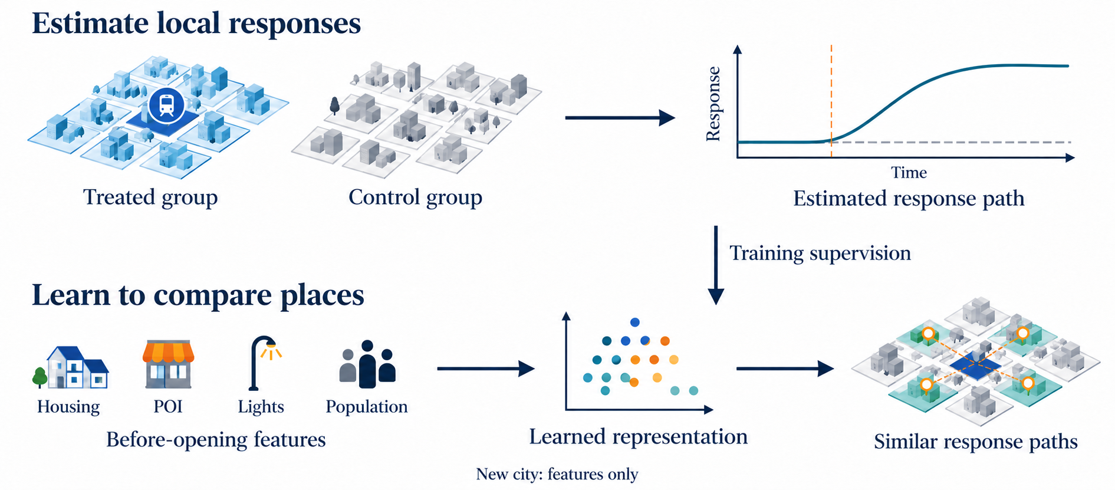
Problem setup: learning from local responses
Each sample is a grid near a station opening.
Conceptual illustration. Treated group: grids near new stations. Control group: eligible comparison grids.
Goal: similar representations should find similar response paths; also check amount and direction.
4
Notes:
We connect them in two steps. The treated group contains areas near new stations; the control group supplies comparison areas. First, we estimate local response paths. Then these paths guide a model that summarizes earlier information. In a new city, it uses earlier information alone.
Sources and figure notes:
Current project_intro.tex and frozen project assets. Conceptual diagrams are illustrations.
Assets: seminar_materials/.
Conceptual illustration generated with built-in GPT-image. Assets and prompts: seminar_materials/concept_figures_v8/. Concept curves do not report measured estimates.

Slide 5
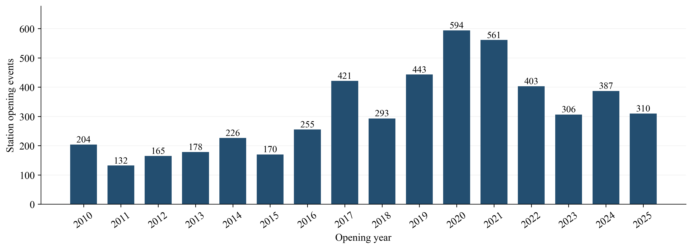
Data: station openings across 44 cities
VIIRS: 6 horizons (1–24 months) | POI: 4 outcomes × 3 years
Annual housing, POI, lights, population and Sentinel-2 features use 1–3 year lags.
Coverage and design support define eligible labels; preprocessing uses training-side cities.
5
Notes:
For these two steps, we combine station openings with housing, nighttime lights, shops, services, and population. The learning tests focus on lights and points of interest, or POI. All model inputs come from before opening.
Sources and figure notes:
Current project_intro.tex and frozen project assets. Conceptual diagrams are illustrations.
Assets: seminar_materials/.

Slide 6
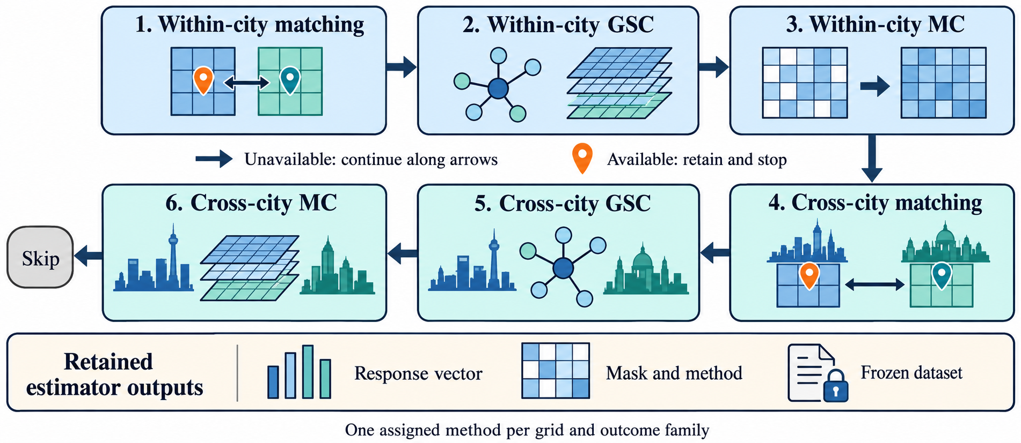
Causal labels: method routing and a frozen dataset
Prefer within-city designs; extend across cities when support requires it.
6
Notes:
With these data, we estimate what would happen without opening. We try Matching first, then Generalized Synthetic Control, or GSC, and Matrix Completion, or MC, to extend coverage. The first method that meets the checks supplies each area's training labels. Here is how Matching works.
Sources and figure notes:
Current project_intro.tex and frozen project assets. Conceptual diagrams are illustrations.
Assets: seminar_materials/.
Routing illustration: generated with the built-in GPT-image tool; concept diagram, no empirical values. Asset: seminar_materials/gpt_image_flowcharts/intro_routing_gpt_icons_v3.png.

Slide 7
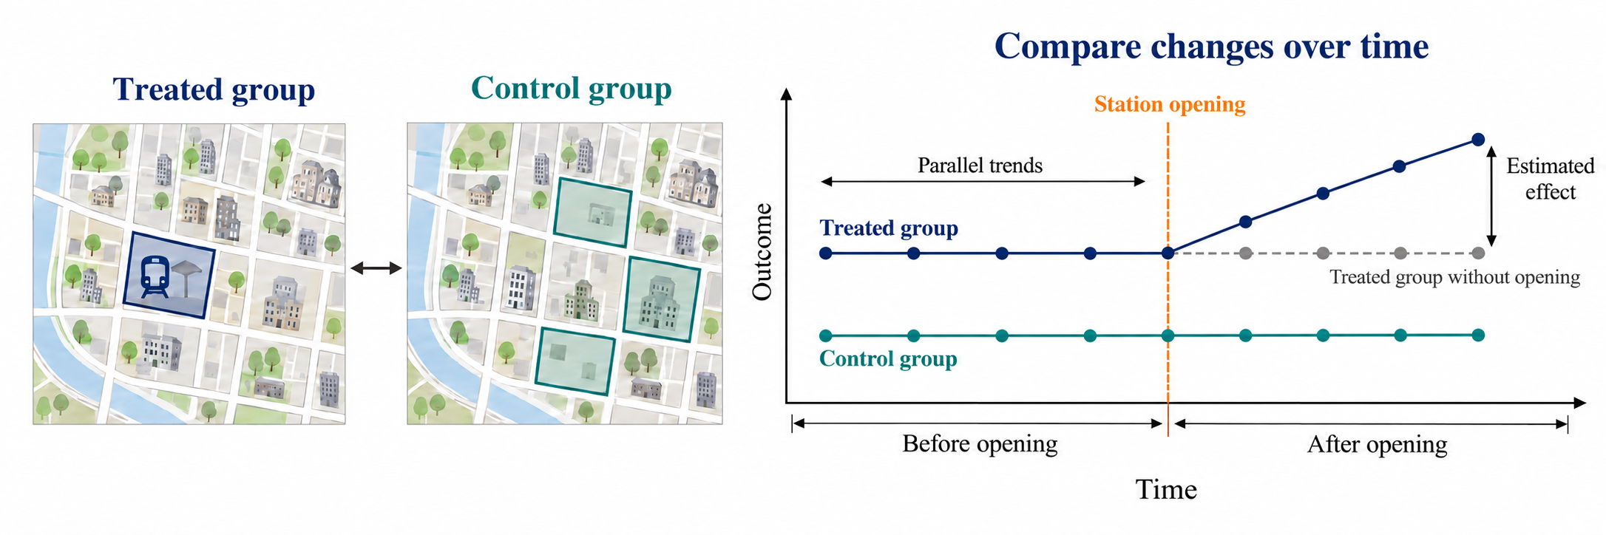
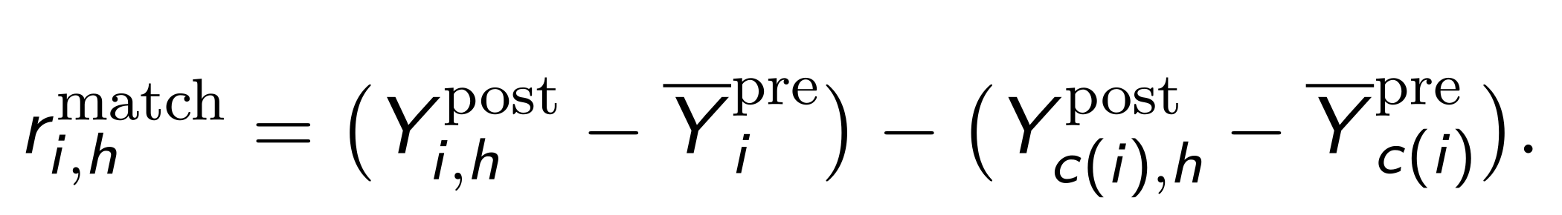
Matching: compare changes in the two groups
c(i): fixed matched grid from the control group. Each treated grid gets its own response path.
Baseline: months −18 to −7 (−6 to −1 anticipation); annual: previous year.
Similar pre-opening trends and a suitable control group support Matching. Imai et al. (2023). Conceptual figure.
7
Notes:
Matching pairs each treated area with a similar control area. In this sketch, their earlier trends are parallel, though their levels differ. The dashed line shows the treated group's path without opening. Its gap from the observed path is the estimated effect: the difference between the two groups' changes.
Sources and figure notes:
Imai et al. (2023). Monthly baseline -18..-7, anticipation -6..-1; frozen project design.
Assets: seminar_materials/.
Conceptual illustration generated with built-in GPT-image. Assets and prompts: seminar_materials/concept_figures_v8/. Concept curves do not report measured estimates.
Matching diagram revised with built-in GPT-image: seminar_materials/concept_figures_v9/matching_parallel_trends_v9.png. Parallel trends are illustrated with two flat pre-opening paths at different levels. The dashed no-opening path starts at the treated opening-time level. The effect compares observed treated and treated counterfactual paths. Conceptual, not measured data. Full prompts: seminar_materials/concept_figures_v9/prompts_and_usage.md.

Slide 8
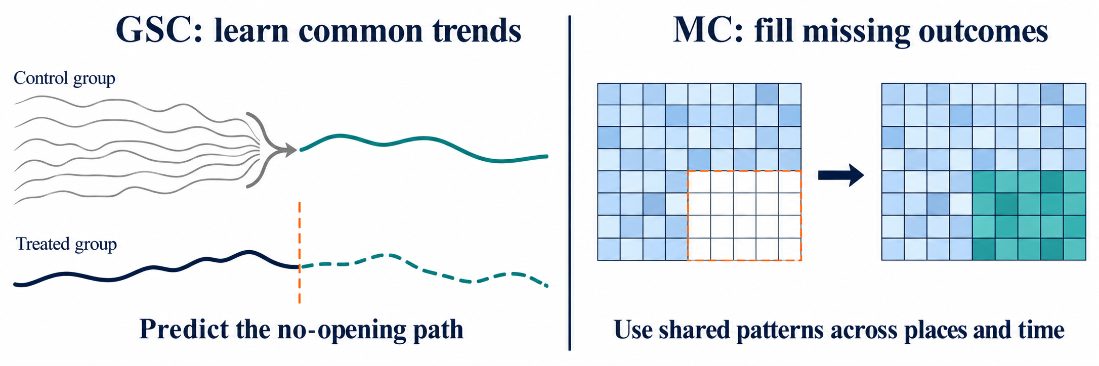
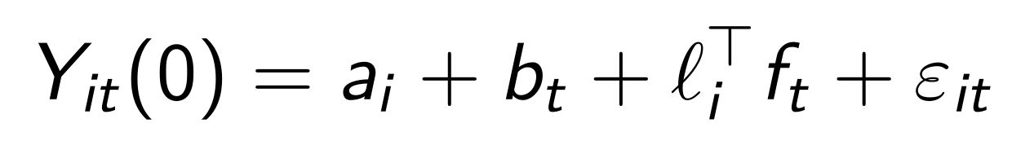
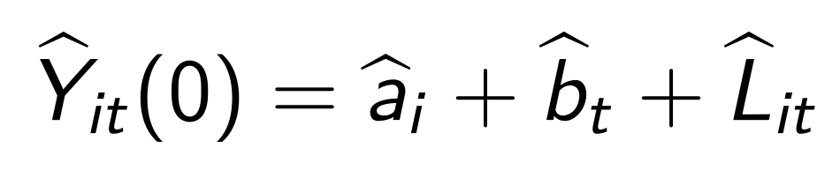
GSC and MC: predict the path without opening
Response = observed outcome − predicted outcome without opening
GSC: factors and loadings; MC: fixed effects and a low-rank matrix. Both need pre-period and control group support.
Uncertainty: GSC bootstrap; MC jackknife. Xu (2017); Athey et al. (2021). Conceptual illustration.
8
Notes:
When Matching has too little support, GSC learns shared control group trends and fits the treated group's earlier pattern. MC fills missing no-opening outcomes using patterns across areas and time. Both estimate what would happen without opening.
Sources and figure notes:
Xu (2017); Athey et al. (2021). Current project counterfactual models.
Assets: seminar_materials/.
Conceptual illustration generated with built-in GPT-image. Assets and prompts: seminar_materials/concept_figures_v8/. Concept curves do not report measured estimates.

Slide 9
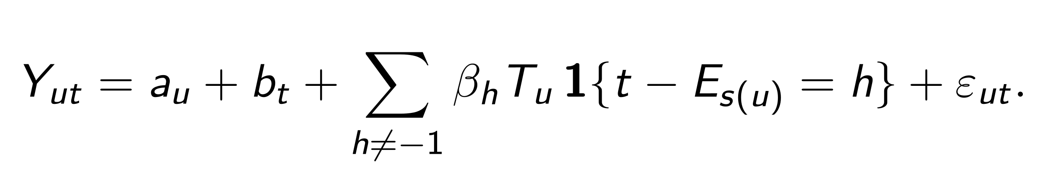
Event study: pre-opening trends and dynamic effects
Before opening: assess the parallel trends assumption.
After opening: show how the estimated effects change over time.
The control group follows the treated group’s opening dates; h = −1 is the reference.
βₕ shows the average path; rᵢ,ₕ is the response for each treated grid.
TWFE event study: staggered openings and heterogeneous effects shape its interpretation.
Sun & Abraham (2021); Goodman-Bacon (2021).
9
Notes:
The event study serves two purposes. Before opening, it checks whether the treated group and control group follow similar trends. This helps assess the parallel trends assumption. After opening, it shows how the estimated effect changes over time. Let us first look at the pre-opening checks.
Sources and figure notes:
Sun & Abraham (2021); Goodman-Bacon (2021). Released pooled matching curves use TWFE; grid responses are separate labels.
Assets: seminar_materials/.

Slide 10
Pre-treatment diagnostics: evidence by method
Outcome | Matching Joint Wald p | GSC Mean-gap p | MC Mean-gap p
Housing | 0.055 | — | 0.955
VIIRS | 0.063 | 0.278 | 0.364
POI count | 0.072 | 0.217 | <0.001
Population | 0.328 | 0.002 | <0.001
Matching pre-trend tests: all p > 0.05; three p < 0.10.
Matching: joint Wald; GSC/MC: mean pre-gap. Grid-clustered tests also flag VIIRS and POI count.
MC housing/VIIRS: 4/2 cities. Interpret alongside pre-fit and support.
10
Notes:
Here are the pre-opening checks. Matching's city-level tests show little evidence of different earlier trends, though some outcomes are near the cutoff. For GSC and MC, we also examine earlier fit and supporting data. These checks help us judge how credible the later comparison is. We now turn to the estimated effects.
Sources and figure notes:
outputs/event_study_final/pretrend_summary.csv. Same-city controls; city-clustered joint Wald for matching and city mean pre-gap for GSC/MC. MC housing/VIIRS: 4/2 cities.
Assets: seminar_materials/.

Slide 11
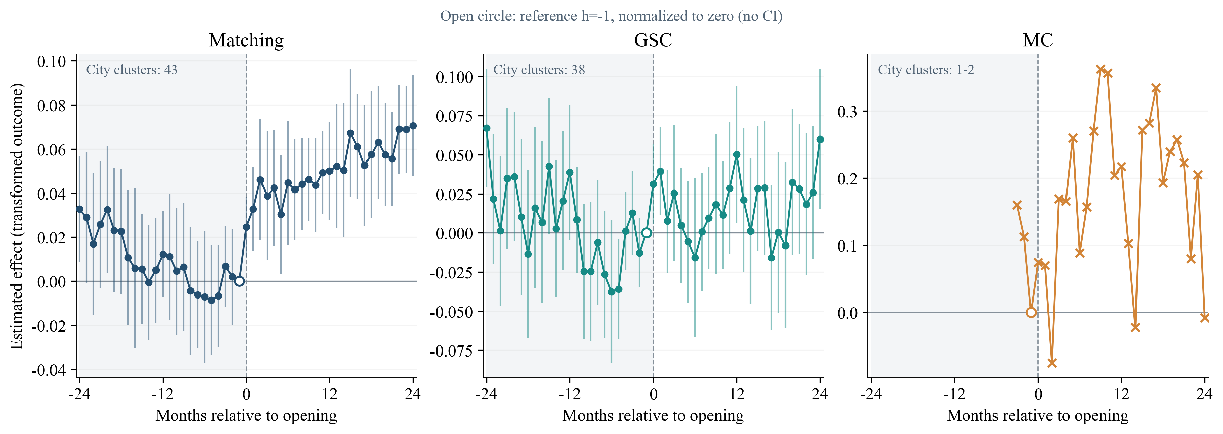
Nighttime lights: positive effects after opening
Matching: positive light effects in the treated group.
Matching: 43 cities; 6/12/18/24-month city-level 95% CIs above zero; 2,255–2,264 units. Asinh scale.
Month 24 CI [0.0475, 0.0935]. Panel axes and samples differ; crosses mark fewer than 3 cities.
11
Notes:
The first result is nighttime lights. The horizontal axis shows months before and after opening. Zero on the vertical axis means no estimated effect. Focus on Matching on the left: after opening, the estimates move above zero and stay positive over the main follow-up period. The intervals at the main reported horizons also sit above zero. This is evidence of higher nighttime brightness in the matched areas. The other panels use different supported samples. For lights, MC covers very few cities, so Matching provides the clearest evidence here. We can now look at another measure of local activity.
Sources and figure notes:
outputs/event_study_final/event_study_panel.csv. Frozen same-city VIIRS event-study estimates. Effects use the asinh scale. Different methods have different supported samples and axes.
Assets: seminar_materials/.

Slide 12
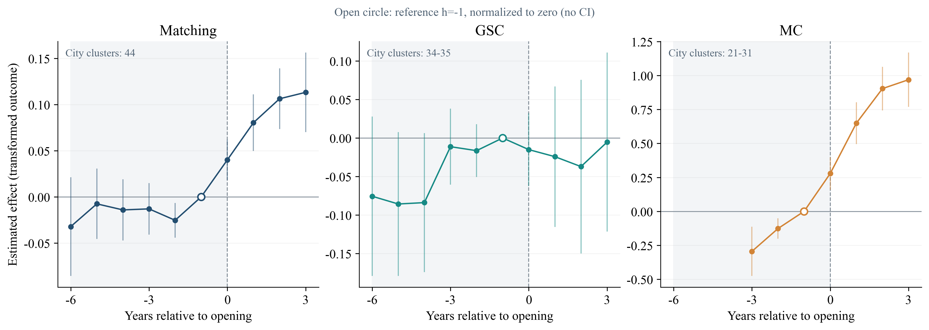
Local activity: more recorded places after opening
Matching: higher POI counts in the treated group.
Matching: 44 cities; all three city-level 95% CIs above zero. Log count scale; POI count is an activity proxy.
Support: 2,476 / 2,242 / 1,947 units. Year 3 CI [0.0701, 0.1564].
12
Notes:
POI gives another view through recorded places such as shops and services. Here, time is measured in years. Matching shows positive effects after opening, with larger estimates at later horizons. The main intervals sit above zero. This suggests more recorded places in the treated group relative to its matched control group. POI count is a proxy for local activity. Coverage changes across years, and each method uses its own supported sample. These charts describe average dynamics. Separate area-level estimates provide the response paths for training. Those paths guide which places should be close in the learned representation.
Sources and figure notes:
outputs/event_study_final/event_study_panel.csv. Frozen same-city POI count event-study estimates. Effects use log count; support changes across horizons.
Assets: seminar_materials/.

Slide 13
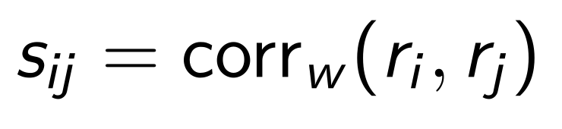
Learning target: response shape and consistency
Pearson compares response shape, allowing shifts and positive rescaling.
Use shared observed cells; evaluate magnitude and direction separately.
Split-half consistency SB corrected | VIIRS | POI
Matching | 0.806 | 0.285
GSC | 0.887 | 0.156
VIIRS has more consistent response-similarity structure
Current POI target pools 4 outcomes × 3 years. Outcome-level evaluation adds detail.
Split consistency describes target structure; causal interpretation follows design and diagnostics.
13
Notes:
To compare places using these paths, we mainly compare how they rise and fall together. Two areas can have a similar pattern even when their response sizes differ. We therefore check size and direction separately. The label checks show a clearer similarity structure for lights. POI combines several outcomes, so its patterns are less consistent. This makes outcome-level evaluation useful when interpreting the learning results.
Sources and figure notes:
Server-reported split-half similarity-matrix diagnostic: Spearman-Brown corrected consistency. Target structure, not a causal-validity test.
Assets: seminar_materials/.

Slide 14
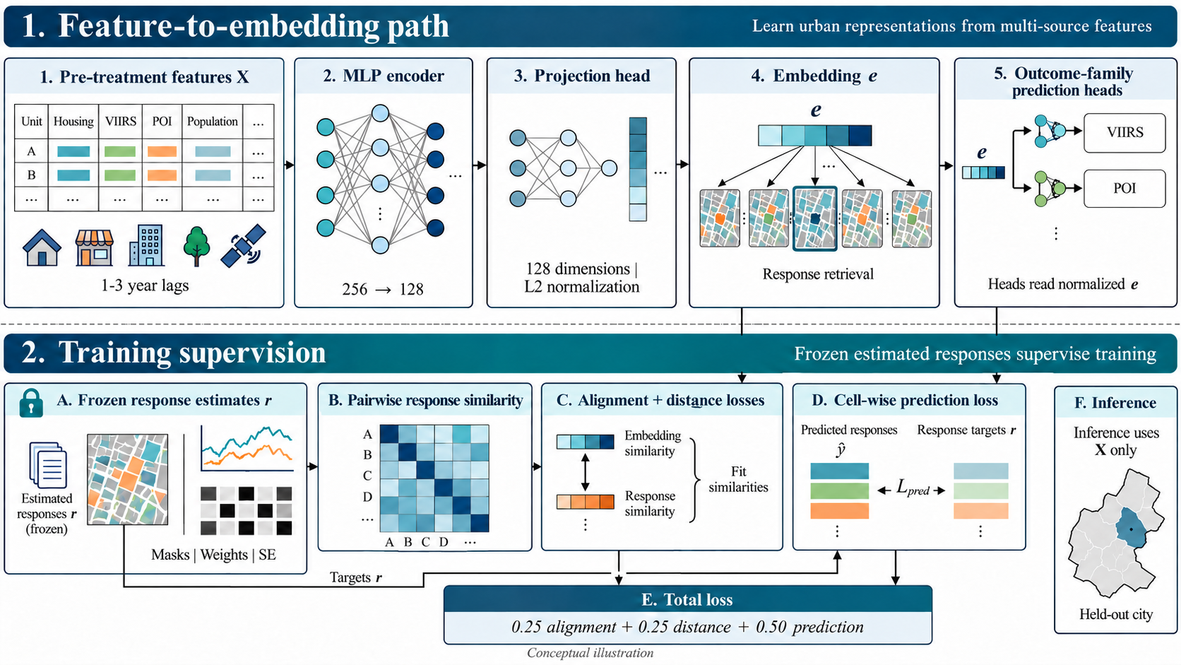
Representation learning: features to embeddings
Default: tabular MLP; normalized 128-dimensional embedding; prediction heads read e.
Optional: images (frozen DINOv2), station/year conditioning and FIFO queue. Held-out inference uses X only.
14
Notes:
Representation learning trains the model to turn earlier local information into a short numerical summary, called a learned representation, or embedding. Response paths guide the training. In a new city, the model uses earlier information alone. We train it with three related goals.
Sources and figure notes:
Current project_intro.tex and frozen project assets. Conceptual diagrams are illustrations.
Assets: seminar_materials/.

Slide 15
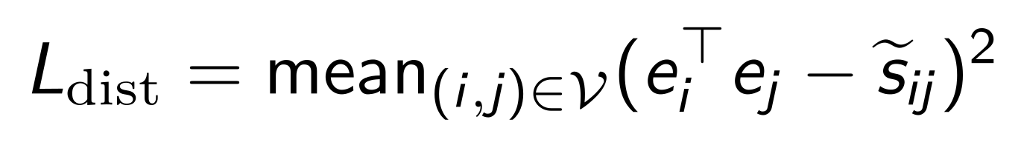
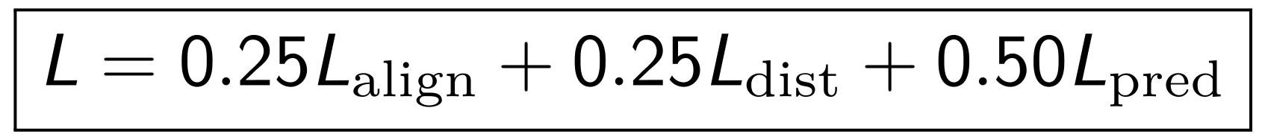
Joint objective: neighbors, similarity and response values
Loss | Role
Alignment | Fit neighbor probabilities using positive response similarity as soft weights
Distance | Fit numerical response similarity with embedding cosine similarity
Prediction | Recover response values with masks and label-weighted MSE
Does joint supervision improve retrieval in held-out cities?
Default temperature τ = 0.07. Valid pairs exclude self and invalid comparisons; SE shrinkage is optional.
Constant within-grid weights cancel in Pearson but affect prediction.
15
Notes:
To learn this representation, the model has three jobs: bring places with similar responses closer, match their similarity scores, and predict response values. We then check whether the learned representation helps in new cities.
Sources and figure notes:
Current project_intro.tex and frozen project assets. Conceptual diagrams are illustrations.
Assets: seminar_materials/.

Slide 16
Evaluation: shape, magnitude and direction
Task | Metric | Baselines
Shape retrieval | nn_corr@5 Mean similarity of 5 neighbors | Raw / Appearance AE / Random
Magnitude | RMSE | Training mean / Ridge / kNN
Direction | Sign accuracy | Training majority sign
5-fold city CV
Earlier city split
Features and direct prediction
Trained embeddings; three seeds
Fold-specific preprocessing and inner tuning; each protocol uses its own matched baseline.
16
Notes:
We check similar paths, prediction error, and the direction of change. For retrieval, we take the nearest places in the embedding and compare their response paths. Higher similarity means better neighbors. Prediction error measures how well we recover response values. Direction measures how often we get the sign right. Direct predictions use city cross-validation; learned representations use an earlier city split. Each comparison has its own baseline. We start with the original features.
Sources and figure notes:
Current project_intro.tex and frozen project assets. Conceptual diagrams are illustrations.
Assets: seminar_materials/.

Slide 17
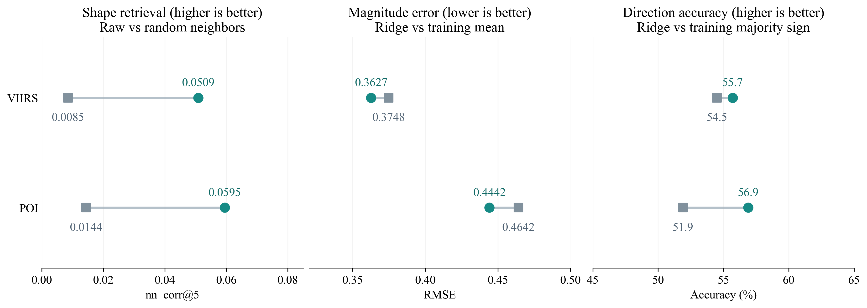
Result 1: do local features help predict responses?
Predicting responses in cities kept out of model fitting
POI direction: about 5 more correct predictions out of 100.
Five-fold city tests: original features and ridge. Direction baseline: the training set’s most common sign.
Shape baseline: random neighbors. Magnitude baseline: training mean.
17
Notes:
The original features carry a small signal. Read the three panels from left to right. On the left, areas that are close in their original features have more similar responses than random neighbors. In the middle, ridge, a simple linear prediction model, reduces error compared with using the training average. On the right, it also improves direction prediction. For POI, it gets direction right about five more times per hundred predictions than choosing the training set's most common direction. These tests keep entire cities out of model fitting. Together, they show that information available before opening carries some predictive signal across cities. This gives us a useful baseline for judging the added value of representation learning.
Sources and figure notes:
seminar_materials/data/representation_city_controls.csv. User-reported 5-fold city CV server aggregates; direction percentage-point gains are ridge versus training majority sign. No fold-level CI reconstructed.
Assets: seminar_materials/.

Slide 18
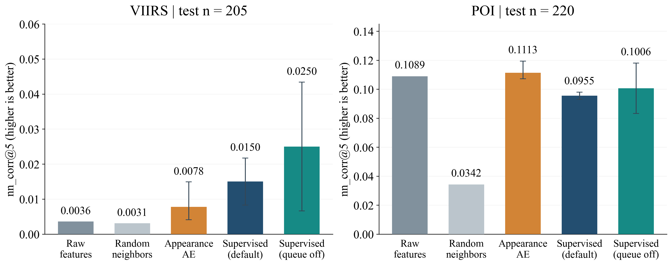
Result 2: do learned representations find better neighbors?
Finding places with similar changes after opening
Lights: higher average score
POI: original features do better
Earlier city split. Higher scores mean more similar response paths among five neighbors.
Model bars: mean ± SD across 3 runs; AE: reported range. Axes and samples differ.
18
Notes:
Next, we compare learned representations with the original features. Taller bars mean that the nearest places have more similar response paths. We also include an appearance autoencoder, which learns to reconstruct the original features. It gives us a comparison with a model trained without response supervision. For lights, the supervised models have higher average scores than the original features. For POI, the original features and appearance baseline do better. The two response families therefore lead to different results. The error bars for supervised models show variation across training runs. They help us see how much the average score depends on training. The next plot makes the gains and their variation easier to compare.
Sources and figure notes:
seminar_materials/data/representation_history.csv. Earlier city split. Supervised: mean and SD over three seeds; AE: reported range. Historical test pools VIIRS 205 / POI 220.
Assets: seminar_materials/.

Slide 19
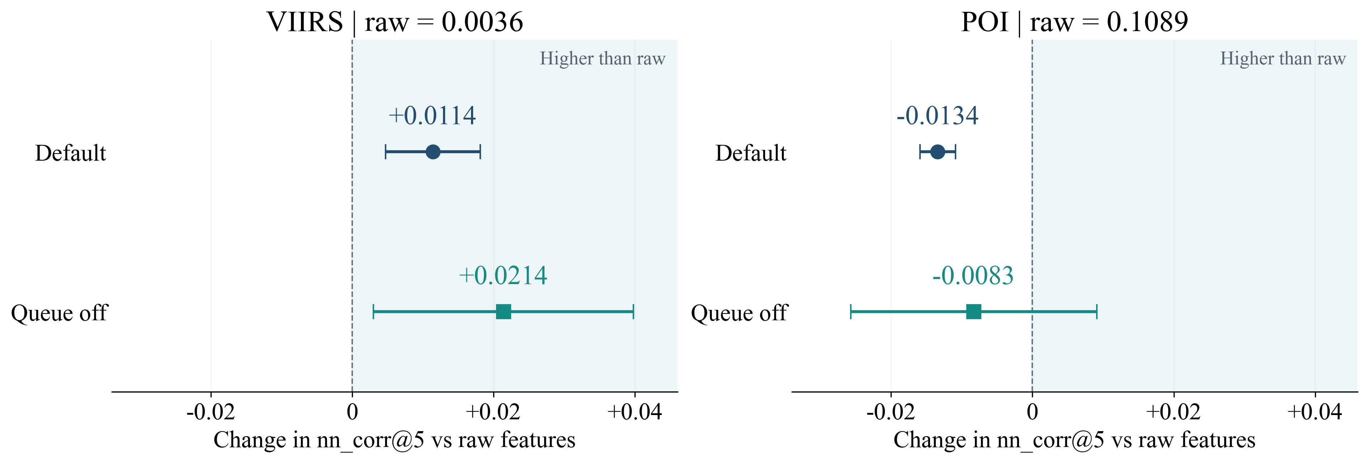
Training settings: do the gains hold up?
Zero = original feature score; right = improvement
Lights improve on average; results vary across training runs.
Earlier city split. Turning the queue off raises the light score and variation; POI stays below raw on average.
Dots: mean change in correlation score ± SD across 3 runs; zero is the original-feature baseline.
19
Notes:
Here, zero is the original-feature baseline, and moving right means improvement. The model can keep examples from earlier training batches to provide more candidates for comparison. We compare training with and without those stored examples. For lights, removing them raises the average score, but the longer horizontal bar shows more variation across runs. For POI, both settings stay below the original-feature baseline on average. So average performance and stability both matter when choosing a training setting. These results point toward keeping the useful original feature structure while adding response information. That is the next test shown on the final slide.
Sources and figure notes:
seminar_materials/data/representation_history.csv and intro_representation_gains.csv. Gains in correlation-score units, SD over three seeds. No city-level significance claim.
Assets: seminar_materials/.

Slide 20
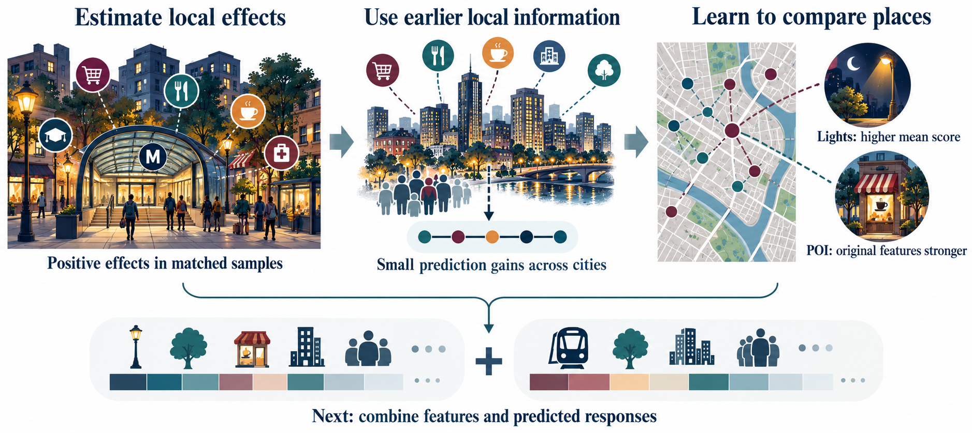
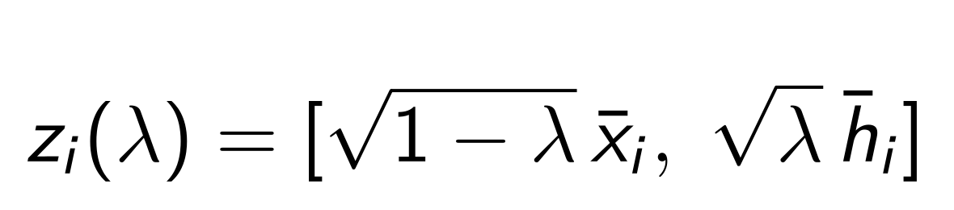
Takeaways: causal evidence and representation learning
Validation chooses the mix; test cities check the gain. Conceptual illustration; fusion results pending.
20
Notes:
These results connect causal evidence with representation learning. Matching shows positive effects on lights and local activity. Earlier information predicts a small part of the responses across cities. Learned representations have a higher mean retrieval score for lights, with variation across training runs. POI favors original features. Our next test combines original features with predicted responses. Validation cities choose the mix, and separate test cities measure the gain. The goal is to use response information while keeping useful local structure. Thank you.
Sources and figure notes:
Current project_intro.tex and frozen project assets. Conceptual diagrams are illustrations.
Assets: seminar_materials/.
Conceptual illustration generated with built-in GPT-image. Assets and prompts: seminar_materials/concept_figures_v8/. Concept curves do not report measured estimates.

Slide 21
References I
[1] Abadie, A., & Gardeazabal, J. (2003). The economic costs of conflict: A case study of the Basque Country. American Economic Review.
[2] Abadie, A., Diamond, A., & Hainmueller, J. (2010). Synthetic control methods for comparative case studies. Journal of the American Statistical Association.
[3] Abadie, A. (2021). Using synthetic controls: Feasibility, data requirements, and methodological aspects. Journal of Economic Literature.
[4] Xu, Y. (2017). Generalized synthetic control method. Political Analysis.
[5] Athey, S., Bayati, M., Doudchenko, N., Imbens, G., & Khosravi, K. (2021). Matrix completion methods for causal panel data models. Journal of the American Statistical Association.
[6] Callaway, B., & Sant’Anna, P. H. C. (2021). Difference-in-differences with multiple time periods. Journal of Econometrics.
[7] Sun, L., & Abraham, S. (2021). Estimating dynamic treatment effects in event studies with heterogeneous treatment effects. Journal of Econometrics.
[8] Goodman-Bacon, A. (2021). Difference-in-differences with variation in treatment timing. Journal of Econometrics.
21
Notes:
Reference page for discussion after the 20-slide main presentation. Entries reproduced from outputs/presentations/project_intro.pdf, page 22. Full reference list also appears in the source LaTeX document.

Slide 22
References II
[9] Imai, K., Kim, I. S., & Wang, E. H. (2023). Matching methods for causal inference with time-series cross-sectional data. American Journal of Political Science.
[10] Roth, J. (2022). Pretest with caution: Event-study estimates after testing for parallel trends. American Economic Review: Insights.
[11] Rambachan, A., & Roth, J. (2023). A more credible approach to parallel trends. Review of Economic Studies.
[12] Baum-Snow, N., & Kahn, M. E. (2000). The effects of new public projects to expand urban rail transit. Journal of Public Economics.
[13] Gibbons, S., & Machin, S. (2005). Valuing rail access using transport innovations. Journal of Urban Economics.
[14] Debrezion, G., Pels, E., & Rietveld, P. (2007). The impact of railway stations on residential and commercial property value: A meta-analysis. The Journal of Real Estate Finance and Economics.
[15] Zheng, S., & Kahn, M. E. (2008). Land and residential property markets in a booming economy: New evidence from Beijing. Journal of Urban Economics.
[16] Gonzalez-Navarro, M., & Turner, M. A. (2018). Subways and urban growth: Evidence from Earth. Journal of Urban Economics.
22
Notes:
Reference page for discussion after the 20-slide main presentation. Entries reproduced from outputs/presentations/project_intro.pdf, page 23. Full reference list also appears in the source LaTeX document.

Slide 23
References III
[17] Dong, H. (2017). Rail-transit-induced gentrification and the affordability paradox of TOD. Journal of Transport Geography.
[18] Cervero, R., & Kockelman, K. (1997). Travel demand and the 3Ds: Density, diversity, and design. Transportation Research Part D.
[19] Lu, K., Han, B., Lu, F., & Wang, Z. (2016). Urban rail transit in China: Progress report and analysis (2008–2015). Urban Rail Transit.
[20] Bao, X. (2018). Urban rail transit present situation and future development trends in China: Overall analysis based on national policies and strategic plans in 2016–2020. Urban Rail Transit.
[21] Wang, L., & Xia, H. (2024). A comprehensive review of the development characteristics and future trends of TOD in Chinese urban rail transit. Urban Rail Transit.
[22] Jean, N., Burke, M., Xie, M., Davis, W. M., Lobell, D. B., & Ermon, S. (2016). Combining satellite imagery and machine learning to predict poverty. Science.
[23] Rolf, E., Proctor, J., Carleton, T., Bolliger, I., Shankar, V., Ishihara, M., Recht, B., & Hsiang, S. (2021). A generalizable and accessible approach to machine learning with global satellite imagery. Nature Communications.
[24] Chen, T., Kornblith, S., Norouzi, M., & Hinton, G. (2020). A simple framework for contrastive learning of visual representations. International Conference on Machine Learning.
23
Notes:
Reference page for discussion after the 20-slide main presentation. Entries reproduced from outputs/presentations/project_intro.pdf, page 24. Full reference list also appears in the source LaTeX document.

Slide 24
References IV
[25] He, K., Fan, H., Wu, Y., Xie, S., & Girshick, R. (2020). Momentum contrast for unsupervised visual representation learning. IEEE/CVF Conference on Computer Vision and Pattern Recognition.
[26] Khosla, P., Teterwak, P., Wang, C., Sarna, A., Tian, Y., Isola, P., Maschinot, A., Liu, C., & Krishnan, D. (2020). Supervised contrastive learning. Advances in Neural Information Processing Systems.
[27] Oquab, M., Darcet, T., Moutakanni, T., et al. (2024). DINOv2: Learning robust visual features without supervision. Transactions on Machine Learning Research.
[28] Schölkopf, B., Locatello, F., Bauer, S., Ke, N. R., Kalchbrenner, N., Goyal, A., & Bengio, Y. (2021). Toward causal representation learning. Proceedings of the IEEE.
[29] Mayer, T., & Trevien, C. (2017). The impact of urban public transportation: Evidence from the Paris region. Journal of Urban Economics.
[30] Diao, M., Leonard, D., & Sing, T. F. (2017). Spatial-difference-in-differences models for impact of new mass rapid transit line on private housing values. Regional Science and Urban Economics.
[31] Bardaka, E., Delgado, M. S., & Florax, R. J. G. M. (2018). Causal identification of transit-induced gentrification and spatial spillover effects: The case of the Denver light rail. Journal of Transport Geography.
[32] Wang, Z., Li, H., & Rajagopal, R. (2020). Urban2Vec: Incorporating street view imagery and POIs for multi-modal urban neighborhood embedding. AAAI.
24
Notes:
Reference page for discussion after the 20-slide main presentation. Entries reproduced from outputs/presentations/project_intro.pdf, page 25. Full reference list also appears in the source LaTeX document.

Slide 25
References V
[33] Li, Y., Huang, W., Cong, G., Wang, H., & Wang, Z. (2023). Urban region representation learning with OpenStreetMap building footprints. KDD.
[34] Wei, Y., Zheng, Y., & Yang, Q. (2016). Transfer knowledge between cities. KDD.
[35] Tec, M., Scott, J. G., & Zigler, C. M. (2023). Weather2vec: Representation learning for causal inference with non-local confounding in air pollution and climate studies. AAAI.
[36] Zeng, J., Zhang, G., Rong, C., Ding, J., Yuan, J., & Li, Y. (2022). Causal learning empowered OD prediction for urban planning. CIKM.
[37] Fang, Z., Zheng, Q., Zheng, S., & Zhao, L. (2025). CGNet-PIE: A causal generative approach for urban planning intervention effect estimation. Transactions in Urban Data, Science, and Technology.
[38] Ahuja, K., Mahajan, D., Wang, Y., & Bengio, Y. (2023). Interventional causal representation learning. ICML.
25
Notes:
Reference page for discussion after the 20-slide main presentation. Entries reproduced from outputs/presentations/project_intro.pdf, page 26. Full reference list also appears in the source LaTeX document.

