Slide 1
PREHISTORIC GIANTS
The 5 Most Famous Dinosaurs
Explore their characteristics, habitats, and secrets
T-Rex · Triceratops · Velociraptor · Brachiosaurus · Stegosaurus
Jurassic & Cretaceous Periods • Millions of Years of Dominance

Slide 2
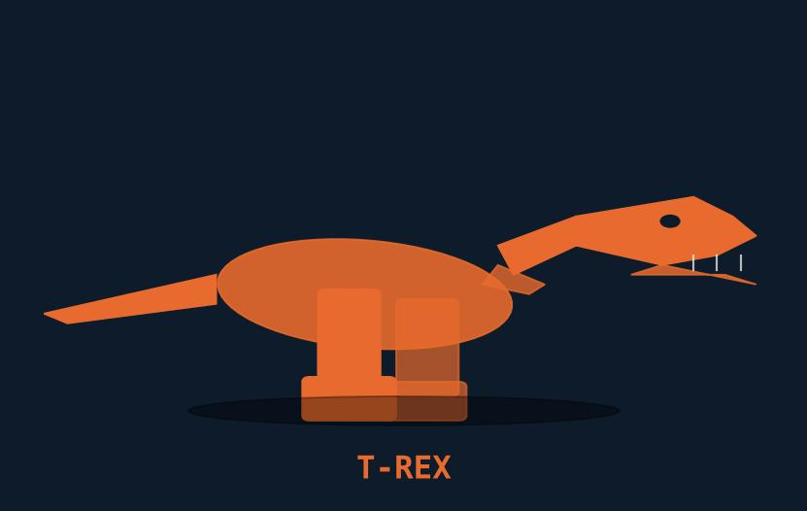
TYRANNOSAURUS REX
Late Cretaceous • 68–66 million years ago
KEY FACTS
1
One of the largest land predators ever to walk the Earth.
2
Tiny arms but a skull over 1.5 m long packed with 60 serrated teeth.
3
Could bite with ~57,000 N of force — the strongest of any land animal.
4
Likely had excellent binocular vision and a keen sense of smell.
LENGTH
WEIGHT
DIET
FOUND IN
12–13 m (40 ft)
8–14 tonnes
Carnivore
North America
5
Recent evidence suggests it may have been partially feathered.
1 / 5

Slide 3
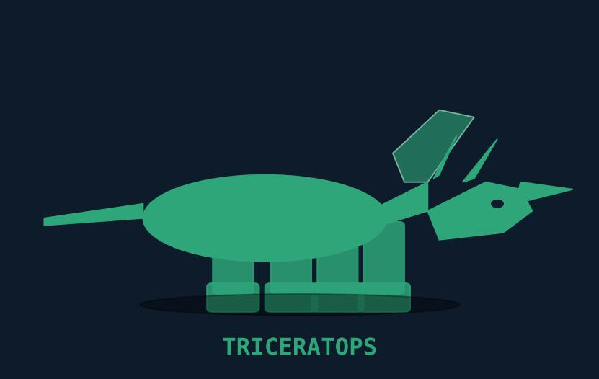
TRICERATOPS
Late Cretaceous • 68–66 million years ago
KEY FACTS
1
Three-horned face: two brow horns up to 1 m long and a short nose horn.
2
The large bony frill at the back of the skull may have been used for display.
3
One of the last non-avian dinosaurs before the mass extinction event.
4
Grazed on low-lying vegetation using a powerful parrot-like beak.
LENGTH
WEIGHT
DIET
FOUND IN
8–9 m (29 ft)
6–12 tonnes
Herbivore
North America
5
Often depicted locked in combat with T-Rex — both lived at the same time.
2 / 5

Slide 4
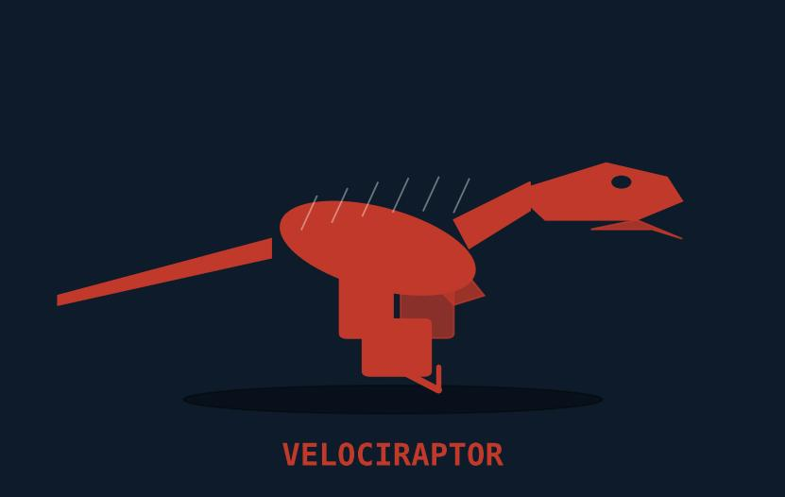
VELOCIRAPTOR
Late Cretaceous • 75–71 million years ago
KEY FACTS
1
Much smaller than depicted in Jurassic Park — closer to a large turkey.
2
Covered in feathers; closely related to modern birds.
3
Sickle-shaped retractable claw on each foot used to pin prey.
4
Hunted alone rather than in packs, based on fossil evidence.
LENGTH
WEIGHT
DIET
FOUND IN
1.8–2.0 m (6 ft)
15–20 kg
Carnivore
Mongolia / China
5
Had a relatively large brain, suggesting high intelligence for a dinosaur.
3 / 5

Slide 5
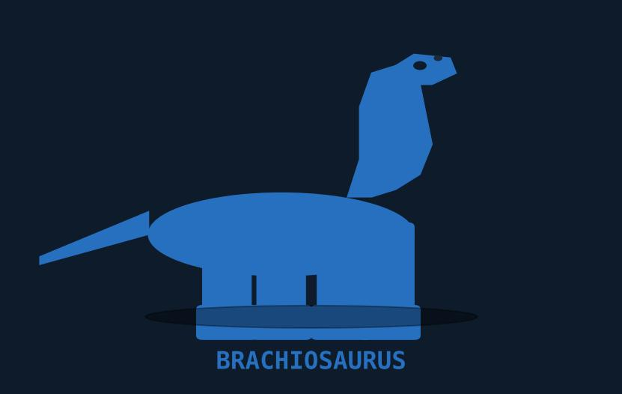
BRACHIOSAURUS
Late Jurassic • 154–153 million years ago
KEY FACTS
1
One of the tallest dinosaurs — could reach 13 m high (4-storey building).
2
Front legs longer than hind legs, giving it a giraffe-like stance.
3
Consumed up to 400 kg of vegetation per day to fuel its massive body.
4
Nostrils positioned on top of the skull, once thought to help it breathe underwater.
LENGTH
WEIGHT
DIET
FOUND IN
20–26 m (85 ft)
28–62 tonnes
Herbivore
North America / Africa
5
The neck alone was estimated at 9 m long with 13 elongated vertebrae.
4 / 5

Slide 6
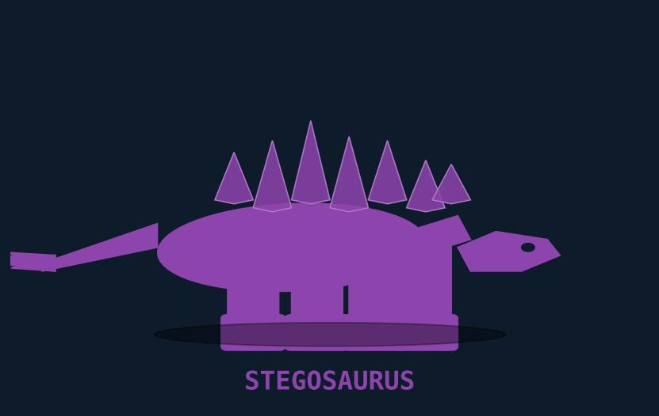
STEGOSAURUS
Late Jurassic • 155–150 million years ago
KEY FACTS
1
Famous for the two rows of large bony plates running along its back.
2
The tail ended in four sharp spikes (thagomizer) used for self-defense.
3
Had a brain the size of a walnut — one of the smallest brain-to-body ratios.
4
Plates may have regulated body temperature or served as display structures.
LENGTH
WEIGHT
DIET
FOUND IN
6–9 m (30 ft)
2.3–7 tonnes
Herbivore
North America / Europe
5
Coexisted with Brachiosaurus and Allosaurus in the Morrison Formation.
5 / 5

