Slide 1
Pytorch study meeting Week9 §6.4~6.5
Mitarai Matsunaga lab.
B4 Takashi Inoue

Slide 2
Today’s Outline
6.4 Faster emotion analysis
→using fastText , average pooling for text
6.5 Emotion analysis using CNN(畳み込みニューラルネットワーク)
→How to use CNN for text data

Slide 3
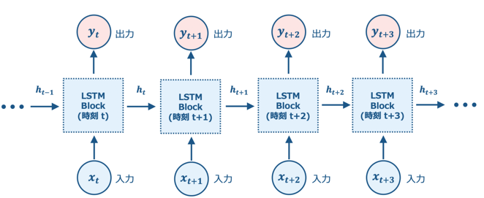
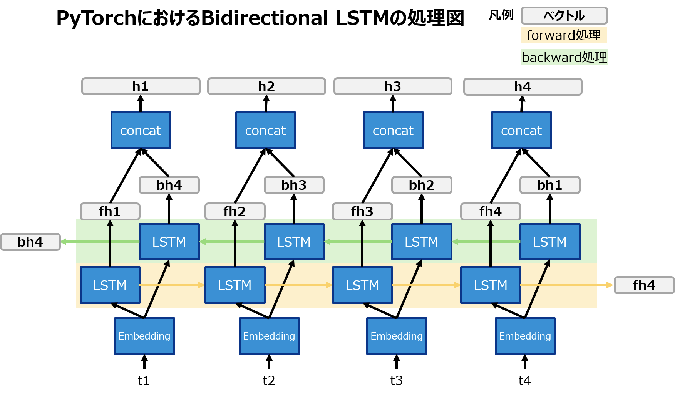
Review
From Week 8 slide
Convientional RNN can’t handle important temporal relationships such as text
But LSTM and Bidirectional LSTM take more time to process
Vanishing gradients https://qiita.com/Suchmos7/items/1b2d76028ae34dfad975

Slide 4
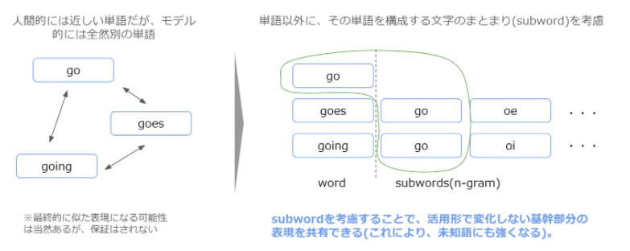
fastText
https://qiita.com/icoxfog417/items/42a95b279c0b7ad26589
Segment words by n-gram
Including character information in word representations

Slide 5
fastText
Break down into words
How
are
you
How are you?
How are
Are you
You ?
Bi-gram

Slide 6
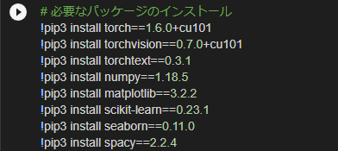
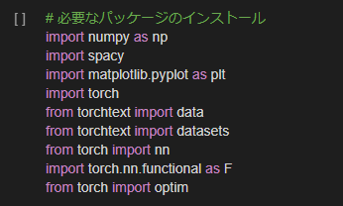
Preparing for implementing fastText
Install the necessary packages

Slide 7
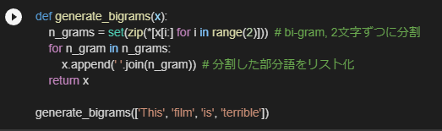

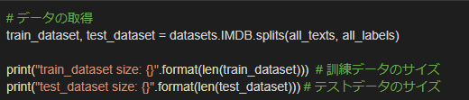
Preparing for implementing fastText
Defining Bi-gram

Slide 8
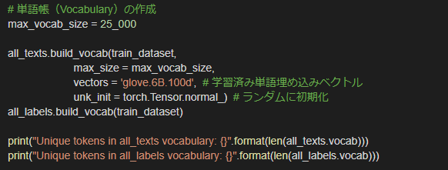



Preparing for implementing fastText
For confirmation

Slide 9
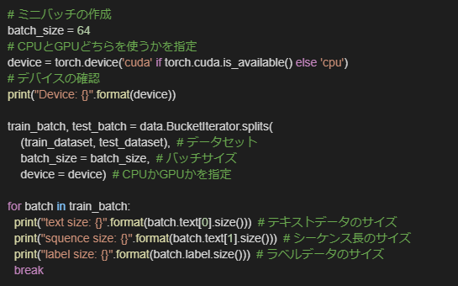
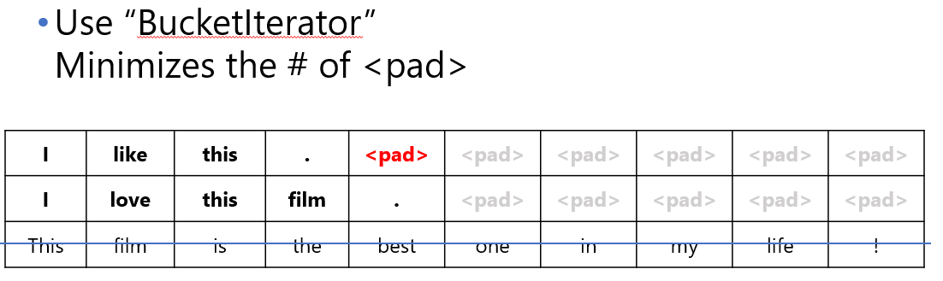
Preparing for implementing fastText
Same as week8
Review)BucketInterator

Slide 10
Definition of NN
0 or 1
Positive or Negative
Full connected layer
Out put average for embedded layer
embedded layer
I
love
this
film

Slide 11
Average pooling
I
love
Dimension of
text length
this
flim
Dimension of embedding
Tensor
1 x (dimension of embedding)
Average pooling

Slide 12
Review from week5
プーリング層
・決まったルールに基づいて画像のサイズを小さくする
・学習パラメータを持たない
・画像の位置ずれに強い
最大値をプーリング
9 | 2 | 0 | 1
1 | 5 | 1 | 4
2 | 5 | 4 | 1
1 | 7 | 6 | 6
9 | 4
7 | 6
画像
ダウンサンプリング

Slide 13
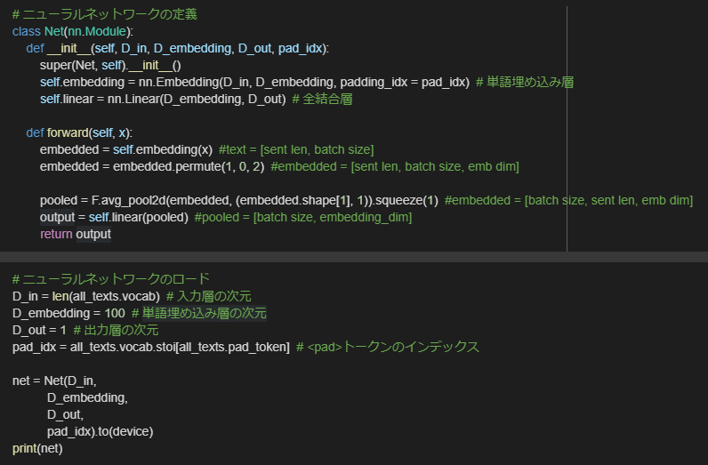
Definition of NN

Slide 14


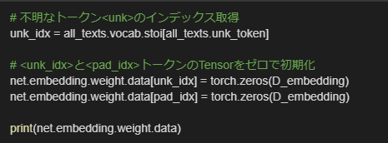
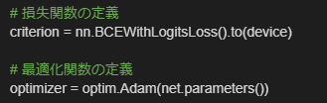
Definition of NN
Same as Week8

Slide 15
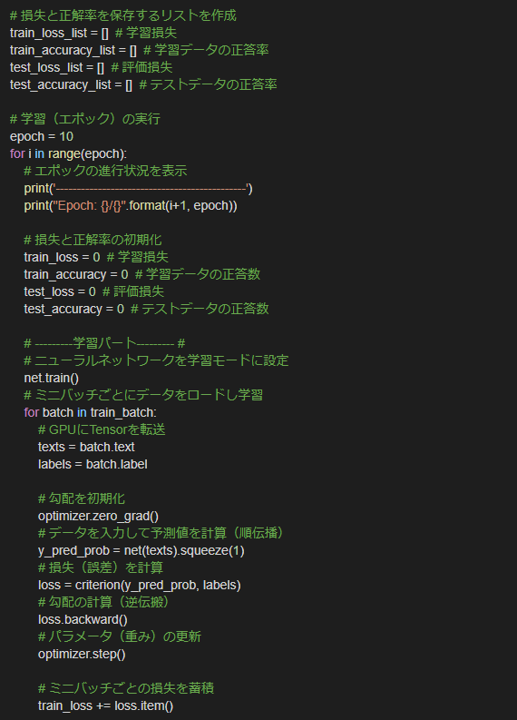
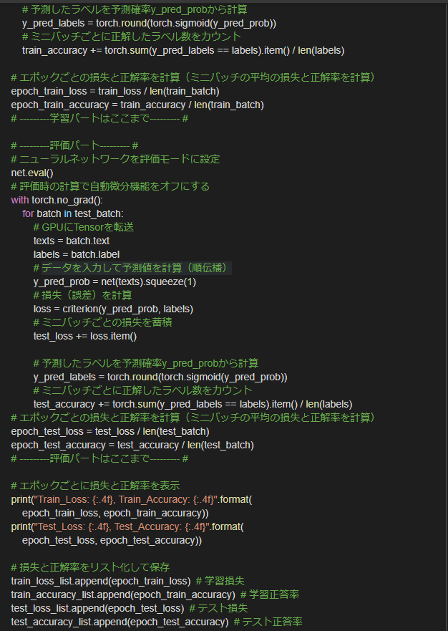
Learning

Slide 16
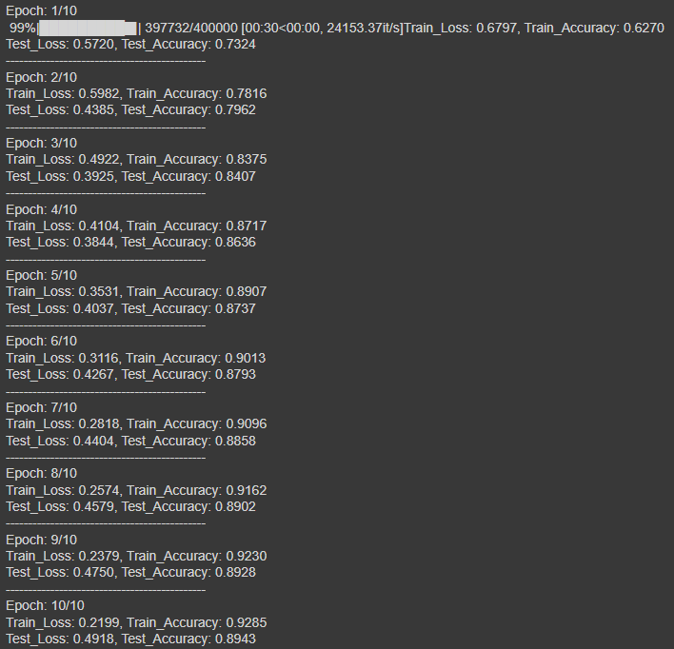
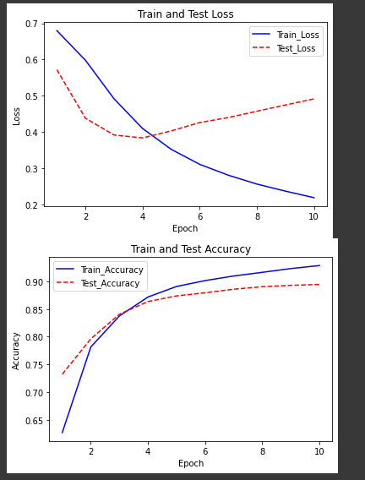
Learing results
LSTM→11min
fastText →3min

Slide 17
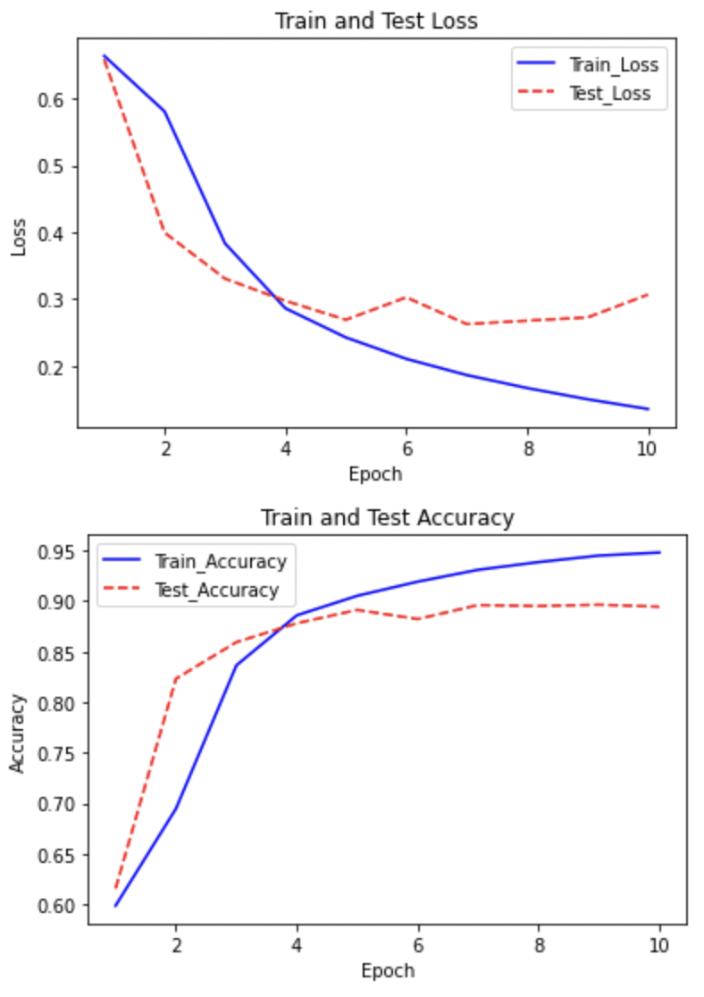
Learing results
LSTM→11min
fastText →3min

Slide 18
How to analysis emotion by CNN
Bi-gram
Filter for CNN of picture analysis
Filter for CNN of word analysis

Slide 19
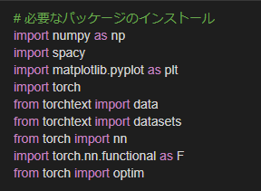
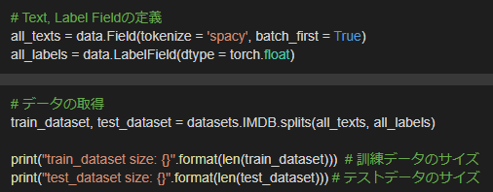
Preparing for implementing CNN
Not necessary since CNN does the text segmentation instead of bi-gram

Slide 20
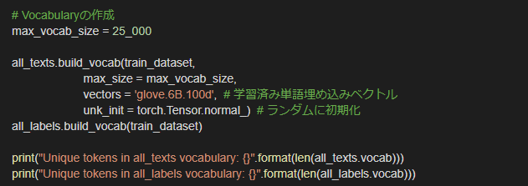
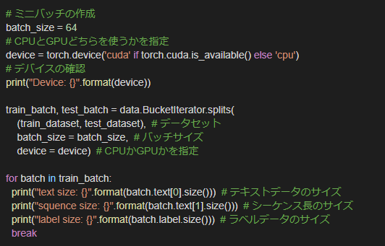
Preparing for implementing CNN

Slide 21
Definition of NN
I
Output
love
this
flim
Embedding by Filter size(2x5)
Dimension of embedding
Output

Slide 22
Definition of NN
I
0.6
0.2
0.8
love
0.8
Output
this
flim
Max pooling
What is the difference between Max pooling and average pooling?

Slide 23
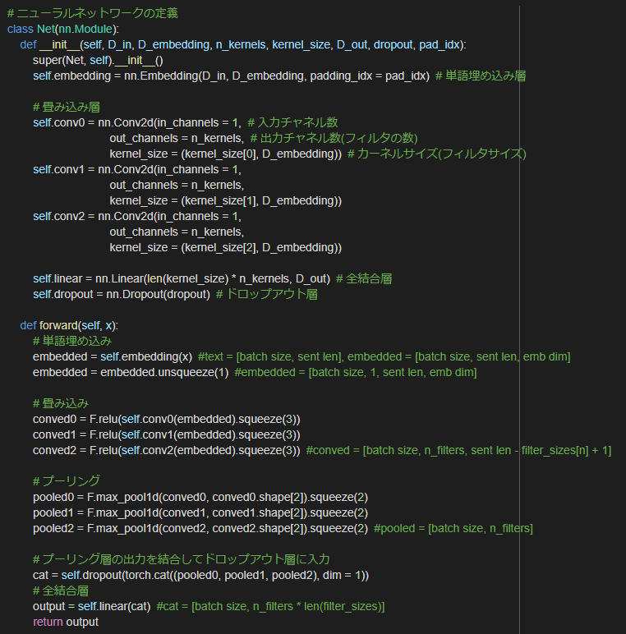
Definition of NN

Slide 24
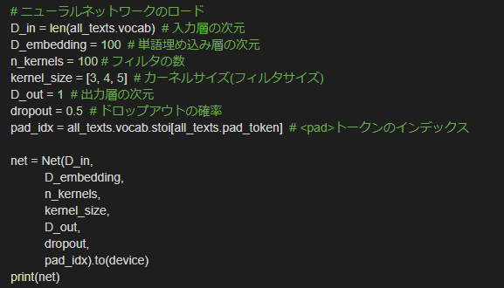
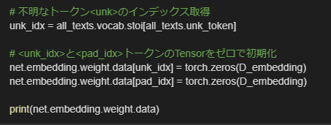
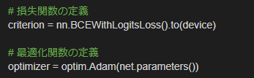


Definition of NN

Slide 25
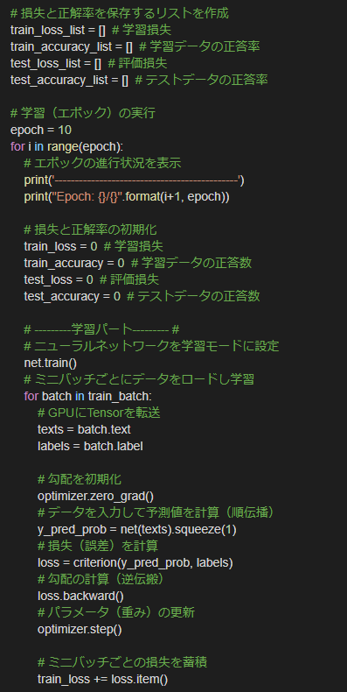
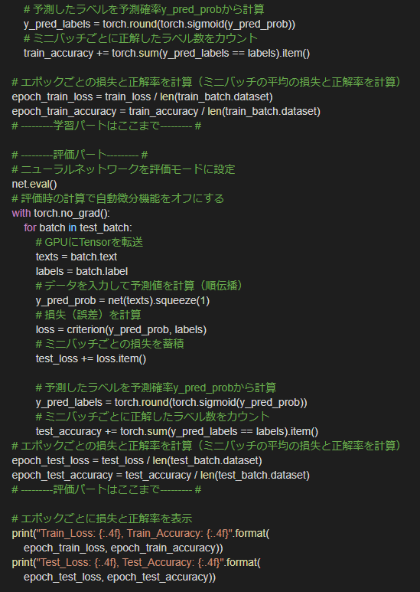
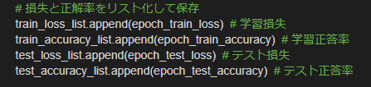
Learning

Slide 26
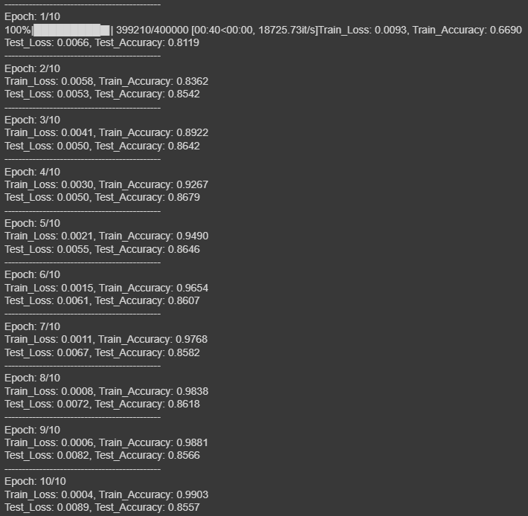
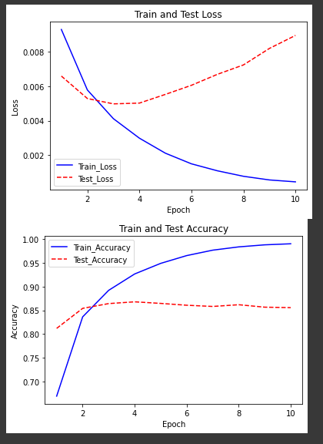
Result

Slide 27
summary
By using fastText, we can improve the processing speed compared to LSTM, and the accuracy is almost the same.
By using filters that group words together, such as fastText, CNN can be used in a similar way to image analysis.

