Slide 1
IS467: Fundamentals of Data Science
Quarter: Autumn 2016
Aleksandar Velkoski
Email: avelkosk@cdm.depaul.edu
Homepage: github.com/avelkoski
School of Computing, CDM, DePaul University

Slide 2
Review of Lecture 6
Bayes Classification Methods
  Bayes Theorem
  Naïve Bayes Classifier
  Zero Probability Problem
  Comments
  Naïve Bayes in Scikit Learn
k-Nearest-Neighbor (kNN) Classification
  Basics of kNN
  Review of Distance Measures
  Comments
  kNN in Scikit Learn
Demo
Data Mining: Concepts and Techniques

Slide 3
Outline of Lecture 7
What is cluster analysis?
How are various approaches characterized?
Partitioning Methods
Hierarchical Methods
Demo
Data Mining: Concepts and Techniques

Slide 4
What is Cluster Analysis?
Finding groups of objects such that the objects in a group will be similar (or related) to one another and different from (or unrelated to) the objects in other groups
Inter-cluster distances are maximized
Intra-cluster distances are minimized

Slide 5
What is Cluster Analysis?
Cluster: a collection of data objects
  Similar to one another within the same cluster
  Dissimilar to the objects in other clusters
Cluster analysis
  Grouping a set of data objects into clusters
Clustering is unsupervised classification: no predefined classes
Typical applications
  As a stand-alone tool to get insight into data distribution
  As a preprocessing step for other algorithms

Slide 6
What is not Cluster Analysis?
Supervised classification
  Have class label information
Simple segmentation
  Dividing students into different registration groups alphabetically, by last name
Results of a query
  Groupings are a result of an external specification
Graph partitioning
  Some mutual relevance and synergy, but areas are not identical

Slide 7
Notion of a Cluster can be Ambiguous
How many clusters?

Slide 8
Notion of a Cluster can be Ambiguous
How many clusters?
Six Clusters
Two Clusters
Four Clusters

Slide 9
Types of Clusterings
A clustering is a set of clusters
Important distinction between hierarchical and partitional sets of clusters
Partitional Clustering
  A division data objects into non-overlapping subsets (clusters) such that each data object is in exactly one subset
Hierarchical clustering
  A set of nested clusters organized as a hierarchical tree

Slide 10

Partitional Clustering (k-means)
Original Points
A Partitional Clustering

Slide 11
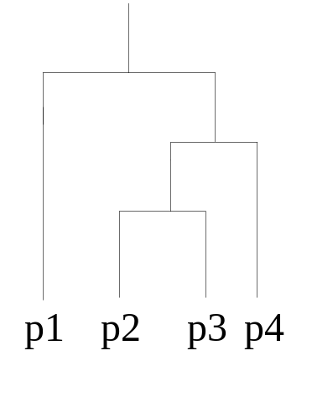
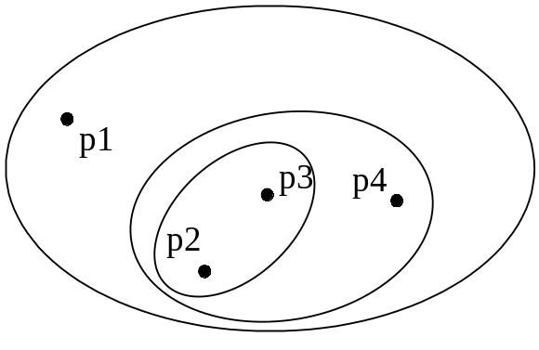
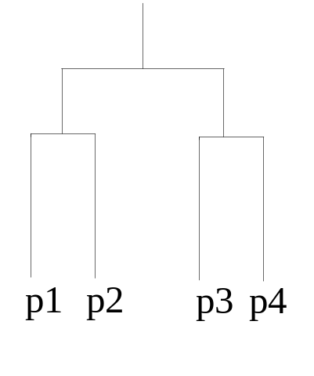
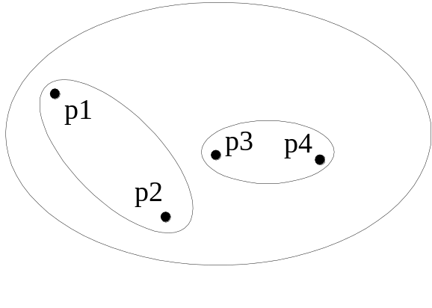
Hierarchical Clustering
Traditional Hierarchical Clustering
Traditional Dendrogram
Non-traditional Hierarchical Clustering
Non-traditional Dendrogram

Slide 12
Other Distinctions Between Sets of Clusters
Exclusive versus non-exclusive
  In non-exclusive clusterings, points may belong to multiple clusters.
  Can represent multiple classes or ‘border’ points
Fuzzy versus non-fuzzy
  In fuzzy clustering, a point belongs to every cluster with some weight between 0 and 1
  Weights must sum to 1
  Probabilistic clustering has similar characteristics
Partial versus complete
  In some cases, we only want to cluster some of the data
Heterogeneous versus homogeneous
  Cluster of widely different sizes, shapes, and densities

Slide 13
Types of Clusters
Well-separated clusters
Center-based clusters
Contiguous clusters
Density-based clusters
Property or Conceptual
Described by an Objective Function

Slide 14

Types of Clusters: Well-Separated
Well-Separated Clusters:
  A cluster is a set of points such that any point in a cluster is closer (or more similar) to every other point in the cluster than to any point not in the cluster.
3 well-separated clusters

Slide 15

Types of Clusters: Center-Based
Center-based
  A cluster is a set of objects such that an object in a cluster is closer (more similar) to the “center” of a cluster, than to the center of any other cluster
  The center of a cluster is often a centroid, the average of all the points in the cluster, or a medoid, the most “representative” point of a cluster
4 center-based clusters

Slide 16
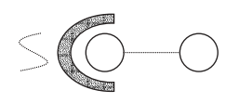
Types of Clusters: Contiguity-Based
Contiguous Cluster
A cluster is a set of points such that a point in a cluster is closer (or more similar) to one or more other points in the cluster than to any point in a different cluster.
8 contiguous clusters

Slide 17
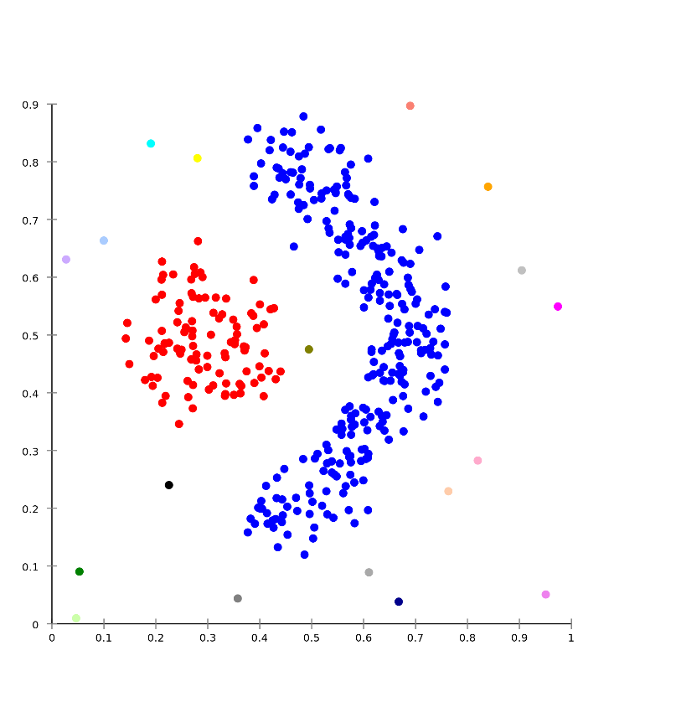
Types of Clusters: Density-Based
Density-based
  A cluster is a dense region of points, which is separated by low-density regions, from other regions of high density.
  Used when the clusters are irregular or intertwined, and when noise and outliers are present.
6 density-based clusters

Slide 18
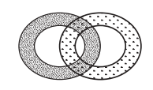
Types of Clusters: Conceptual Clusters
Shared Property or Conceptual Clusters
  Finds clusters that share some common property or represent a particular concept.
2 Overlapping Circles

Slide 19
Types of Clusters: Objective Function
Clusters Defined by an Objective Function
  Finds clusters that minimize or maximize an objective function.
  Enumerate all possible ways of dividing the points into clusters and evaluate the `goodness' of each potential set of clusters by using the given objective function. (NP Hard)
  Can have global or local objectives.
    Hierarchical clustering algorithms typically have local objectives
    Partitional algorithms typically have global objectives
  A variation of the global objective function approach is to fit the data to a parameterized model.
    Parameters for the model are determined from the data.
    Mixture models assume that the data is a ‘mixture' of a number of statistical distributions.

Slide 20
Types of Clusters: Objective Function …
Map the clustering problem to a different domain and solve a related problem in that domain
  Proximity matrix defines a weighted graph, where the nodes are the points being clustered, and the weighted edges represent the proximities between points
  Clustering is equivalent to breaking the graph into connected components, one for each cluster.
  Want to minimize the edge weight between clusters and maximize the edge weight within clusters

Slide 21
General Applications of Clustering
Pattern Recognition
Image Processing
Economic Science (especially market research)
Text mining: Document classification
Cluster Web log data to discover similar users with similar access patterns
Marketing: Help marketers discover distinct groups in their customer bases, and then use this knowledge to develop targeted marketing programs

Slide 22
Examples of Clustering Applications
Land use: Identification of areas of similar land use in an earth observation database
Insurance: Identifying groups of motor insurance policy holders with a high average claim cost
City-planning: Identifying groups of houses according to their house type, value, and geographical location
Earth-quake studies: Observed earth quake epicenters should be clustered along continent faults

Slide 23
What Is Good Clustering?
A good clustering method will produce high quality clusters with
  high intra-class similarity (i.e. similarity of objects within clusters)
  low inter-class similarity (i.e. great variation between clusters)
The quality of a clustering result depends on both the similarity measure used by the method and its implementation.
The quality of a clustering method is also measured by its ability to discover some or all of the hidden patterns.

Slide 24


Data Structures
Data matrix
Dissimilarity matrix

Slide 25
Characteristics of the Input Data Are Important
Type of proximity or density measure
  This is a derived measure, but central to clustering
Sparseness
  Dictates type of similarity
  Adds to efficiency
Attribute type
  Dictates type of similarity
Type of Data
  Dictates type of similarity
  Other characteristics, e.g., autocorrelation
Dimensionality
Noise and Outliers
Type of Distribution

Slide 26
Measure the Quality of Clustering
Dissimilarity/Similarity metric: Similarity is expressed in terms of a distance function, or metric: d(i, j)
There is a separate “quality” function that measures the “goodness” of a cluster.
The distance functions depend on variable types and are usually very different for interval-scaled, boolean, categorical, ordinal and ratio variables.
It is hard to define “similar enough” or “good enough”
  the answer is typically highly subjective.

Slide 27
Major Clustering Approaches
Partitioning algorithms: Construct various partitions and then evaluate them by some criterion
Hierarchy algorithms: Create a hierarchical decomposition of the set of data (or objects) using some criterion
Density-based: based on connectivity and density functions
Grid-based: based on a multiple-level granularity structure
Model-based: A model is hypothesized for each of the clusters and the idea is to find the best fit of that model to each other

Slide 28
Partitioning Algorithms: Basic Concept
Partitioning method: Partitioning a database D of n objects into a set of k clusters, such that the sum of squared distances is minimized (where c_{i} is the centroid or medoid of cluster C_{i})
Given k, find a partition of k clusters that optimizes the chosen partitioning criterion
  Global optimal: exhaustively enumerate all partitions
  Heuristic methods: k-means and k-medoids algorithms
  k-means (MacQueen’67, Lloyd’57/’82): Each cluster is represented by the center of the cluster
  k-medoids or PAM (Partition around medoids) (Kaufman & Rousseeuw’87): Each cluster is represented by one of the objects in the cluster

Slide 29

K-means Clustering
Attributes are scale variables
Each cluster is associated to a centroid (center point)
Each point is assigned to the cluster with the closest centroid
Number of clusters, K, must be specified
The basic algorithm is very simple

Slide 30
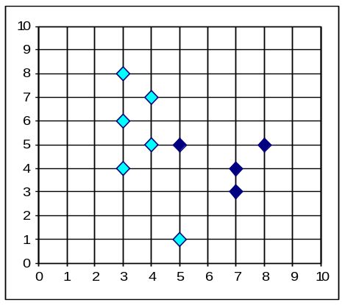


The K-Means Clustering Method
Mean for cluster 1
Mean for cluster 2
Center for cluster 1
Center for cluster 2
10
10
9
9
8
8
7
7
6
6
5
5
4
Assign each objects to most similar center
Find the means for each cluster
4
3
3
2
2
1
1
0
0
0
1
2
3
4
5
6
7
8
9
10
0
1
2
3
4
5
6
7
8
9
10
reassign
reassign
K=2
Arbitrarily choose K object as initial cluster center
Update the cluster means

Slide 31

K-means Clustering – Details
Initial centroids are often chosen randomly.
  Clusters vary from one run to another.
The centroid is (typically) the mean of the points in the cluster: (for P attributes)
‘Closeness’ is measured by Euclidean distance, cosine similarity, correlation, etc.
K-means will converge for common similarity measures mentioned above.
Most of the convergence happens in the first few iterations.
  Often the stopping condition is changed to ‘Until relatively few points change clusters’
Complexity is O( n * K * I * d )
  n = number of points, K = number of clusters,
  I = number of iterations, d = number of attributes

Slide 32






Importance of Choosing Initial Centroids

Slide 33
Importance of Choosing Initial Centroids

Slide 34
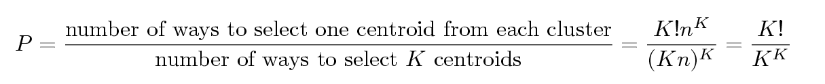
Problems with Selecting Initial Points
If there are K ‘TRUE’ clusters then the chance of selecting one centroid from each cluster is small.
  Chance is relatively small when K is large
  If clusters are the same size, n, then
  For example, if K = 10, then probability = 10!/10¹⁰ = 0.00036
  Sometimes the initial centroids will readjust themselves in ‘right’ way, and sometimes they don’t

Slide 35
Solutions to Initial Centroids Problem
Multiple runs
  Helps, but probability is not on your side
Sample and use hierarchical clustering to determine initial centroids
Select more than k initial centroids and then select among these initial centroids
  Select most widely separated
Postprocessing

Slide 36
Pre-processing and Post-processing
Pre-processing
  Normalize the data
  Eliminate outliers
Post-processing
  Eliminate small clusters that may represent outliers
  Split ‘loose’ clusters, i.e., clusters with relatively high SSE
  Merge clusters that are ‘close’ and that have relatively low SSE
  Can use these steps during the clustering process

Slide 37
Limitations of K-means
K-means has problems when clusters are of different
  Sizes
  Densities
  Non-globular shapes
K-means has problems when the data contains outliers.

Slide 38


Limitations of K-means: Differing Sizes
Original Points
K-means (3 Clusters)

Slide 39


Limitations of K-means: Differing Density
Original Points
K-means (3 Clusters)

Slide 40
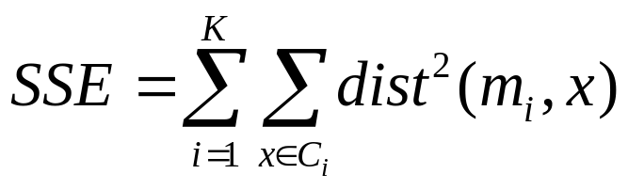
Evaluating “Quality” of K-means Clusters
Most common measure is Sum of Squared Error (SSE)
  For each point, the error is the distance to the nearest cluster
  To get SSE, we square these errors and sum them.
  x is a data point in cluster C_{i} and m_{i} is the centroid (representative point for cluster C_{i} ) (a.k.a. mean of the cluster)
  Given two clusters, we can choose the one with the smallest error SSE
  One easy way to reduce SSE is to increase K, the number of clusters
    A good clustering with smaller K can have a lower SSE than a poor clustering with higher K

Slide 41


Evaluating clusters quality
The sum of squared error is defined as
This criterion defines clusters by their mean vectors m_{i,}and minimizes the sum of the squared lengths of the error x – m_{i} (distance of object x from centroid m_{i})
The minimum variance partition minimizes SSE
  Good when clusters form well separated compact clouds (SSE is small)
  Bad with large differences in the number of samples in different clusters. (SSE is large)
SSE small
SSE large

Slide 42
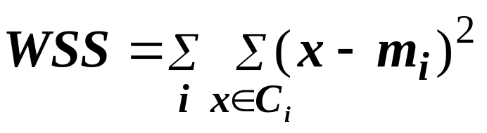
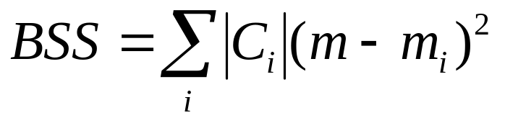
Internal Measures: Cohesion and Separation
Cluster Cohesion: Measures how closely related are objects in a cluster
Cluster Separation: Measure how distinct or well-separated a cluster is from other clusters
Example: Squared Error
  Cohesion is measured by the cluster within sum of squares (SSE)
  Separation is measured by the cluster between sum of squares
      Where |C_{i}| is the size of cluster i

Slide 43
Internal Measures: Cohesion and Separation
Separation measures inter-cluster distances
Cohesion measures intra-cluster distances
Good clusters: Maximizes separation and minimizes cohesion

Slide 44
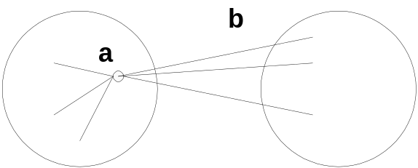
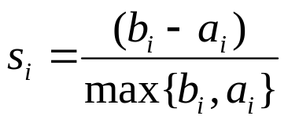
Clustering evaluation: Silhouette Coefficient
Silhouette Coefficient combine ideas of both cohesion and separation, but for individual points, as well as clusters
For an individual point, i
  Calculate a_{i} = average distance of i to the points in its cluster
  Calculate b_{i} = min (average distance of i to points in another cluster)
  The silhouette coefficient for a point is then given by
  -1< S_{i} < 1 - The closer to 1 the better.
Average Silhouette width is global measure of cluster.

Slide 45
Summary on the K-Means Method
Comment: Often terminates at a local optimum. The global optimum may be found using techniques such as: deterministic annealing and genetic algorithms
Weakness
  Applicable only when mean is defined, then what about categorical data?
  Need to specify k, the number of clusters, in advance
  Unable to handle noisy data and outliers
  Not suitable to discover clusters with non-convex shapes

Slide 46
Variations of the K-Means Method
A few variants of the k-means which differ in
  Selection of the initial k means
  Dissimilarity calculations
  Strategies to calculate cluster means
Handling categorical data: k-modes (Huang’98)
  Replacing means of clusters with modes
  Using new dissimilarity measures to deal with categorical objects
  Using a frequency-based method to update modes of clusters
  A mixture of categorical and numerical data: k-prototype method

Slide 47
What is the problem of k-Means Method?
The k-means algorithm is sensitive to outliers !
  Since an object with an extremely large value may substantially distort the distribution of the data.
K-Medoids: Instead of taking the mean value of the object in a cluster as a reference point, medoids can be used, which is the most centrally located object in a cluster (analogous to medians in one-dimensional space).
10
10
9
9
8
8
7
7
6
6
5
5
4
4
3
3
2
2
1
1
0
0
1
2
3
4
5
6
7
8
9
10
0
0
1
2
3
4
5
6
7
8
9
10

Slide 48
The K-Medoids Clustering Method
Find representative objects, called medoids, in clusters
PAM (Partitioning Around Medoids, 1987)
  starts from an initial set of medoids and iteratively replaces one of the medoids by one of the non-medoids if it improves the total distance of the resulting clustering
  PAM works effectively for small data sets, but does not scale well for large data sets:O(k(n-k)² ) for each iteration
where n is # of data,k is # of clusters
CLARA (Kaufmann & Rousseeuw, 1990)
CLARANS (Ng & Han, 1994): Randomized sampling

Slide 49

Typical k-medoids algorithm (PAM)
Total Cost = 20
10
9
8
Arbitrary choose k object as initial medoids
Assign each remaining object to nearest medoids
7
6
5
4
3
2
1
0
0
1
2
3
4
5
6
7
8
9
10
K=2
Randomly select a nonmedoid object,O_{ramdom}
Total Cost = 26
Do loop
Until no change
10
10
9
Compute total cost of swapping
9
Swapping O and O_{ramdom}
If quality is improved.
8
8
7
7
6
6
5
5
4
4
3
3
2
2
1
1
0
0
1
2
3
4
5
6
7
8
9
10
0
0
1
2
3
4
5
6
7
8
9
10

Slide 50
Hierarchical Clustering
Two main types of hierarchical clustering
  Agglomerative:
    Start with the points as individual clusters
    At each step, merge the closest pair of clusters until only one cluster (or k clusters) left
  Divisive:
    Start with one, all-inclusive cluster
    At each step, split a cluster until each cluster contains a point (or there are k clusters)
Traditional hierarchical algorithms use a similarity or distance matrix
  Merge or split one cluster at a time

Slide 51
Agglomerative Clustering Algorithm
More popular hierarchical clustering technique
Basic algorithm is straightforward
  Compute the proximity matrix
  Let each data point be a cluster
  Repeat
  Merge the two closest clusters
  Update the proximity matrix
  Until only a single cluster remains
Key operation is the computation of the proximity of two clusters
  Different approaches to defining the distance between clusters distinguish the different algorithms

Slide 52
Conclusions
K-means is a very popular approach for clustering
Applicable only when means can be computed (i.e. with scale attributes)
Define K (number of clusters) in advance. In practice, try different values for k, and choose a good k according to some metric & your judgment on the resulting clusters.

Slide 53
k-Means in Scikit Learn
In scikit learn, k-Means is implemented via KMeans class:
n_clusters = number of clusters to form
max_iter = maximum number of iterations of k-means algorithm
n_init = number of times algorithm will run with different centroid seeds
init = {‘k-means++’, ‘random’, or an ndarray}
precompute_distances = {‘auto’, True, False}
tol = tolerance to inertia to declare convergence
n_jobs = number of parallel jobs
random_state = generator used to initialize centers
Data Mining: Concepts and Techniques

Slide 54
Demo
Data Mining: Concepts and Techniques

