Slide 1
IS467: Fundamentals of Data Science
Quarter: Autumn 2016
Aleksandar Velkoski
Email: avelkosk@cdm.depaul.edu
Homepage: github.com/avelkoski
School of Computing, CDM, DePaul University

Slide 2
Review of Lecture 7
Cluster Analysis Methods
  Partitioning Methods (k-Means, k-Medoides)
  Hierarchical Methods (dendogram)
Type of Clusters
  Well-separated, center-based, contiguous, density, property or conceptual, described by an objective function
Applications of Cluster Analysis
  Pattern recognition, image processing, economic sciences, text mining, fraud detection, and land use
Good clusters: high intra-class similarity and inter-class distance
Data Mining: Concepts and Techniques

Slide 3
Introduction to Hyper Parameter Tuning
Hyper parameters are parameters that are not directly learned
In scikit learn (and other modules), hyper parameters are arguments to the constructor of an estimator
Often times, we’re not certain what hyper parameters to include in our model
To address this concern, we can conduct a “search” to see how various parameters impact model performance
Data Mining: Concepts and Techniques

Slide 4
Introduction to Hyper Parameter Tuning
All hyper parameters provided in a Scikit Learn estimator can be tuned by searching the parameter space.
The various hyper parameters for an estimator can be viewed via the “get_params()” attribute:
Overall, the search consists of:
  Estimator
  Parameter space
  Method for searching
  Cross-Validation Scheme
  Score Function
Data Mining: Concepts and Techniques

Slide 5
Introduction to Hyper Parameter Tuning
There are two approaches to hyper parameter tuning that are provided in Scikit Learn:
  GridSearchCV
  RandomizedSearchCV
In GridSearchCV, we exhaustively consider all combinations of available (or specified) hyper parameters
In RandomizedSearchCV, we sample a given number of candidate parameters from the parameter space
Data Mining: Concepts and Techniques

Slide 6
Hyper Parameter Tuning: GridSearchCV
In Scikit Learn, an exhaustive search of the hyper parameter space is managed by the GridSearchCV class:
estimator = scikit learn estimator
param_grid = dictionary of parameter names and search values
scoring = scikit learn model evaluation metric or custom callable
fit_params = params to pass to the fit method
iid = {True, False} (data assumed to be identically distributed)
cv = cross-validation generator (cross-validation strategy)
refit = {True, False} (refit best estimator with entire data)
n_jobs = number of parallel jobs
Data Mining: Concepts and Techniques

Slide 7
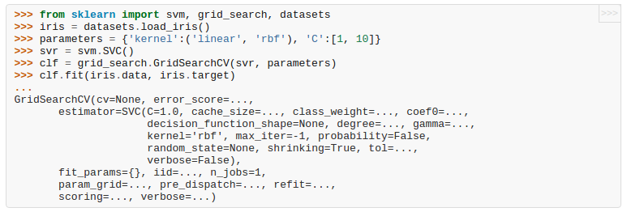
Hyper Parameter Tuning: GridSearchCV
Motivation is to exhaustively search the parameter space in order to find the combinations of parameters that provide the best performance
Data Mining: Concepts and Techniques

Slide 8

Hyper Parameter Tuning: RandomizedSearchCV
In Scikit Learn, a randomized search of the hyper parameter space is managed by the RandomizedSearchCV class:
estimator = scikit learn estimator
param_distributions = dictionary of parameter names and distributions
n_iter = number of parameter settings that sampled
scoring = scikit learn model evaluation metric or custom callable
fit_params = params to pass to the fit method
iid = {True, False} (data assumed to be identically distributed)
cv = cross-validation generator (cross-validation strategy)
refit = {True, False} (refit best estimator with entire data)
n_jobs = number of parallel jobs
Data Mining: Concepts and Techniques

Slide 9
Tips for Hyper Parameter Tuning
In order to determine model performance, Hyper Parameter Tuning in Scikit Learn leverages the score function of the estimator that you pass to it.
For instance, in lecture 5 we showed that Scikit Learn's DecisionTreeClassifier leverages “accuracy” score for classification problems.
For some classification applications, a different measure of model performance may be more useful.
Hyper Parameter Tuning can be conducted in parallel
Data Mining: Concepts and Techniques

Slide 10
Lab
Data Mining: Concepts and Techniques

