Slide 1
Front-end unit tests

Slide 2
Agenda
What is test
The Type of Tests
Why test？
Demo
Summary

Slide 3
What is testing?
Testing is code that checks the code you write in your app works as expected.
About unit test?
Unit test is the test that tests the unit of code, whether they be functions, modules, or classes.

Slide 4
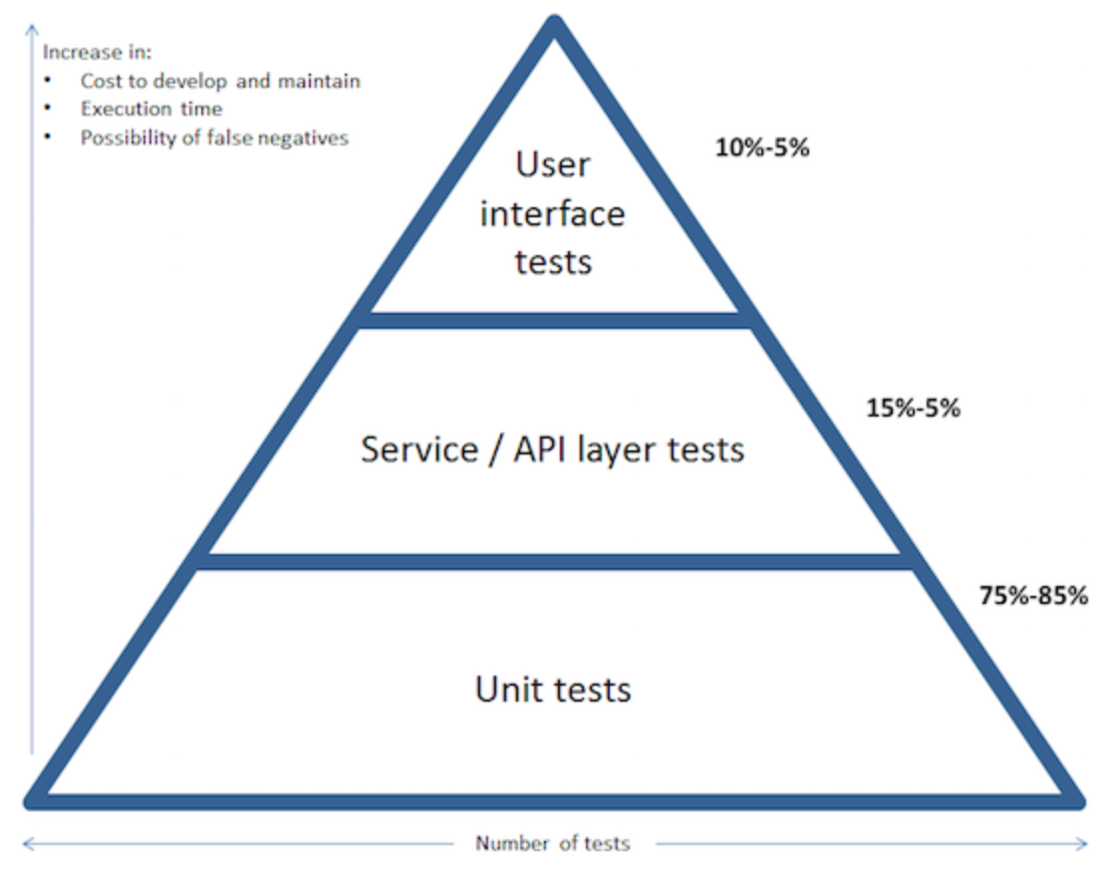
The Types of Tests（Test Pyramid）
E2E Test: Longer running time,high value cost
And higher maintenance cost
Integration Test(Feature test):
Running time and value in between
Unit Test: shorter running time, lower value cost
And lower maintenance cost

Slide 5
Why Test?
When we develop a new feature, writing tests can help us：
organize our ideas
think of some boundary anomalies
ensure the quality of the code
increase our code confidence.

Slide 6
Why Test?
2. When we want to modify existing code, such as: bug or refactoring, unit testing can ensure that we do not destroy existing features.

Slide 7
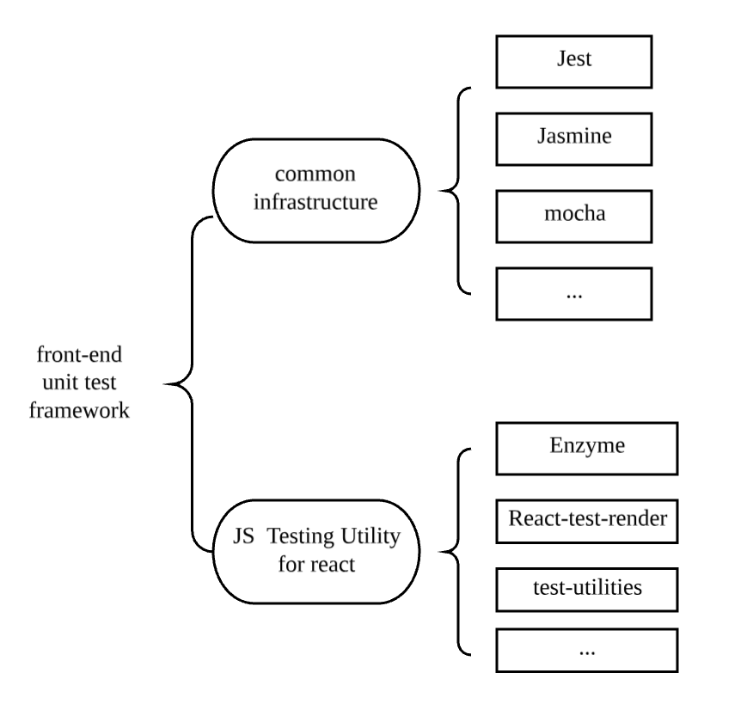
Test framework for front-end

Slide 8
Learning from the demo
Here is a story:
My name is Json, I am a front-end developer.Yesterday I got a story card from our BA. I have finished the development of the features of this card.Now I need to add the tests to verify the correctness of the code.
This is my code:
GitHub ：git@github.com:MHwishes/react-unit-test-demo.git

Slide 9
Story AC:
AC1：When user input a new todo-item, and the press enter, we can see the new todo item in the list.
AC2: When user finish this todo-item, Click this todo-item, the item is marked as completed.
AC3: When user click footer `All` button, all the items should be show.
AC4: When user click footer `Completed` button, all the completed items should be show.
AC5: When user click footer `Active` button, all the unfinshed items should be show.

Slide 10
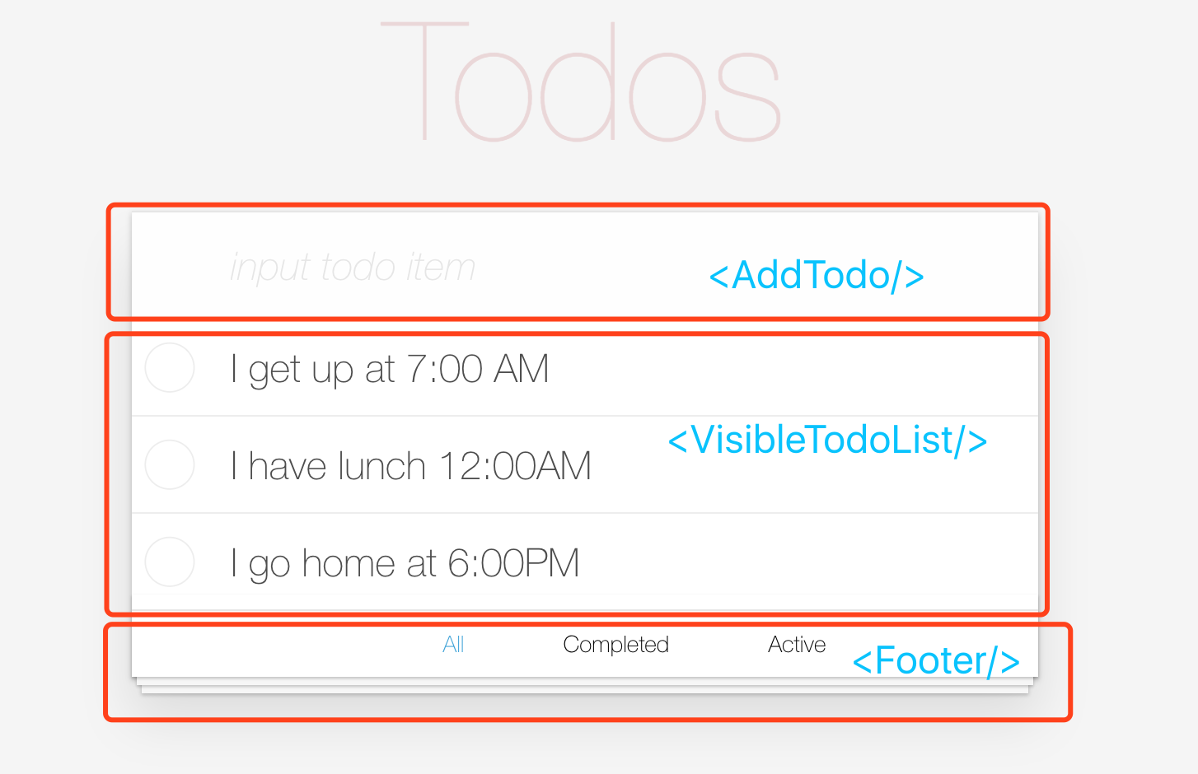
Demo components

Slide 11
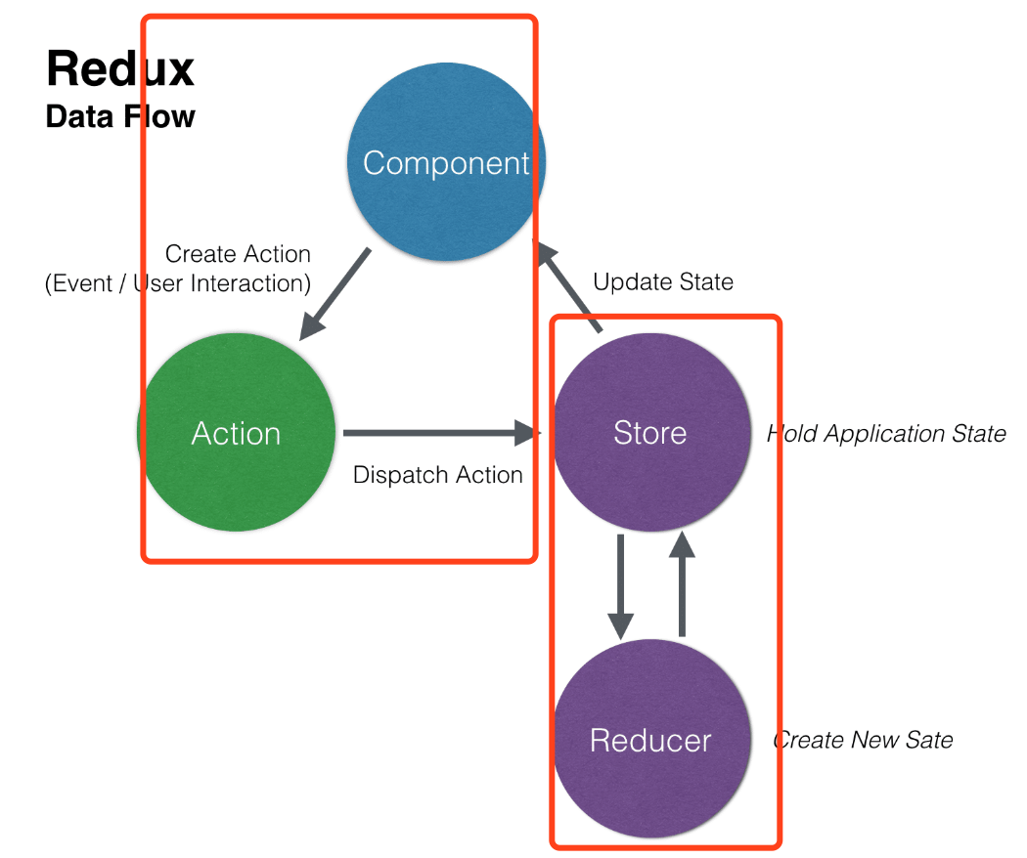
How to split to write test?

Slide 12
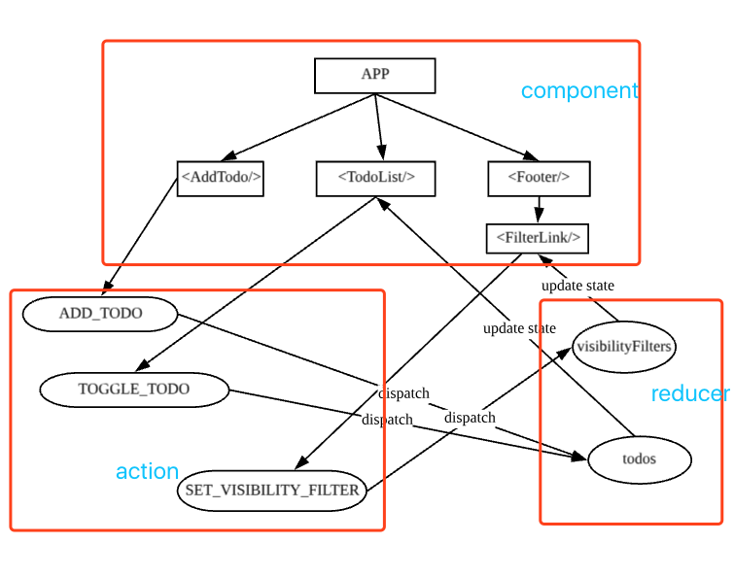
Todo-list demo structure

Slide 13
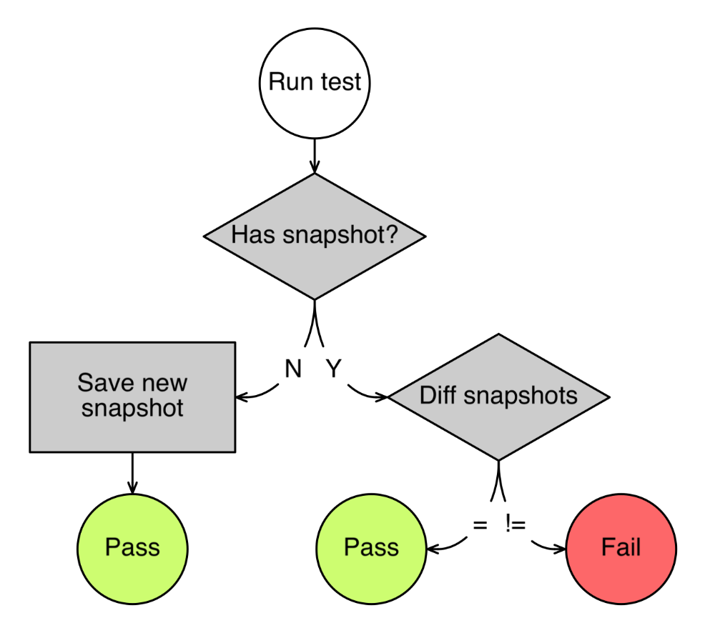
Snapshot flow

Slide 14
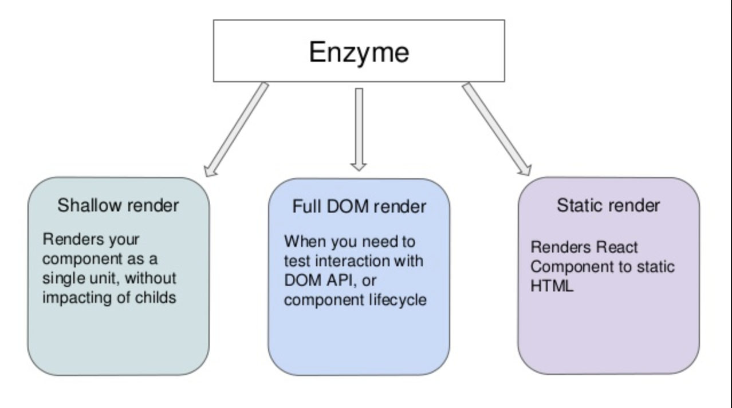
The three rendering way of Enzyme

Slide 15
Summary
What does the front-end need to test?
Function , such as ordinary logic test
Interface & Interactive Testing

Slide 16
Summary
Reference document:
Snapshot Test : https://jestjs.io/docs/en/snapshot-testing
Enzyme : https://airbnb.io/enzyme/
Demo : https://github.com/MHwishes/react-unit-test-demo
https://medium.com/codeclan/testing-react-with-jest-and-enzyme-20505fec4675

Slide 17
Thank you

