Slide 1

Sensor

Slide 2
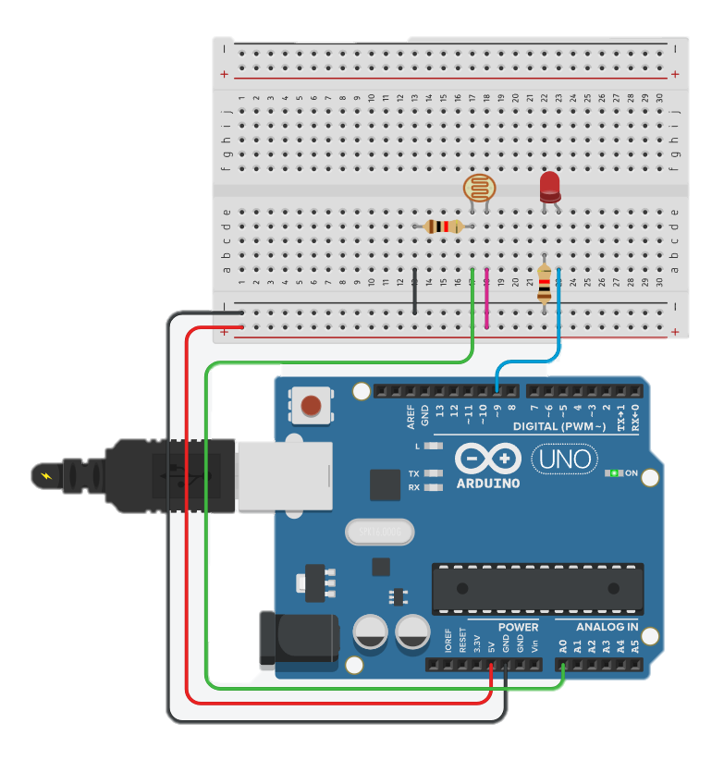
포토 레지스터 : 빛 센서(CDS)
void setup()
{
pinMode(9, OUTPUT);
}
void loop()
{
int val1 = analogRead(0);
int val2 = map(val1, 0, 1023, 0, 255);
analogWrite(9, val2);
delay(20);
}
int sensorValue = 0;
void setup()
{
pinMode(A0, INPUT);
Serial.begin(9600);
pinMode(9, OUTPUT);
}
void loop()
{
// read the value from the sensor
sensorValue = analogRead(A0);
// print the sensor reading so you know its range
Serial.println(sensorValue);
// map the sensor reading to a range for the LED
analogWrite(9, map(sensorValue, 0, 1023, 0, 255));
delay(100); // Wait for 100 millisecond(s)
}

Slide 3
포토 레지스터 : 빛 센서(CDS)
int sensorPin = A0; //아날로그 핀은 입력 명시하지 않아도 됨.
int ledPin = 9; // PWM
int lightLevel;
void setup()
{
pinMode(ledPin, OUTPUT);
}
void loop()
{
lightLevel = analogRead(sensorPin);
adjustBrightness(); //LED 밝기 조절 함수
analogWrite(ledPin, lightLevel);
}
void adjustBrightness()
{
lightLevel = map(lightLevel, 500, 1023, 0, 255);
lightLevel = constrain(lightLevel, 0, 255);
//lightlevel이 0보다 작으면 0을 출력
//255보다 크면 255를 출력, 0~255사이의 숫자면 그대로 출력
}

Slide 4
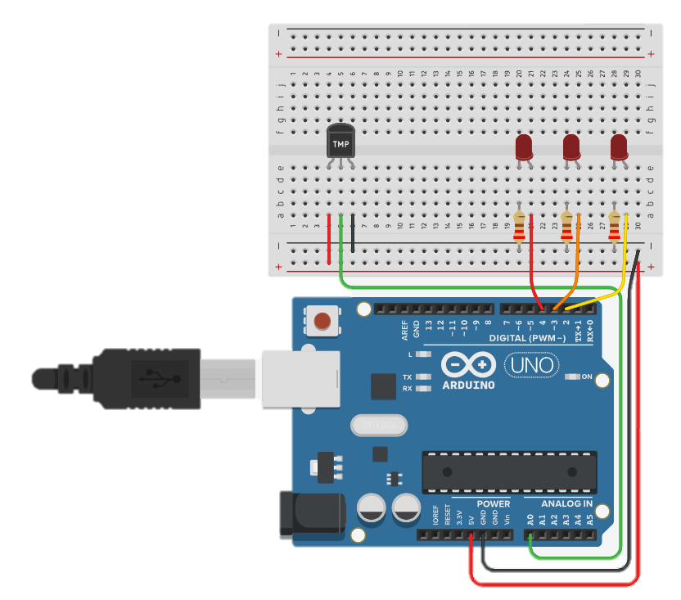
온도 센서 : TMP36 - 1

Slide 5
온도 센서 : TMP36 - 2
int baselineTemp = 0;
int celsius = 0;
int fahrenheit = 0;
void setup()
{
pinMode(A0, INPUT);
Serial.begin(9600);
pinMode(2, OUTPUT);
pinMode(3, OUTPUT);
pinMode(4, OUTPUT);
}
void loop()
{
// set threshold temperature to activate LEDs
baselineTemp = 40;
// measure temperature in Celsius
celsius = map(((analogRead(A0) - 20) * 3.04), 0, 1023, -40, 125);
// convert to Fahrenheit
fahrenheit = ((celsius * 9) / 5 + 32);
Serial.print(celsius);
Serial.print(" C, ");
Serial.print(fahrenheit);
Serial.println(" F");
if (celsius < baselineTemp) {
digitalWrite(2, LOW);
digitalWrite(3, LOW);
digitalWrite(4, LOW);
}
if (celsius >= baselineTemp && celsius < baselineTemp + 10) {
digitalWrite(2, HIGH);
digitalWrite(3, LOW);
digitalWrite(4, LOW);
}
if (celsius >= baselineTemp + 10 && celsius < baselineTemp + 20) {
digitalWrite(2, HIGH);
digitalWrite(3, HIGH);
digitalWrite(4, LOW);
}
if (celsius >= baselineTemp + 20 && celsius < baselineTemp + 30) {
digitalWrite(2, HIGH);
digitalWrite(3, HIGH);
digitalWrite(4, HIGH);
}
if (celsius >= baselineTemp + 30) {
digitalWrite(2, HIGH);
digitalWrite(3, HIGH);
digitalWrite(4, HIGH);
}
delay(1000); // Wait for 1000 millisecond(s)
}

Slide 6
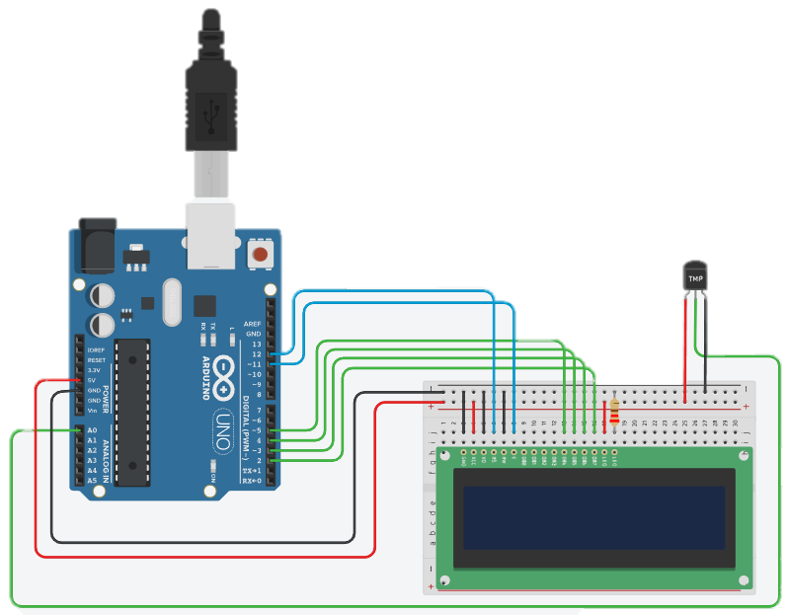
온도 센서 : TMP36 and LCD Display
#include <LiquidCrystal.h>
LiquidCrystal lcd(12, 11, 5, 4, 3, 2);
void setup() {
lcd.begin(16, 2);
}
void loop() {
int reading = analogRead(A0);
// read value returned by temperature sensor at analog input A0
float voltage = reading * 5.0;
// converting that reading to voltage
voltage /= 1024.0;
float temperatureC = (voltage - 0.5) * 100 ;
//converting from 10 mv per degree wit 500 mV
//offset to degrees ((voltage - 500mV) times 100)
lcd.setCursor(0,0); // set cursor at top left of the display
lcd.clear();
lcd.print("degrees: ");
lcd.print(temperatureC);
lcd.print("C");
delay(500);
}

Slide 7
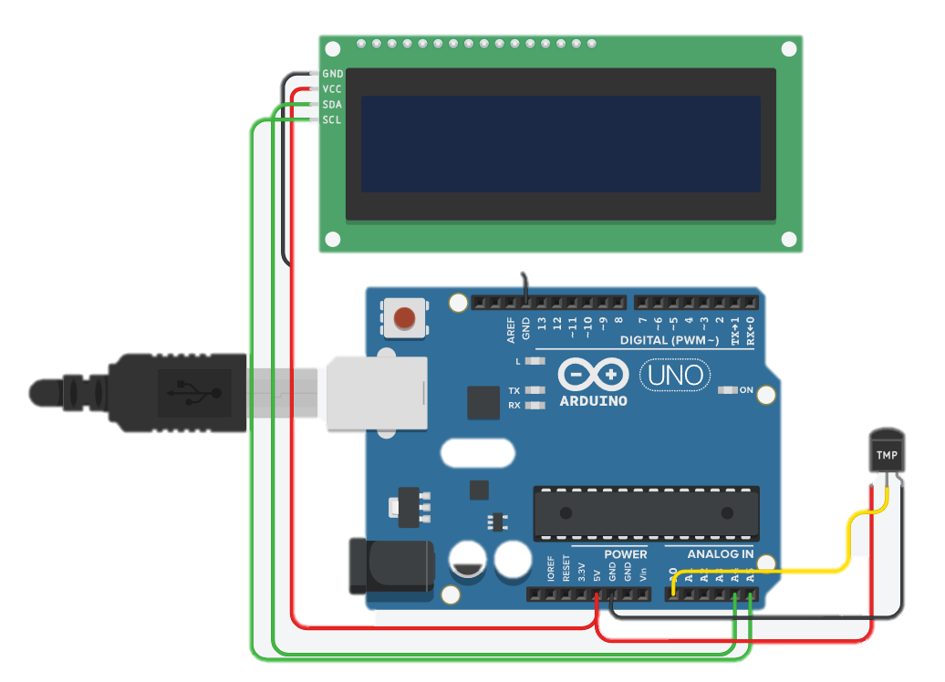
온도 센서 : TMP36 and 12C LCD Display
#include <Wire.h>
#include <LiquidCrystal_I2C.h>
LiquidCrystal_I2C lcd(32,16,2);
void setup()
{
lcd.begin(16,2);
lcd.init();
lcd.backlight();
lcd.clear();
lcd.setCursor(0, 0);
lcd.print("Temperature: ");
}
void loop()
{
// Read the temperature from the sensor
int sensorValue = analogRead(A0);
// Convert the temperature to degrees Celsius
float temperature = (sensorValue * 5.0 / 1024.0 - 0.5 ) * 100.0;
// convert the sensor value to temperature in degrees Celsius
// Display the temperature on the LCD
lcd.setCursor(8, 1);
lcd.print(temperature);
lcd.print(" C");
}

Slide 8
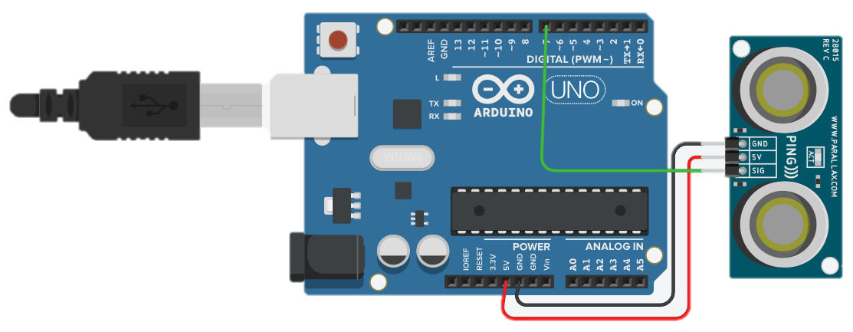
초음파 거리 센서(3 pin)
/* 3핀 초음파센서 활용 */
int ultra = 7; // 출력 단자
void setup(){
Serial.begin(9600);
}
void loop(){
pinMode(ultra, OUTPUT);
//sig핀 기본출력설정
digitalWrite(ultra, LOW);
delay(1); // Wait for 100 millisecond(s),
digitalWrite(ultra, HIGH);
delayMicroseconds(10);//센서를 동작하기 위한 시작신호로
// sig핀에 5us동안 high신호 출력후 low출력
digitalWrite(ultra, LOW);
pinMode(ultra, INPUT);
//ultra 핀이 HIGH를 유지한 시간을 저장
unsigned long duration = pulseIn(ultra, HIGH);
//HIGH였을땨 시간(초음파가 보냈다가 다시 돌아온 시간)을 가지고 거리계산
//초음파는 340m/s속도로 이동함에 따라(25도씨 기준)
//이때 속도와 센서가 보낸 시간을 이용하여 거리를 계산
//왕복해서 오는것이므로 결과를 2로 나누어 줌
double dist = ((340*duration)/10000)/2;
Serial.print("Distance: ");
Serial.print(dist);
Serial.println("cm");
delay(100);
}

Slide 9
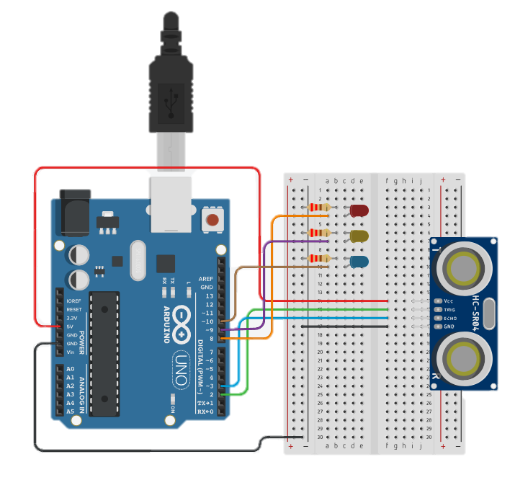
초음파 거리 센서(4 pin) - 1
/*거리에 따라 LED 표시*/
int trig = 2;
int echo = 3;
int RED = 8;
int YELLOW = 9;
int GREEN = 10;
void setup()
{
Serial.begin(9600);
pinMode(trig, OUTPUT);
pinMode(echo, INPUT);
pinMode(RED, OUTPUT);
pinMode(YELLOW, OUTPUT);
pinMode(GREEN, OUTPUT);
}
void loop()
{
digitalWrite(trig, HIGH);
delayMicroseconds(10);
digitalWrite(trig, LOW);
// echoPin 이 HIGH를 유지한 시간을 저장 한다.
unsigned long duration = pulseIn(echo, HIGH);
// HIGH 였을 때 시간(초음파가 보냈다가 다시 들어온 시간)을 가지고 거리를 계산 한다.
float distance = ((float)(340 * duration) / 10000) / 2;
Serial.print(distance);
Serial.println("cm");
delay(100);

Slide 10
초음파 거리 센서(4 pin) - 2
if (distance > 80) // distance(거리) 가 80보다 크면
{
digitalWrite(GREEN, HIGH); // GREEN이 연결된 핀에 HIGH 신호(5V)를,
digitalWrite(YELLOW, LOW); // YELLOW가 연결된 핀에 LOW 신호(0V)를,
digitalWrite(RED, LOW); // RED가 연결된 핀에 LOW신호(0V)를.
}
if (distance > 30 & distance <= 70)
{
digitalWrite(GREEN, LOW);
digitalWrite(YELLOW, HIGH);
digitalWrite(RED, LOW);
}
if (distance > 0 & distance <= 30)
{
digitalWrite(GREEN, LOW);
digitalWrite(YELLOW, LOW);
digitalWrite(RED, HIGH);
}
}

Slide 11
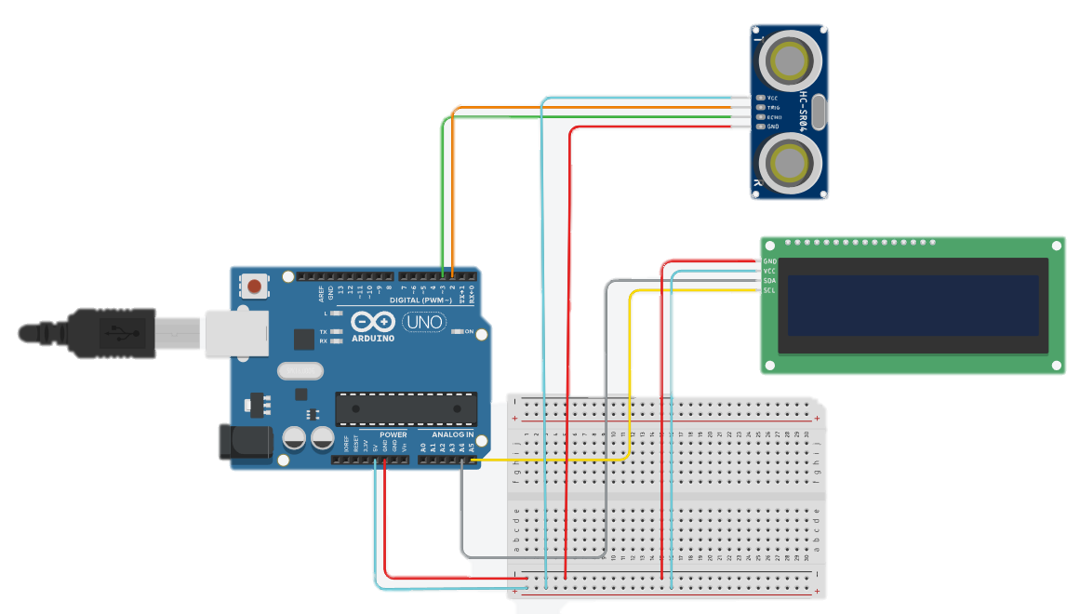
Ultrasonic sensor and 12C LCD
#include <Adafruit_LiquidCrystal.h>
#define trigPin 2
#define echoPin 3
long duration;
int distance;
Adafruit_LiquidCrystal lcd_1(0);
void setup() {
pinMode(trigPin, OUTPUT);
pinMode(echoPin, INPUT);
Serial.begin(9600);
lcd_1.begin(16,2);
lcd_1.print("Sensor Value :");
}
void loop() {
digitalWrite(trigPin, LOW);
delayMicroseconds(5);
digitalWrite(trigPin, HIGH);
delayMicroseconds(10);
digitalWrite(trigPin, LOW);
duration = pulseIn(echoPin, HIGH);
distance = duration * 0.034 / 2;
lcd_1.setCursor(0,1);
lcd_1.print(distance);
lcd_1.print("cm - Andrea");
delay(50);
}

Slide 12
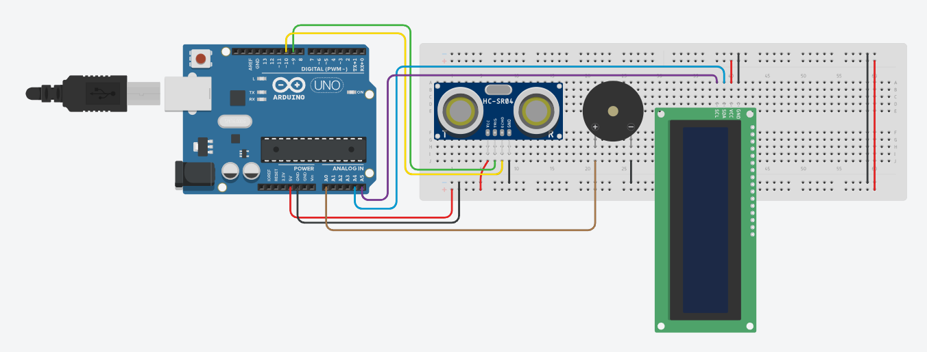
Ultrasonic sensor with LCD and Buzzer - 1

Slide 13
Ultrasonic sensor with LCD and Buzzer - 2
// C++ code
//
#include <Adafruit_LiquidCrystal.h>
Adafruit_LiquidCrystal lcd(0);
// Define the ultrasonic sensor pins
const int trigPin = 9;
const int echoPin = 10;
// Define the buzzer pin
const int buzzerPin = A0;
void setup() {
Serial.begin(9600);
lcd.begin(16,2);
lcd.setCursor(0,0);
lcd.print("Initializing...");
pinMode(trigPin, OUTPUT);
pinMode(echoPin, INPUT);
pinMode(buzzerPin, OUTPUT);
delay(2000);
lcd.clear();
lcd.print("Ready");
delay(1000);
}
void loop() {
long duration, distance;
digitalWrite(trigPin, LOW);
delayMicroseconds(2);
digitalWrite(trigPin, HIGH);
delayMicroseconds(10);
digitalWrite(trigPin, LOW);
duration = pulseIn(echoPin, HIGH); // measure the time it takes to travel
distance = duration * 0.034 / 2; //34cm ms divide 2 is half of total distance
lcd.clear();
lcd.setCursor(0, 0);
lcd.print("Distance: ");
if (distance >= 70 || distance <= 0) {
lcd.print("Out of range");
noTone(buzzerPin);
} else {
lcd.print(distance);
lcd.print(" cm");
if (distance > 60) {
tone(buzzerPin, 2500); // Play a tone at 2500Hz for distances greater than 60 cm
} else if (distance > 20) {
tone(buzzerPin, 1500); // Play a tone at 1500Hz for distances between 20 and 60 cm
} else if (distance > 1) {
tone(buzzerPin, 500); // Play a tone at 500Hz for distances less than 20 cm
}
}
delay(500);
}

Slide 14
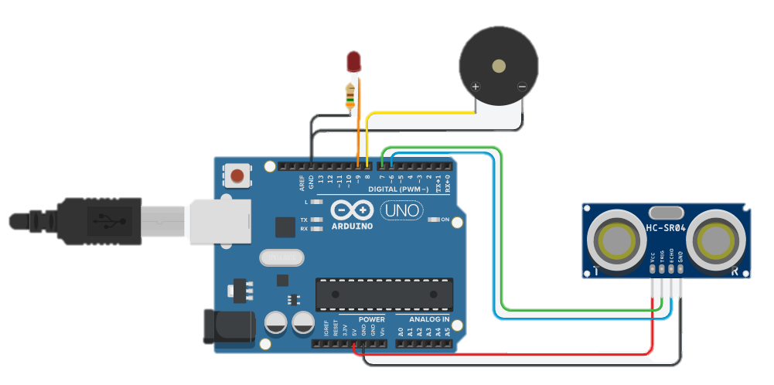
Ultrasonic sensor with LED and Buzzer - 1

Slide 15
Ultrasonic sensor with LED and Buzzer - 2
int trigPin = 7; // Trigger
int echoPin = 6; // Echo
long duration, cm, inches;
void setup()
{
//Serial Port begin
Serial.begin (9600);
//Define inputs and outputs
pinMode(trigPin, OUTPUT);
pinMode(echoPin, INPUT);
pinMode(9,OUTPUT);
pinMode(8,OUTPUT);
}
void loop()
{
// The sensor is triggered by a HIGH pulse of 10 or more microseconds.
// Give a short LOW pulse beforehand to ensure a clean HIGH pulse:
digitalWrite(trigPin, LOW);
delayMicroseconds(5);
digitalWrite(trigPin, HIGH);
delayMicroseconds(10);
digitalWrite(trigPin, LOW);
// Read the signal from the sensor: a HIGH pulse whose
// duration is the time (in microseconds) from the sending
// of the ping to the reception of its echo off of an object.
pinMode(echoPin, INPUT);
duration = pulseIn(echoPin, HIGH);
// Convert the time into a distance
cm = (duration/2) / 29.1;
// Divide by 29.1 or multiply by 0.0343
inches = (duration/2) / 74;
// Divide by 74 or multiply by 0.0135
Serial.print(inches);
Serial.print("in, ");
Serial.print(cm);
Serial.print("cm");
Serial.println();
if(cm<200){
digitalWrite(9,HIGH);
} else {
digitalWrite(9, LOW);
}
if(cm<50){
digitalWrite(8,HIGH);
} else {
digitalWrite(8, LOW);
}
delay(250);
}

Slide 16
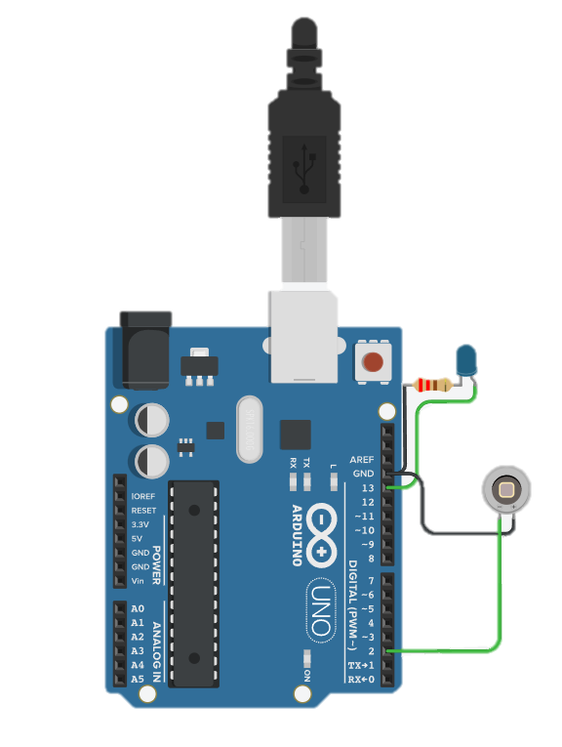
Photodiode
int ledPin = 13;
int buttonApin = 2;
byte leds = 0;
void setup()
{
pinMode(ledPin, OUTPUT);
pinMode(buttonApin, INPUT_PULLUP);
}
void loop()
{
if (digitalRead(buttonApin) == LOW)
{
digitalWrite(ledPin, HIGH);
}
else
{
digitalWrite(ledPin, LOW);
}
}

Slide 17
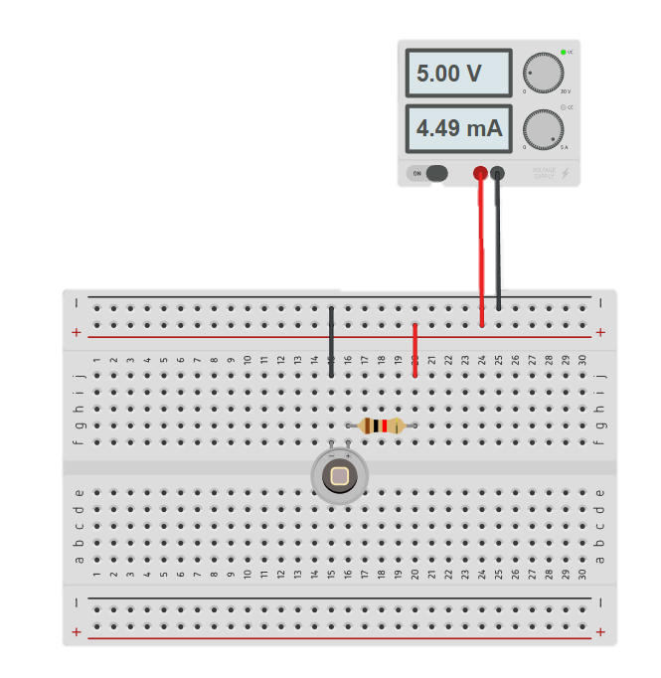
Photodiode with Power supply

Slide 18
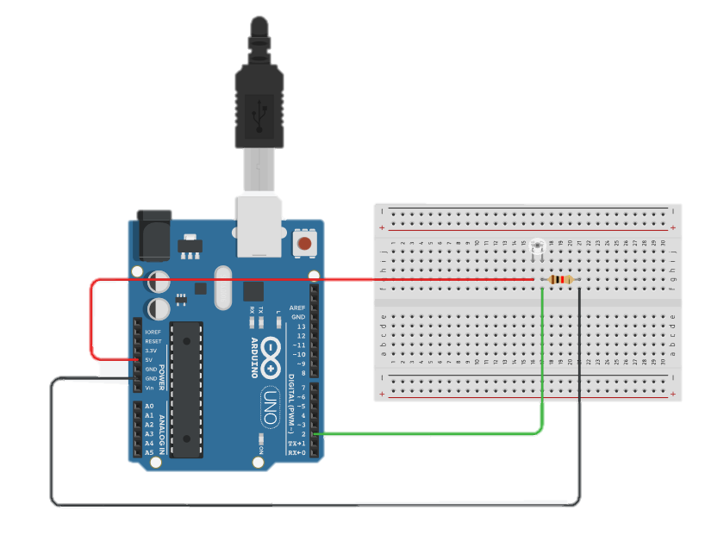
Phototransistor
void setup()
{
Serial.begin(9600);
pinMode(2, INPUT);
}
void loop()
{
int val=digitalRead(2);
Serial.println(val);
}

Slide 19
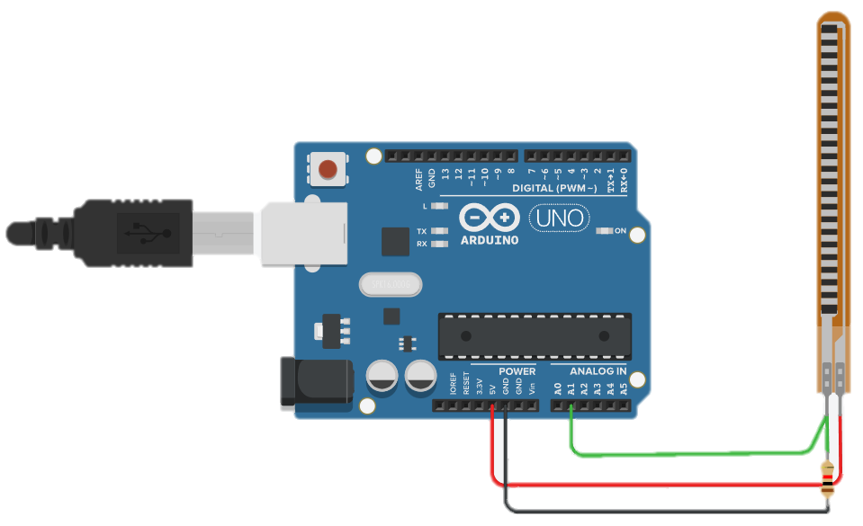
Flex sensor
#include <Servo.h>
int pos = 0;
void setup()
{
Serial.begin(9600);
pinMode(A1,INPUT);
}
void loop()
{
int flexread = analogRead(A1);
Serial.println("flexread: " + String(flexread) );
Serial.println("Start poss of the Serial : " + String(flexread*5.45454545455));
delay(1000);
//180 ----> 0
//6 ----> 33
}

Slide 20
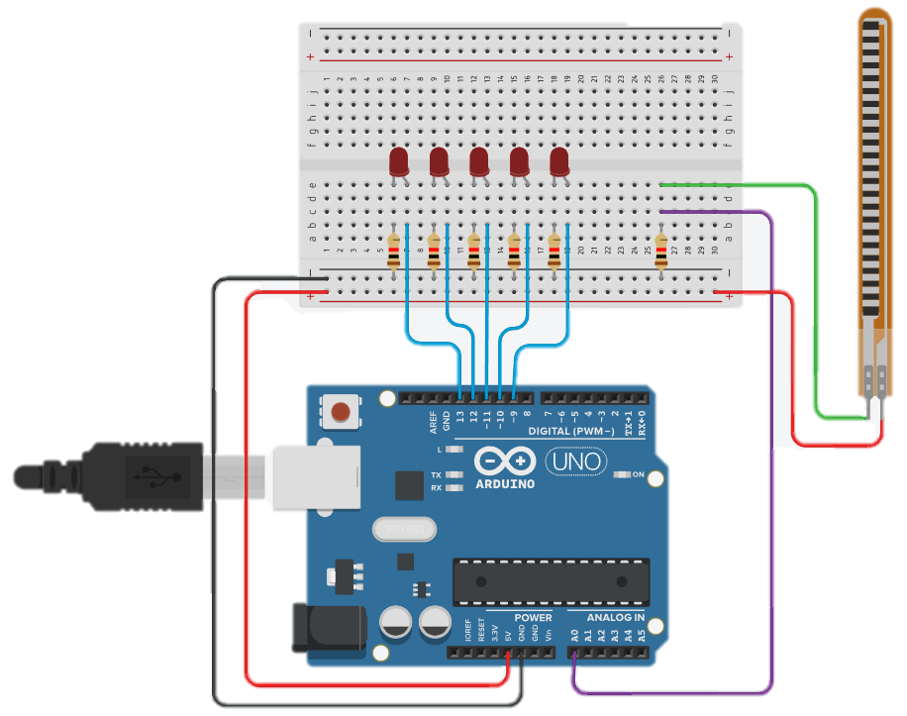
Flex sensor with LED - 1

Slide 21
Flex sensor with LED - 2
//
#define sensorPin A0 // Flex Sensor is connected to this pin
float VCC = 5; // Arduino is powered with 5V VCC
float R2 = 10000; // 10K resistor is
float sensorMinResistance = 30000; // Value of the Sensor when its flat
float sensorMaxResistance = 163000; // Value of the Sensor when its bent at 90*
void setup()
{
pinMode(A0, INPUT);
Serial.begin(9600);
pinMode(9, OUTPUT);
pinMode(10, OUTPUT);
pinMode(11, OUTPUT);
pinMode(12, OUTPUT);
pinMode(13, OUTPUT);
}
void loop()
{
int ReadValue = analogRead(sensorPin);
Serial.println(ReadValue);
//float ADCVoltage = (ADCRaw * VCC) / 1023; // get the voltage e.g (512 * 5) / 1023 = 2.5V
//float Resistance = R2 * (VCC / ADCVoltage - 1); // Calculate Resistance Value
//uint8_t ReadValue = map(Resistance, sensorMinResistance, sensorMaxResistance, 0, 100);
// map the values 16700 to 0 18200 to 255
digitalWrite(9, LOW);
digitalWrite(10, LOW);
digitalWrite(11, LOW);
digitalWrite(12, LOW);
digitalWrite(13, LOW);
if (ReadValue > 20) {
digitalWrite(13, HIGH);
} else {
if (ReadValue > 18) {
digitalWrite(13, HIGH);
digitalWrite(12, HIGH);
} else {
if (ReadValue > 15) {
digitalWrite(13, HIGH);
digitalWrite(12, HIGH);
digitalWrite(11, HIGH);
} else {
if (ReadValue > 12) {
digitalWrite(13, HIGH);
digitalWrite(12, HIGH);
digitalWrite(11, HIGH);
digitalWrite(10, HIGH);
} else {
digitalWrite(13, HIGH);
digitalWrite(12, HIGH);
digitalWrite(11, HIGH);
digitalWrite(10, HIGH);
digitalWrite(9, HIGH);
}
}
}
}
delay(100); // Wait for 100 millisecond(s)
}

Slide 22
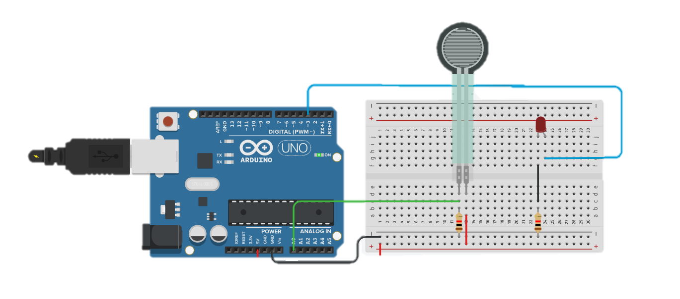
Force sensor with LED
int force = 0;
void setup()
{
pinMode(A0, INPUT);
pinMode(3, OUTPUT);
}
void loop()
{
force = analogRead(A0);
analogWrite(3, force);
delay(10); // Delay a little bit to improve simulation performance
}

Slide 23
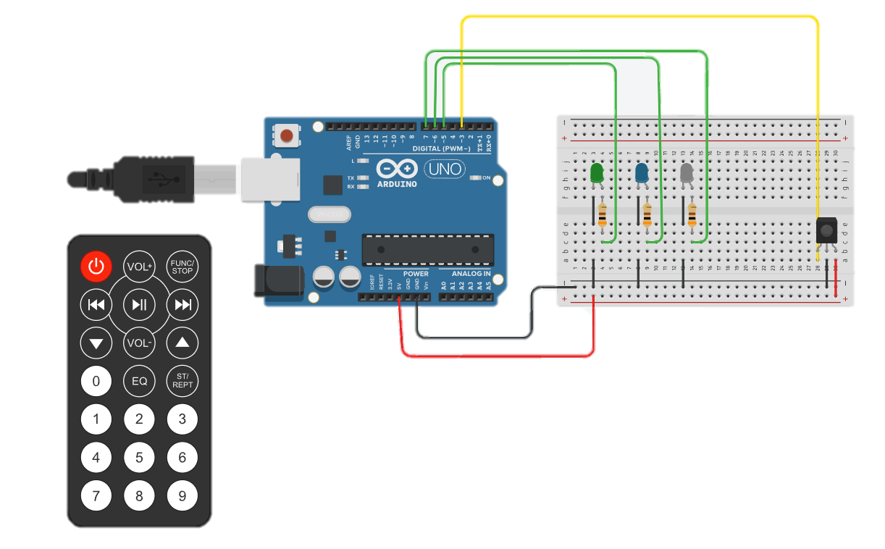
IR sensor with LED

Slide 24
IR sensor with LED
#define DECODE_NEC
#define IR_RECEIVE_PIN 3
#if !defined(RAW_BUFFER_LENGTH)
// Maximum length of raw duration buffer. Must be even. 100 supports up to 48 bit codings inclusive 1 start and
// 1 stop bit.
#define RAW_BUFFER_LENGTH 100 \
// #define RAW_BUFFER_LENGTH 112 // MagiQuest requires 112 bytes.
#endif
#define EXCLUDE_UNIVERSAL_PROTOCOLS // Saves up to 1000 bytes program space.
#define EXCLUDE_EXOTIC_PROTOCOLS // saves around 650 bytes program space if all other protocols are active
#include <IRremote.hpp>
// Give the pin numbers a descriptive name (Pins 5,6 and 7)
enum Led : uint8_t {green = 5, blue, white}; // https://en.cppreference.com/w/cpp/language/enum
void setup()
{
Serial.begin(115200);
#if defined(__AVR_ATmega32U4__) || defined(SERIAL_PORT_USBVIRTUAL) || defined(SERIAL_USB) || defined(ARDUINO_attiny3217)
delay(1000);
#endif
Serial.println(F("START " __FILE__ " from " __DATE__ "\r\nUsing library version " VERSION_IRREMOTE));
Serial.println(F("Enabling IRin..."));
IrReceiver.begin(IR_RECEIVE_PIN, ENABLE_LED_FEEDBACK);
Serial.print(F("Ready to receive IR signals of protocols: "));
printActiveIRProtocols(&Serial);
Serial.print(F("at pin "));
Serial.println(IR_RECEIVE_PIN);
pinMode(Led::green, OUTPUT);
pinMode(Led::blue, OUTPUT);
pinMode(Led::white, OUTPUT);
}

Slide 25
IR sensor with LED
void loop() {
if (IrReceiver.decode()) {
switch(IrReceiver.decodedIRData.command) {
case 0x10: Serial.println("1"); // Button 1
digitalWrite(Led::green,HIGH);
// digitalWrite(Led::green,!digitalRead(Led::green));
break;
case 0x11: Serial.println("2"); // Button 2
digitalWrite(Led::green,LOW);
break;
case 0x12: Serial.println("3"); // Button 3
digitalWrite(Led::blue,HIGH);
break;
case 0x14: Serial.println("4"); // Button 4
digitalWrite(Led::blue,LOW);
break;
case 0x15: Serial.println("5"); // Button 5
digitalWrite(Led::white,HIGH);
break;
case 0x16: Serial.println("6"); // Button 6
digitalWrite(Led::white,LOW);
break;
default: IrReceiver.printIRResultShort(&Serial);
}
delay(65);
IrReceiver.resume(); // Receive the next value
}
}

Slide 26
void loop()
{
if(irrecv.decode(&results)) {
Serial.println(results.value);
if(results.value == 0xFFFFFFFF) {
results.value = lastValue;
}
if(results.value == 4054436099)
printRGB(255, 105, 180);
else if(results.value == 4054436099)
printRGB(0, 255, 255);
else if(results.value == 0xFD48B7)
printRGB(0, 255, 0);
else
printRGB(0, 0, 0);
delay(30);
lastValue = results.value;
irrecv.resume();
}
}
#include<IRremote.h>
const int RED_PIN = 11;
const int GREEN_PIN = 9;
const int BLUE_PIN = 10;
unsigned long lastValue = 0;
IRrecv irrecv(8);
decode_results results;
void setup()
{
irrecv.enableIRIn();
pinMode(RED_PIN, OUTPUT);
pinMode(GREEN_PIN, OUTPUT);
pinMode(BLUE_PIN, OUTPUT);
Serial.begin(9600);
}

Slide 27
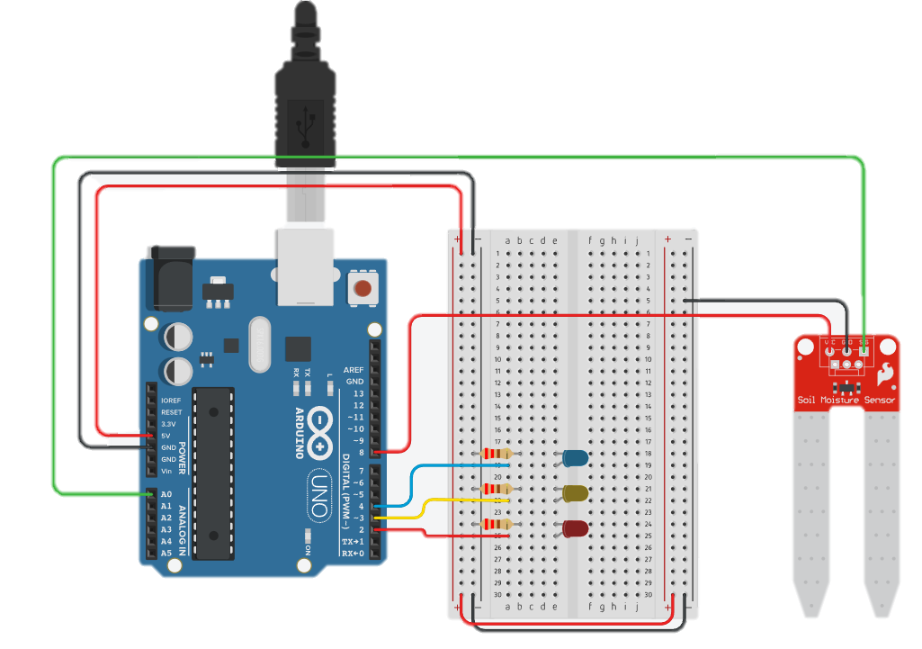
Soil Moisture Sensor with LED

Slide 28
Soil Moisture Sensor with LED
// Arduino soil moisture sensor code
// https://www.sciencebuddies.org/science-fair-projects/project-ideas/PlantBio_p055/plant-biology/arduino-automatic-plant-watering
// declare variables for pins
const int sensorpin = A0;
const int sensorpower = 8;
const int LED1 = 2;
const int LED2 = 3;
const int LED3 = 4;
// variable for sensor reading
int sensor;
// delay time between sensor readings (milliseconds)
// this helps prevent the sensor from corroding by
// not leaving it powered on all the time
// (note: the Tinkercad simulation can run slowly,
// you may want to decrease the delay time if running
// this in Tinkercad
const int delayTime = 1000;
// "wet" and "dry" thresholds - these require calibration
int wet = 800;
int dry = 500;
void setup(){ // code that only runs once
// set pins as outputs
pinMode(LED1,OUTPUT);
pinMode(LED2,OUTPUT);
pinMode(LED3,OUTPUT);
pinMode(sensorpower,OUTPUT);
// initialize serial communication
Serial.begin(9600);
}
void loop(){ // code that loops forever
// power on sensor and wait briefly
digitalWrite(sensorpower,HIGH);
delay(10);
// take reading from sensor
sensor = analogRead(sensorpin);
// turn sensor off to help prevent corrosion
digitalWrite(sensorpower,LOW);
// print sensor reading
Serial.println(sensor);
// If sensor reading is greater than "wet" threshold,
// turn on the blue LED. If it is less than the "dry"
// threshold, turn on the red LED. If it is in between
// the two values, turn on the yellow LED.
if(sensor>wet){
digitalWrite(LED1,LOW);
digitalWrite(LED2,LOW);
digitalWrite(LED3,HIGH);
} else if(sensor<dry){
digitalWrite(LED1,HIGH);
digitalWrite(LED2,LOW);
digitalWrite(LED3,LOW);
} else{
digitalWrite(LED1,LOW);
digitalWrite(LED2,HIGH);
digitalWrite(LED3,LOW);
}
// wait before taking next reading
delay(delayTime);
}

Slide 29
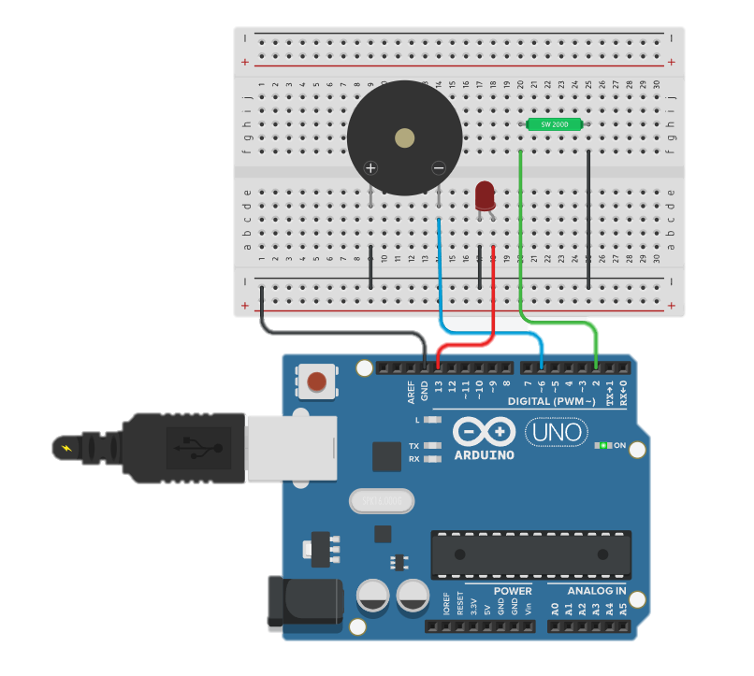
Tilt Sensor with LED and Buzzer
#define SENSOR_PIN 2
#define LED_PIN 13
#define BUZZ_PIN 6
void setup()
{
pinMode(SENSOR_PIN, INPUT_PULLUP);
pinMode(BUZZ_PIN,OUTPUT);
pinMode(LED_PIN, OUTPUT);
Serial.begin(9600);
}
void loop()
{
if (digitalRead(SENSOR_PIN) == LOW)
{
digitalWrite(BUZZ_PIN,HIGH);
digitalWrite(LED_PIN, HIGH);
Serial.println("alert");
}
else
{
digitalWrite(BUZZ_PIN,LOW);
digitalWrite(LED_PIN, LOW);
Serial.println("no alert");
}
}

Slide 30
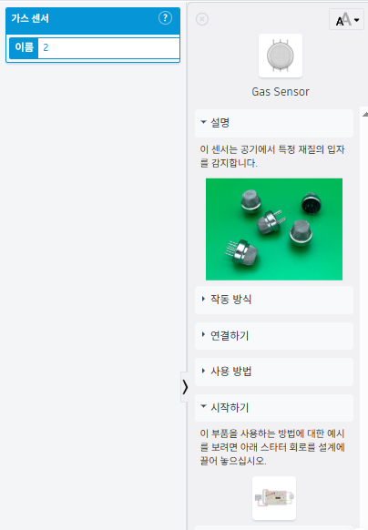
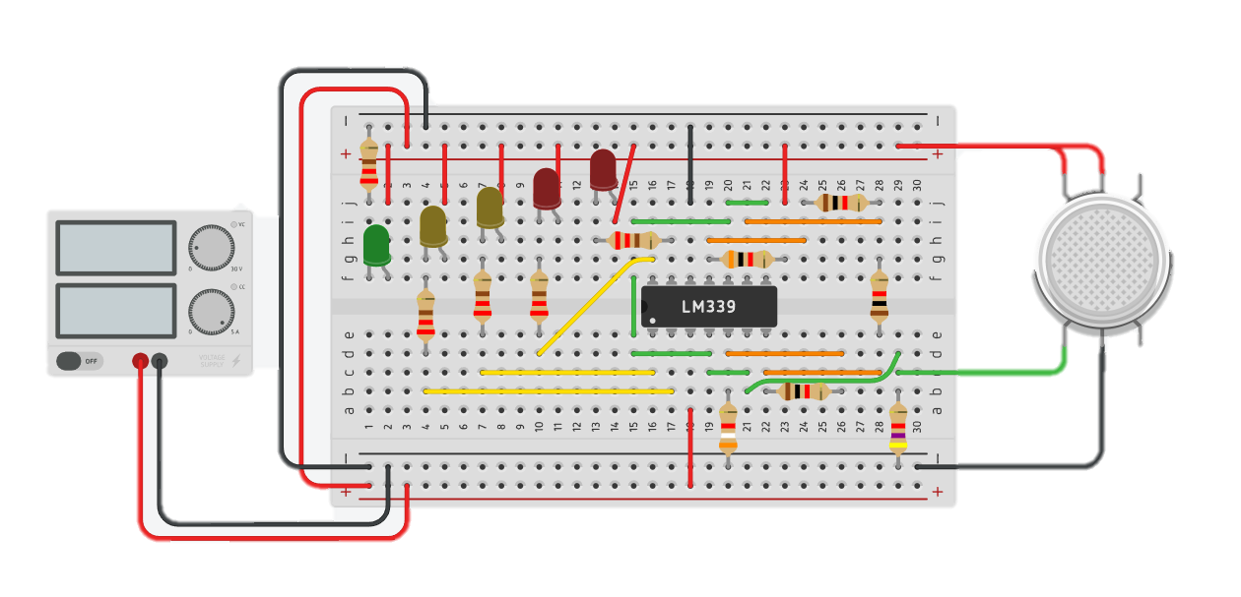
Gas Sensor

Slide 31
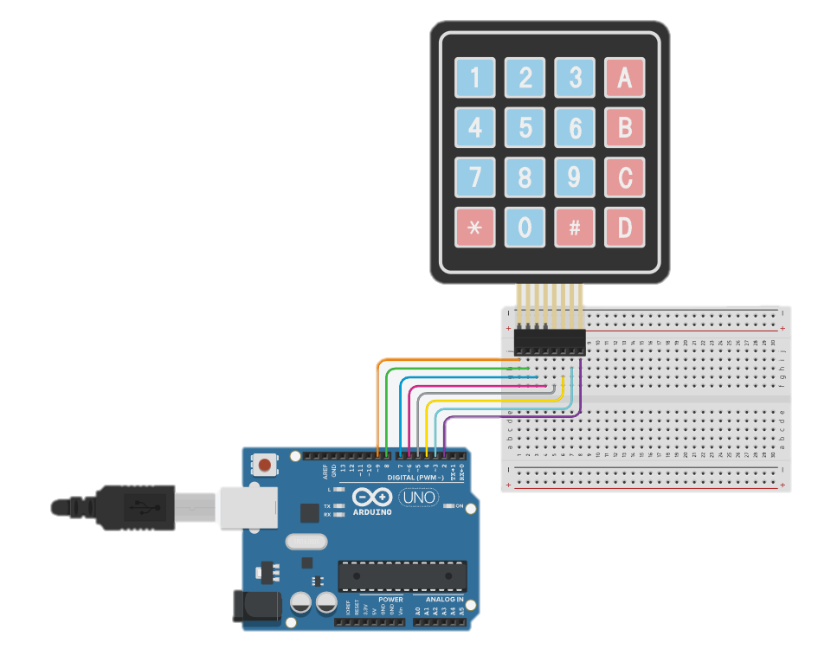
Keypad 4x4
#include <Keypad.h>
const byte numRows= 4; //number of rows on the keypad
const byte numCols= 4; //number of columns on the keypad
//keymap defines the key pressed according to the row and columns just as
// appears on the keypad
char keymap[numRows][numCols]=
{
{'1', '2', '3', 'A'},
{'4', '5', '6', 'B'},
{'7', '8', '9', 'C'},
{'*', '0', '#', 'D'}
};
//Code that shows the the keypad connections to the arduino terminals
byte rowPins[numRows] = {9,8,7,6}; //Rows 0 to 3
byte colPins[numCols]= {5,4,3,2}; //Columns 0 to 3
//initializes an instance of the Keypad class
Keypad myKeypad= Keypad(makeKeymap(keymap), rowPins, colPins, numRows, numCols);
void setup()
{
Serial.begin(9600);
}
//If key is pressed, this key is stored in 'keypressed' variable
//If key is not equal to 'NO_KEY', then this key is printed out
//if count=17, then count is reset back to 0
//(this means no key is pressed during the whole keypad scan process
void loop()
{
char keypressed = myKeypad.getKey();
if (keypressed != NO_KEY)
{
Serial.println(keypressed);
}
}

Slide 32
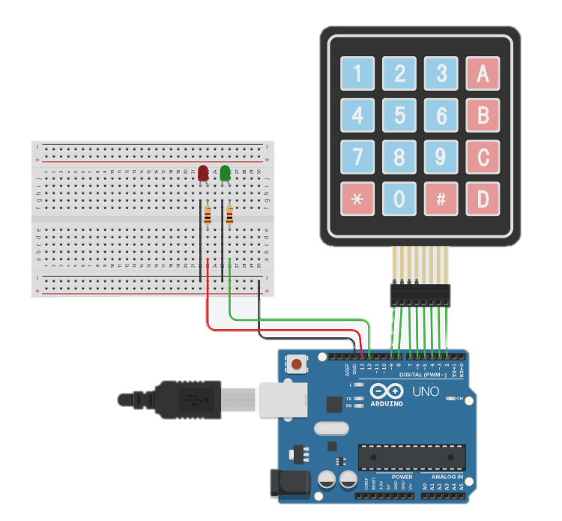
Keypad 4x4 with password

Slide 33
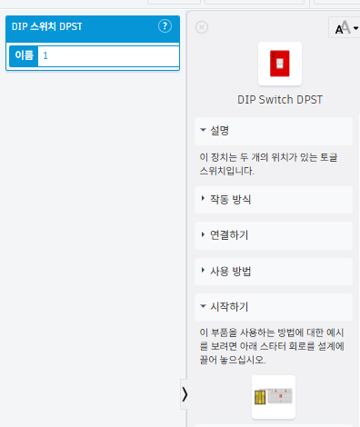
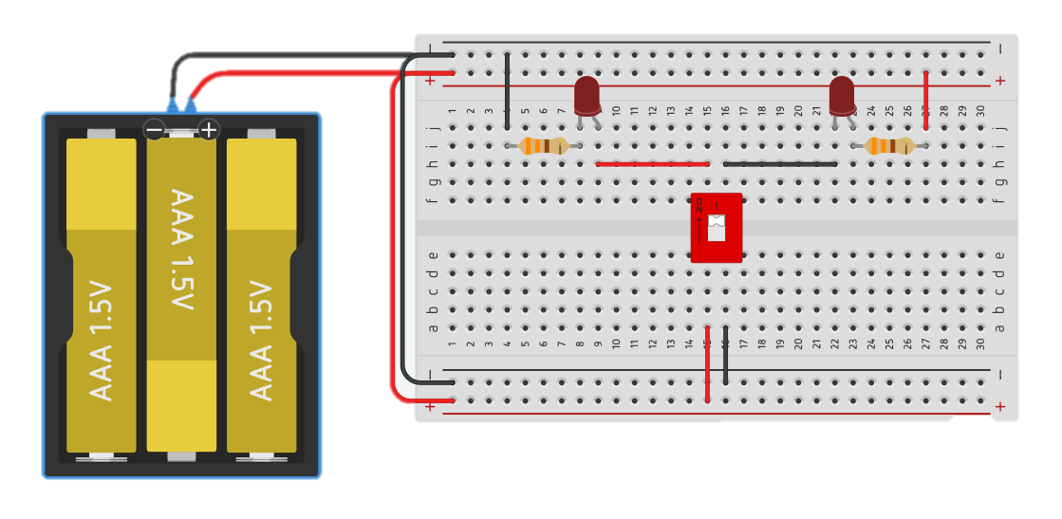
DIP Switch DPST

Slide 34
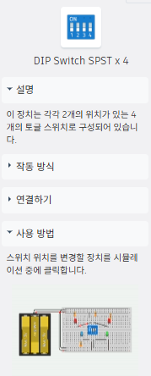
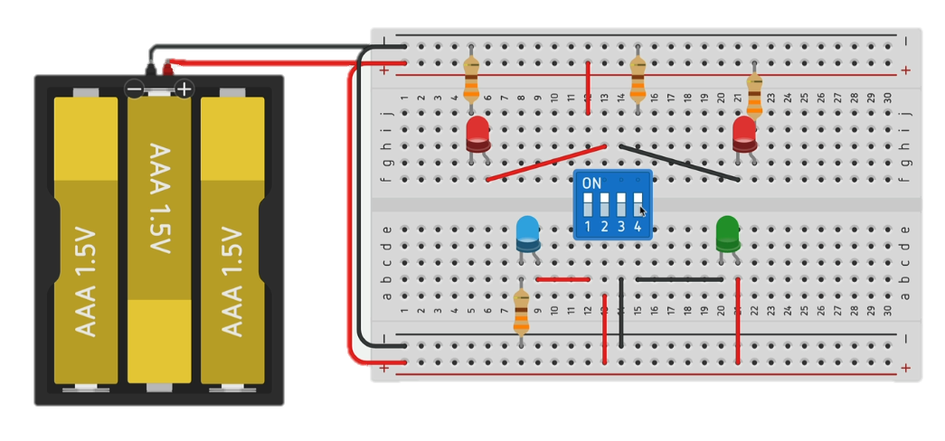
DIP Switch SPST x 4

Slide 35
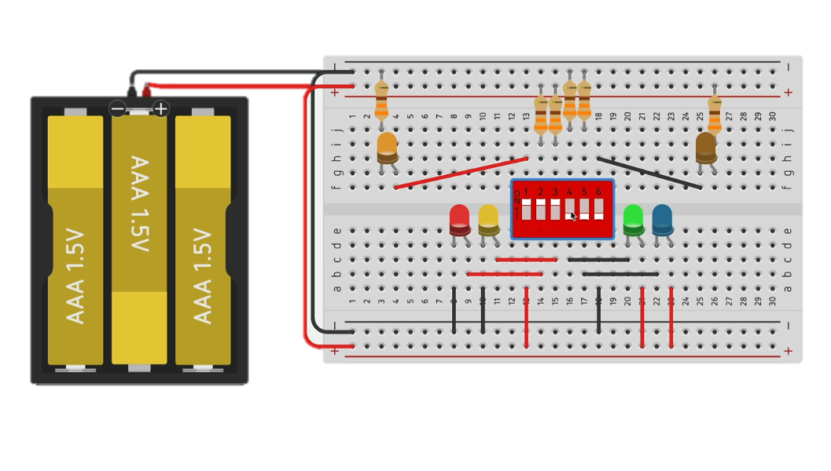
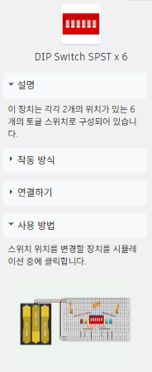
DIP Switch SPST x 6

Slide 36
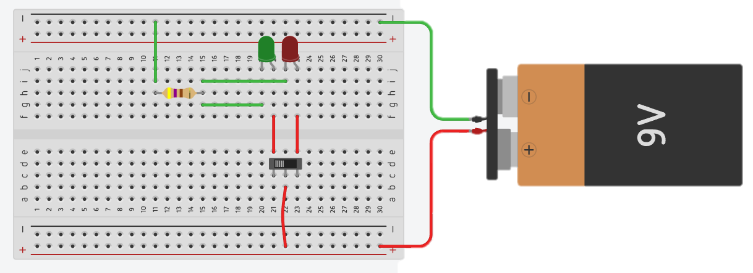
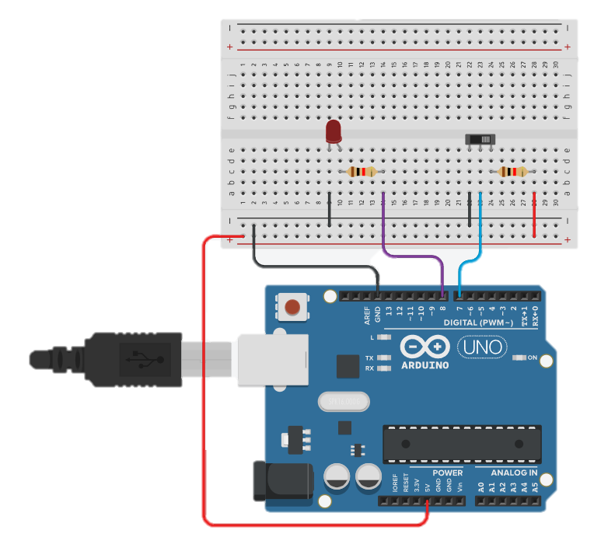
슬라이드 스위치
void setup()
{
Serial.begin(9600);
pinMode(8, OUTPUT);
pinMode(7, INPUT);
}
void loop()
{
int readValue = digitalRead(7);
Serial.println(readValue);
if(readValue == HIGH) {
digitalWrite(8, HIGH);
}
else {
digitalWrite(8, LOW);
}
}

Slide 37
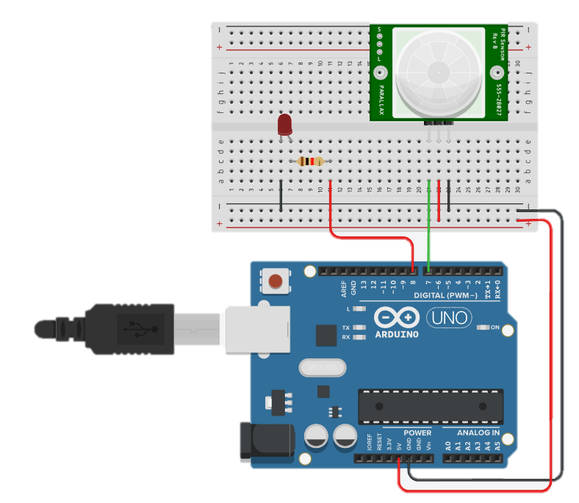
PIR 센서로 현관등 만들기
void setup()
{
Serial.begin(9600);
pinMode(8, OUTPUT);
pinMode(7, INPUT);
}
void loop()
{
int readValue = digitalRead(7);
Serial.println(readValue);
if(readValue == HIGH) {
digitalWrite(8, HIGH);
}
else {
digitalWrite(8, LOW);
}
}

Slide 38
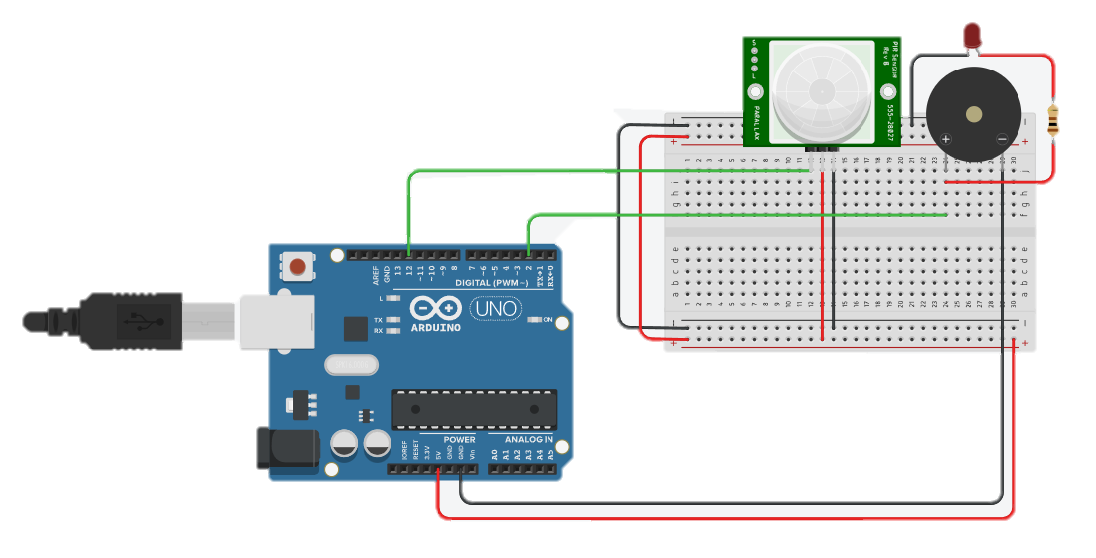
Motion Detection using PIR Sensor
int pir_pin=12;
int buzzer_pin=2;
void setup()
{
pinMode(pir_pin,INPUT);
pinMode(buzzer_pin,OUTPUT);
}
void loop()
{
int motion=0;
motion = digitalRead(pir_pin);
if (motion==HIGH){
digitalWrite(buzzer_pin,HIGH);
}
else {
digitalWrite(buzzer_pin,LOW);
}
delay(15);
}

Slide 40
Reference
만들면서 배우는 아두이노와 40개의 작품들. 장문철, 앤써북
스마트폰, 블루투스, 이더넷, WiFi 그리고 아두이노, 조도현 외 4, 북두출판사
https://wikidocs.net/30784

