Slide 1
Cyclic Atomic N-party Swap (CANS) Protocol
Trustless Cross-chain Swaps via Adaptor Signatures

Slide 2
Motivations
Solution
Code
Demo
Challenges
Table of Contents
Risks of bridges
Risks of Hashed Time Lock Contracts
Why move assets between blockchains?
Adaptor Schemes (Secret Sauce)
Leader Election and Secret Sharing
Lock, Spend and Refund Transactions
Refund Windows
CANS Protocol Summary
Cyclic Atomic N-party Swap (CANS) Protocol Summary
Session States
Wire Messages
Daemon
20-Party Swap
Open Issues

Slide 3
Why move assets between blockchains?
Motivations
Untapped liquidity: Bitcoin has largest store of value in crypto, approx $1 trillion in market cap, not earning interest.
Bitcoin scripting is intentionally limited for security reasons, so no native lending, no DEX, no stable-coins.
Cardano has rich programmable finance: oracles, DEXs, lending & borrowing, liquid staking - but not Bitcoin’s liquidity.
If you sell one for the other, lose exposure and potentially taxable event.

Slide 4
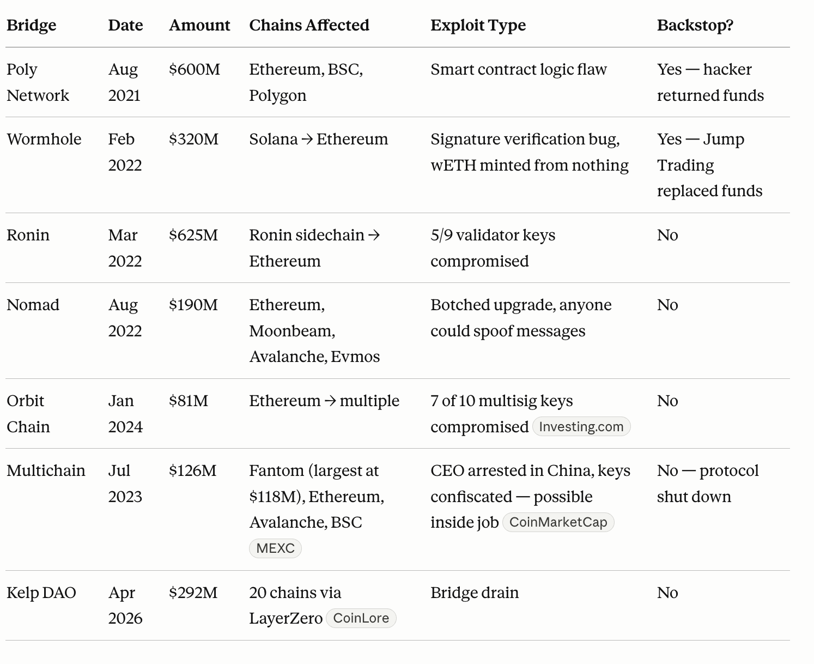
Risk of Bridges
Motivations
Bridges use wrapped tokens (lets you keep exposure) that you can then yield.
Most bridges require a trusted third-party/custodian to upgrade the contract logic, pause or drain the bridge.
Fully-custodial, multi-sig validators, optimistic bridges, zk-bridges.
Bridges have lost >$2B to exploits.

Slide 5
Risks of Hashed Timelock Contracts
Motivations
CEXs impose custody risk, KYC requirements, and settlement delays
Atomic swaps require no custodian, no shared pool. You own the asset
HTLC-based atomic swaps publish a common hash on both chains — trivially linking both swap legs for chain analysts
HTLC ring swaps lock sequentially — each hop waits for the previous confirmation, making total lock-time O(N × block_time); timeouts must be staggered by the same factor
Goal: Atomic swap that is efficient, trustless, private, and has minimal on-chain footprint

Slide 6
Cyclic Atomic N-party Swap (CANS) Protocol Summary
Solution
CYCLIC: P₁ → P₂ → … → P_{n} → P₁: each participant sends exactly once and receives exactly once
ATOMIC: Either all spend txs complete, or all refunds fire. If any participant aborts, time-locked refunds guarantee no participant loses funds
N-party: Scales to N participants — same ring protocol handles 3 or 20 counterparties with no structural changes
Supports same-chain or cross-chain legs (BTC ↔ ADA, ADA ↔ ADA, BTC ↔ BTC)
Participants need only trust the cryptographic protocol — not each other
Scriptless on Bitcoin: Taproot key-path spend is indistinguishable from a regular transfer
Happy path is quick (refund is no quicker)

Slide 7
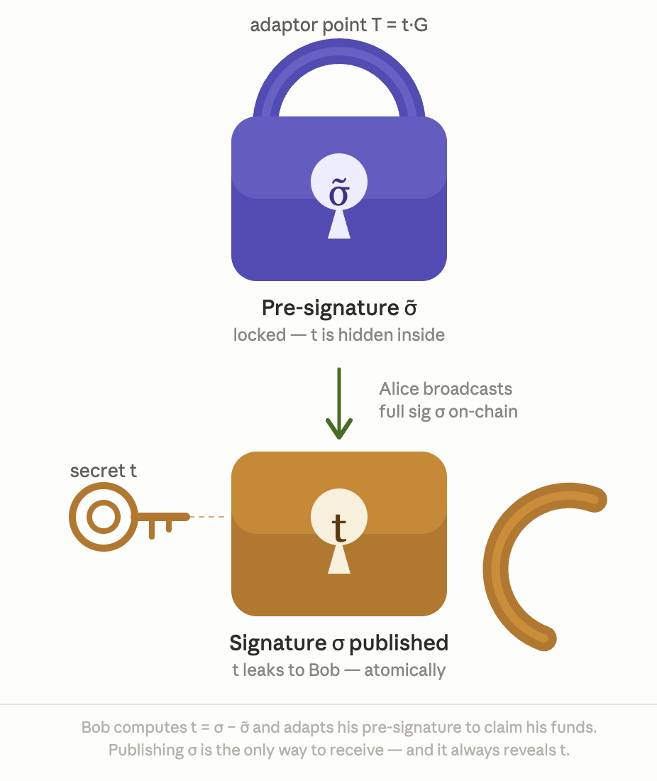
Adaptor Schemes (Secret Sauce)
Solution
An adaptor signature is a pre-signature that becomes valid when a secret scalar is added,
i.e. valid_sig = pre_sig + secret
Adaptor point is public commitment to adaptor secret and is shared early.
The adaptor point alone is enough to create and verify a pre-signature — the secret is only needed at claim-time to complete it into a valid signature.
Unlike hashed timelocks, the mathematics of adaptor points allows secrets to be combined — making the multi-party sum construction possible.
Each participant holds one adaptor secret per swap leg; the secret is only revealed at claim-time.
Collective secret for swap is sum of individual secrets (i.e. t₁ + … + t_{n}).
Publishing a valid spend Tx reveals the secret to all chain observers.

Slide 8
Lock, Spend and Refund Transactions
Solution
Three Txs prepared per leg before any lock is broadcast:
  Lock Tx — signed by sender only; funds sent to N-of-N aggregate address (Taproot / Plutus);
  Spend Tx — pre-signed by all N participants; adaptor secret needed to complete (t₁ + t₂ + … + t_{n});
  Refund Tx — fully signed by all N participants; valid only after specific block/slot, if swap fails.
Refund Txs are fully signed and spend Txs are aggregated into adaptor signatures before any lock Tx is broadcast — no party locks funds without a guaranteed exit path and a spend tx that needs only the adaptor secret to finalise.
Sender Wallet
Lock Tx
N-of-N Address
Spend Tx
Spend Tx
all N pre-sign + secret
all N full-sign + time-lock
Recipient Wallet

Slide 9
Bitcoin and Cardano
Solution
Bitcoin — Taproot / MuSig2
  Pay-to-Taproot key-path spend: looks like a regular single-sig transaction on-chain
  N-of-N key aggregation via MuSig2 — private, efficient, no script visible
  Adaptor signatures integrate naturally into the Schnorr two-round signing protocol
Cardano — Plutus
  Cardano doesn’t natively support Schnorr (EdDSA)
  Locked UTXO guarded by a Plutus validator script
  Script checks: correct N-of-N multisig
  Supports any native Cardano asset — not limited to ADA

Slide 10
Leader Election and Secret Sharing
Solution
Leader elected via commit-reveal (hash of random nonce)
Non-leaders each send their adaptor secret to the leader (once Lock Tx is broadcast).
Leader adapts and broadcasts Spend Tx — secret becomes visible on-chain.
Non-leaders observe the Spend Tx and extract the secret to claim their funds.
P2
SecretReveal
Spend Tx
(secret on-chain)
P1 (Leader)
On-chain
observe &
extract secret
P3
SecretReveal

Slide 11
Refund Windows
Solution
P1 -> P2 -> P3 -> P1
(P1 claims from P2, etc)
A refund tx is fully-signed but only valid after a certain block/slot height.
The participant whose refund-window opens first is the one the leader claims from to create economic pressure to broadcast the spend tx promptly.
A participant's refund window opens after the window of whoever is claiming from them.
The leader waits longest — they cannot reclaim until all others have had the chance to exit.
Guarantees no participant can simultaneously claim their deposit and claim their target's funds.
Total refund horizon grows linearly with ring size.
P2
P3
P1 — Leader
blocks →
start
start + W
start + 2W
start + 3W
P2 refunds
P3 refunds
P1 refunds

Slide 12
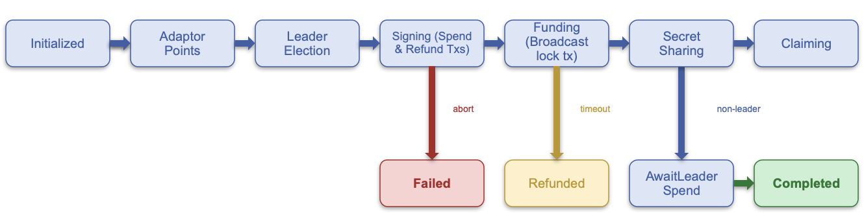
Session States
Code
Leader path: Initialized → AdaptorPts → LeaderElect → Signing → Funding → SecretSharing → Claiming → Completed
Non-leader fork: SecretSharing → AwaitLeaderSpend → Claiming → Completed

Slide 13
Wire Messages
Code
Peer-to-peer TCP messages drive state transitions across all daemons:
  AdaptorPoint — initial secret commitment broadcast to all peers,
  LeaderElectionCommitment / LeaderElectionNonce — commit-reveal for leader selection,
  SchnorrNonce / PartialSignature — MuSig2 two-round signing,
  LockTxBroadcast — participant signals their lock tx is on-chain,
  SecretReveal — each participant sends adaptor secret to leader,
  SpendTxBroadcast — leader notifies others the spend tx is live.
No central coordinator — every message is routed directly between peers.

Slide 14
Architecture
Code
Each participant runs an independent daemon process
Components:
  TCP listener — peer-to-peer, no central server,
  Chain pollers — watches Bitcoin/Cardano for lock confirmations, leader spend txs, refund windows,
  Session Finite State Machine —routes incoming messages into the SwapSession
  Key management — BTC Taproot keys, ADA Ed25519 / Plutus keys
OpenTelemetry tracing for distributed observability across all daemons
Written in Rust — memory-safe, async (Tokio), tested via a full regtest harness with UI dashboard
Architectural documentation maps between the protocol specification and the reference implementation.

Slide 15

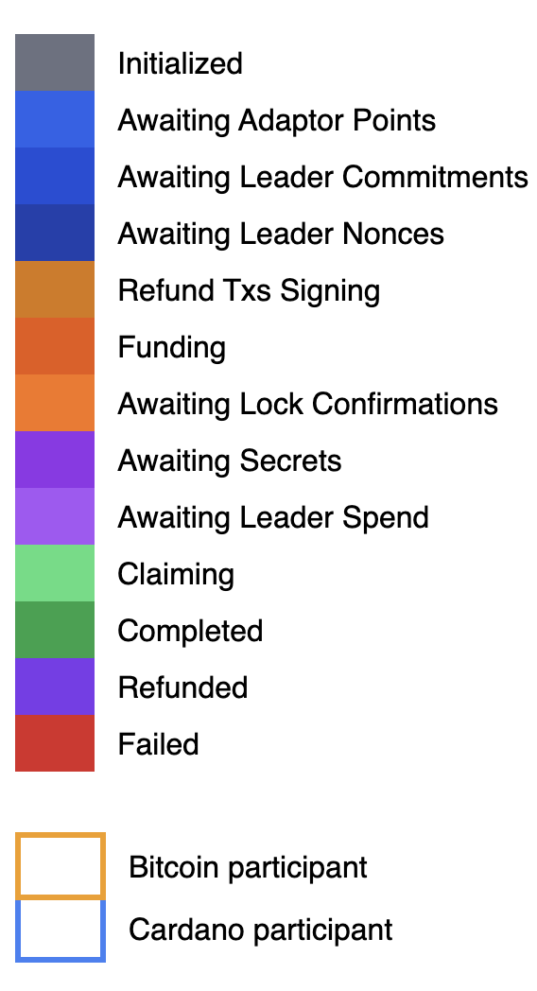
20-Party Swap
Demo
Video Length 2’:12” Colour Code

Slide 16
Open Issues
Challenges
Ring-Structure
  Participants must form a connected ring.
  Even non-overlapping rings are forbidden from occurring in the same swap.
DoS Attack
  A censoring miner suppresses a participant's spend tx until the target's refund window opens, at which point the target reclaims their funds and the spend tx becomes invalid.
Cross-chain clock coordination
  Bitcoin and Cardano advance independently — no universal block clock.
  Refund windows must be calibrated conservatively to avoid timing races.
Refund window length scales with N
  Outermost participant waits up to N × window_duration before a safe refund.
  Practical upper bound on ring-size for time-sensitive swaps.

Slide 17
Questions?
Thank you for listening
https://discord.com/invite/56EQWW4rzv
https://www.iog.io/contact

