Slide 1


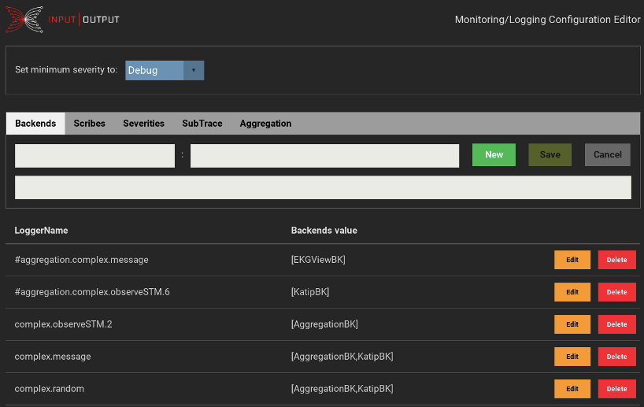
L O G G I N G
contra-tracer
A minimal implementation of Tracer m a is suf- ficient to start tracing observables in any code. Simply create a trace and add transformers to process the observables.
create a tracer
In this example, the terminal transformer outputs a text representation to the console:
let logTrace = showTracing $ stdoutTracer
showTracing :: (Show a) => Tracer m String
-> Tracer m a
stdoutTracer :: (MonadIO m) => Tracer m String
usage of the tracer argument in a function
fun logTrace = do
...
curBlockHeader :: Header <- ...
traceWith logTrace curBlockHeader
...
transformers
This usage of a Tracer m a can later be adapted to include filtering tracer transformers such as:
let logTrace’ = condTracing checkP logTrace
condTracing :: (a -> Bool) -> Tracer m a
-> Tracer m a
Or, to forward to the more elaborate logging and monitoring capabilities of Trace m a via the toLogObject transformer, without changing the call site.
toLogObject :: Tracer m (LogObject a) -> Tracer m a
Hierarchy of traces
The derived Trace m a type accepts LogObject for further processing and routing depending on the context name.
A hierarchy of traces can be created by entering a local namespace with:
trace’ <- appendName “deeper” trace
Observables on the new trace are annotated with the extended name.
Privacy annotation
The logged observables can be annotated with either Confidential or Public.
This will be taken into account when dispatching to the Katip backend and its output scribes which are itself annotated to only process observables of a certain kind.
Example Trace with severity annotation
trace <- setupTrace (Left “config.yaml”) “test”
logInfo trace “Info”
logError trace “Error”
leads to outputs:
[iohk.test:Info:ThreadId 104] [2019-03-27 07:30:32.37 UTC] "Info"
[iohk.test:Error:ThreadId 104] [2019-03-27 07:30:32.37 UTC] "E..
Configuration - output selection
The configuration is loaded on startup from a YAML file.
baseTrace <- setupTrace (Left “config.yaml”) “base”
The returned Trace in the namespace “base” will route all messages to the Switchboard which dispatches the messages to the backends according to configuration. The Katip backend handles output to the console or log files, and also includes the log rotator.
The configuration contains mappings from the named context (LoggerName) to values changing the trace’s behaviour.
cabal new-run example-complex and access the editor on http://localhost:13789
Changes are effective immediately, because the changed configuration will be queried on arrival of every traced message.

