Slide 1



Student Management System
by
AZMAIN INQUAID HAQUE (230218)
FIDA TALBIA (190216) MD. SABBIR KHAN (230204)

Slide 2
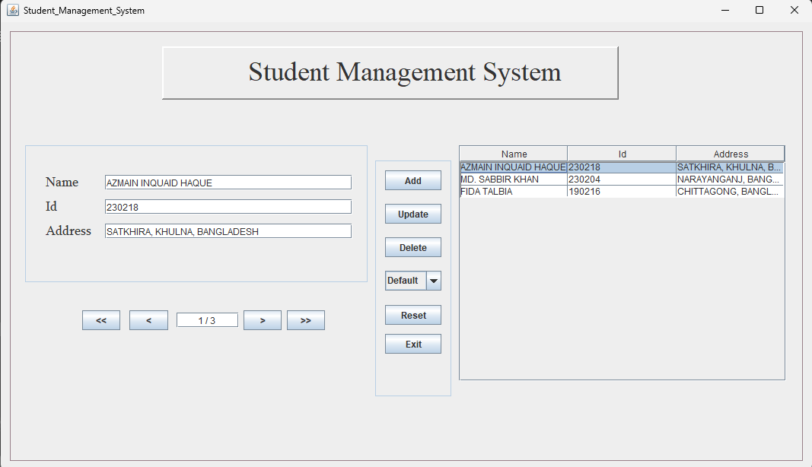
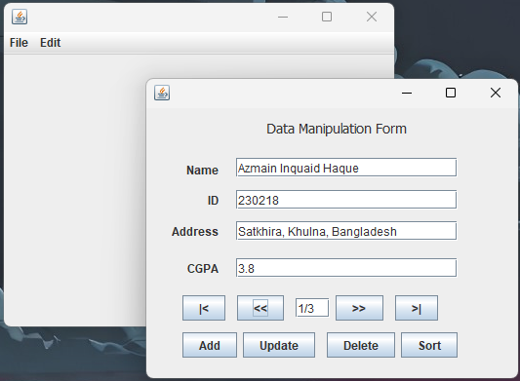
Project 1: using java swing and SQL
Project 2: using java swing and serializer / deserializer

Slide 3
Java Swing and AWT
Swing
AWT
Advantages
Swing is a powerful Java GUI toolkit that provides a wide range of customizable components for building desktop applications.
AWT (Abstract Window Toolkit) is an earlier Java GUI toolkit that provides basic components for creating windows and UI elements.
Both Swing and AWT offer flexibility, platform independence, and extensive libraries for developing sophisticated student management systems.

Slide 4
CRUDS Operations
CRUD Operations
1
Create
2
Read
1
Create
2
Read
Allows users to add new student records to the system.
Enables users to view and retrieve existing student data.
Allows users to add new student records to the system.
Enables users to view and retrieve existing student data.
3
Update
4
Delete
3
Update
4
Delete
Gives users the ability to edit and modify student information.
Allows authorized users to remove student records from the system.
Gives users the ability to edit and modify student information.
Allows authorized users to remove student records from the system.
5
5
Sort
Sort
Allows user to sort the records as per demand

Slide 5
Data Retention
File Serialization
Secure Storage
Student data is stored in .ser files, ensuring reliable and persistent data storage.
The .ser files are protected and accessible only to authorized personnel, maintaining the integrity of student records.
Backup and Restore
Scalability
The system supports seamless backup and restore functionalities, enabling data recovery in case of system failures or unexpected events.
The file-based data storage can accommodate growing student populations and expand as the institution's needs evolve.

Slide 6
MySQL Database
Efficient Storage
The MySQL database provides a robust and scalable solution for storing and managing student records.
Structured Data
Student information is organized and stored in a structured format, allowing for easy retrieval and reporting.
Transactions
The database supports ACID (Atomicity, Consistency, Isolation, Durability) transactions, ensuring data integrity during CRUD operations.
Backup and Recovery
MySQL offers comprehensive backup and recovery tools, enabling seamless data protection and restoration as needed.

Slide 7




Reliable Data Storage
File Serialization
Student records are persistently stored in .ser files, ensuring data retention even in the event of system failures.
MySQL Database
The MySQL database provides a scalable and secure platform for managing student data, with robust transaction support.
Backup and Recovery
Comprehensive backup and recovery mechanisms are in place to safeguard student data and enable quick restoration if needed.

Slide 8




Conclusion
Comprehensive
Reliable
Resilient
Efficient
The student management system offers a complete set of features to effectively manage student records and data.
Robust data storage solutions, including file serialization and MySQL database, ensure the integrity and security of student information.
Backup and recovery capabilities protect against data loss and enable seamless restoration in the event of system disruptions.
The user-friendly interface and intuitive CRUD operations streamline the management of student records.

Slide 9
The Road Ahead
Future Enhancements
1
Planned improvements include integrating advanced analytics, reporting, and user-friendly dashboards to further enhance the system's capabilities.
2
Expanding Functionality
Additional features such as student attendance tracking, grade management, and automated notifications will be implemented to provide a more comprehensive solution.
Continuous Improvement
3
The student management system will undergo regular updates and upgrades to ensure it remains aligned with evolving educational needs and industry best practices.

