Slide 1
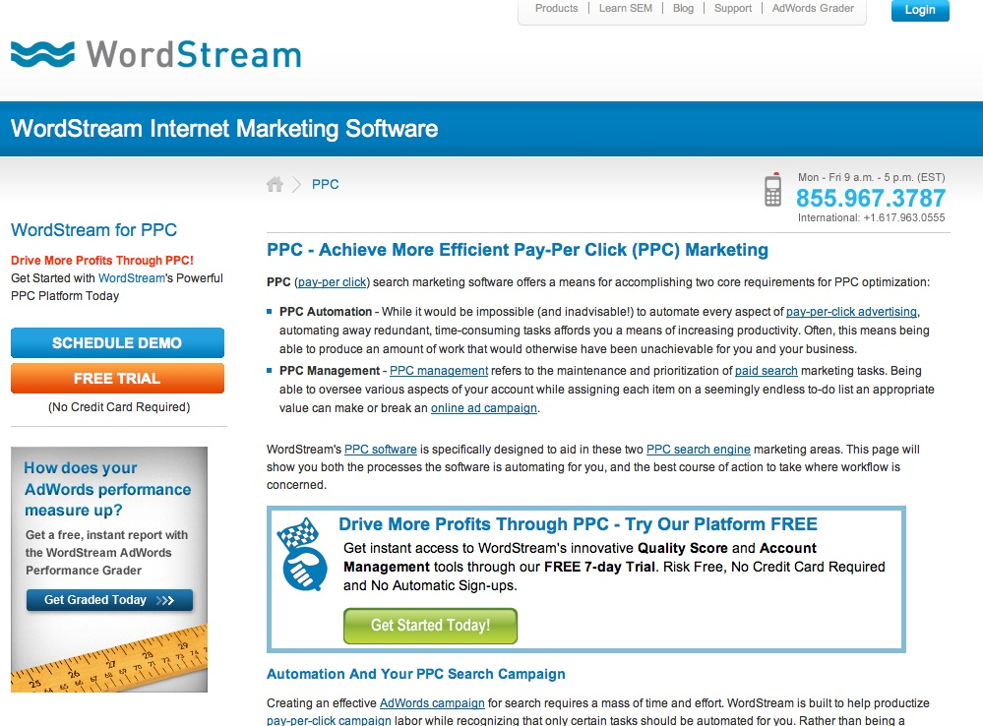
#header
.logo, .logo__img, .logo__text
.navigation, .navigation__list
.banner, .banner__title
#side-content
.breadcrumbs,
.breadcrumbs__icon,
.breadcrumbs__text
.contact, .contact__icon, .contact__details
.signup-callout,
.signup-callout__title,
.signup-callout__heading
.signup-callout__demo-btn,
. signup-callout__trial-btn
--side
#primary-content
.report-callout,
.report-callout__title,
. report-callout__btn
.signup-callout,
.signup-callout__title,
.signup-callout__icon
.signup-callout_header,
. signup-callout__trial-btn
--primary

Slide 2
215px
Products
335px
10.15’’ = 960px
410px
660px
PPC (pay-per click) search marketing software offers a means for accomplishing two core requirements for PPC optimization:
205px
210px
620px
165px

