Slide 1

RECOMMENDATION SYSTEMS USING K-NEAREST NEIGHBOR ALGORITHM
Presented By: AAKRITI SINGH
Roll No.: 1912902
B.TECH (CS) V SEM BATCH-A
Department of Computer Science
Banasthali Vidyapith

Slide 2
OVERVIEW
Introduction
Need of recommendation systems
Working of recommendation systems
using K-nearest neighbor algorithm
Issues and challenges
Conclusion

Slide 3




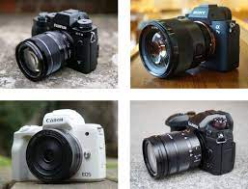
INTRODUCTION
SEARCH:
HP 250 G8 LAPTOP
USER A
SEARCH:
CAMERA
10 BEST CAMERAS OF 2021
USER B

Slide 4

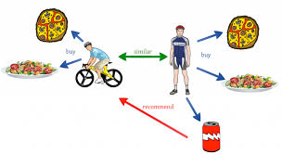
INTRODUCTION
Recommender systems->
-finds match between product and user
-takes care of user’s interest
-filter large volume of data

Slide 5

NEED OF RECOMMENDATION SYSTEMS
“We have made a big leap from scarcity to abundance.”

Slide 6
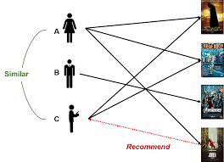
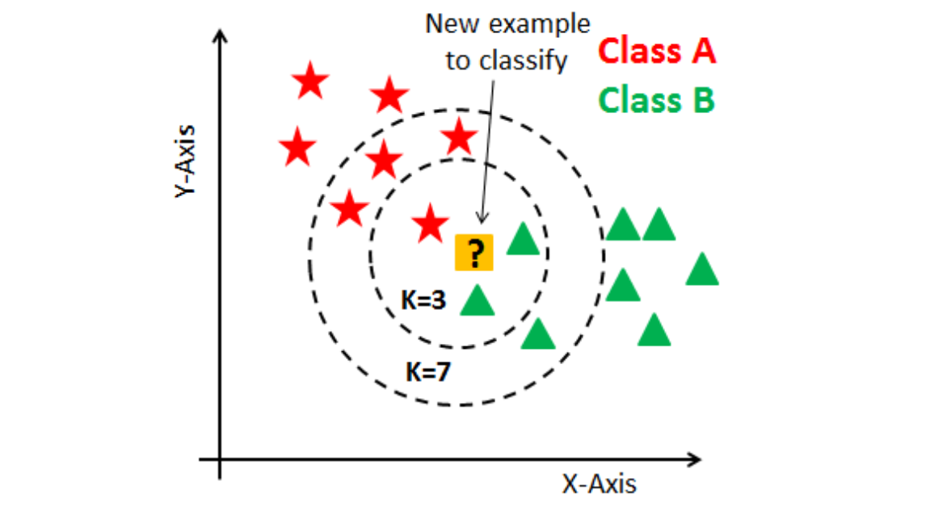
WORKING OF RECOMMENDER SYSTEMS
Algorithm used :-
K-Nearest Neighbour Algorithm
Approach for explanation:-
Collaborative filtering (User Based) for movie recommendation systems

Slide 7
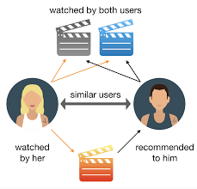
WORKING OF RECOMMENDER SYSTEMS
Formulation of problem
statement:-
1.Consider user X.
2.A group of users like the movie as X does and dislikes the movie as X does. These set of users are neighbourhood of user X.
3.Then we find other movies liked by these set of users N and recommend it to X.

Slide 8
WORKING OF RECOMMENDER SYSTEMS
Formal model :-
U: set of users
S: set of movies
p: U X S -> R (p: utility function)
where R is the rating of user for a movie
Objective: Learn ‘p’ from the data
Output:
When new unlabelled data is given it produces appropriate output.

Slide 9
WORKING OF RECOMMENDER SYSTEMS
Algorithm:-
1.Generate user-item two-dimensional matrix of rating as Rmxn , where each rating is ru,i.
2.Use principle of Pearson correlation similarity to calculate similarity between 2 users and generate user-similarity matrix.
3.According to result obtained in step 2,find K number of ratings which has maximum value and these K users forms the neighborhood of user X.
4.Use the formula,
rxi=∑ Sxy * ryi
∑ Sxy
To calculate the predictive value of i for target user X.

Slide 10
1.Generate user-item two-dimensional matrix of rating as Rmxn , where each score is ru,i.
ITEM USER | Harry Potter1 | Harry Potter2 | Toy Story | StarWars
A | 5 | 3 | 1 | 5
B | 2 | 4 | 4 | 2
C | 4 | 3 | 1 | ?
D | 4 |  | 4 | 2
E | 1 |  |  | 4
Target User

Slide 11
2.Use principle of Pearson correlation similarity to calculate similarity between 2 users and generate user-similarity matrix
2.1)Normalize ratings by subtracting row means.
2.1.1)Calculate row means for given row respectively.
Avg(A)=14/4 ; Avg(B)=12/4 ; Avg(c)=8/3
Avg(D)=10/3 ; Avg(E)=5/2
2.1.2)Subtracting row means from individual rows respectively except
missing values.
 | Harry Potter1 | Harry Potter 2 | Toy Story | StarWars
A | 6/4 | -2/4 | -10/4 | 6/4
B | -4/4 | 4/4 | 4/4 | -4/4
C | 4/3 | 1/3 | -5/3 | ?
D | 2/3 |  | 2/3 | -4/3
E | -3/2 |  |  | 3/2

Slide 12
2.2)Compute Cosine similarity using cosӨ
cos(rC,rA)=0.837
cos(rC,rB)=0.617
cos(rC,rD)=-0.063
cos(rC,rE)=-0.436
3.According to result obtained in step 2,find K number of ratings which has maximum value and these K users forms the neighbourhood of user X.
Let K=3, so the top K users that forms the neighborhood are
A,B and D.

Slide 13
4.Use the formula,
rxi=∑(yԐN) Sxy * ryi
∑ (yԐN) Sxy
To calculate the predictive value of i for target user X.
Substituting the values we get,
0.837*6/4 + 0.617*-4/4 + 0.063*4/3
0.837 + 0.617 - 0.063
=0.51
THIS PREDICTED RATING IS ABOVE 0 WHICH MEANS
MOVIE STARWARS MIGHT ALSO BE LIKE BY USER C
AS COMPARED TO AVERAGE RATING.
SO MOVIE STARWARS IS RECOMMENDED TO USER C.

Slide 14


ISSUES AND CHALLENGES
Cold Start Problem
Data Sparsity
New User?
I don’t know the interests!
Lets create account on spotify!
Recommendation System

Slide 15
CONCLUSION
Challenges were there, are
there and will continue to be
there in the field of
technology!

Slide 16
REFERENCES
A. R. Lahitani, A. E. Permanasari, and N. A. Setiawan, “Cosine similarity to determine similarity measure: Study case in online essay assessment,” In 2016 4th International Conference on Cyber and IT Service Management, Apr, 2016.
P. Phorasim and L. Yu, “Movies recommendation system using collaborative filtering and k-means,” International Journal of Advanced Computer Research.
Balabanovíc, M., Shoham, Y.: Fab: Content-Based, Collaborative Recommendation. Communications of the ACM, (1997) 40(3).

