Slide 1
Netsoc Hackathon
Brief Introduction

Slide 2
Netsoc Hackathon
Brief Introduction

Slide 3
DistractLess
To help you Distraction Less 😎
A project by;
Oli Cunnington, Ozzak Jura Matek, Dylan Deasy

Slide 4
DistractLess
What is it?
DistractLess is a tool designed to maintain effective and productive workflow.

Slide 5
DistractLess
How can DistractLess help me?
Make the decision to be motivated now
Predetermine your productivity
Take Control
Surrender to DistractLess

Slide 6
DistractLess
How does it work? Can I be sure that i'm protected from distraction?
Create Custom Profiles
Block Undesirable IP Addresses
Prevent Unwanted Notifications
Remove Embedded Web Nuascances
Elminate Distraction

Slide 7
DistractLess
How is all this achieved?
What makes DistractLess function?
Domain Name Server
IP ban
Stopping the problem at the source

Slide 8
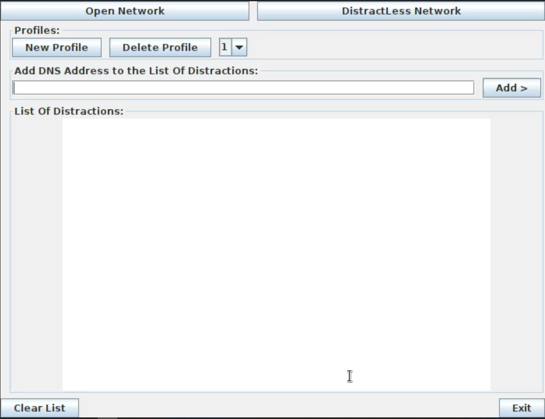
DistractLess

Slide 9
Future Implemented Features
Track your productivity
Planner and Schedules

Slide 10
DistractionLess
Be the person you want to be
- with the click of a button
A project by Oliver Cunnington, Ozzak Jura Matek, Dylan Deasy

