Slide 1
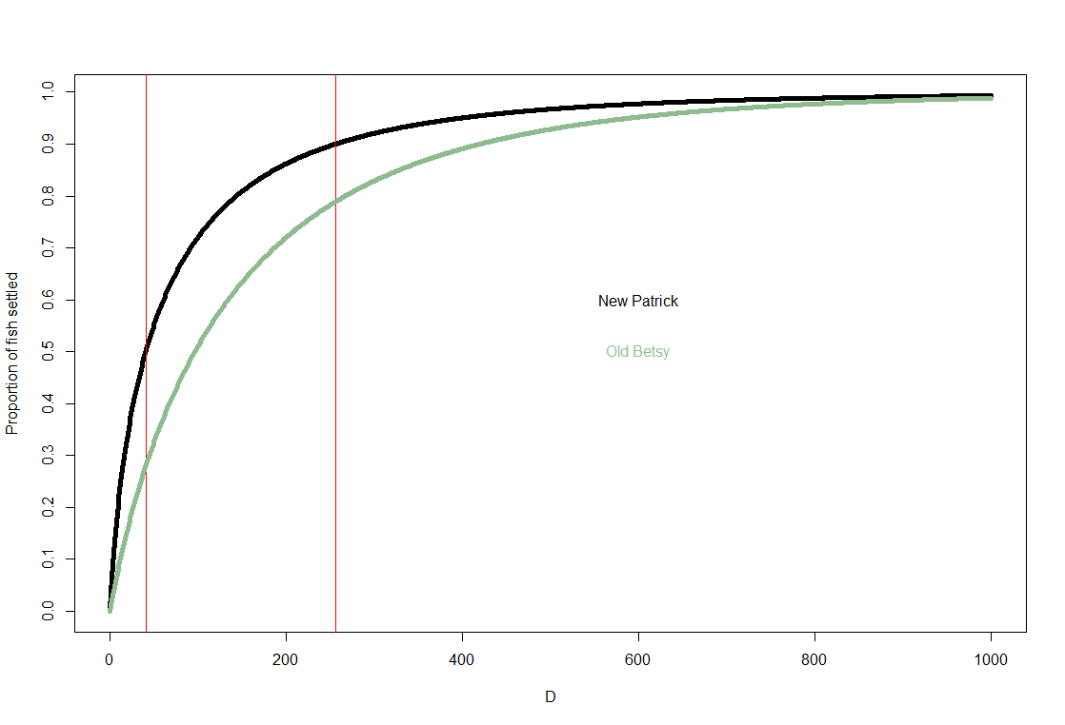
Cumulative proportion of fish that have settled, using the old (Betsy’s) and new (Patrick) values for alpha and beta

Slide 2
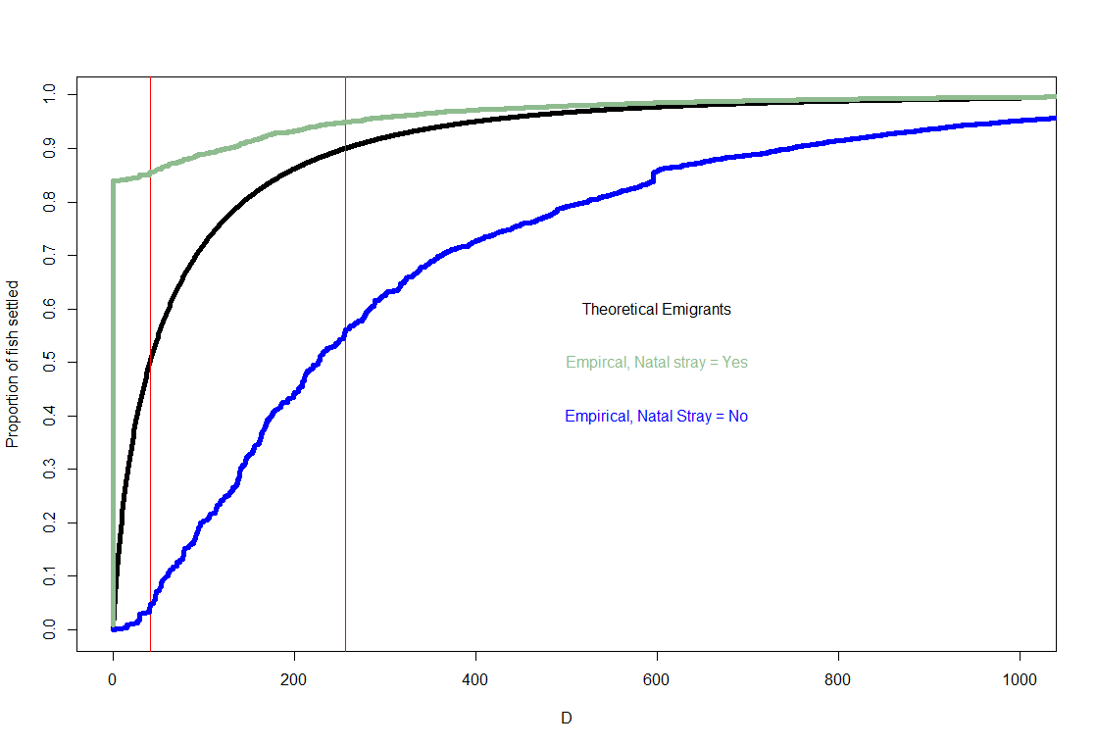
These are the empirical distributions, from running the model with the current selection of basins (102 basins ~ Andy)
Very few basins that are < mean disp. Distance and few that are between the red lines

Slide 3
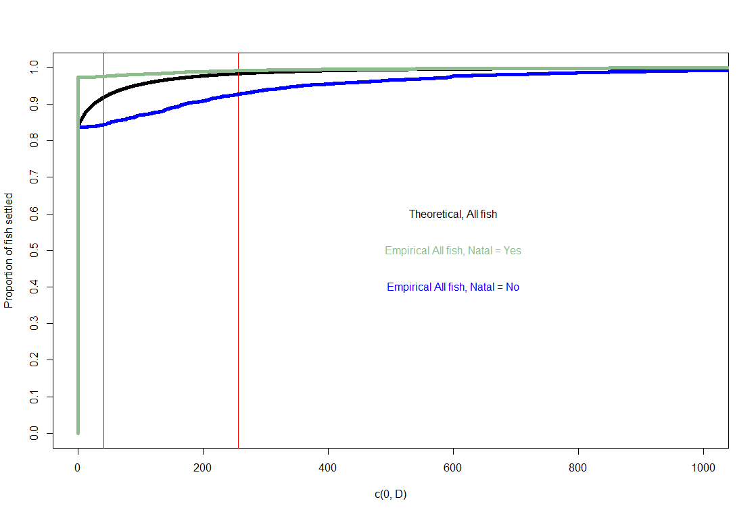
This shows all fish, homing and straying

Slide 4
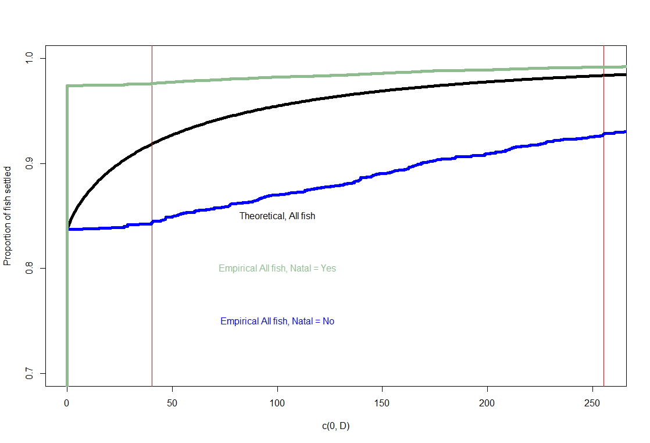
This is a zoomed in view of the previous graph

Slide 5
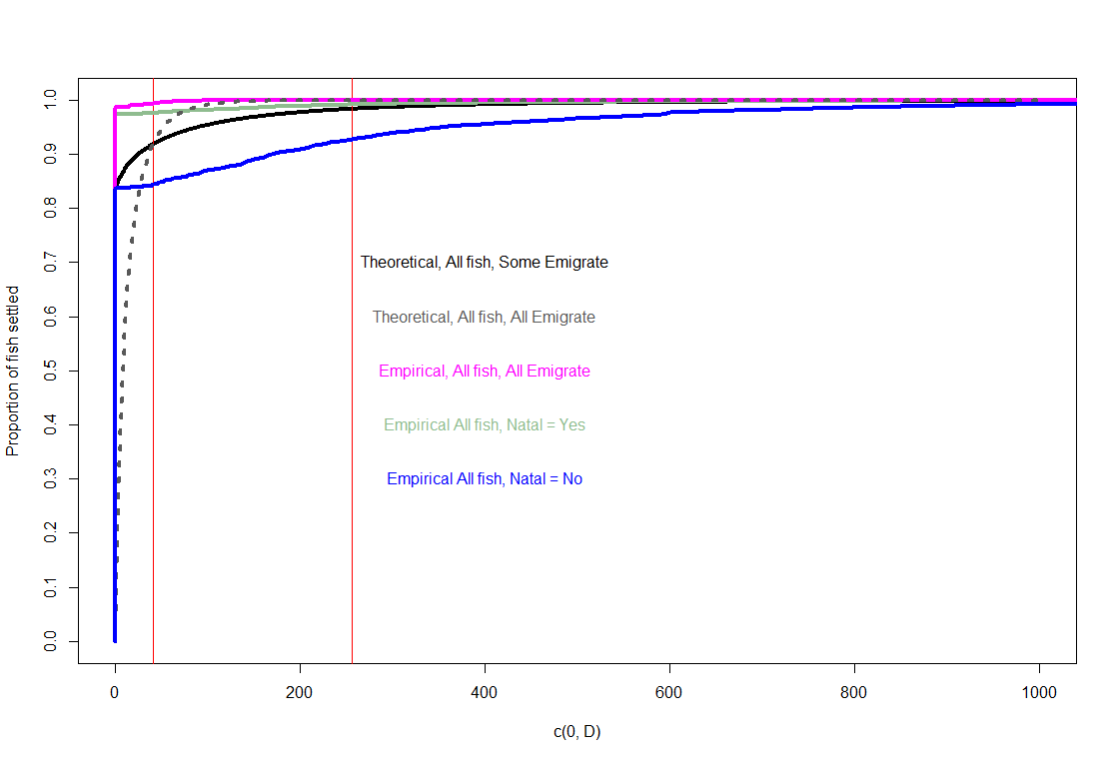
This shows all fish, homing and straying.
What happens if we eliminate parameter Y, and put ALL fish into the dispersal equation?
First, re-estimate alpha and beta (dotted line)
New empirical distribution in Magenta

Slide 6
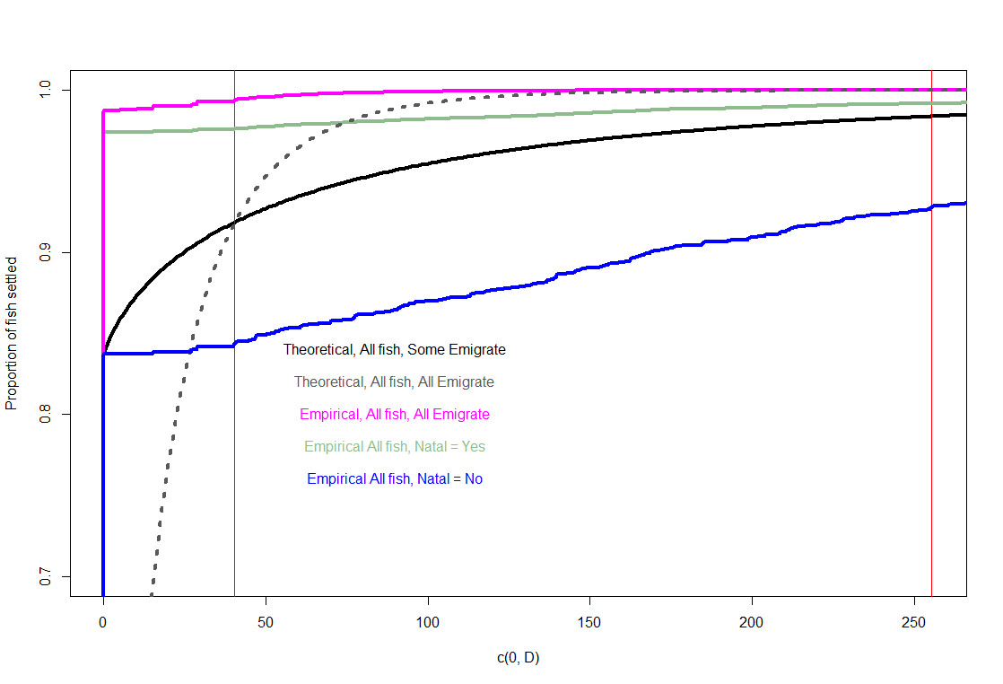
This is a zoomed in version of the previous graph.

Slide 7
Suggestion: Allow Natal straying = Yes, but put ALL fish into dispersal function
This would eliminate an artificial separation in the model between homers and strayers
Empirically, this seems like it will have more fish homing, and fewer long-distance strayers compared to the current set-up
This might result in higher levels of straying in very close catchments compared to the current set-up
Math:
In the equations for immigrants, emmigrants, and homers, γ = 1, therefore:
Emigration from a catchment:
All fish will be treated as emigrants, so:
Ej(t)=γ N j (t) becomes Ej(t)= N j (t)
Homing to a catchment:
All fish are treated as emigrants, so:
Ni(t−1)⋅(1−γ ) becomes Ni(t−1)⋅(1−1 )
Ni(t−1)⋅(1−1 ) = 0
B₁:

Slide 8
Y from the survey would no longer be needed in any of the dispersal and population equations directly.
It would instead be used for estimating alpha and beta.
At mean dispersal distance,
Probability of settling = 0.5 * y
proportion of fish settled = (1- y) + 0.5 * y
At “max” dispersal distance,
Probability of settling = 0.1 * y
Proportion of fish settled = (1-y) + 0.9 * y

Slide 9
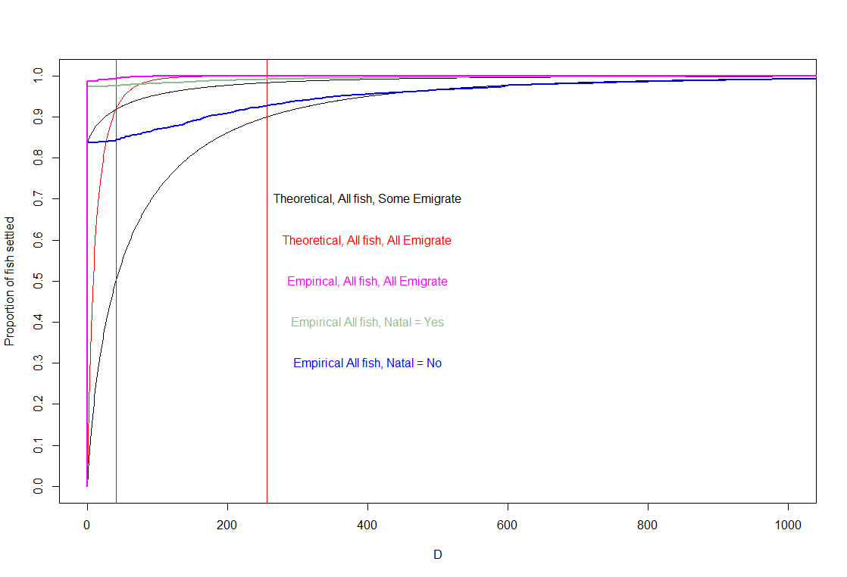

Slide 10
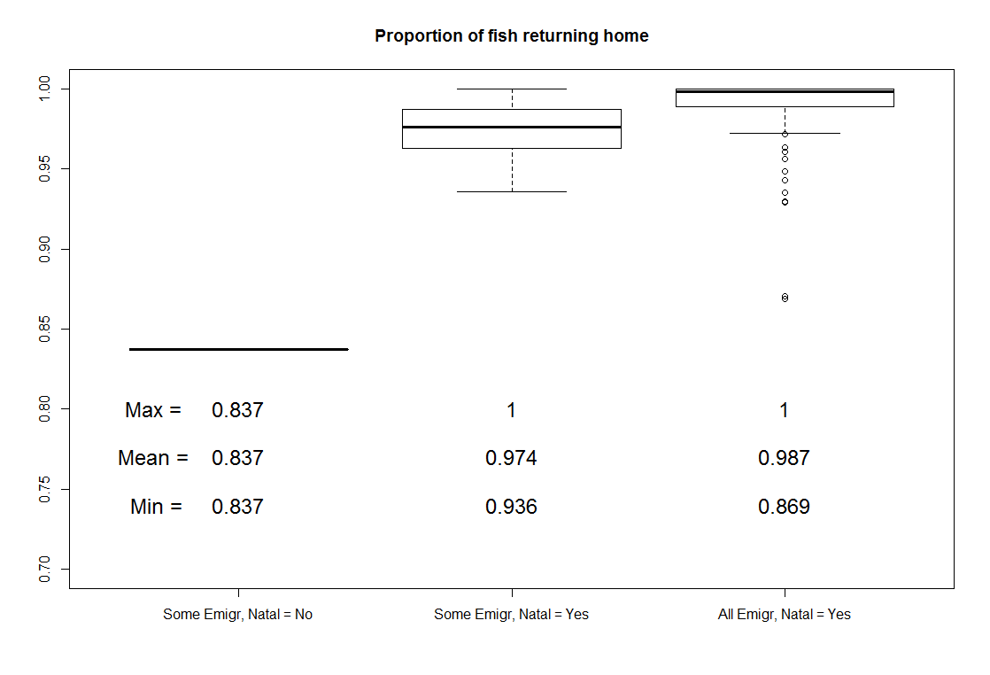

Slide 11
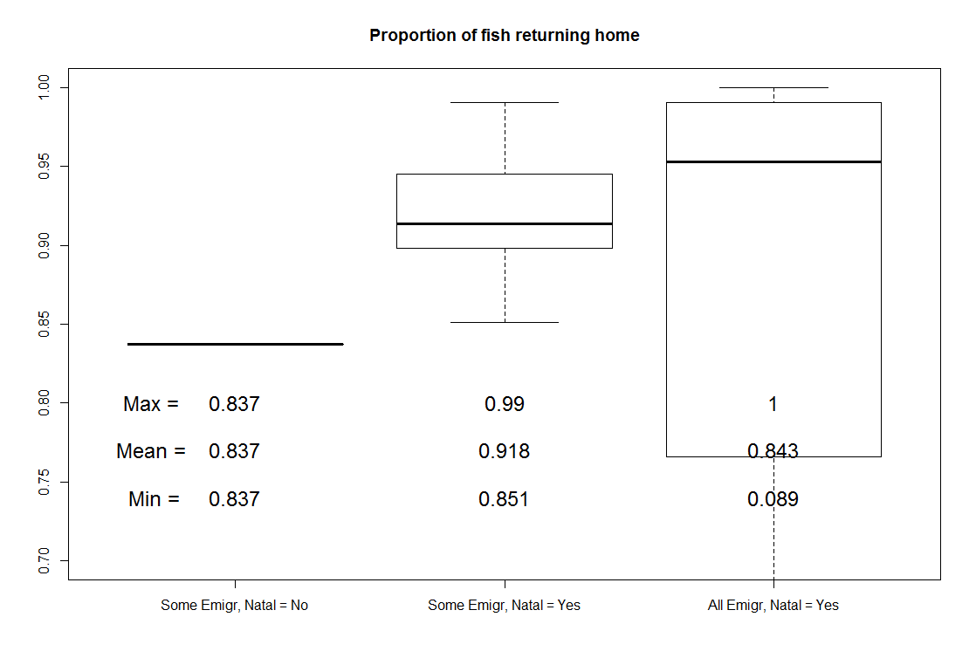

Slide 12
