Slide 1






Game rules
Serious game
Number of players: 3 to 5
Age: 14+
Duration: 40 min

Slide 2
Table of Contents
1. Equipment............................................................................4
2. The components of the game..............................................5
Smartphone “board” ........................................................5
Resource cards ................................................................6
Penalty cards ...................................................................8
Resource-summary cards.................................................9
Event cards ......................................................................9
3. Set-up.................................................................................10
4. Object of the game ............................................................12
5. Gameplay ...........................................................................12
Who goes first? ...............................................................12
A round in the game ........................................................12
Action: procure materials ..........................................13
Action: manufacture a component ............................14
Action: clean up pollution...........................................14
End of a round in the game ..............................................14
6. End of the game ..................................................................15
Conditions for the end of game ........................................15
Calculating the points ........................................................15
7. To find out more ..................................................................16
Credits ......................................................................................16

Slide 3

Discover the wide variety of metals used to manufacture your smartphone and the environmental impact of extracting them
You play the role of a smartphone manufacturer in the town of TechCity. As competition rages to produce ever-more innovative mobile phones, a crucial issue has come to the fore: the environmental impact of producing these devices.
Over the course of your turns in the game and the events that occur, you will learn about the various metals found in smartphones, the major stages in mining these resources and their environmental and social impact.
You will need to make strategic choices that take into account the different environmental and economic constraints! But be careful, every choice you make will have consequences...
The time has come to build a more sustainable future. Are you ready to take on this major challenge? TechCity's destiny is in your hands.
3

Slide 4
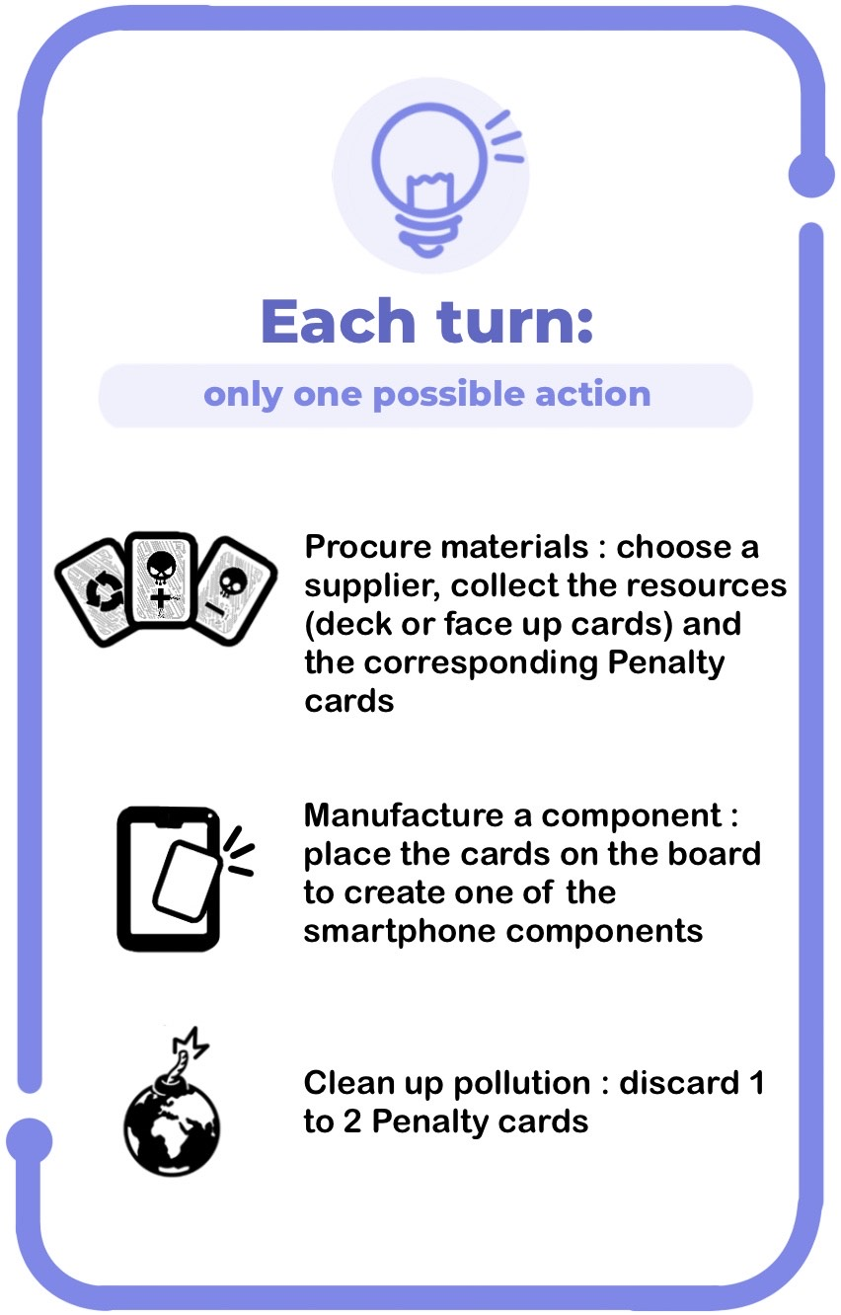
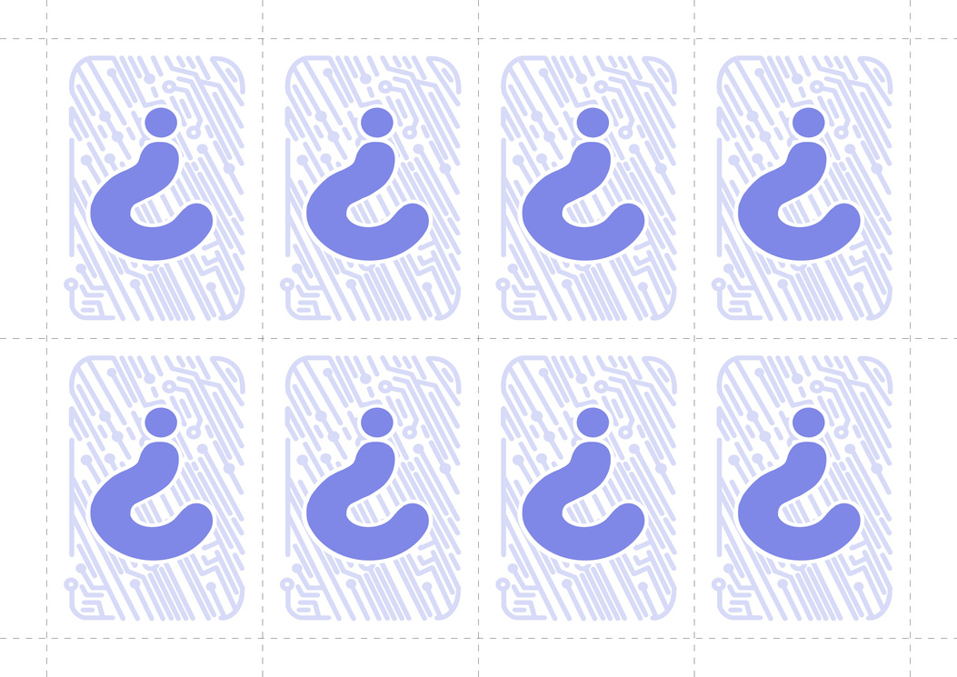
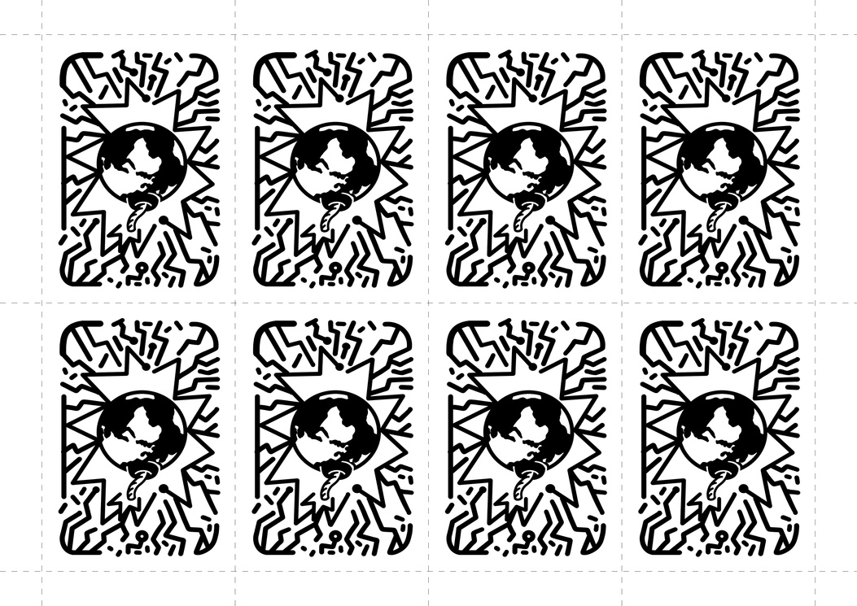
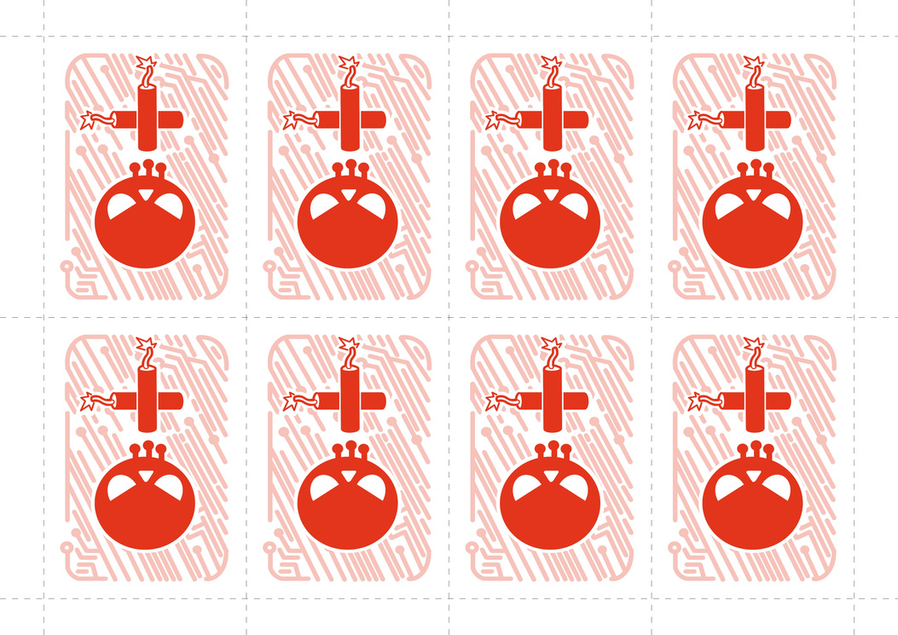
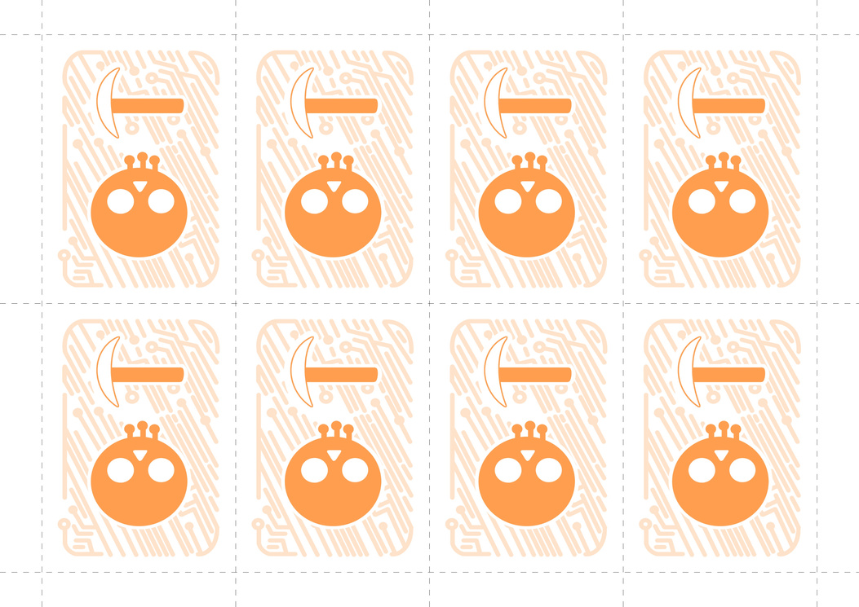
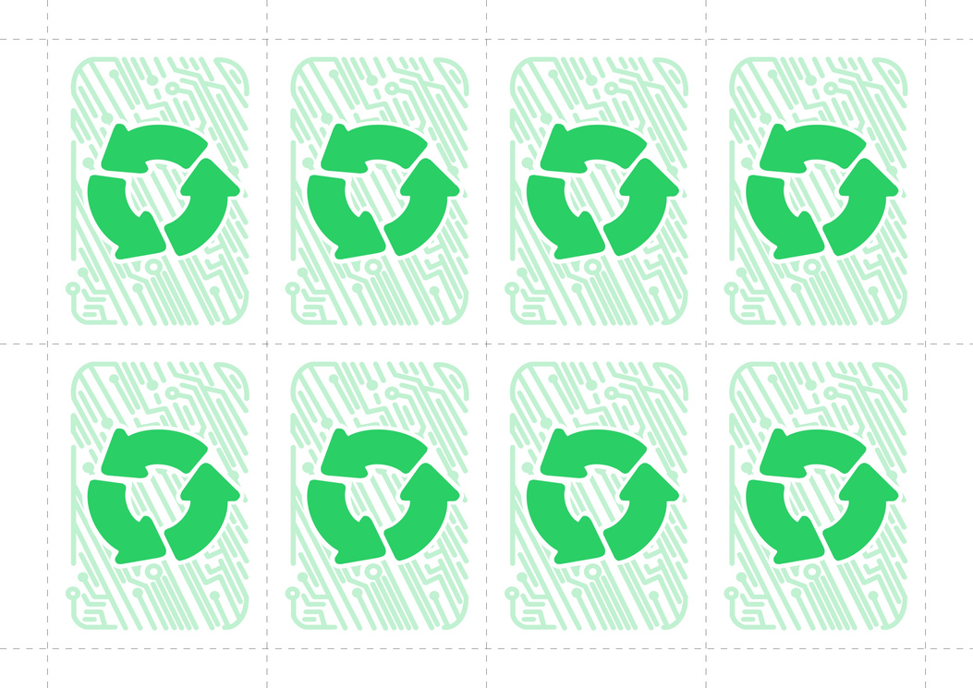
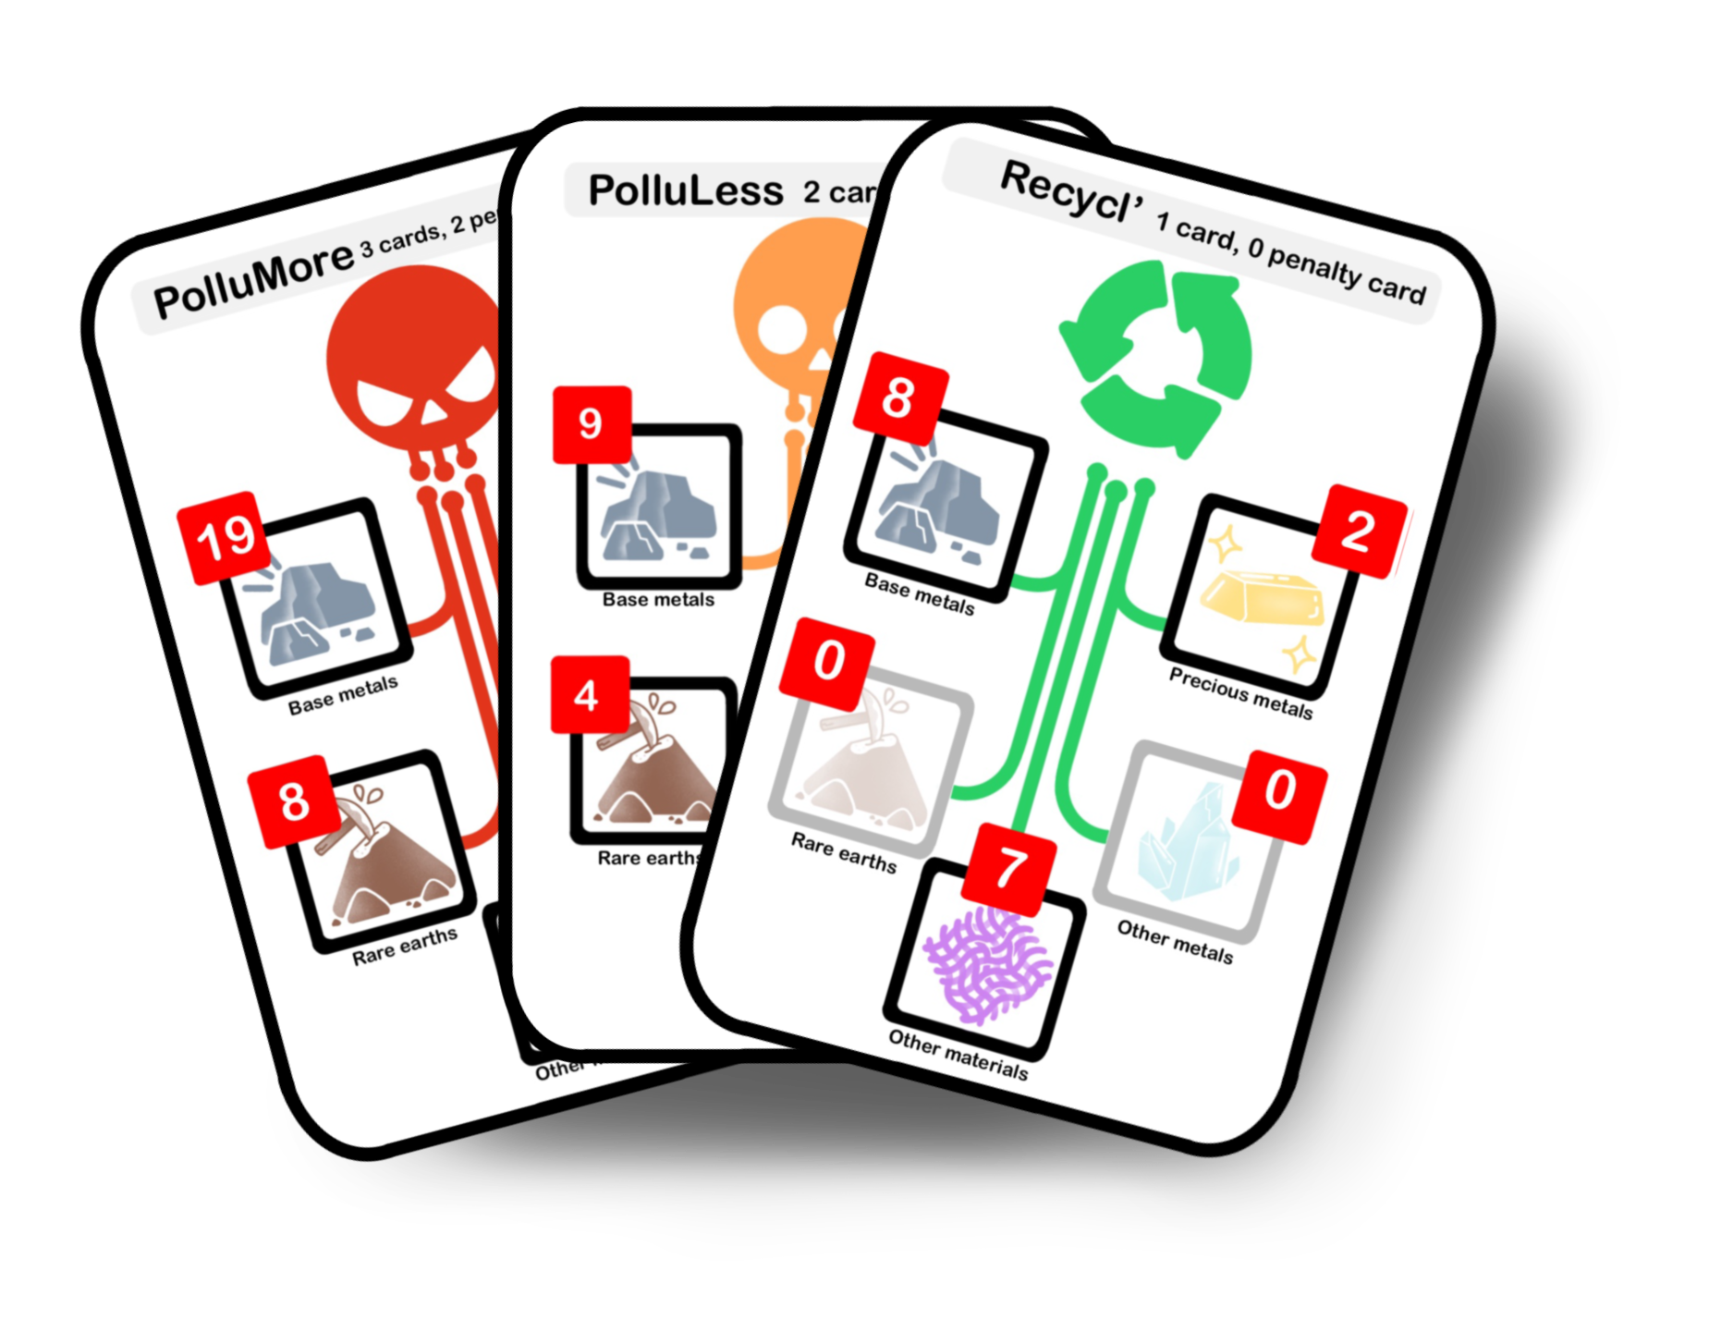
1. Equipment
5 Smartphone “boards”
1 Help card
15 Event cards
60 Penalty cards
134 Resource cards
(77 red PolluMore cards, 40 orange PolluLess cards, 17 green Recycl' cards)
Resource-summary cards
4

Slide 5
2. The components of the game
Smartphone “board”
The smartphone you are going to build is represented by a Smartphone “Board” made up of 4 components: Casing, Motherboard, Battery and Touchscreen. Manufacturing a component earns you a certain number of points, indicated next to the component's name on the “board”.
Each component is manufactured from resources, which are made up of different types of specific resources (Base metals, Precious metals, Rare earths, Other metals and Other materials). The numbers shown on each type of resource indicate the quantity required to manufacture each component.
Note:
For the sake of simplicity, the Motherboard component also incorporates all the associated electronic components: processor, RAM, etc. as well as the speakers, cameras, antenna, and so on.
The number of cards required for the different components does not represent the actual weight of these resources in a smartphone or the quantity of materials used, but symbolizes the variety of resources required.
5

Slide 6
Resource cards
To manufacture the components of your smartphone, you will need resources. You can procure the resources from 3 suppliers, who are differentiated by their color and logo:
Red: PolluMore
uses traditional mining methods that pollute and are not eco-friendly.
Orange: PolluLess
uses more responsible mining methods and tries to take environmental and social issues into account.
Green: Recycl'
specializes in recycling resources and therefore generates much less pollution.
6

Slide 7





There are 5 types of resources required to manufacture the components of a smartphone:
Base metals (e.g. aluminum, copper, iron): these can also be referred to as common metals, since they are the most commonly-used metals in industry. Base metals account for most of the metals used to manufacture a smartphone.
Precious metals (e.g. silver, gold, palladium, platinum): these metals are very scarce in the Earth's crust, but above all they are of great economic value. In smartphones, they are used essentially for their conductivity and resistance to corrosion.
Rare earths (e.g. neodymium, yttrium): despite their name, rare earths are actually quite abundant in the Earth's crust, but they occur in low levels of concentration and are difficult to extract. Among other things, they are used to make magnets for smartphone vibrators and to color the LEDs in the screens.
Other metals (e.g. cobalt, lithium, tantalum): a smartphone also contains many other metals, which are neither common, precious nor rare earths. There are around fifty metals and metalloids used in smartphones, which enable specific functions to be performed.
Other materials (e.g. ceramic, plastic, synthetic materials, glass): in addition to metals, smartphones contain various other materials, such as glass and plastic for the screen, the casing, and the printed circuits in the motherboard, etc.
7

Slide 8
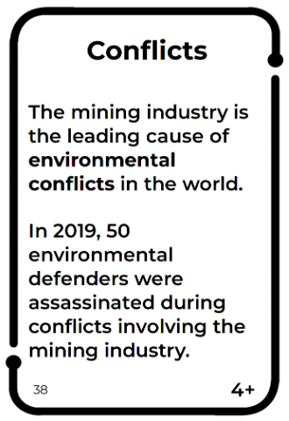
Penalty cards
Producing the resources required to manufacture the components of a smartphone has environmental and social impacts. These impacts are represented by the Penalty cards you receive when you purchase resources from PolluMore and PolluLess.
Each Penalty card provides information about how the metals are produced, in particular the operations involved (e.g. Ore processing or Metal recycling) and the environmental impacts (penalty for Pollution, Disaster) and social impacts (penalty for Socio-political Tensions, Conflicts).
Note: The Penalty cards focus on the environmental and social impacts of producing the metals contained in smartphones. It is important to remember that these metals are used for many different purposes, other than for manufacturing smartphones, and that the environmental and social impacts of smartphones are not solely confined to the production of the metals used to make them.
The number on the bottom right indicates in which configurations - i.e. numbers of players - the Penalty is used.
For example: in a 4-player game, the 3+ and 4+ cards are used and the 5+ cards are put back in the box.
Note: The number in the bottom left of the card is used to find the related sources on the game's web portal :
https://phoneimpact.inria.fr
8

Slide 9
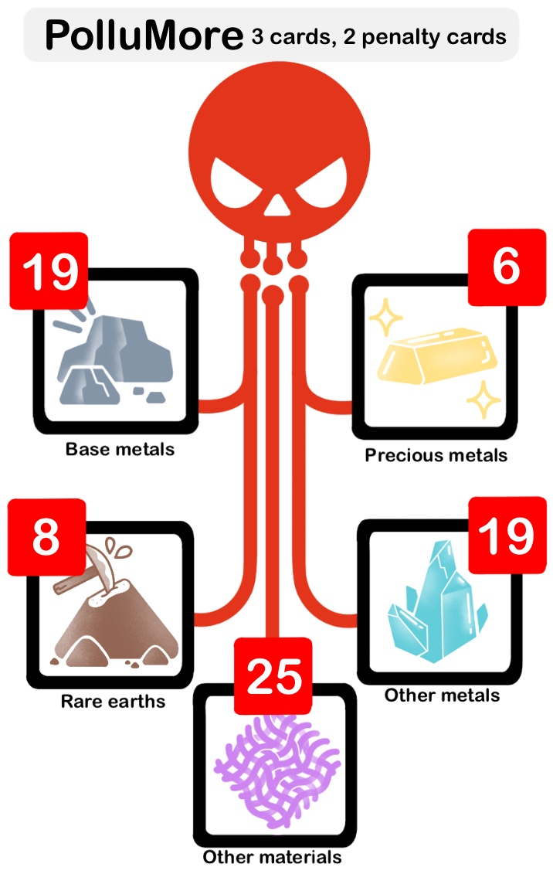
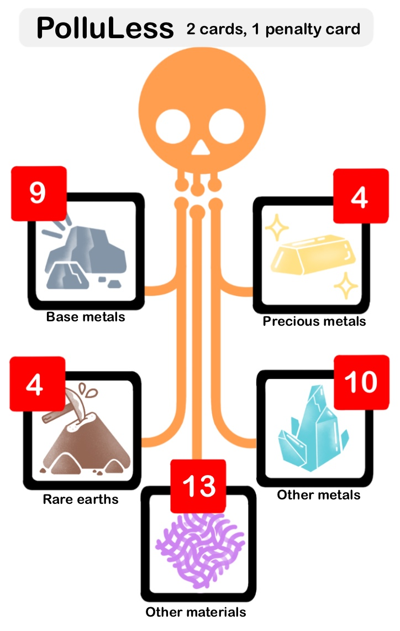
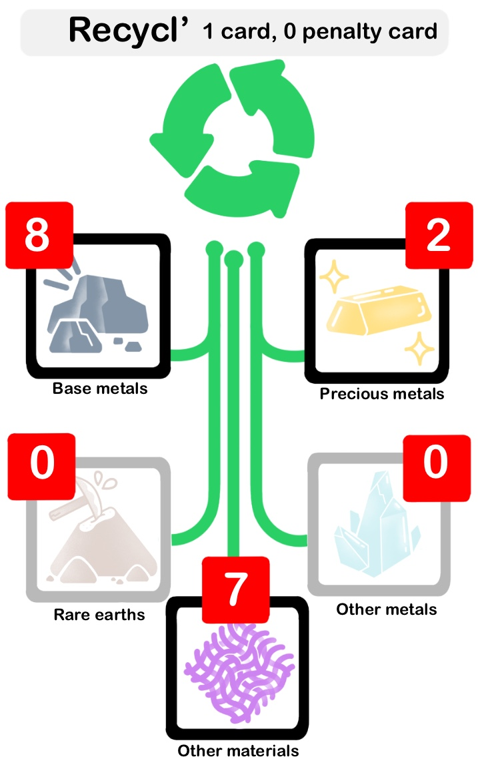
Resource-summary cards
These cards show the breakdown of the different types of resource in the sets of cards for each supplier. The number of Resource cards and Penalty cards to be picked up are indicated next to the supplier's name.
Note:
Recycl' (in green) does not supply Other metals or Rare earths, which are non-recyclable resources.
The figures are chosen to make the game flow as smoothly as possible, but are not representative of the real production figures.
Event cards
The Event cards are numbered from 1 to 14, including a special 1b card.
Each card describes an event (sometimes real, sometimes fictional but rooted in reality) that occurs in TechCity and an action, which is to be read out at the start of each round and which applies to all the players. These events introduce unforeseen situations and additional challenges, which significantly influence the course of the game.
9

Slide 10
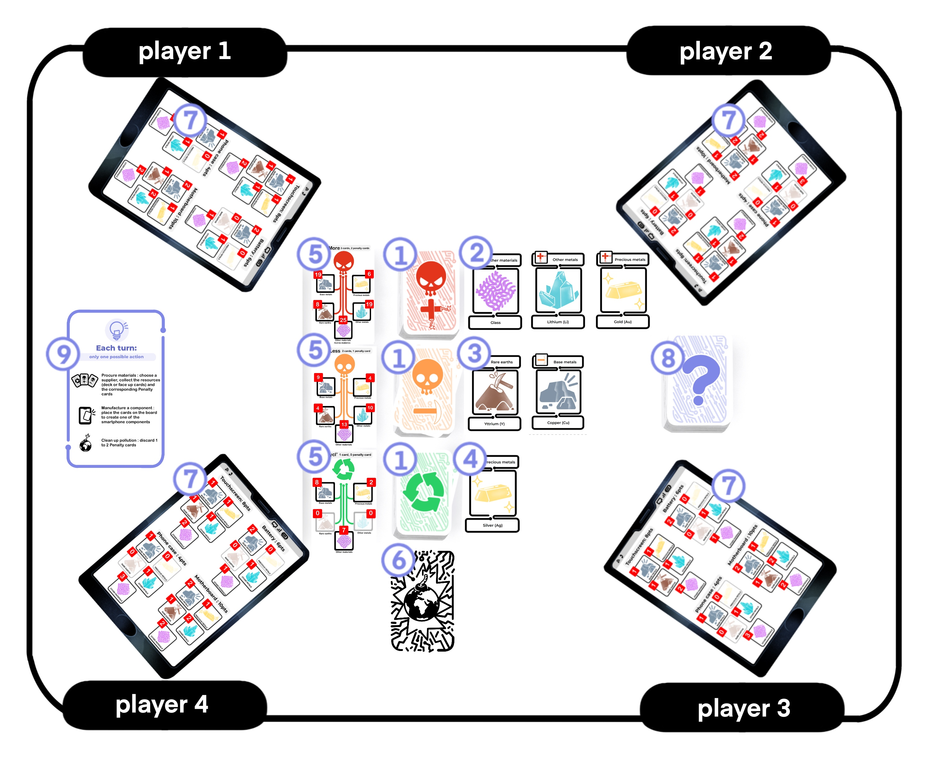





3. Set-up
Example of the set-up for 4 players
STEP 1:
Shuffle the Resource cards of each supplier (PolluMore, PolluLess, Recycl') to form 3 piles, with the cards face down.
The 3 piles are placed in a vertical line in the center of the table: PolluMore at the top, PolluLess in the center, Recycl' at the bottom.
To the right of each pile, take the following number of Resource cards and place them face up: 3 cards for PolluMore , 2 cards for PolluLess , 1 card for Recycl' .
Then, to the left of each pile, place the Resource-Summary cards for each supplier.
10

Slide 11




STEP 2:
Create your pile of Penalty cards according to the number of players.
To do this, first put the 1/6 to 6/6 cards aside.
According to the number of players, select the Penalty cards as follows:
in a 3-person game, the 3+ cards are to be used. The 4+ and 5+ cards are put back in the box.
In a 4-person game, the 3+ and 4+ cards are to be used. The 5+ cards are put back in the box.
In a 5-person game, all the cards are used.
Shuffle the pile of cards you have created and add the "1/6 to 6/6" cards (which were set aside) in descending order, so that the 1/6 card is at the top of the pile.
Summary:
Number of players | 3 players | 4 players | 5 players
Number of Penalty cards | 36 Penalty cards | 48 Penalty cards | 60 Penalty cards
Composition of the pile of Penalty cards | Cards 1/6 to 6/6 and 3+ cards | All Penalty cards except 5+ cards | All Penalty cards
STEP 3:
Each player gets an individual Smartphone “board” .
Place the pile of Event cards , face down, on the table. The Event cards are ranked in descending order at the start of the game (1, 1b, 2, ... 14), so that card 1 is at the top of the pile.
A Help card is available to help players.
11

Slide 12
4. Object of the game
The aim is to earn as many points as possible by making components for your smartphone before the end of the game. To do this, you must acquire the resources needed to manufacture them from the 3 suppliers available.
But be careful not to pollute too much!
5. Gameplay
Who goes first?
The title of Player 1 is given to the person who owns the most "eco-friendly" smartphone, based on the following order:
If one of the participants does not own a smartphone, then that person goes first.
Otherwise, the person with the oldest smartphone goes first.
If participants do not know how old their smartphones are, then the person who has a refurbished smartphone, or who has recovered an old smartphone should go first.
If you are unable to designate Player 1 based on these criteria, then the youngest person goes first.
The pile of Event cards is placed in front of Player 1.
A round in the game
Players take turns to play, moving clockwise around the table.
When a player has their turn, they must perform one of the following three actions (you are not allowed to skip a turn):
Procure materials
Manufacture a component
Clean up pollution
12

Slide 13
Action: procure materials
Choose a supplier and pick up the corresponding number of Resource cards and Penalty cards according to the supplier chosen.
a. Choose a supplier
The number of Resource cards you pick up depends on the supplier you choose, ranging from the most polluting (PolluMore) to the most eco-friendly (Recycl').
b. Pick up the resources
Once you have chosen a supplier, you must pick up 1 to 3 resource cards from the cards that are face up next to the related supplier and/or from the pile.
For example: for PolluMore, you pick up 3 Resource cards. You can either choose the 3 face-up cards, or 2 face-up cards and 1 from the pile, or 1 face-up card and 2 from the pile, or 3 cards from the pile.
You keep the Resource cards in hand and do not let the other players see them. If a player has picked up any of the face-up cards, then these must be replaced at the end of their turn.
c. Pick up Penalty cards
Procuring resources from PolluMore and PolluLess means you receive Penalty cards, corresponding to the pollution caused by the production of those resources.
You read out to the other players the title and text of the Penalty cards you have picked up and then place them in front of you. Be careful, the number of Penalty cards in your possession can affect your progress in the game!
13

Slide 14
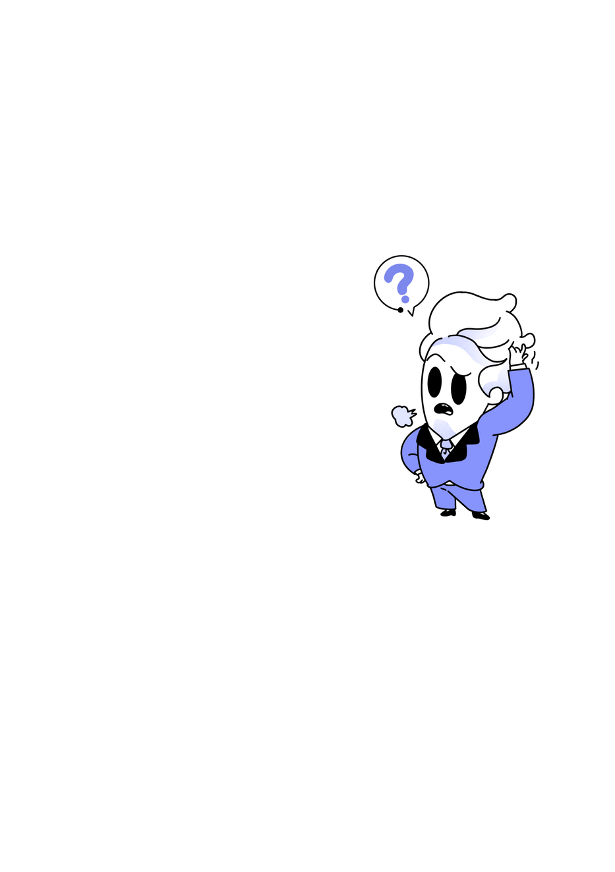
Action: manufacture a component
Place the Resource cards needed to manufacture one of the 4 smartphone components (Casing, Motherboard, Battery or Touchscreen), by putting them in a pile on the component concerned.
Each component can only be made once. Only one component can be manufactured per turn in the game.
Action: clean up pollution
Get rid of 1 to 2 Penalty cards from your hand. The discarded cards are set aside and are not placed back in the pile of Penalty cards.
Note: it is important to bear in mind that the clean-up process is much longer and more complex in the real world.
End of a round in the game
At the end of each round in the game, Player 1 draws an Event card, which will affect all players. Read out the text on the card and follow the instructions.
If an event affects the face-up Resource cards, then they must be replaced before the start of the next round in the game.
14

Slide 15
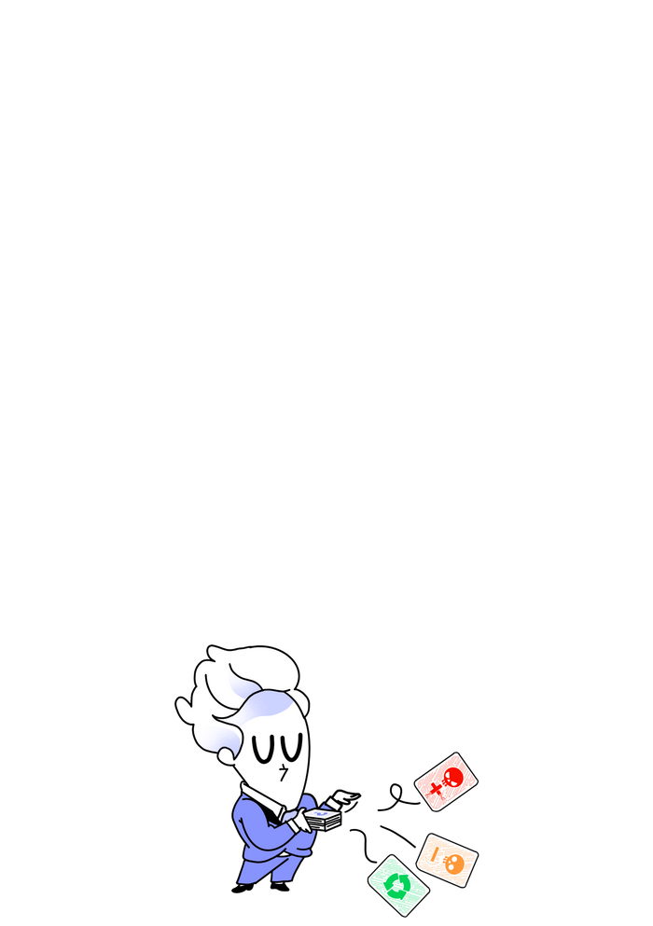
6. End of the game
Conditions for the end of the game
A PhoneImpact game can end in 3 different ways:
If a player manages to make all 4 components of their smartphone, the game ends on completion of that round.
If a player picks up the last Penalty card, the game ends on completion of that round. During that final round, if players choose the Procure materials action, they can only procure them from Recycl' (since there are no more Penalty cards left in the pile).
If the "End of game" Event card is drawn, the game ends immediately.
The person with the most points wins the game.
Calculating the points
Calculate your score by adding up all the points (written on the game “board”) corresponding to each component you have built.
A bonus of 2 points is awarded to the person that built the most eco-friendly smartphone, i.e. the person with the most Recycl' cards among all the cards placed on their game “board”. In the event of a tie, each person concerned gets 2 extra points.
15

Slide 16


7. To find out more
If you would like to find out more about the environmental impact of smartphones and put the information provided in the game into a broader context, or if you would like to consult the sources used for the Penalty cards and have access to additional bibliographical resources, please visit the game's web portal (https://phoneimpact.inria.fr).
If you would like to use the game with a group of people for educational purposes, you will also find resources on the web portal for running the session, from the initial briefing to the final debriefing.
Credits
Game creators:
The Inria Learning Lab Teaching Team: Sherazade Djeballah, Laurence Farhi, Aurélie Lagarrigue, Madeline Montigny, Benoit Rospars
Developer: Nathan Viaud
Scientific experts: Benjamin Ninassi (Deputy Head of Inria's Digital and Environment program) and Sophie Quinton (Researcher at Inria)
Graphics: Donovann Bonnet
Acknowledgements: Suzon Beaussant (Serious Game Designer), STIP Department Inria Grenoble, Guilain Praseuth (TBS Education).
With the support of the French Ministry of Culture, which provided funding for the game boxes.
16

