Slide 1
Eye-based wheelchair control and task manager for disable person
KUET.CV Sakib Reza
Rahat-uz-Zaman
Asifur Rahman
Hasib Iqbal

Slide 2
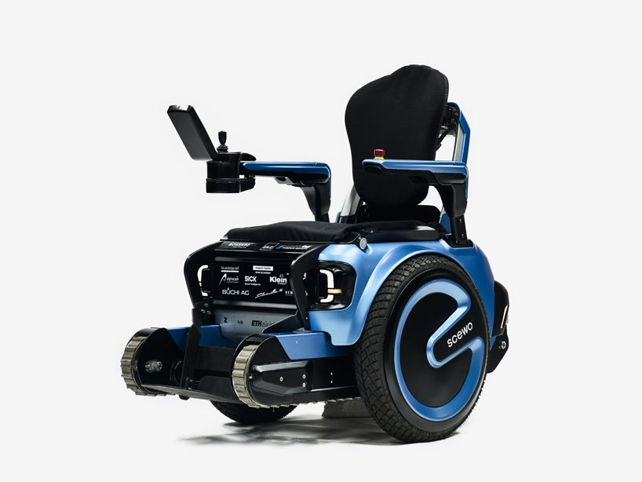
Overview
In our society, there are people who have critical physical disability, some of them have paralysis, cannot move any body part except only eyes and/or head. Our system will make them able to operate wheel chair and task manager using their eyes, voice and/or head gesture.

Slide 3
Aim and Objectives
Overcoming any type of physical disability using eyes, voice and/or head gesture
Operating task manager and wheel chair using eye gaze/eye blink/head gesture/ voice command
Make disable persons able to do everyday works

Slide 4
Who can use this with which features
Person’s active body part |  |  |  |  | Feature
Hand | Leg | Eye | Head | Speak | Voice | Eye-gaze | Eye-blink | Head-guesture
❌ | ❌ | ✔ | ❌ | ❌ | ❌ | ✔ | ✔ | ❌
❌ | ❌ | ✔ | ❌ | ✔ | ✔ | ✔ | ✔ | ❌
❌ | ❌ | ✔ | ✔ | ❌ | ❌ | ✔ | ✔ | ✔
❌ | ❌ | ✔ | ✔ | ✔ | ✔ | ✔ | ✔ | ✔
❌ | ❌ | ❌ | ❌ | ✔ | ✔ | ❌ | ❌ | ❌

Slide 5
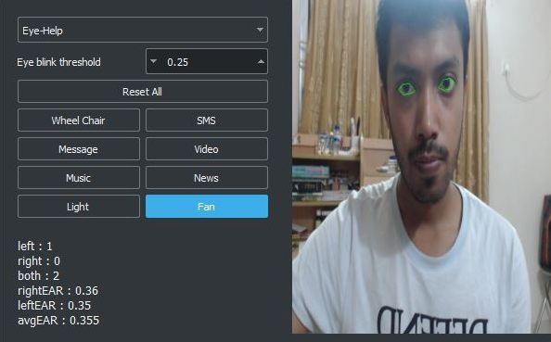
Task manager to control both menu and wheel chair
The person can do the following things with this task manager.
Control wheel chair
SMS
Email
Video
Music
News
Turn on/off light
Turn on/off fan
Place your screenshot here
Control tasks by
Eye
Head
Voice

Slide 6
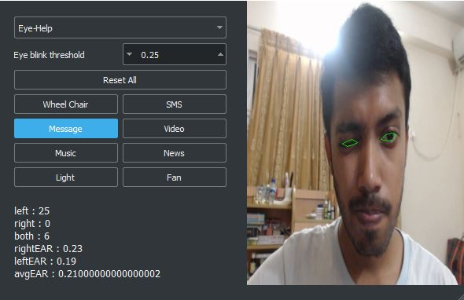
Controlling menu with eye blinks
One can use only blinks to navigate through the whole task manager.
Place your screenshot here
Blink right
Blink left
Blink both
Move selection right
Move selection left
Press selected menu

Slide 7
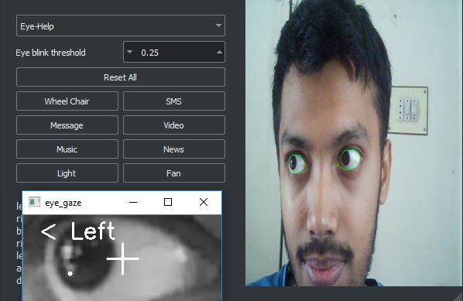
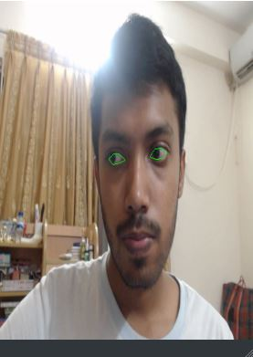
Controlling wheel chair with eye gaze
One can go 3 directions with eye gaze and start/stop with eye blinks.
Place your screenshot here
Look right
Look left
Look front
Move wheel chair right
Move wheel chair left
Move straight
Blink
Start/Stop

Slide 8
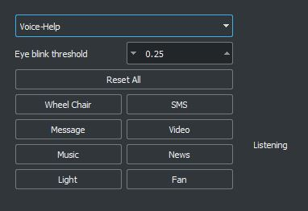
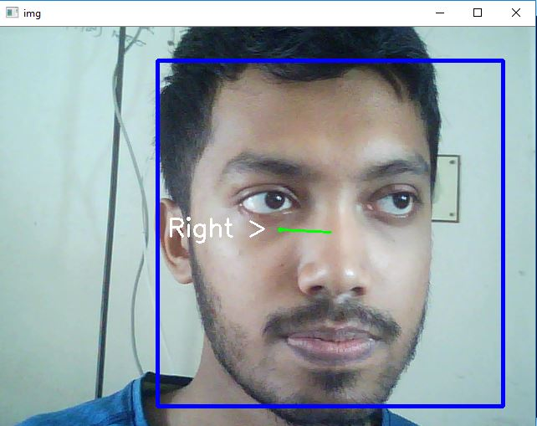
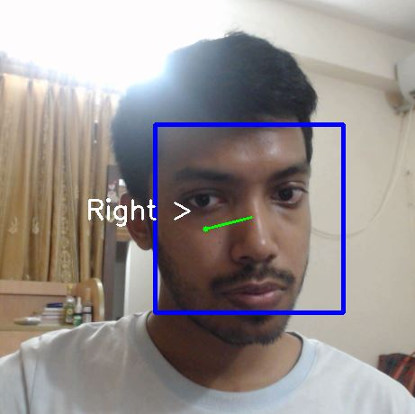
Controlling wheel chair with head gesture
Go 3 directions with head gesture and start/stop with eye blinks.
Place your screenshot here
Move right
Move left
Move up
Move wheel chair right
Move wheel chair left
Move straight
Move down
Stop

Slide 9
Controlling wheel chair and task manager with voice command
Tell the task manager what to do.
Place your screenshot here
“Right”
“Left”
“Start”
Move wheel chair right
Move wheel chair left
Move straight
“Stop”
Stop

Slide 10
Our Future Plan
Increasing the accuracy of eye gaze, eye blink, head gesture and voice command
Adding more real life features
Making this system more robust, accurate and deployable for general users

Slide 11
Thank You!
Any questions?

