Slide 1
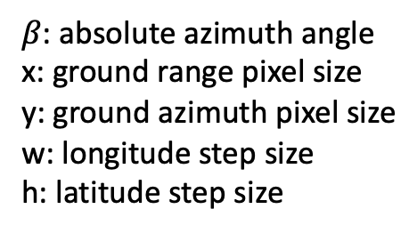

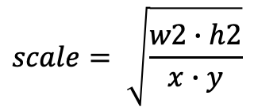
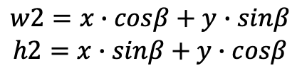
$β$: absolute azimuth angle
x: ground range pixel size
y: ground azimuth pixel size
w: longitude step size
h: latitude step size
y
β
h2
$$w2=x∙cosβ+y∙sinβ$$
$$h2=x∙sinβ+y∙cosβ$$
h
$$scale= \sqrt{\frac{w2∙h2}{x∙y}}$$
x
$$w=w2∙scale$$
$$h=h2∙scale$$
w
β
w2
Notes:
Get the lat/lon step size for geocoding by ensuring the same pixel area before/after resampling. The idea is treating the pixel in the radar coordiantes as an rotated rectangle, so the goal is to find the original un-rorated length and width.

