Slide 1
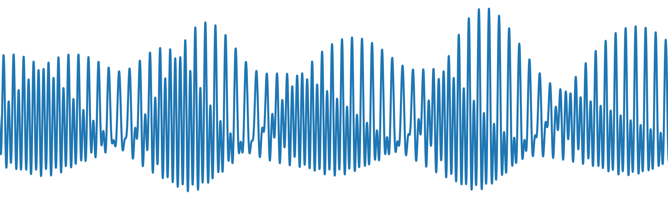
PySolid: A Python wrapper for solid Earth tides

