Slide 1
INVESTMENT ASSIGNMENT SUBMISSION
Ravi Dhir

Slide 2
Sparks Fund Investment Analysis
The CEO of Sparks Fund is looking forward to invest in few companies of various sectors across the globe and needs to figure out the best investment for the company.
She has a few constraints:
The investment amount is limited from 5 to 15 million USD per round of investment.
The investment must be in a English speaking country.
Other important thing keep in mind is to invest where others are investing.

Slide 3
Understanding the Process
Extract Data
Transform and Load Data
Identify the Correct Funding Type
Identify the Best Countries for investment
Load multiple Data Sets (country, rounds)
Explore the Dataset (using info, describe)
Identify the data for interested investment type
Group the Data Based on Countries to identify top countries
Massage the Data and put it in desirable format
Figure out the best Invent Type Based on Data
Figure out the English Speaking Countries and merge the result to identify top countries
Remove the Unwanted Rows and Fill Null Values
Load Other Dependencies (Country – via web scraping)
Filter the Data to use Identified Type Only
Filter the Data to use Top Countries Only
Adjust the Data Types to improve performance of Data Frame
Identify the Sectors and Companies to invest
Plot the Visuals for CEO
Identify The Primary Sectors
Figure out top 3 sectors for each country
Map the primary sector with main sector
Figure out the Best company in the Top Sector

Slide 4
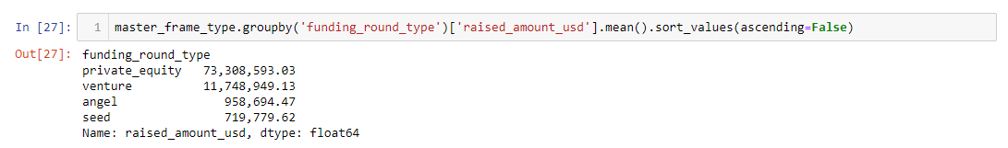
Funding Type Analysis
From a list of interested investment types, we analyse the best Funding type that is suited for Sparks Fund.
The Budget is 5 to 15 million USD and we are looking in the data where others have invested.
We Find the investment done in each Funding Type by others to identify the best Type for Sparks Fund
We conclude that Venture is the best suited type for out investment.

Slide 5
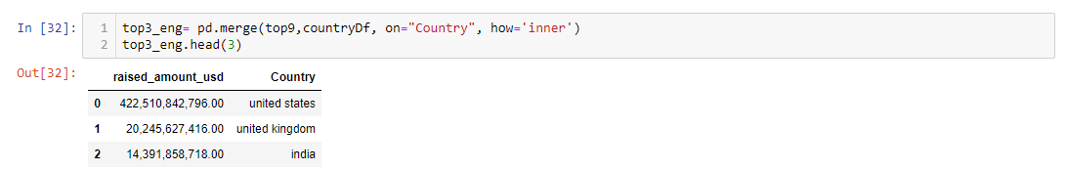
Country Analysis
For the identified Venture Type, we will now identify the country where most have invested.
The country must be have English as an Official Language.
Result Set – Top 3 Most heavily invested English Speaking Countries
We Identify below as top three countries for investment:
USA
GBR
IND

Slide 6
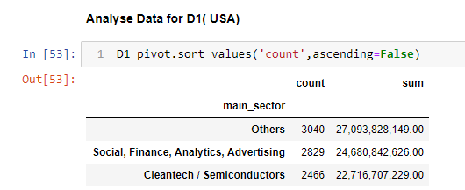
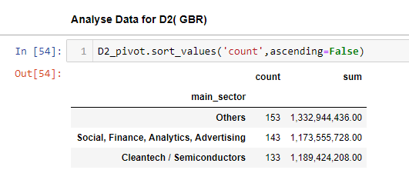
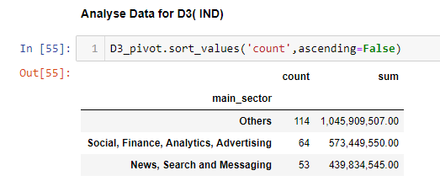
Sector Analysis
We now identify the three best sectors amongst the identified countries for investment.
The sectors must be mapped as a Main Sector to cover various primary business sectors
Result Set - Top three sectors in each county.
We Identify below as top sectors in each country:
Others
Social, Finance, Analytics, Advertising
Cleantech / Semiconductors / News, Search and Messaging

Slide 7
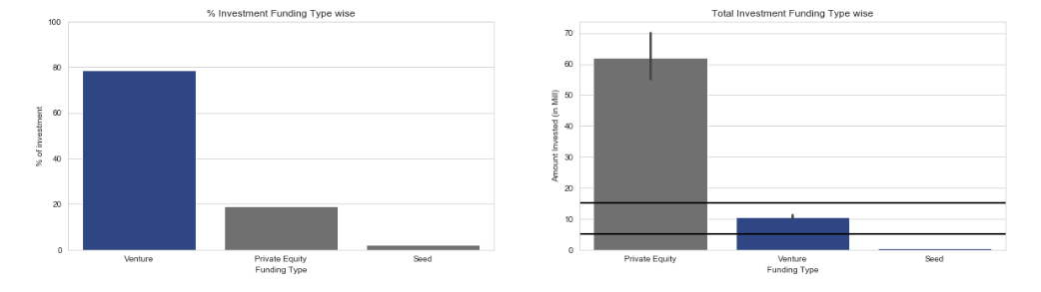
A plot showing the fraction of total investments (globally) in venture, seed, and private equity, and the average amount of investment in each funding type. This chart should make it clear that a certain funding type (FT) is best suited for Spark Funds.

Slide 8
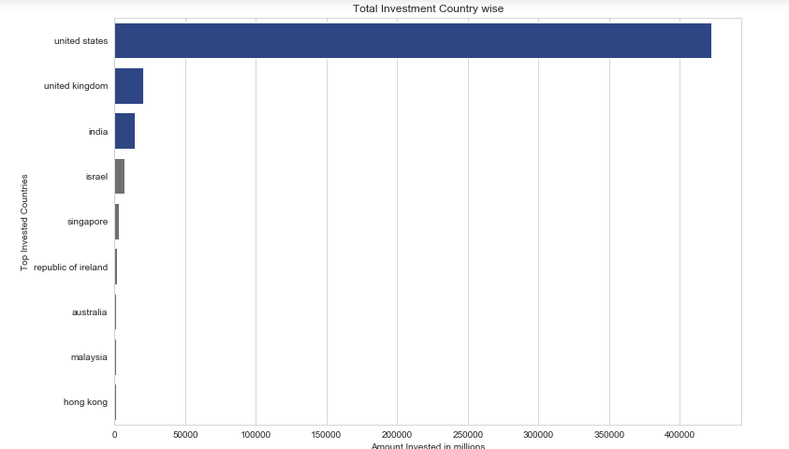
A plot showing the top 9 countries against the total amount of investments of funding type FT. This should make the top 3 countries (Country 1, Country 2, and Country 3) very clear.

Slide 9
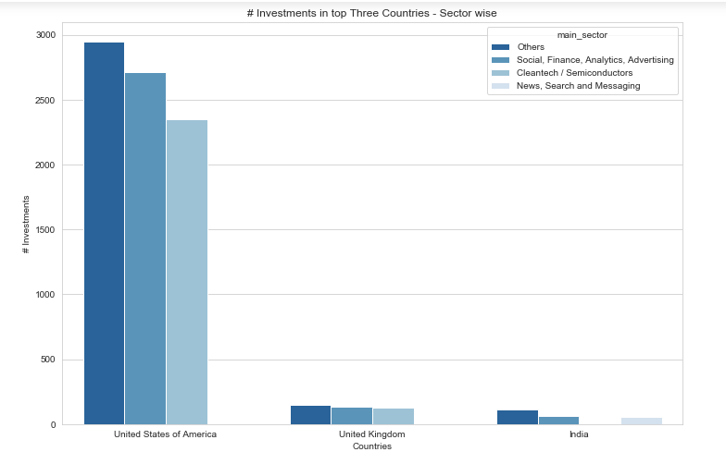
A plot showing the number of investments in the top 3 sectors of the top 3 countries on one chart (for the venture FT).

Slide 10
Final Verdict with CEO
Observing the Data, we can make the below inferences:
Venture is the best suited Funding Type considering the range of investment of Sparks Fund.
The Top three countries to invest are
United States of America
United Kingdom
India
The best sectors for investment are:
Others
Social, Finance, Analytics, Advertising
Cleantech / Semiconductors / News, Search and Messaging

