Slide 1
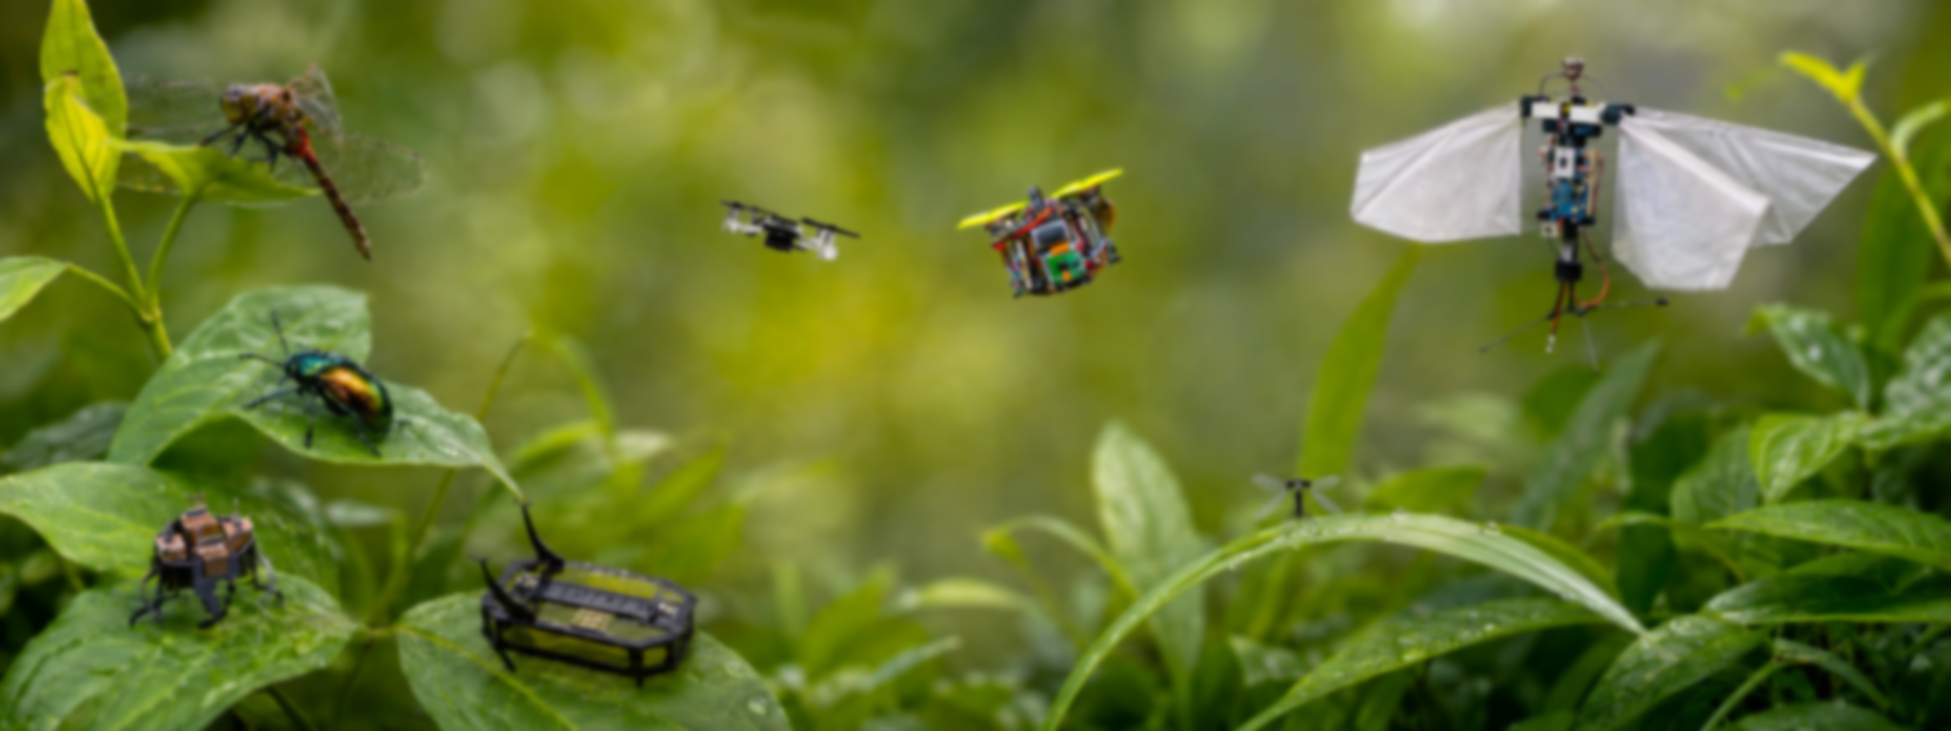

IROS 2026 · FULL-DAY WORKSHOP
OCTOBER 1 · PITTSBURGH, USA
INSECT-SCALE AUTONOMY
Reliable autonomy when sensing, compute, power, actuation, and mass are all scarce.
SUBMISSION DEADLINE
3–4 PAGE PAPERS / 1–2 PAGE POSTER ABSTRACTS
Sep 1, 2026 · 11:59 PM AoE
Three tightly coupled research fronts
We invite research that connects algorithms, bodies, and hardware for reliable small-scale autonomy.
CONFIRMED
SPEAKERS
A
RESOURCE-AWARE PERCEPTION & LEARNING
Yiannis Aloimonos
University of Maryland
Vijay Janapa Reddi
Harvard University
Frances Chance
Sandia National Laboratories
Geoffrey Barrows
CentEye, Inc. Elia Cereda
IDSIA, USI–SUPSI
Extract task-relevant information under severe energy, memory, bandwidth, and latency limits.
B
MECHANICS, ACTUATION, DESIGN & CONTROL
Co-design morphology, compliant mechanics, actuation, sensing, and feedback control.
C
ON-BOARD COMPUTE & EDGE AI
Deploy estimation, planning, learning, and control within strict power, thermal, and mass budgets.
POST-WORKSHOP OUTCOME
Join a community perspective paper defining shared bottlenecks, evaluation needs, and a research roadmap for insect-scale autonomy.
SUBMIT YOUR WORK
IEEE/RSJ International Conference on
Intelligent Robots and Systems · IROS 2026
insect-autonomy.github.io
Invited talks · Spotlights · Posters · Panel
Notes:
[Sources]
- https://insect-autonomy.github.io/
- D:/insect-autonomy.github.io/src/content/pages/cfp.md
- D:/insect-autonomy.github.io/src/content/pages/speakers.md
- D:/insect-autonomy.github.io/public/insect-autonomy-banner.jpg
- D:/insect-autonomy.github.io/public/BeeLogo.png
[/Sources]

