Slide 1
LINEAR ALGEBRA IN CHEMISTRY
Presented By:
Ismail Ahmed Ansari (20K-0228)
Insha Samnani (20K-0247)
Yusra Adam (20K-0207)

Slide 2
TOPICS TO BE DISCUSSED
INTRODUCTION
BALANCING CHEMICAL EQUATIONS
BALANCING CHEMICAL EQUATIONS USING CHEMISTRY METHOD
IS THERE ANY OTHER APPROACH?
BALANCING CHEMICAL EQUATIONS USING LINEAR ALGEBRA
BENEFITS OF USING LINEAR ALGEBRA
EXAMPLES
CONCLUSION

Slide 3
INTRODUCTION
Linear algebra extends its reaches in all parts of science and mathematics. Few of its applications are involved in traffic flow, electrical circuits, least square approximation and much.
In chemistry, linear algebra is used to solve unescapable task of balancing chemical equations. Balancing chemical equations is fundamental when it comes to laboratory work as the correct ratios of reactants and products is vital to most chemical reactions.

Slide 4
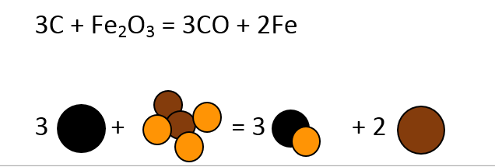
BALANCING CHEMICAL EQUATIONS
Chemical compounds required to produce a certain result are used as a starting material, or reactants, which by convention are written on the left side of the equation, and the final compounds produced, are written on the right.
Chemical equations must be balanced in order to give correct proportion of chemical compounds used to produce a certain product.
In a chemical equation there are subscripts and coefficients. The subscripts tell you how many atoms are in a compound while the coefficient tells you how many molecules are of the compound. If there isn't a subscript present next to the element, it implies that there is only one atom present.
To balance equations, we make changes to the coefficient of the compounds.

Slide 5
BALANCING CHEMICAL EQUATIONS USING CHEMISTRY METHOD
Balancing a chemical equation in chemistry through traditional method involves few steps. Suppose we want to balance the below equation:
CH₄ + O₂ CO₂ + H₂O
Step 1:
Extracting number of atoms from both reactant and product side. For simplicity make a table:
Analyzing the current state of atoms in both reactant and product side, it is clear that the equation is unbalanced because in reactant side there are 4 atoms of hydrogen and on product side there are 2 atoms of hydrogen. Similarly, on reactant side there are 2 atoms of oxygen and 3 atoms on product side.
Name of Atom | Reactant Side | Product Side
Carbon | 1 | 1
Hydrogen | 4 | 2
Oxygen | 2 | 3

Slide 6
Continued..
Step 2:
In this step, coefficients are added to the terms that can balance unbalanced atoms in the equations.
CH₄ + 2O₂ CO₂ + 2H₂O
After adding coefficients, repeat step 1.
From above table, it is clear that now elements from both reactant and product side are balanced.
In certain cases to balance equation, repetition of step 2 is done by trying different coefficients.
Name of Atom | Reactant Side | Product Side
Carbon | 1 | 1
Hydrogen | 4 | 4
Oxygen | 4 | 4

Slide 7

IS THERE ANY OTHER APPROACH?
Using this traditional method is fine when dealing with a simple equation with few elements.
But what if I have to balance a complex equation with 7 to 8 elements?
Using this same approach, can lead to lot of time consumption, as step 2 will be repeated many times in order to find the perfect coefficient that satisfies each and every element of the compound and thus produce a balance chemical equation.

Slide 8

BALANCING CHEMICAL EQUATIONS USING LINEAR ALGEBRA
LAW OF CONSERVATION OF MASS: Mass is neither created nor destroyed in any chemical reaction. Therefore balancing of equation requires the same number of atoms on both sides of a chemical reaction. The mass of all the REACTANTS (the substances going into the reaction) must equal the mass of the PRODUCTS (the substances produced by the reactions).
What if I use LINEAR ALGEBRA instead of real method for balancing a chemical reaction?

Slide 9
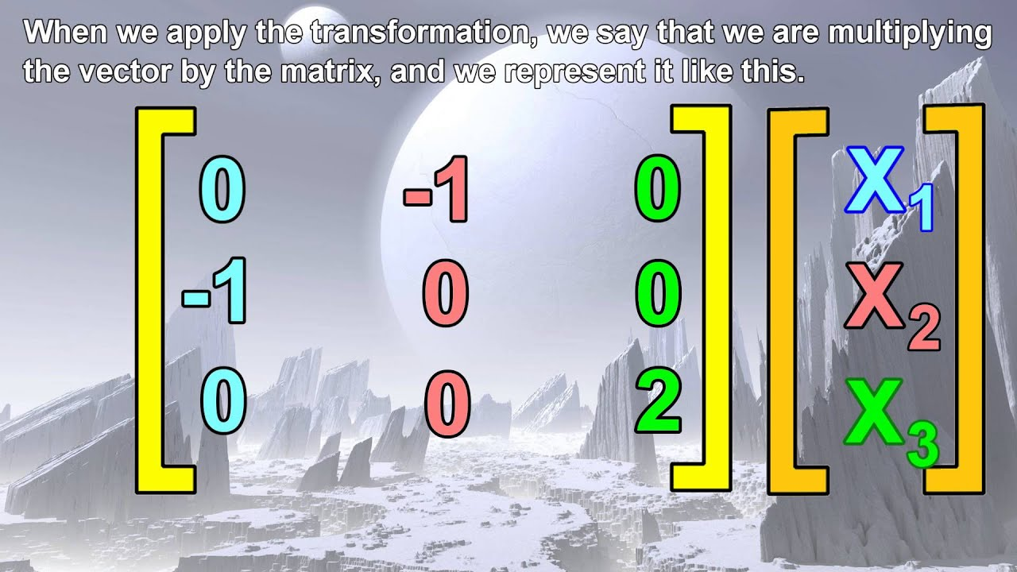
BENEFITS OF USING LINEAR ALGEBRA
When you use LINEAR ALGEBRA, it enables you to verify your coefficients via advance calculators or online solving reduced row echelon form websites.
It is possible to handle any chemical reaction with any number of given reactants and products.
This methodology lends well for both simple and complex reactions.

Slide 10
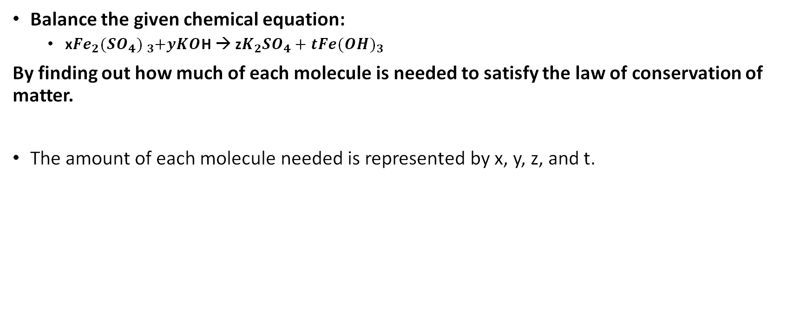
EXAMPLE 1
Balance the given chemical equation:
x$Fe_{2}{(SO_{4}) }_{3}+yKO$H → z$K_{2}{SO}_{4}+tFe{(OH)}_{3}$
By finding out how much of each molecule is needed to satisfy the law of conservation of matter.
The amount of each molecule needed is represented by x, y, z, and t.

Slide 11
REWRITE AS LINEAR EQUATIONS
The amount of each type of atom is written in parentheses:
(2X)Fe + (3X)S + (12X)O + (Y)K + (Y)O + (Y)H = (2Z)K + (Z)S + (4Z)O + (T)Fe + (3T)O + (3T)H
We can break this down into equations by matching them up by the atom:
Fe: 2X = T
S: 3X = Z
O: 12X + Y = 4Z + 3T
K: Y = 2Z
H: Y = 3T

Slide 12
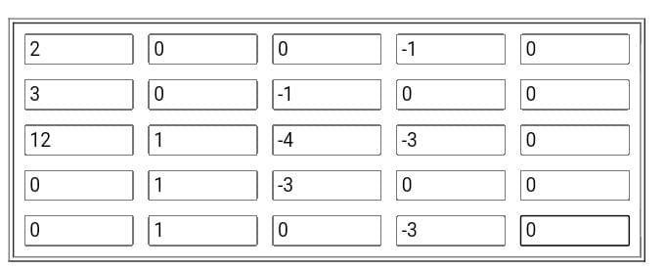
REWRITE AS MATRIX
First rewrite equations:
2X – T = 0
3X – Z = 0
12X + Y – 4Z – 3T = 0
Y – 3Z = 0
Y – 3T = 0

Slide 13
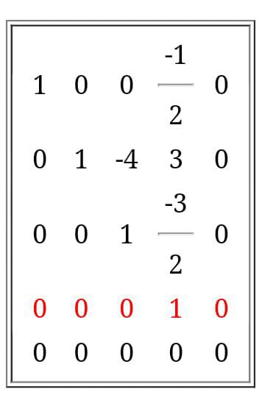

REDUCED ECHELON FORM
Writing back to the equations:
X = 1
Y = 6
Z = 3
T = 2
BALANCED CHEMICAL EQUATION:
$Fe_{2}{(SO_{4}) }_{3}+6KO$H → 3${SO}_{4}+2Fe{(OH)}_{3}$

Slide 14
EXAMPLE 2
Balance the given chemical equation:
xFe(NO₃)₃ + y(NH₄)₂CO₃ z Fe₂(CO₃)₃ + t NH₄NO₃
By finding out how much of each molecule is needed to satisfy the law of conservation of matter.
The amount of each molecule needed is represented by x, y, z, and t.

Slide 15
REWRITE AS LINEAR EQUATIONS
The amount of each type of atom is written in parentheses:
(X)Fe + (3X)N + (9X)O + (2Y)N + (8Y)H + (Y)C + (3Y)O = (2Z)Fe + (3Z)C + (9Z)O + (T)N + (4T)H + (T)N + (3T)O
We can break this down into equations by matching them up by the atom:
Fe: X = 2Z
N: 3X + 2Y = 2T
O: 9X + 3Y = 9Z + 3T
H: 8Y = 4T
C: Y = 3Z

Slide 16
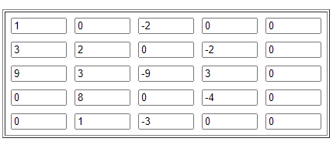
REWRITE AS MATRIX
First rewrite equations:
X – 2Z = 0
3X + 2Y - 2T = 0
9X + 3Y – 9Z – 3T = 0
8Y – 4T = 0
Y – 3Z = 0

Slide 17
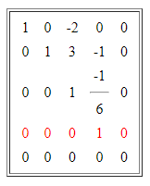
REDUCED ECHELON FORM
Writing back to equations:
X = 2
Y = 3
Z = 1
T = 6
BALANCED CHEMICAL EQUATION:
2Fe(NO₃)₃ + 3(NH₄)₂CO ₃ Fe₂(CO₃)₃ + 6NH₄NO₃

Slide 18
EXAMPLE 3
Balance the given chemical equation:
xPbO₂ + yCO₂ + zH₂O + tPb(CH₃COO)₂ u[2PbCO₂.Pb(OH)₂] + vCH₃COOH + wO₂
By finding out how much of each molecule is needed to satisfy the law of conservation of matter.
The amount of each molecule needed is represented by x, y, z, t, u, v and w.

Slide 19
REWRITE AS LINEAR EQUATIONS
The amount of each type of atom is written in parentheses:
(X)Pb + (2X)O + (Y)C + (2Y)O + (2Z)H + (Z)O + (T)Pb + (2T)C + (6T)H + (2T)C + (2T)O + (2T)O = (2U)Pb + (2U)C + (4U)O + (U)Pb + (2U)O + (2U)H + (V)C + (3V)H + (V)C + (V)O + (V)O + (V)H + (2W)O
We can break this down into equations by matching them up by the atom:
Pb: X + T = 3U
O: 2X + 2Y + Z + 4T= 6U + 2V + 2W
C: Y + 4T = 2U + 2V
H: 2Z + 6T= 2U + 4V

Slide 20
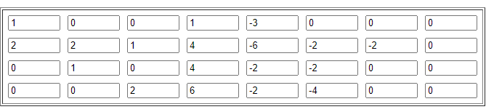
REWRITE AS MATRIX
First rewrite equations:
X + T – 3U = 0
2X + 2Y + Z + 4T - 6U - 2V – 2W = 0
Y + 4T - 2U – 2V = 0
2Z + 6T - 2U – 4V = 0

Slide 21
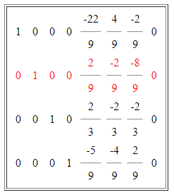
REDUCED ECHELON FORM
Writing back to equations:
X = 20
Y = 8
Z = 6
T = 7
U = 9
V = 9
W = 9
BALANCED CHEMICAL EQUATION:
20PbO₂ + 8CO₂ + 6H₂O + 7Pb(CH₃COO)₂ 9[2PbCO₂.Pb(OH)₂] + 9CH₃COOH + 9O₂

Slide 22
CONCLUSION
Linear algebra is playing a great role in almost all aspects of science.
In the field of chemistry, balancing any kind of chemical equations whether it is simple or complex is much easier using row reduced echelon method because it is one go method.
Chemical balance calculators are the easiest method to balance chemical equations because all that needs to be done is for the equation to be typed into the system and the system does the rest of the work.
However, these systems are using the same linear algebra technique of solving for the reduced row echelon form for a system of linear equations derived from a chemical equation.

