Slide 1
PRODUCT TITLE CLASSIFICATION
GROUP MEMBERS:
Insha Samnani (20K-0247)
Ismail Ahmed Ansari (20K-0228)
Abdul Basit (20K-0333)

Slide 2
Table of contents
01
02
03
04
INTRODUCTION
METHODOLOGY
CONCLUSION
TOOLS, TECHNOLOGIES, AND SOFTWARE

Slide 3
01
INTRODUCTION

Slide 4
PROBLEM STATEMENT
Product title classification is merely an instance of text classification problems, which are well-studied in literature. It is a crucial task that can help sellers list their items in the appropriate category. Although product titles are short descriptions and incomplete sentences, they possess unique properties that differ from general documents. Therefore, a product title classier may need to be designed differently from a text classier.

Slide 5
PRODUCT TITLE CLASSIFICATION
Product title classification refers to the task of automatically categorizing product titles into appropriate categories or classes in e-commerce platforms. This task is important because it helps sellers to list their products in the correct category and assists buyers to find products, they are interested in. Product titles are typically short descriptions of the product and incomplete sentences, which makes the classification task more challenging than traditional text classification tasks.

Slide 6
DIFFERENCE BETWEEN PRODUCT TITLE CLASSIFICATION AND GENERAL TEXT CLASSIFICATION
Product title classification is a specific type of text classification that involves categorizing product titles into pre-defined categories. It differs from general text classification in that it focuses on a specific type of text (product titles) and pre-defined categories, rather than open-ended categorization of general text.

Slide 7
GOALS OF PRODUCT TITLE CLASSFICATION
To classify e-commerce product titles into predefined categories.
To help users find the products they are searching for quickly and easily.
To automate the product categorization process, which can save time and resources.

Slide 8
OBJECTIVES OF PRODUCT TITLE CLASSIFICATION
To build a high-performing product title classification model using a deep learning algorithm.
To preprocess the product titles and generate features that can be used by the model.
To train and evaluate the model using a large dataset of product titles and their corresponding categories.
To fine-tune the model to achieve the best possible accuracy and performance.

Slide 9
02
METHODOLOGY

Slide 10
DATA PREPARATION
To start with, the data was imported from "data_train.csv" file. Initially, the data contained columns such as "country", "sku_id", "title", "category_lvl1", "category_lvl2", "category_lvl3", "description", "price", and "type". However, we dropped the columns 'country', 'sku_id', 'price', and 'type' and considered only 'title' and 'description' as feature variables. The target variables were 'category_lvl1', 'category_lvl2', and 'category_lvl3'. We applied several techniques like stemming, stop-word removal, and feature representation to convert the text into a format that can be processed by the algorithm.

Slide 11
CONT..
Afterwards, we imputed the missing values from the target variables. Prior to that, we encoded non-null values in each of the target columns to prepare categorical data for machine learning algorithms that typically require numerical data. To impute the missing values, we used the KNNImputer method and rounded off the results. Finally, we wrote the resulting data to a CSV file named "train_df_imputed.csv" with columns 'Title_desc', 'category_lvl1', 'category_lvl2', and 'category_lvl3'.

Slide 12
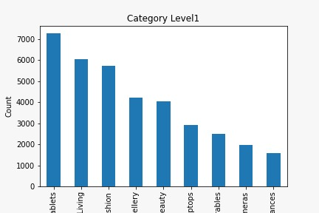
DATA VISUALIZATION: CATEGORY 1

Slide 13
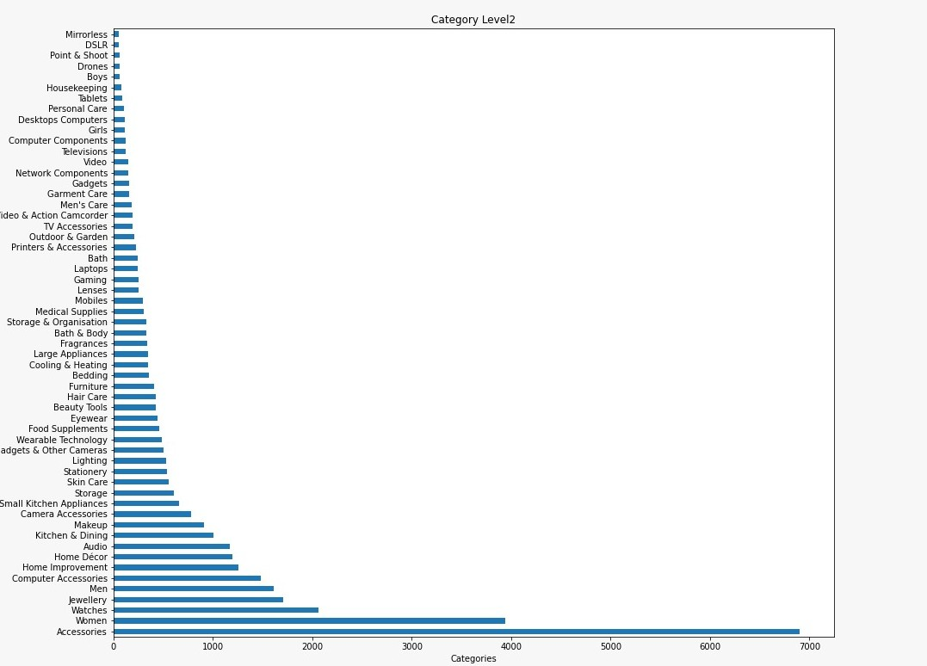
CONT: CATEGORY 2

Slide 14
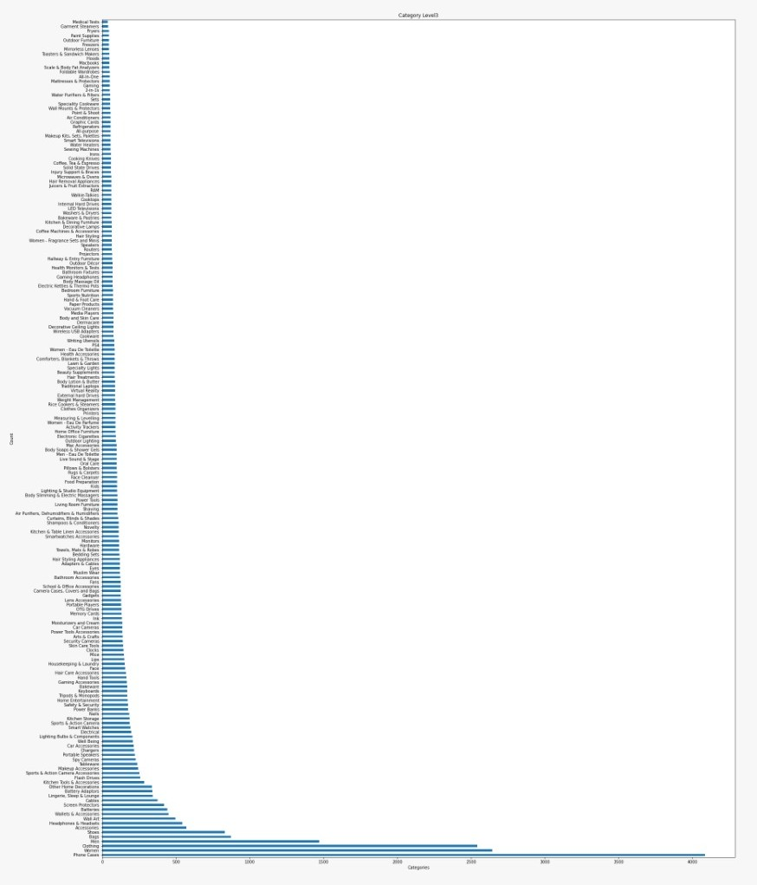
CONT: CATEGORY 3

Slide 15
FEATURE REPRESENTATION
We used TfidfVectorizer from the scikit-learn library to extract features from the 'Title_desc' column of the DataFrame. TfidfVectorizer is an implementation of the TF-IDF algorithm which measures the importance of each word in a document. It was initialized with parameters such as min_df, stop_words, and lowercase. The fit_transform() method was called to fit the vectorizer to the training data and then transform the 'Title_desc' feature into a sparse matrix of numerical features. The resulting feature matrix is stored in the variable X_train_features. The sparse matrix is represented using a compressed sparse row (CSR) format, which efficiently stores only the non-zero elements of the matrix.

Slide 16
CLASSIFICATION METHODS
We implemented two models, SUPPORT VECTOR MACHINE (SVM) and RANDOM FOREST CLASSIFIER. We split the training data into two parts: X_train and X_test, and the corresponding target values for each category 1,2,3 into Y_train_cat_1,2,3 and Y_test_cat_1,2,3. To achieve this, we used the train_test_split function from scikit-learn. After that, we built three different models using X_train and Y_train_cat_1,2,3 respectively. We predicted X_test on each of these models. We then imported, imputed, and cleaned the testing data in the same way as the training data, and predicted the categories for different titles in the testing data.

Slide 17
CONT..
We instantiated the Random Forest Classifier by setting the n_estimators' parameter to the square root of the number of training examples.
For the Support Vector Machine classifier, we set the kernel parameter to 'linear' and the random_state parameter to 0 during instantiation. The 'linear' kernel ensures that the decision boundary between classes will be a linear function, while the random_state parameter ensures that the results of the SVM are reproducible.

Slide 18
CONT: RANDOM FOREST CLASSIFIER
Random Forest Classifier works in the following way:
It selects a random subset of the training data.
For each subset, it constructs a decision tree.
It repeats the above two steps multiple times, creating a forest of decision trees.
When making a prediction, each decision tree in the forest independently predicts the class of the input data point.
The final prediction is made by combining the predictions of all the trees in the forest. This is typically done by taking the mode of the predicted classes.

Slide 19
CONT: SUPPORT VECTOR MACHINE
Support Vector Machine (SVM) works in the following way:
The hyperplane is chosen to be the one that maximizes the margin between the two classes. The margin is the distance between the hyperplane and the closest data points from each class.
If the two classes of data cannot be perfectly separated by a hyperplane, SVM uses a kernel function to map the data into a higher-dimensional space where they can be separated.
During training, SVM selects the support vectors and computes the corresponding weights and biases to define the decision boundary.
During prediction, SVM uses the learned weights and biases to classify new data points.

Slide 20
EXPERIMENTAL RESULTS
We evaluated the accuracy of the three models (for both training and testing data) using various metrics including accuracy score, classification reports, and confusion matrix. We represented these metrics using heatmaps. Additionally, we plotted the accuracy of SVM and RFC for both training and testing data to determine which model performed better.

Slide 21
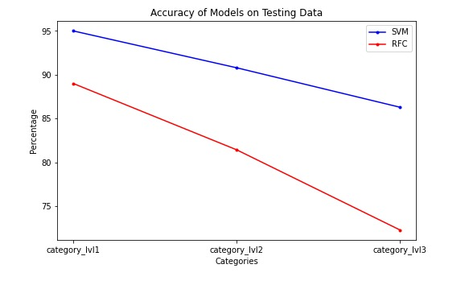
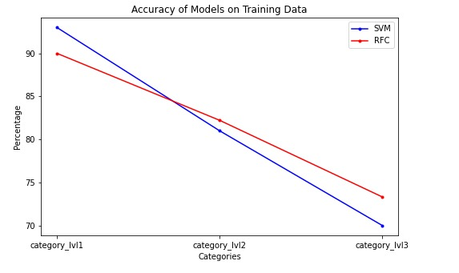
CONT: MODEL EVALUATION
Based on these graphs, we can conclude that although the accuracy scores of the models overlapped on the training data, the Support Vector Machine (SVM) model performed exceptionally well on the testing data.

Slide 22
CONT: QUERY EXECUTION
After executing the queries for different titles from the testing data on SVM, we observed that most of the titles were correctly categorized into their respective categories.

Slide 23
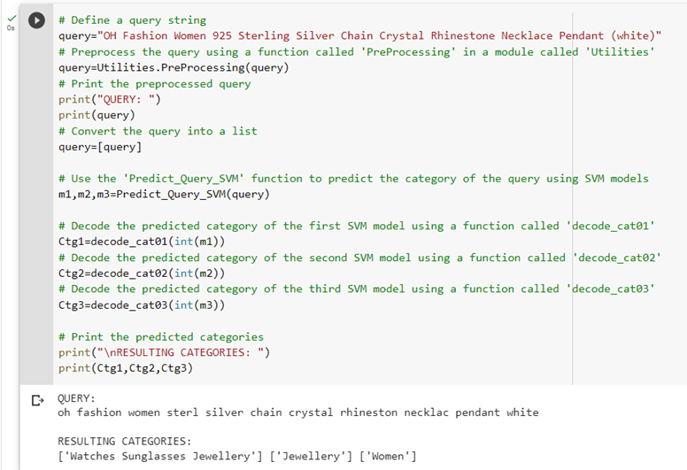
CONT: AN EXAMPLE EXECUTION
Query:
Expected Result:
Code Result:

Slide 24
03
TOOLS, TECHNOLOGIES, AND SOFTWARE

Slide 25
BRIEF OVERVIEW
The project was implemented in Python programming language using Google Collaboratory notebook, with the help of various libraries including numpy, pandas, re, nltk, sklearn, seaborn, matplotlib, and pickle.
NumPy for numerical computations and array manipulation.
Pandas for data manipulation and analysis.
Regular expression (re) for text preprocessing.
Natural Language Toolkit (NLTK) for text processing and analysis.
Scikit-learn for machine learning model implementation.
Seaborn and Matplotlib for data visualization.
Pickle for model serialization and deserialization.

Slide 26
03
CONCLUSION

Slide 27
SVM AS A POWERFUL CLASSIFICATION TOOL
To conclude used Support Vector Machine (SVM) and Random Forest Classifier (RFC) to build models for categorizing titles into three different categories. We split the data into training and testing sets and evaluated the performance of the models using various metrics such as accuracy score, classification reports, and confusion matrix. The results showed that SVM outperformed RFC on the testing data. We also found that when we executed queries for different titles from the testing data on SVM, most of the titles were correctly categorized in their respective categories. In conclusion, SVM is a powerful tool for classification tasks, and its performance can be enhanced with appropriate parameter tuning and feature engineering.

Slide 28
Thank you!
Do you have any questions?
k200247@nu.edu.pk
k200228@nu.edu.pk
k200333@nu.edu.pk
SUBMITTED TO:
DR MUHAMMAD RAFI

