Slide 1
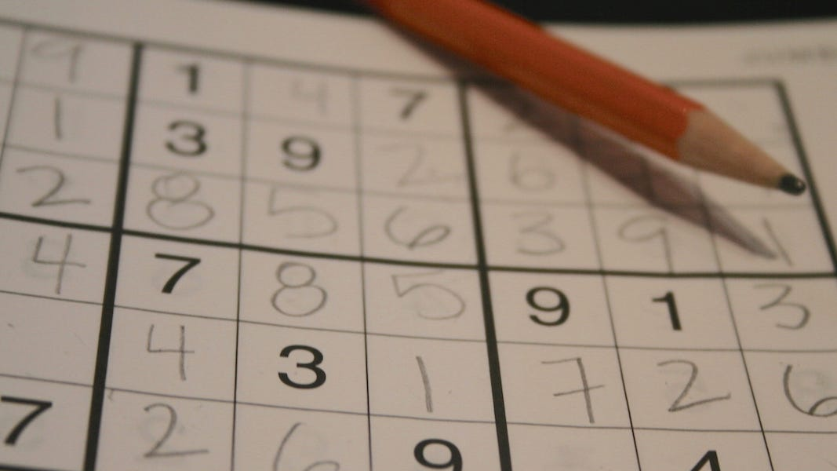
SUDOKU MYSTIFIER

Slide 2

SUBMITTED TO:
SIR SHOAIB RAUF
MISS QURATULAIN SOHAIL
GROUP MEMBERS:
INSHA SAMNANI (20K-0247)
YUSRA ADAM (20K-0207)
ISMAIL AHMED ANSARI (20K-0228)

Slide 3

SUDOKU, SOUNDS INTERESTING? A 9 by 9 grid that needs to be completed in such a way that each row, each column and each of the 9 main 3 by 3 sub-grids contains just one of each of the numbers 1 to 9. Our project “Sudoku Mystifier” also performs the same functionality, Solving the sudoku puzzle with user defined inputs as well as solving grid with random values detecting whether the inputs are valid or not is what “Sudoku Mystifier” does.

Slide 4

HOW SUDOKU IS BENEFICIAL TO HUMAN AND SOCIETY

Slide 5

Maintaining a healthy mindset.
Playing challenging thinking games like sudoku, can help you boost your vitality and resists negative thoughts.
Improves concentration.
Solving sudoku without concentration is impossible as it demands critical thinking because a little interruption can break the chain.
The more times you play puzzles, the more you will be focused and absorbed each time. and resists negative thoughts.
Improves concentration.
Solving sudoku without concentration is impossible as it demands critical thinking because a little interruption can break the chain.
The more times you play puzzles, the more you will be focused and absorbed each time.

Slide 6

IMPROVES PROBLEM SOLVING SKILLS:
Sudoku, can be a simple easy puzzle game if you have got good problem solving and detecting skills. The need is to engage logical and wise thinking to fill the grid correctly.
The process of repeated trial and error also helps in analyzing the problem which improves problem detection skills.

Slide 7
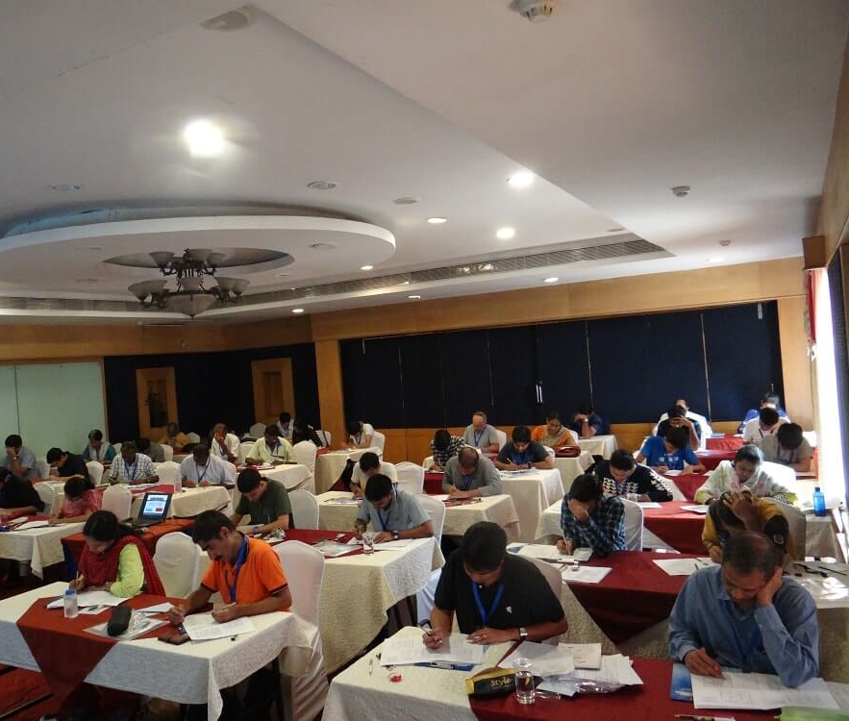
SUDOKU COMPETITIONS: Annual Sudoku competitions organized by World Sudoku championship creates thrill and helps in showcasing individuals skills of problem solving and detecting.

Slide 8
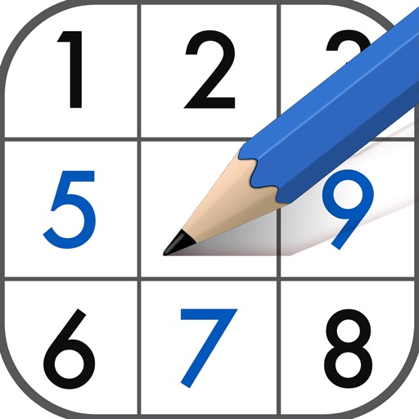
REAL LIFE APPLICATIONS OF SUDOKU

Slide 9

ARTIFICIAL INTELLIGENCE AND SUDOKU
The Sudoku puzzle is used as a teaching tool in an artificial intelligence.
It includes the possibilities of no solution and multiple solutions.
Sudoku approach to solving the puzzle is used to demonstrate artificial intelligence solution strategies.

Slide 10

MATHEMATICS AND SUDOKU
Sudoku puzzles are sometimes translated into coloring problems that links the game to class of important mathematical problems

Slide 11

SPY-WARE AND SUDOKU
Data-hiding techniques like Steganography, uses Sudoku like a key to hide data behind images.

Slide 12
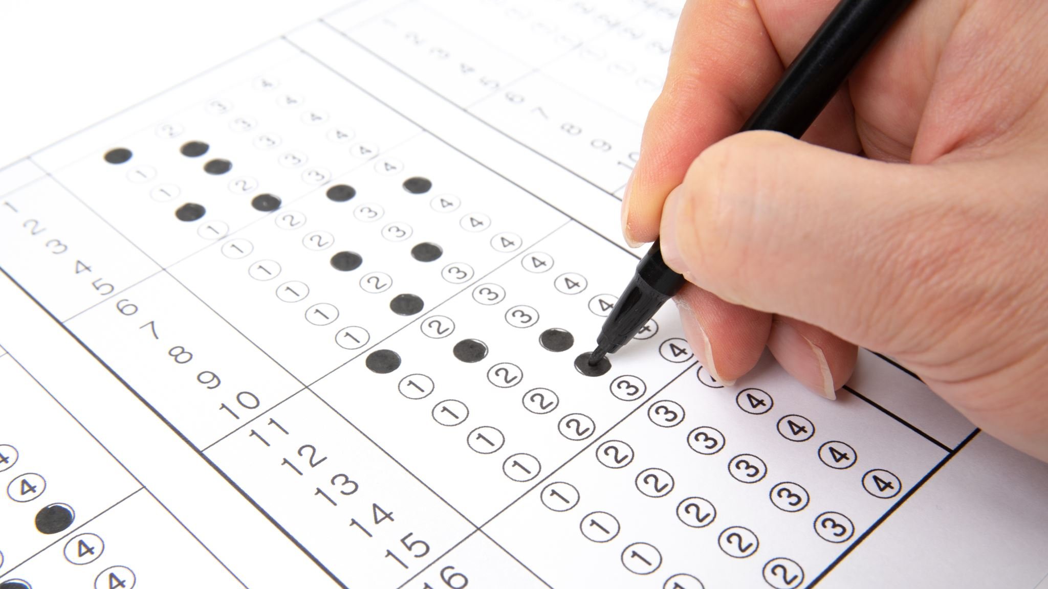
Scheduling and Sudoku
Making a master scheduling lesson for students.

Slide 13
MNEMONICS DESCRIPTION
WelcomeInterface: The function is showing the front cover of our output (using setTextColor, writeString, clrscr, ReadInt). It is also taking the option as input from user (0 for playing game, 1 for getting your Sudoku solved).
PlayGame: The function is further calling ReadTheGrid, PrintGrid, inputValues.
ReadTheGrid: The function is using filing and its functions (SIZEOF, OFFSET, OpenInputFile, ReadFromFile) to read one Sudoku puzzle out of 10 from the file. It is using Randomize and RandomRange function for selection. (INC, CMP, and Jumps are also used).
PrintGrid: The function is further calling printHorizontalLine using different variables to display a user defined grid to play the game in a successful user interface. It will also make the selected Sudoku to be displayed on the console along with the grid. Jumps are used to achieve respective tasks. (CMP, writeString, writeDec etc are also used).
inputValues: The function is calling findEmptyPlace to see if any of the element in the grid is 0 so that it will continue the process of taking values as input from user. Then user will be asked about row no col no and a value to be placed. All these will be verified via function Authentication1. It is also calling checkGrid function to check if the required space is containing 0(empty). Then value along with row and column will be checked via function isvalidplace. isValidPlace further calls three functions: isPresentInRow, isPresentInCol, isPresentInBox. All these functions check if the value entered by the user are not repeated in the specified row, column, and the box. (CMP, INVOKE, and Jumps are used). LEA is also used to hold offsets of row and columns. It is also calling PrintGrid function to print grid immediately after user enters the value.

Slide 14
CONT…
Getting your Sudoku solved (sudokuSolver): Firstly the function is calling inputgrid function, solverSudoku function.
Inputgrid: The function calls PrintGrid function. It is using nested looping to take input all the 9 values of 9 rows from the user. All the values are checked through Authentication0 function. (INC, DEC, clrscr, writeString, CMP etc are used).
solveSudoku: It is a recursive approach to solve Sudoku for the user. It traverses whole grid and tries to place a value starting from 1 if it is valid via isvalidplace. If it finds it valid so indexes of rows and columns are incremented respectively. Else it is backtracked and filled with 0 to again check it for incremented value that is 2. The process is continued unless it is unable to find some empty space(0) via findEmptyPlace. (LEA, CMP, PUSH, Jumps, INC etc are used).
Now after the whole process, it is checking that whether the Sudoku is solved or not, if solved so printed via PrintGrid, else an error is shown that Sudoku cant be solved.

Slide 15




